Slide 1


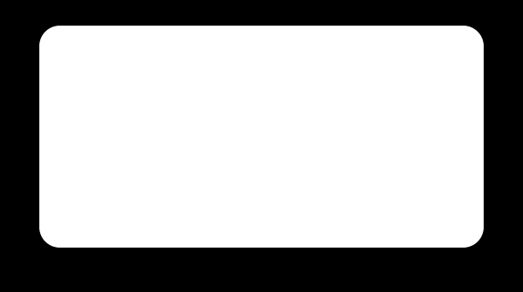
FIRST IMPRESSIONS
Mastering Interviews
01
Dress neatly and presentably.
02
Offer a firm handshake (if in person).
03
Maintain a confident posture and deliver assured answers.

Slide 2
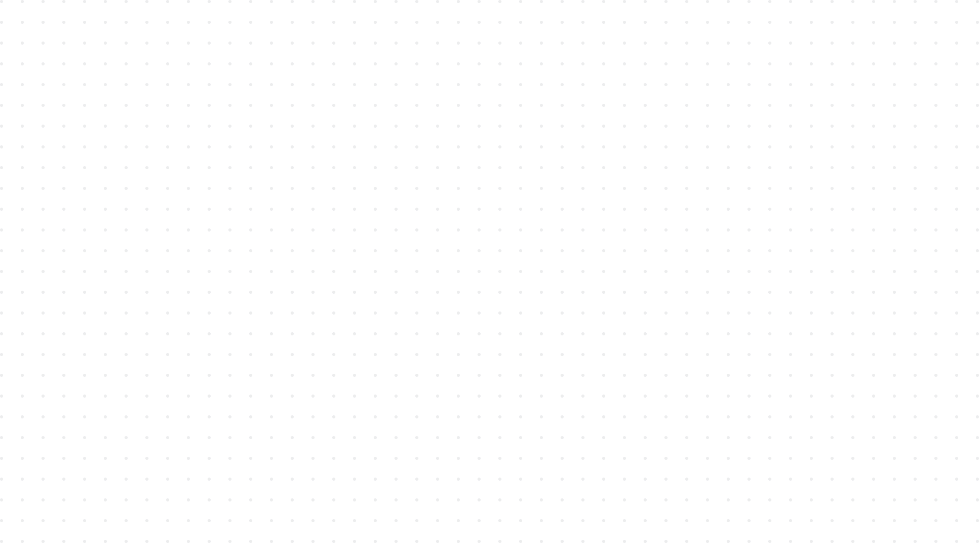
Technical Interviews - Standard Behavioral Questions
Tell me about yourself
Explain project XYZ
Tell me about a technical challenge you overcame during the Internship / Projects.
What is your most significant accomplishment across your projects?
Where do you see yourself in next 5 years ?
Why do you want to join our company ?
How do you manage conflict within the team ?
Do you have any question for me or the company ?

Slide 3

Tell me about yourself
Typical Version
My name is Arun. I am currently pursuing my B.Tech in AI&DS. I know Java, Python and SQL. I have done two projects and completed a few certifications. I am a hardworking person and I am looking for a good opportunity to start my career. I am also quick learner who is passionate about coding, and in my free time, I like playing badminton and reading tech blogs.
Improved, Impact-Focused Version
I’m a final-year AI&DS undergrad with a core focus on backend systems and clean API design. Over the past two years, I’ve built full-stack applications and interned at XYZ Company, where I focused primarily on database optimization and asynchronous task queues. I enjoy solving problems and understanding how things work rather than just implementing them. Through my projects and coding practice, I’ve been strengthening both my technical fundamentals and problem-solving skills, and I’m now looking for an opportunity where I can apply these skills and continue learning as a software developer.

Slide 4
Explain Project XYZ
Typical Version
My project is an Online Book Store. We developed a website using React, Node.js and MySQL. Users can login, search books, add them to cart and place orders. I worked with my team on the project.
Improved, Impact-Focused Version
Our project was an Online Book Store designed to simplify book discovery and ordering for students and readers. I worked as a Full Stack Developer and was mainly responsible for the search, cart and order modules and their API integration. We used React, Node.js, Express and MySQL. One of the main challenges was making the search and filtering efficient as the number of books increased, so I worked on improving the query and filtering logic. The final application supported more than 200 book records during testing and has been rolled out to 800 students currently.

Slide 5
Tell me about a technical challenge you overcame
Typical Version
During my project, we had some issues with the database and API. I checked the code and searched online for solutions. After trying a few things, I fixed the issue.
Improved, Impact-Focused Version
One challenge I faced was that our API response time increased significantly when retrieving a larger set of records. I first reproduced the issue and checked the API and database queries to identify where the delay was occurring. I found that the query was retrieving more data than required and was not using the database efficiently. I optimized the query and changed the API to return only the required fields. This reduced the response time significantly during our testing. More importantly, it taught me to diagnose a problem systematically instead of immediately changing the code.

Slide 6
Most significant accomplishment across your projects
Typical Version
My biggest accomplishment is completing my final-year project successfully. We worked hard as a team and two weeks ahead of schedule. Our team scored the highest marks in our department and I learned many technologies while doing the project.
Improved, Impact-Focused Version
My most significant accomplishment was taking ownership of the recommendation module in our project. Initially, the recommendations were inconsistent because the input data was not being processed correctly. I analyzed the data, identified the issue and redesigned the preprocessing logic. This improved the recommendation accuracy from 72% to 84% during testing. I consider this significant because I was able to take a problem that was affecting the project and independently work through it to a measurable improvement. More importantly, it taught me to diagnose a problem systematically instead of immediately changing the code.

Slide 7
How do you manage conflict within the team?
Typical Version
I am a friendly person, so I usually avoid conflicts. If someone disagrees, we hold a group discussion, vote on it, or ask our project guide to make the final decision.
If there is a conflict, I will talk to the team members and try to solve the problem. I believe teamwork is important and everyone should cooperate.
Improved, Impact-Focused Version
During a project, we had different opinions about which technology to use for one module. Instead of making it a personal disagreement, I suggested that we compare the options based on performance, development time and our team's familiarity with the technology. We discussed the pros and cons and selected the option that best suited the project requirements. I believe the important thing in a team conflict is to focus on the problem and the project goal rather than on who is right.

Slide 8
Where do you see yourself in the next 5 years?
Typical Version
In five years, I want to become a successful software engineer and get a good position in the company. I want to learn new technologies and become a team leader.
Improved, Impact-Focused Version
In the next five years, I would like to grow into a reliable software engineer who can take ownership of significant technical problems. In the first 1-2 years, my goal is to master the codebase and domain, delivering production code reliably with minimal supervision. I would focus would be on strengthening my fundamentals, understanding real-world development practices and learning from experienced team members. As I gain experience, I would like to take ownership of larger modules and eventually contribute to technical decisions and mentor junior team members.

Slide 9
Why do you want to join our company?
Typical Version
Your company is a very reputed company and provides good opportunities for freshers. I want to join because It has great work-life balance and I can learn new technologies and grow my career. Joining here would be a dream come true for me.
Improved, Impact-Focused Version
I’m interested in joining your company because the role matches the areas, I’ve been building my skills in, particularly Java and backend development. I also like that the role provides exposure to real-world projects and structured learning for early-career engineers. I believe I can contribute with the problem-solving and technical foundation I’ve developed through my projects, while learning from experienced teams and growing into a stronger software engineer

Slide 10
Do you have any questions for me or the company?
Typical Version
No, I don't have any questions.
What is the salary package?
When will the results be announced? Does the company provide hybrid/remote options, and what are the office timings?
Improved, Impact-Focused Version
What would you expect a fresher joining this role to accomplish during the first six months?
What kind of projects or technologies would a fresher in this role typically get exposure to?
What does the onboarding path look like for a new graduate joining this specific team?

Slide 11
Show Curiosity and Technical Depth
Inquire About the Tech Stack
Ask specific questions about the tools, frameworks, and architecture the team uses daily.
Discuss Engineering Challenges
Ask the interviewer about the most complex technical problem they are currently trying to solve.
Understand Team Dynamics
Ask about code review processes, mentorship opportunities, and how the engineering team collaborates on large features.

Slide 12
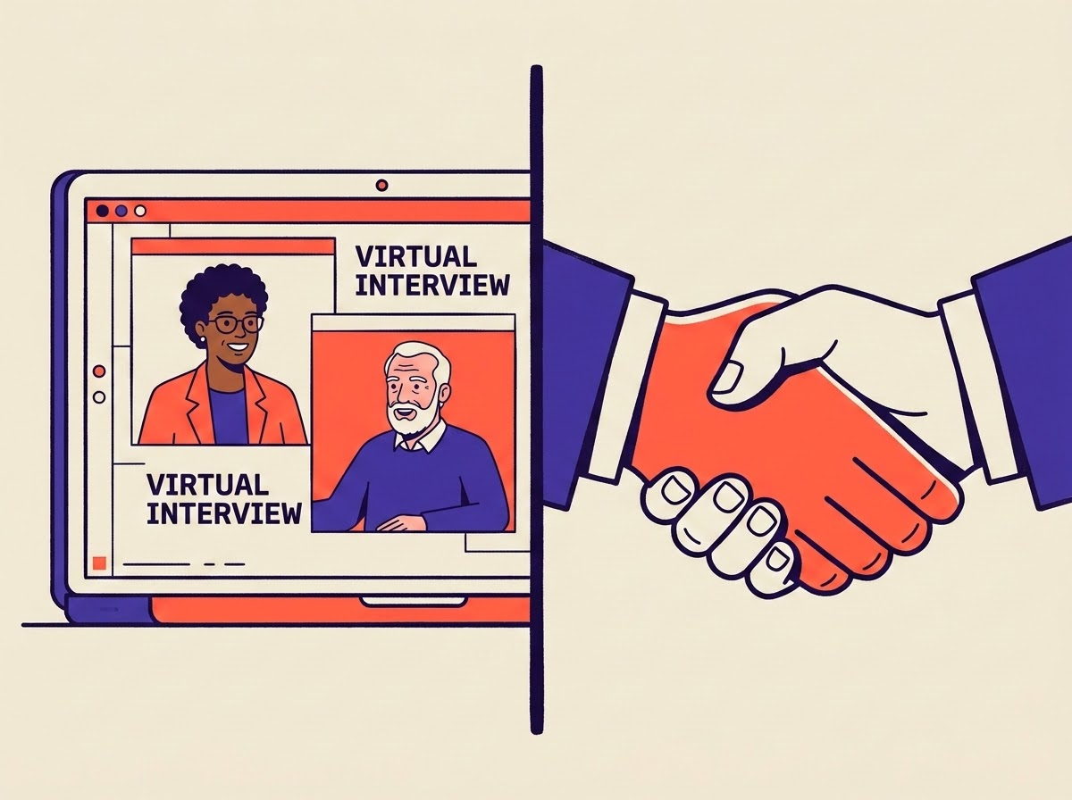
Interviews
Medium-Specific Tactics
The final stages involve direct interaction, requiring different strategies depending on the medium.
Face-to-Face: Emphasize body language, firm handshakes, and whiteboard coding. You must articulate your thought process while writing code manually.
Online: Rely heavily on shared screens and collaborative editors. Clear vocal communication is critical to compensate for the lack of physical presence.
The HR Round: Focuses on behavioral questions, situational judgment, and alignment with the company's core values, regardless of the format.

Slide 13
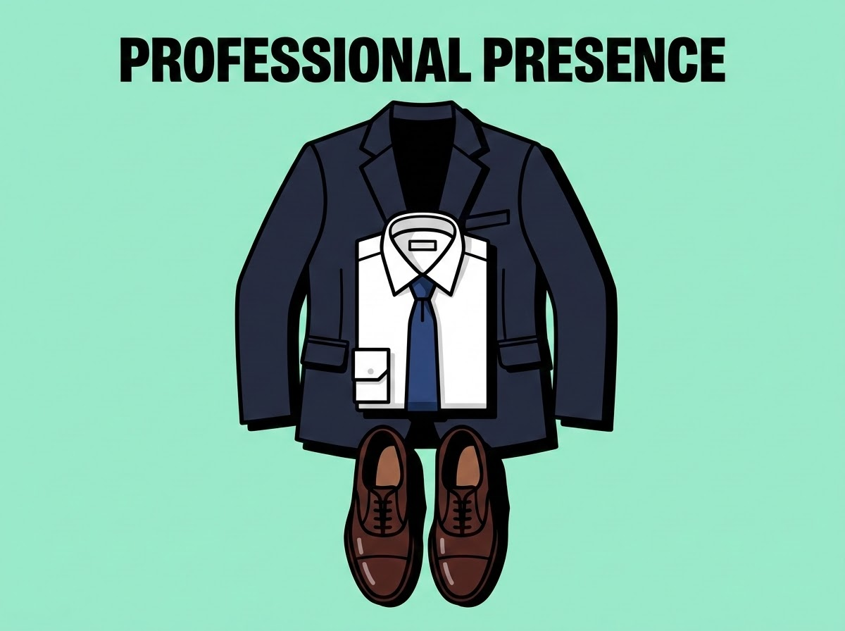
Navigating Face-to-Face vs. Online Interviews
Appearance & Grooming - First Impression Matters
✔ Dress neatly ✔ Be presentable ✔ Maintain hygiene ✔ Sit confidently
Remember:
Confidence is visible

Slide 14
Face-to-Face Interviews
Face-to-Face Interview Etiquette - Interview Room Behavior
✔ Enter confidently ✔ Smile politely ✔ Firm handshake (if initiated) ✔ Maintain eye contact
Avoid: ❌ Overconfidence ❌ Slouching ❌ Looking nervous

Slide 15

Online Interviews
Slide 18 – Online Interview Tips & Readiness:
✔ Join on time ✔ Video ON ✔ Stable internet ✔ Quiet environment ✔ Proper lighting
Important:
Look at camera while answering
Avoid: ❌ Looking at other apps ❌ Reading answers
VISUAL GUIDE

Slide 16
Dos & DONTs
Interview Dos
✔ Listen carefully ✔ Think before answering ✔ Be honest ✔ Ask clarifying questions ✔ Speak confidently
Interview Don’ts
❌ Bluff answers ❌ Interrupt interviewer ❌ Speak negatively ❌ Panic after one mistake

Slide 17
Dos & DONTs
What If You Don’t Know an Answer?
Best Response
Instead of guessing:
“I am not fully sure, but based on my understanding…”
OR
“I have not worked on this yet, but I am interested in learning.”
Never:
Fake confidence

Slide 18
30-day Action Plan
Biggest Mistakes Students Make
Avoid These Placement Killers
❌ Last-minute preparation
❌ No coding practice
❌ Weak fundamentals
❌ Resume copied from internet
❌ Poor communication
Daily Practice Plan
30 mins → Aptitude
45 mins → Coding
30 mins → Technical concepts
15 mins → Resume/communication
Consistency beats last-minute effort

Slide 19
Thank you

