Slide 1
The Gumball Experiment
An Exercise in Estimation

Slide 2
How many gumballs do you see ?

Slide 3
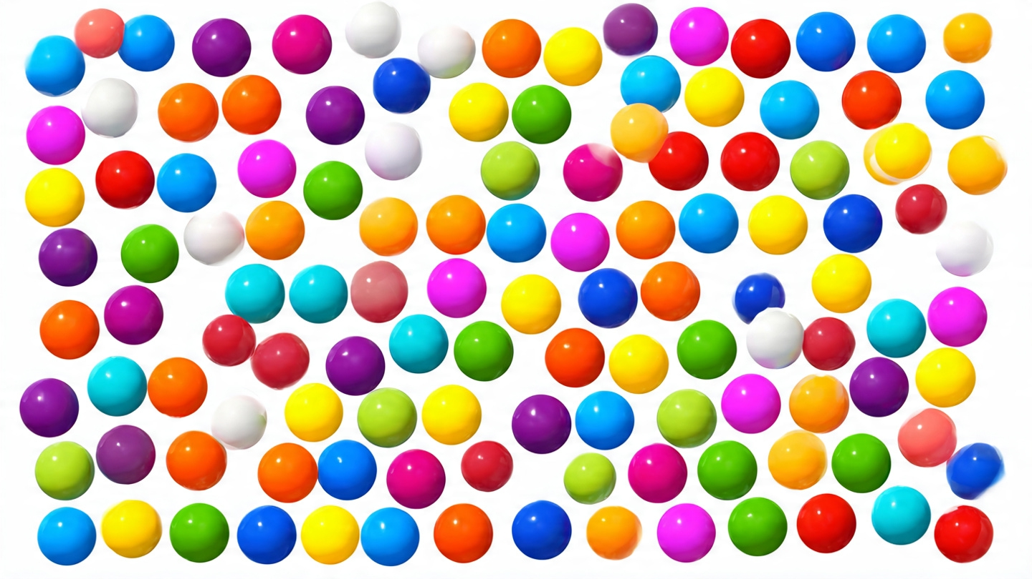
How many gumballs do you see ?

Slide 4
And the correct answer is ...
122

