Slide 1

IT Software Placement Aptitude Review
Complete Question & Answer Breakdown for Engineering Students
KEY STRATEGY
Learn mathematical shortcuts, utilize option elimination, and avoid time-consuming algebraic traps.
IT Software Placement Aptitude Review
Brinda Dorairaj

Slide 2
Workforce and Salary Aptitude Analysis
Q1: Employee Percentages
Q2: Salary Ratios
• Development: 40%
• Testing: 35%
• Support Remaining: 100% - (40% + 35%) = 25%
• Support Count: 150 employees
Calculation:
Let Total Workspace be x.
25% of x = 150
x = 150 / 25% = (150 / 25) * 100 = 600
• Junior : Senior Ratio = 3 : 5 = 3x : 5x
• Difference in Salary: 5x- 3x = 2x
• Difference in Salary = ₹40,000
Calculation:
2x = ₹40,000
1x = ₹20,000
Junior Salary (3x) = 3 * ₹20,000 = ₹60,000
PRO TIP / NOTE
In distribution problems, always find the missing percentage or unit first before equating it to the known absolute value.
IT Software Placement Aptitude Review
Brinda Dorairaj

Slide 3
Quantitative Problem Solving
Q3: TIME & WORK
Q4: BATCHED AVERAGES
Arjun takes 6 hours, Vikram takes 12 hours.
Step 1: Reciprocal Hourly Rates
Arjun's Rate: 1/6 module/hr
Vikram's Rate: 1/12 module/hr
Step 2: Combined Rate
1/6 + 1/12 = 2/12 + 1/12 = 3/12 = 1/4
Result: 4 hours working together.
Initial group: 5 students with avg 85.
Step 1: Initial Total Sum
5 × 85 = 425
Step 2: Add 6th Student (Score 97)
425 + 97 = 522
Step 3: New Average
522 / 6 = 87
Result: New average score is 87.
PRO TIP: DEVIATION METHOD
For averages, use the deviation method: the new student scores 12 points above the average (97 - 85). Divide this "surplus" by the new total number of students (12 / 6 = 2) and add it to the old average (85 + 2 = 87).
IT Software Placement Aptitude Review
Brinda Dorairaj

Slide 4
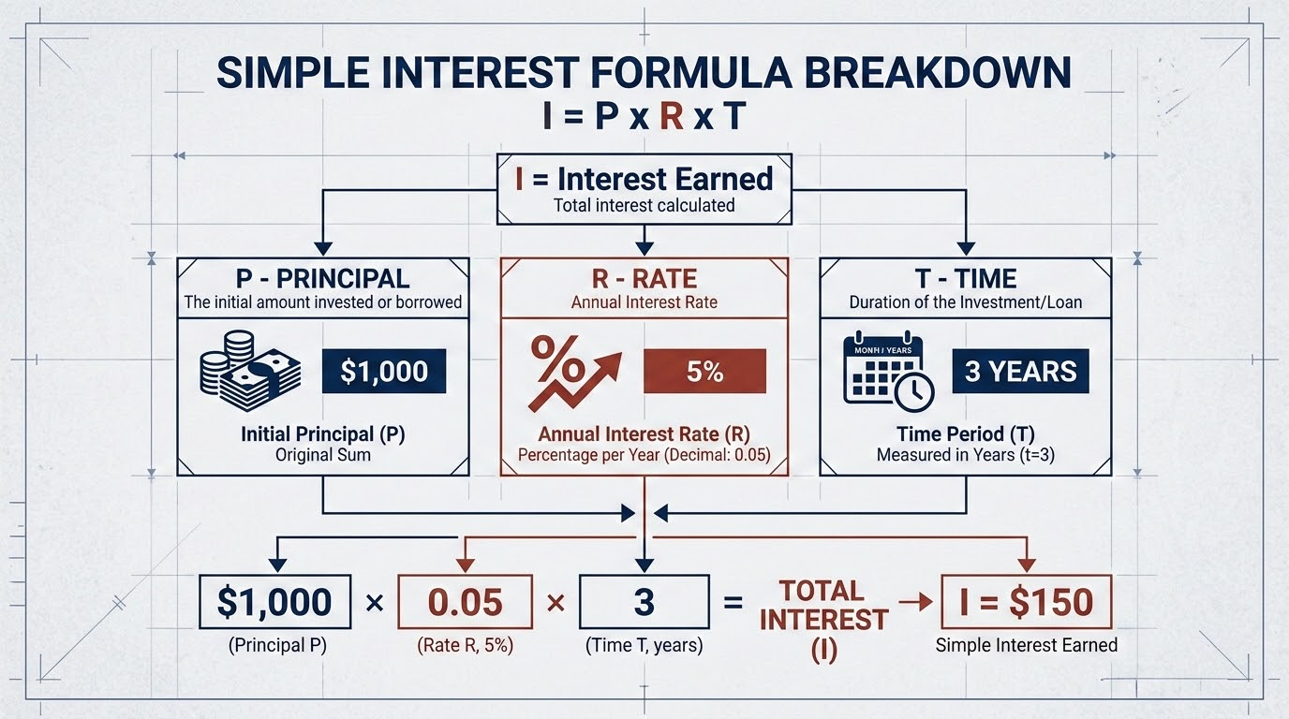
Interest & Cost Price Calculations
CORE FORMULAS
QUESTION 5: SIMPLE INTEREST
SI = (P × R × T) / 100
CP = (SP × 100) / (100 + Profit%)
Principal (P) = ₹50,000 | Rate (R) = 10% | Time (T) = 3 yrs
Calculation:
(50,000 × 10 × 3) / 100 = ₹15,000
QUESTION 6: COST PRICE
Selling Price (SP) = ₹4,600 | Profit = 15%
Calculation:
SP = 115% of CP -> 4,600 = 115/100 * CP
CP = 4,600 / 1.15 = ₹4,000
PRO TIP: PERCENTAGE RELATIONSHIP
Always remember that Selling Price at a profit is (100 + Profit%) of the Cost Price. Use decimal division (e.g., 1.15 for 15% profit) for faster calculations during aptitude tests.
IT Software Placement Aptitude Review
Brinda Dorairaj

Slide 5
Kinematics & Number Theory Analysis
QUESTION 7: TRANSMISSION KINEMATICS
QUESTION 8: DIVISIBILITY RULES
A data packet travels a distance of 1200 meters in a time of 4 milliseconds.
Step 1: Convert time to seconds.
4 ms = 4 / 1000 = 0.004 seconds
Step 2: Apply speed formula (v = d/t).
Speed = 1200 m / 0.004 s
Speed: 300,000 m/s
Determine if the number 45612 is divisible by 9.
The Rule for 9:
A number is divisible by 9 if the sum of its digits is divisible by 9.
Calculation:
4 + 5 + 6 + 1 + 2 = 18
18 is divisible by 9 YES
STRATEGIC NOTE: UNIT CONVERSIONS
Always verify unit consistency (m/s vs ms) before calculation. In network schematics, latency is often provided in ms but must be converted to seconds for kinematic equations.
IT Software Placement Aptitude Review
Brinda Dorairaj

Slide 6
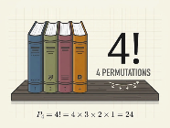
Permutations & Time Intervals
Q9: PERMUTATIONS
Q10: LCM INTERVALS
Arrange 4 distinct programming books on a shelf.
Number of ways = n!
Calculation: 4!
= 4 × 3 × 2 × 1
= 24 Arrangements
Next simultaneous ping for servers at 12s and 18s intervals.
Multiples of 12: 12, 24, 36, 48...
Multiples of 18: 18, 36, 54...
LCM(12, 18) = 36
Next Simultaneous Event: 36 seconds
Visualizing 4!: Any of 4 books can go first, 3 in second spot, 2 in third, 1 in last.
STRATEGIC TIP
Recognize LCM in "ping/interval" or "simultaneous event" problems to find the smallest common time unit.
IT Software Placement Aptitude Review
Brinda Dorairaj

Slide 7
Sequence Patterns & Priority Hierarchy
QUESTION 11: NUMBER SEQUENCE
QUESTION 12: TASK HIERARCHY
Sequence: 2, 3, 7, 16, 32, ...
Differences between terms:
• 3 - 2 = 1 (1²)
• 7 - 3 = 4 (2²)
• 16 - 7 = 9 (3²)
• 32 - 16 = 16 (4²)
Next difference: 5² = 25
Result: 32 + 25 = 57
DECODED TRANSITIVE CHAIN
D
A
B
C
E
Relationship: D > A > B > C > E
Conclusion: Task D holds the highest overall priority in the workflow chain.
STRATEGIC ADVICE
For complex number series, always write out the first and second-level differences to identify squares, cubes, or arithmetic progressions that aren't immediately obvious.
IT Software Placement Aptitude Review
Brinda Dorairaj

Slide 8
Spatial Reasoning & Logical Puzzles
QUESTION 13: SHORTEST DISTANCE
QUESTION 14
"He is the only son of my mother's only daughter." What is the relation?
A
6m
B
8m
LOGICAL BREAKDOWN
10m
1. "My mother's only daughter": Since the speaker is female, she is referring to herself.
2. "Only son of [Speaker]": The boy is her son.
Result: The speaker is the Mother of the boy.
O
Apply Pythagorean theorem: 8² + 6² = 64 + 36 = 100.
√100 = 10 meters shortest distance.
IT Software Placement Aptitude Review
Brinda Dorairaj

Slide 9
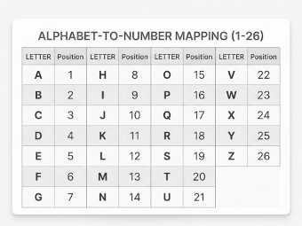
Alphabetical Coding & Backward Sequences
QUESTION 15: ALPHABETICAL CIPHER
QUESTION 16: BACKWARD SEQUENCE
Logic: Map letters to numerical positions (A=1, B=2, ... Z=26).
SERVER: 19-5-18-22-5-18
(S=19, E=5, R=18, V=22)
CLIENT: 3-12-9-5-14-20
C=3, L=12, I=9, E=5, N=14, T=20
Sequence: Z, W, S, N, ?
Pattern Analysis:
Z to W: -3 steps
W to S: -4 steps
S to N: -5 steps
N to ?: -6 steps
Result: Counting 6 letters back from N lands on H.
STRATEGIC TIP
Save time by writing the A-Z (1-26) and Z-A (26-1) mappings on your rough sheet immediately after the test begins.
IT Software Placement Aptitude Review
Brinda Dorairaj

Slide 10
Logic and Seating Review
QUESTION 17
QUESTION 18
Identify the person sitting at the extreme left boundary in the row arrangement [Z, W, Y, X].
PYTHON (35)
BOTH (20)
JAVA (25)
SOLUTION
1. Sequence Array: [Z, W, Y, X]
2. Left to Right Mapping: Pos 1=Z, Pos 2=W, Pos 3=Y, Pos 4=X.
Extreme Left Position: Z
Total Students: 50 | Neither: 10
Inclusion-Exclusion Principle: Total = (A + B - Both) + Neither
IT Software Placement Aptitude Review
Brinda Dorairaj

Slide 11
Classification & Calendar Logic
QUESTION 19: ODD ONE OUT
QUESTION 20: CALENDAR LOGIC
Find the odd one out: Linux, Python, Java, C++.
Linux: Operating System (OS)
Python: Programming Language
Java: Programming Language
C++: Programming Language
Solution: Linux is an Operating System, while the others are languages.
If today is Friday, what day is it after 22 days?
Step 1: Divide days by 7 (days in a week)
22 / 7 = 3 Weeks, Remainder 1
Step 2: Add remainder to current day
Friday + 1 Day = Saturday
STRATEGIC TIP: ODD DAYS LOGIC
In calendar problems, focus only on the remainder (odd days). Any number of days divisible by 7 results in the same day of the week.
IT Software Placement Aptitude Review
Brinda Dorairaj

Slide 12
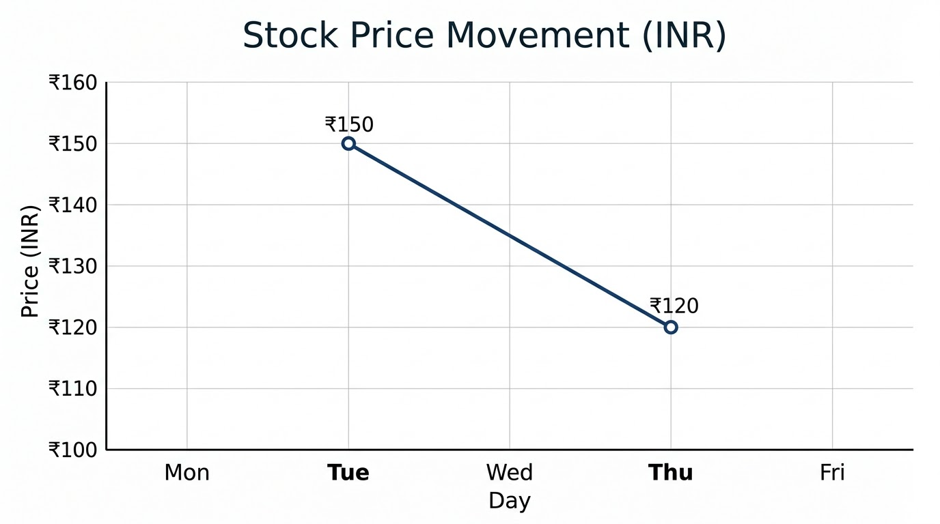
Question 21: IT Stock Price Trends
STOCK PRICE MOVEMENT (INR)
QUESTION 21
Calculate the percentage change for a tech stock priced at ₹150 on Tuesday that dropped to ₹120 by Thursday.
PERCENTAGE DECREASE CALCULATION
1. Change: New - Original = 120 - 150 = - ₹30
2. Formula: (Change / Original Price) × 100
3. Calc: (-30 / 150) × 100 = -1/5 × 100 = -20
Result: -20% = 20% Decrease
CRITICAL RULE: Always divide the change by the ORIGINAL (starting) value to find the percentage.
Positive / Negative change indicates increase / decrease respectively.
IT Software Placement Aptitude Review
Brinda Dorairaj

Slide 13
Question 22: Algorithm Execution
QUESTION 22
LOGIC EVALUATION
Evaluate the condition 'X > 10' and calculate the final output of Y - X.
Set X = 15
Set Y = 25
If X > 10 Then
X = X + 5 // X = 15 + 5 = 20
End If
If Y > X Then
Print Y - X // 25 - 20 = 5
Else
Print X - Y
End If
TRACE RESULTS
1. Initial: X = 15, Y = 25.
2. Condition: 15 > 10 is True.
3. Reassignment: X becomes 20.
4. Calculation: Y - X = 25 - 20.
Final Printed Output: 5
PRO TIP
Always act as the compiler: trace every variable update step-by-step to avoid mental calculation errors.
IT Software Placement Aptitude Review
Brinda Dorairaj

Slide 14
Rapid-Fire Theory: CS Fundamentals
Q23: Binary to Decimal
Q24: FIFO Structure
Q25: Diamond Shape
Convert binary 1011 to decimal:
(1 * 2⁰) + (1 * 2¹) + (0 * 2²) + (1 * 2³)
=1 + 2 + 0 + 8
Result: 11
Which data structure operates on a First-In, First-Out basis?
The correct answer is a Queue, mimicking a real-world waiting line.
In algorithm flowcharting, what does a diamond represent?
It denotes a Decision point, typically evaluating a true/false or yes/no condition.
Bank time on these fundamental theory questions to solve harder problems later.
IT Software Placement Aptitude Review
Brinda Dorairaj

Slide 15
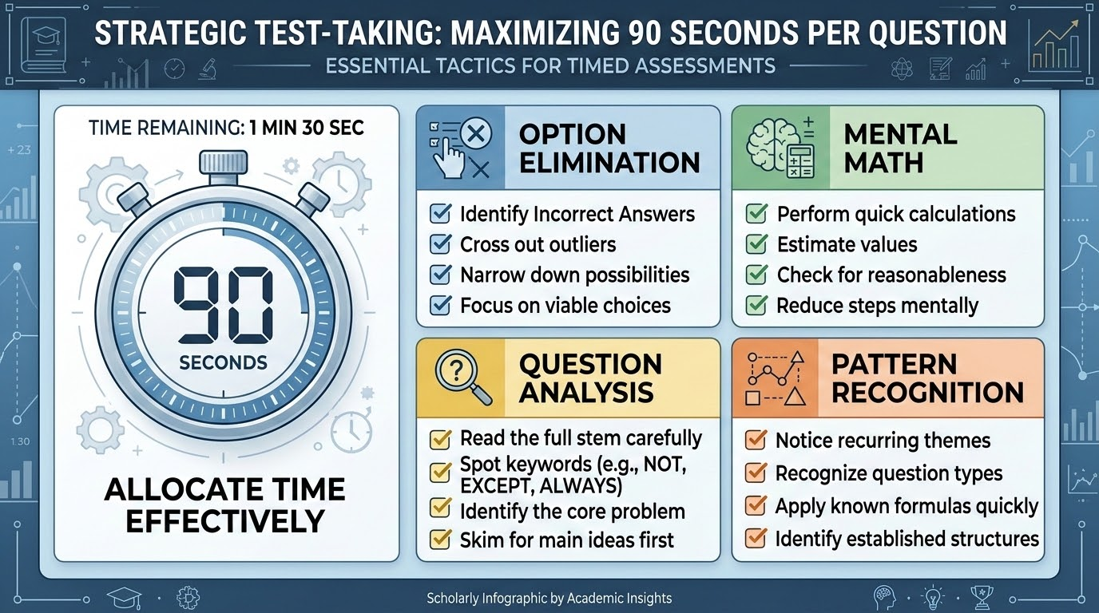
Success Strategies & Exam Day Tactics
Strict Pacing: Allocate an average of 90 seconds per problem to ensure full coverage of the exam.
Mental Math Mastery: Memorize common fractions, percentages, and Pythagorean triples to bypass manual work.
Option Elimination: Rapidly discard obviously incorrect choices—it's often faster than calculation.
Avoid Sunk Costs: Do not get stuck on a single difficult puzzle; maintain momentum through the section.
Q&A SESSION
Addressing specific problem types or testing strategies
IT Software Placement Aptitude Review
Brinda Dorairaj

