Slide 1
Data Science Interview Mastery
Interactive Logic & Intuition Puzzles for Undergraduate Students

Slide 2


Which Surgeon has a superior success rate ?
DR. A SUCCESS
79%
79 / 100 Patients
DR. B SUCCESS
84%
84 / 100 Patients

Slide 3
Which Doctor has a superior success rate ?
DR. A SUCCESS
Cataract: 76%
Glaucoma: 90%
DR. B SUCCESS
Cataract: 75%
Glaucoma: 86%

Slide 4
Which Doctor has a superior success rate ?
DR. A SUCCESS
79%
79 / 100 Patients
Cataract: 76%
Glaucoma: 90%
DR. B SUCCESS
84%
84 / 100 Patients
Cataract: 75%
Glaucoma: 86%
Is this even possible ?

Slide 5
Which Doctor has a superior success rate ?
DR. A SUCCESS
79%
79 / 100 Patients
Cataract: 76% (61/80)
Glaucoma: 90% (18/20)
DR. B SUCCESS
84%
84 / 100 Patients
Cataract: 75% (15/20)
Glaucoma: 86% (69/80)
Can you expain why this happens ? and what this phenomenon is called ?

Slide 6
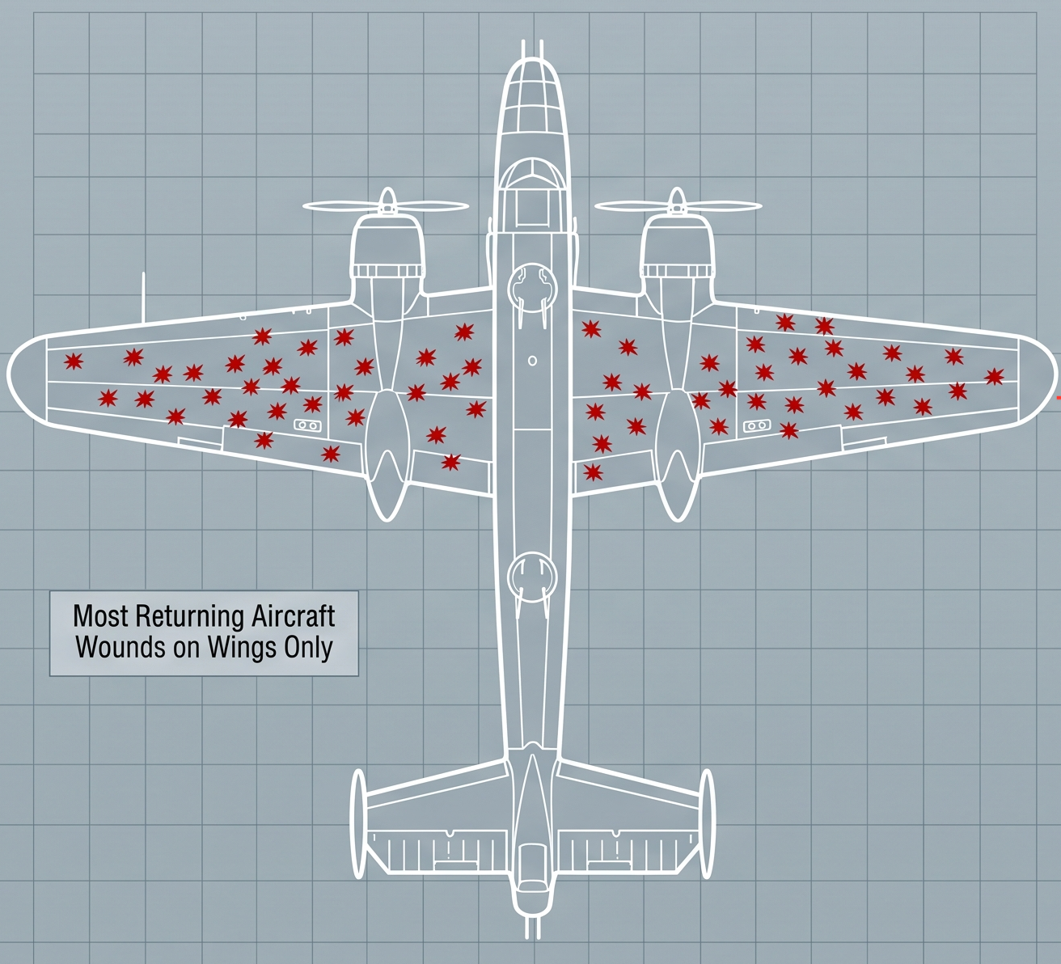
The Bomber Paradox
An exercise in logical analysis and survivorship bias
A country is waging a war
It sends 1000 aircraft to fight the enemy
Only 700 aircraft return safely, the rest are lost to enemy fire
The objecive is to mimize losses by adding heavy armor
Bullet holes on the 700 aircraft are analyzed
The Critical Question
Based on the data showing bullet holes, where should you add armor to improve survival rates?

Slide 7
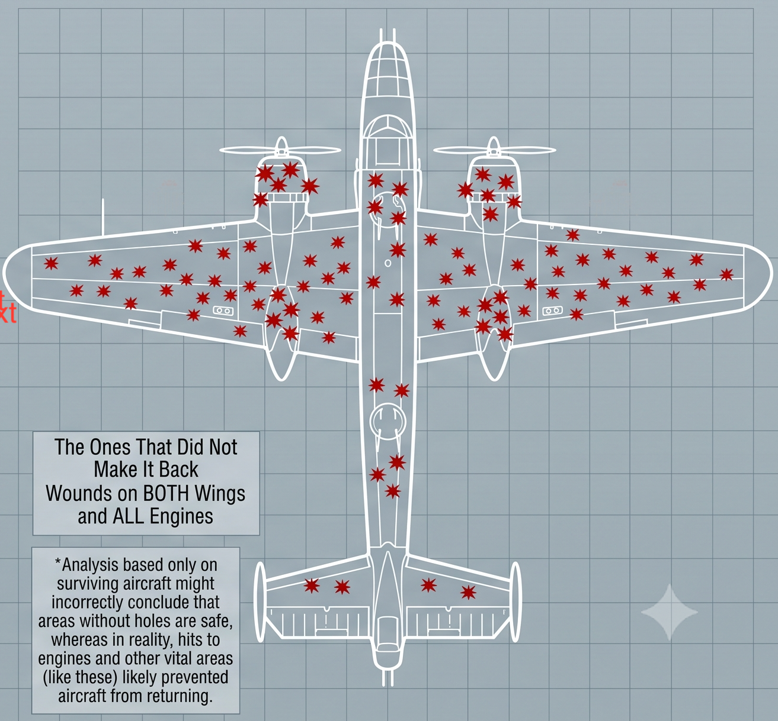
Survivorship Bias
The 700 aircraft only includes planes that successfully survived enemy fire
The 300 that were missing never returned to be analyzed
This is MISSING DATA - a HUGE problem
So, may be the armor should be applied to where the bullet holes aren't present
INSIGHT - If you only train models on existing customer data, you miss churned users.
The Missing Perspective
Always ask: "What data am I NOT seeing?"

Slide 8

Engineering Fairness from Bias
Probability & Repeated Trials
What is a Fair Coin ?
P(H) = P(T) = 0.5 (i.e. 50%)
The Coin Flip Game
Two players toss a coin
Player 1 wins if it is Heads
Player 2 wins if it is Tails
The game is fair - Both players have equal chance of winning

Slide 9
Engineering Fairness from Bias
Probability & Repeated Trials
What is a Biased Coin ?
P(H) != P(T)
For e.g.
P(H) = 0.8 (i.e. 80%)
P(T) = 0.2 (i.e. 20%)
Question - Can two players play a Coin Flip game with a Biased coin ? How do they ensure the game is fair ?

Slide 10
Sequential Symmetry
Solving the Biased Coin Problem through Pairwise Probability
Sequential Workflow
1. Flip the coin twice
Possible outcomes are:
HT
TH
HH
TT
2. Filter Outcome
If you roll
HH or TT,
discard the result and flip again
3. Rule Decision
For a fair game:
HT - Player 1 wins,
TH - Player 2 wins
Mathematical Proof
P(HH) = 0.8 × 0.8 = 0.64
P(HT) = 0.8 × 0.2 = 0.16
P(TT) = 0.2 × 0.2 = 0.04
P(TH) = 0.2 × 0.8 = 0.16

Slide 11
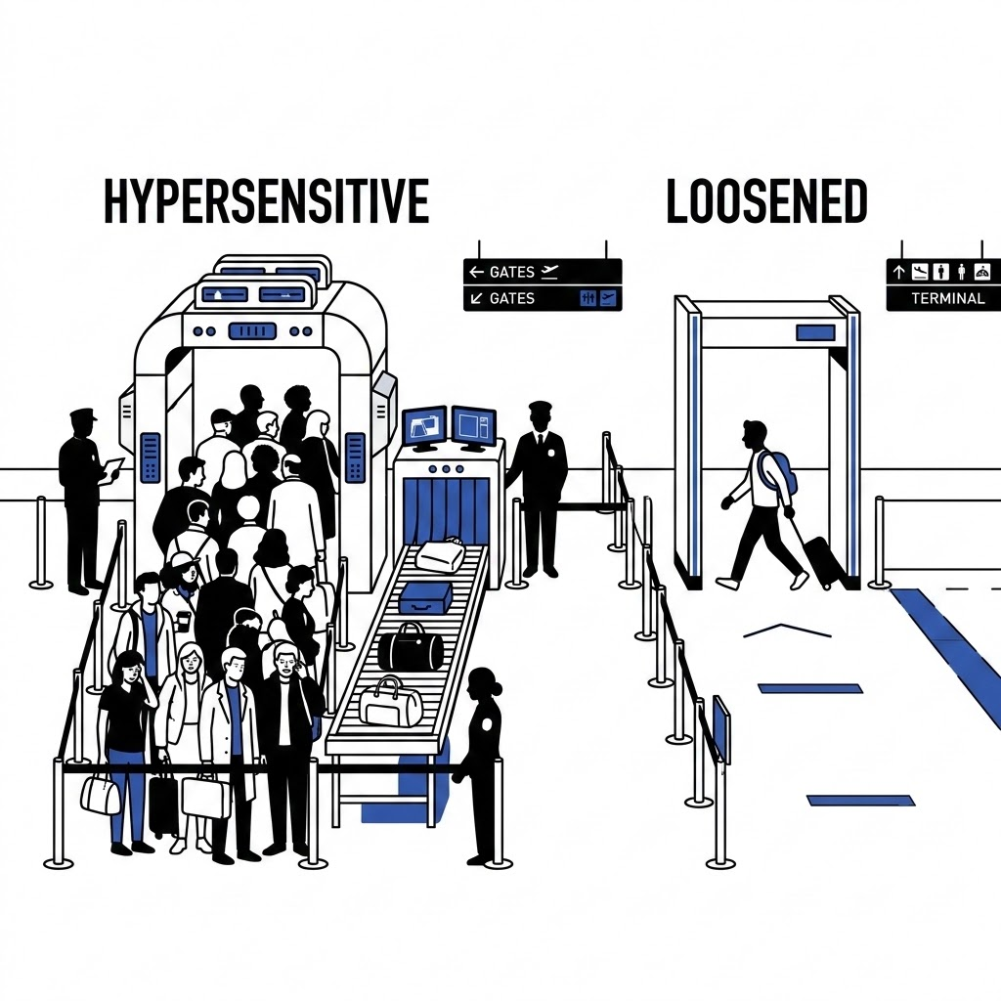
Balancing Security & Flow
The Precision-Recall Dilemma in Detection Algorithms
The Competing Forces
Recall (Sensitivity) vs. Precision (Specificity)
Hypersensitive (High Recall): Flags every potential threat to eliminate False Negatives. However, it floods the system with False Positives (metal buttons, foil), causing massive passenger bottlenecks.
Loosened (High Precision): Reduces false alarms to ensure rapid throughput. However, it increases the rate of False Negatives, raising the critical risk that dangerous items pass undetected.
Optimizing the Threshold
Cost-Benefit ROC Curve Analysis
Data scientists utilize an ROC or Precision-Recall curve to find the mathematically optimal threshold. The decision boundary is determined by weighting the catastrophic security cost of a missed threat against the operational costs of extreme airport delays.

Slide 12
Precision vs. Recall
Understanding the Tradeoff Between Precision and Recall
Precision (Quality)
Precision measures quality
Core Question
Of all flagged items, how many are actually guilty?
System Outcome
High precision means zero false alarms and short lines.
Recall (Quantity)
Recall measures quantity
Core Question
Of all actual threats, how many did we catch?
System Outcome
High recall means zero threats missed but long lines.
Strategic Tradeoff: High-stakes scenarios optimize for Recall, while low-stakes optimize for Precision.

Slide 13
The Mapping Challenge
Design a function - f(x) = y with the following specifications:
Input x - any real number [-∞, +∞]
Output y - has to be in the interval [0, 7]
The function must be smooth and monotonic
i.e. as input x increases, the output y also increases
Design a function that accepts any real number as an input

Slide 14

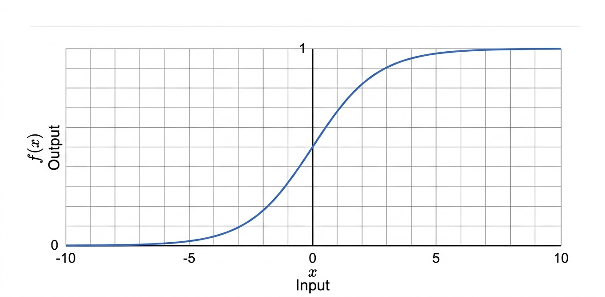
Foundation: Pure Sigmoid Function
Evaluate the function:
f(-∞) = 0
f(0) = 0.5
f(+∞) = 1

Slide 15

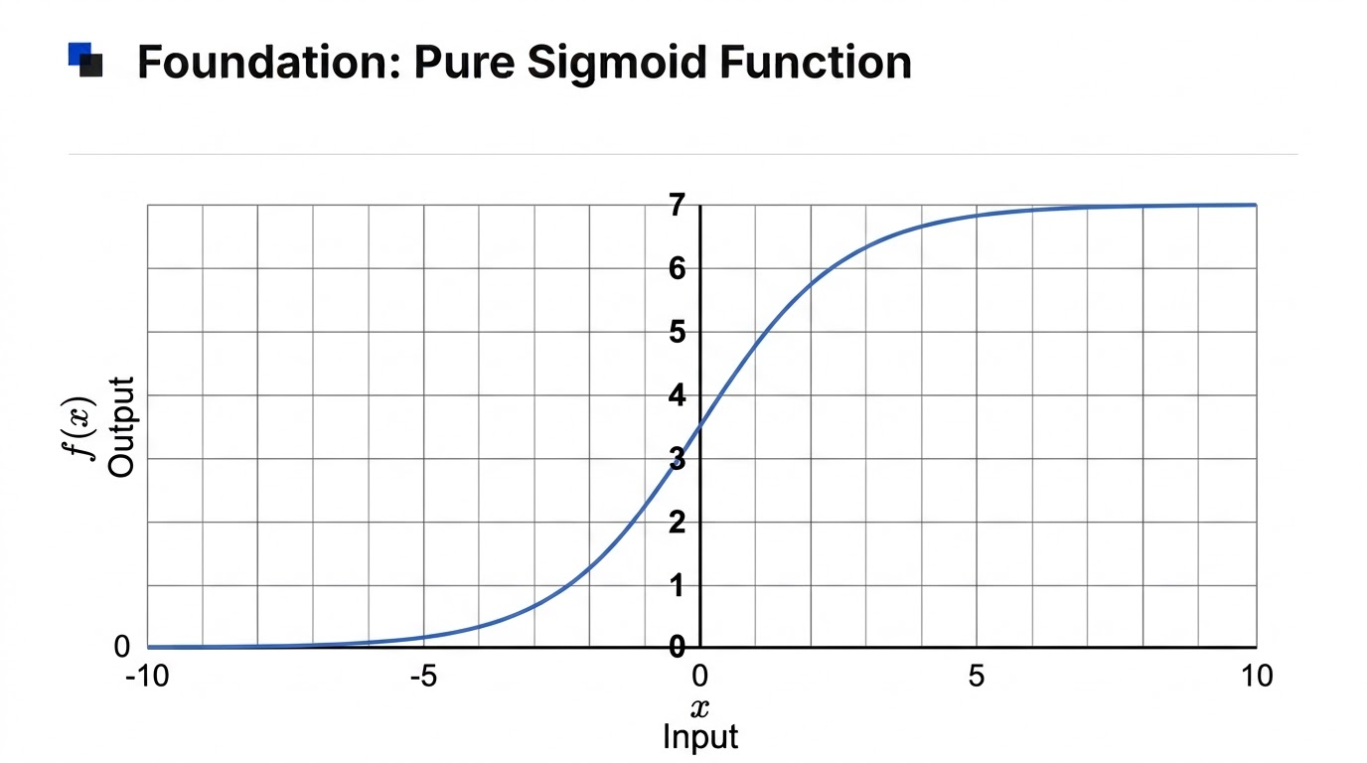
Tweaking the Sigmoid Function
Evaluate the function:
f(-∞) = 0
f(0) = 3.5
f(+∞) = 7

Slide 16
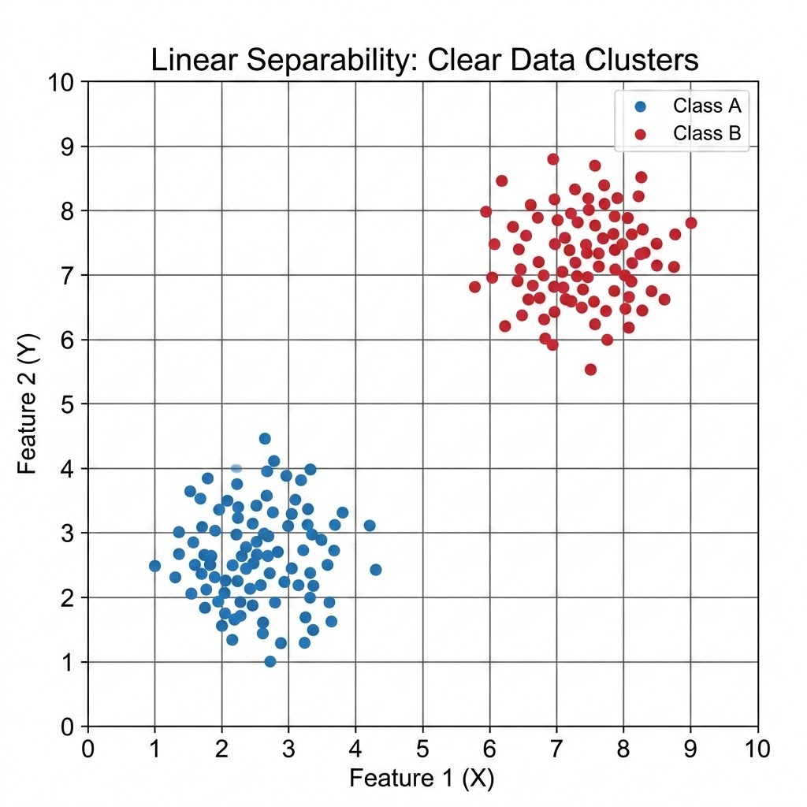
The Linear Baseline
How does a Linear Classifier work ?
Take any two points on the line:
(x1, y1) = (7, 3)
(x2, y2) = (3, 7)
Equation of the line
y - y1 = m (x-x1),
where m = (y2-y1)/(x2-x1)
y = -x + 10
or
x + y - 10 = 0
Now, plug in a blue point to the equation:
For (x, y) = (3,3)
3 + 3 - 10 = -4 (Negative Number)
Now plugin a red point:
For (x, y) = (7,7)
7 + 7 - 10 = +4 (Positive Number)

Slide 17
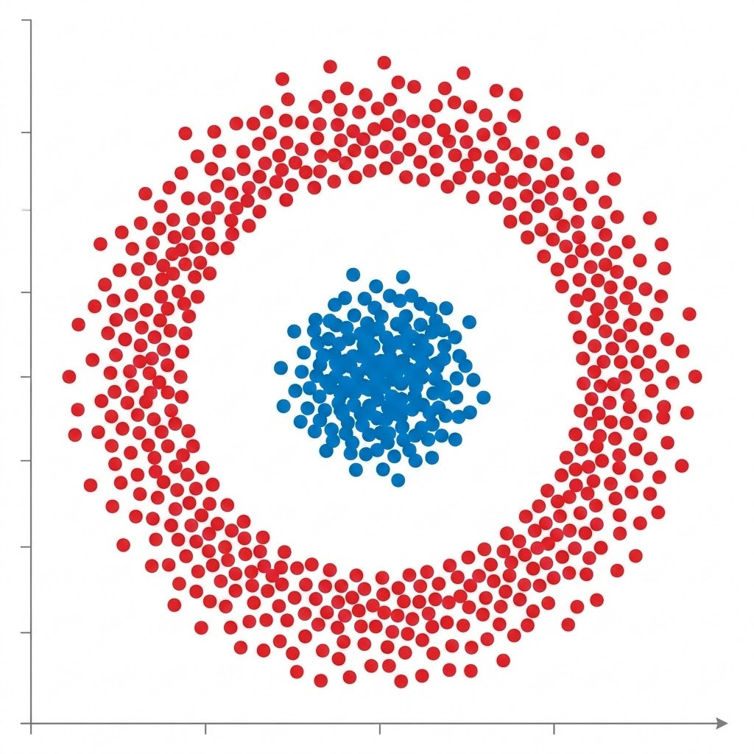
The Linear Constraint
Can a straight line separate concentric circular classes?
The Scenario
A 2D classification scenario requires separating Red versus Blue classes, where Red completely surrounds a tight cluster of blue dots in the center.
Strict Constraint
The machine learning model is purely linear, meaning it can only draw a straight line.
The Puzzle
How can a straight line perfectly separate these two groups? Is it mathematically possible without changing the algorithm to something more complex?

Slide 18
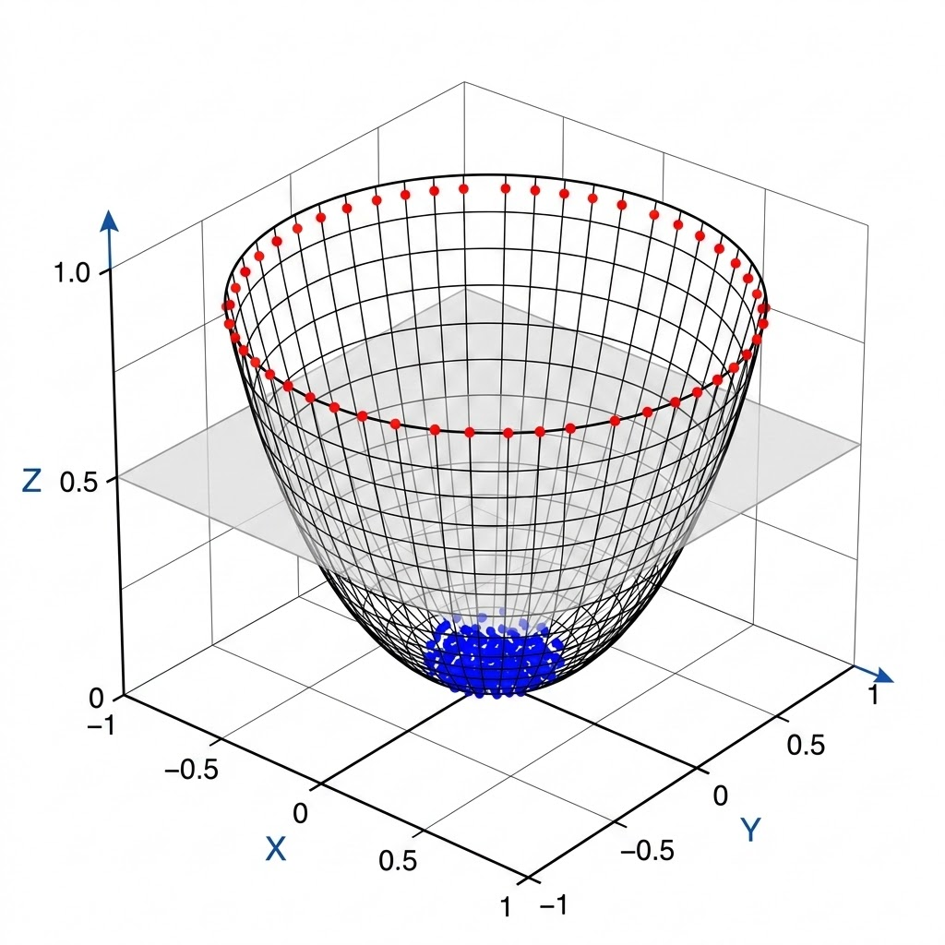
Dimensionality Uplift
The solution is Dimensionality Uplift
Dimensional Mapping
z = x² + y²
Measures distance from center
By adding a third dimension (z) using the simple formula z = x^2 + y^2, we measure the distance from the center.
Blue points remain low, while Red points shoot upward into a 3D bowl shape.
This illustrates the core intuition behind Kernel Methods, such as Support Vector Machines (SVMs), and Feature Engineering.
Projecting data into a higher dimension achieves linear separability without increasing model complexity.
Figure 1: 3D Projection into a Linearly Separable Space

