Slide 1

Technical Interview
Undergraduate Level Quiz
Data Structures | OOP | DBMS | Machine Learning

Slide 2

PART 01
Data Structures & Algorithms

Slide 3
FUNCTION CALL MANAGEMENT
Which data structure is used by the compiler to manage function calls and local variables?
A) Queue
B) Stack
C) Tree
D) Linked List
B) Stack

Slide 4



IDENTIFY THE STRUCTURE
"I operate under a very strict rule: 'First In, First Out'. If you want to insert something, you have to do it at my Rear, but if you want to remove something, you must take it from my Front."
Who am I?
Queue

Slide 5
IDENTIFY ME
"I am a searching algorithm. I am simple but not very efficient for large datasets. I start at the very beginning of a collection and check every single item one by one until I find a match or run out of elements. Who am I?"
Who am I?
Linear Search

Slide 6
IDENTIFY ME
"I am a self-referential linear data structure. Unlike arrays, my elements are not stored in contiguous memory locations. Instead, each of my nodes holds a piece of data and a pointer pointing to the next node in line. Who am I?
Who am I?
Singly Linked List

Slide 7
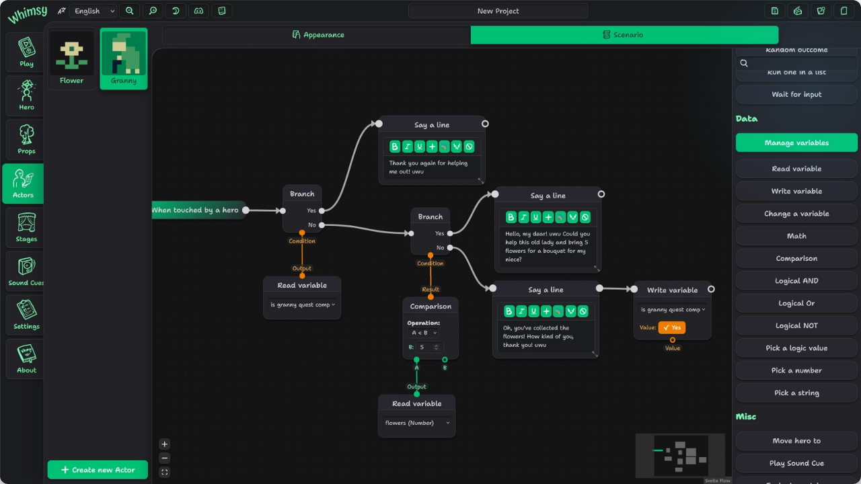
PART 02
Object-Oriented Programming

Slide 8
CORE PRINCIPLES
Wrapping data and methods together into a single unit is known as:
A) Inheritance
B) Polymorphism
C) Encapsulation
D) Abstraction
C) Encapsulation

Slide 9
METHOD REDEFINITION
Which concept allows a subclass to provide a specific implementation of a method already defined in its superclass?
A) Method Overloading
B) Method Overriding
C) Composition
D) Encapsulation
B) Method Overriding

Slide 10
METHOD REDEFINITION
What is method overloading?
A) Same method with different implementation in child class
B) Same method name with different parameters
C) Multiple classes with same name
D) Multiple objects
B) Method Overriding

Slide 11
REDUNDANT CODE
Which OOP pillar is primarily used to eliminate redundant code by reusing existing code structures?
A) Abstraction
B) Polymorphism
C) Inheritance
D) Encapsulation
C) final

Slide 12
ABSTRACT METHOD
What is an abstract method in JAVA ?
A) A function that cannot be overridden
B) A function with no implementation in the base class, forcing derived classes to implement
C) A function that can only access private data members
D) A function that belongs to a class rather than an object instance
C) final

Slide 13
JAVA KEYWORDS
Which keyword prevents a method from being overridden in Java?
A) static
B) private
C) final
D) public
C) final

Slide 14



IDENTIFY THE COMPONENT
"I define what an object should do, not how. Classes implement me. I enable pure abstraction and have no physical existence."
Who am I?
Interface

Slide 15
IDENTIFY ME
"I am a design blueprint. I define the properties and behaviors that my instances will possess, but I don't occupy any memory myself until an object is created from me. Who am I?"
Who am I?
Class

Slide 16
IDENTIFY ME
“I am a special type of member function. I have the exact same name as my class, I have no return type, and I am automatically triggered the moment an object is born into memory. Who am I"
Who am I?
Constructor

Slide 17

PART 03
Database Management Systems

Slide 18
ACID PROPERTIES
Which ACID property guarantees that once a transaction is committed, its updates will survive system crashes?
A) Atomicity
B) Consistency
C) Isolation
D) Durability
D) Durability

Slide 19
SQL SUBSETS
Which of the following SQL commands belongs to the Data Definition Language (DDL) subset?
A) SELECT
B) UPDATE
C) CREATE
D) INSERT
C) CREATE

Slide 20
ACID
In database transaction management, what does the "I" stand for in the ACID properties?
A) Indexes
B) Integrity
C) Isolation
D) Iteration
C) CREATE

Slide 21
ODD ONE OUT
Identify the ODD database term regarding concurrency control:
A) Deadlock
B) Shared Lock
C) Exclusive Lock
D) Outer Join
D) Outer Join

Slide 22
JOINS
Which JOIN returns only matching records from both tables?
A) LEFT JOIN
B) RIGHT JOIN
C) INNER JOIN
D) FULL JOIN
D) Outer Join

Slide 23
SQL GROUPS
Which SQL clause filters grouped data?
A) HAVING
B) WHERE
C) GROUP BY
D) ORDER BY
D) Outer Join

Slide 24
IDENTIFY ME
“I uniquely identify every row. I cannot contain NULL values. There is only one of me in a table. Who am I?"
Who am I?
Primary Key

Slide 25
IDENTIFY ME
“I am an integrity constraint. My primary job is to establish a link between two tables by matching a column in a child table to the primary key of a parent table. Who am I?"
Who am I?
Foreign Key

Slide 26
PART 04
Machine Learning & AI

Slide 27
LEARNING MODELS
What is the main goal of unsupervised machine learning algorithms?
A) To predict a specific labeled target value
B) To find hidden patterns or structures in unlabeled data
C) To optimize a continuous reward function
D) To minimize validation classification error
B) Find hidden patterns in data

Slide 28
MODEL DIAGNOSTICS
A model achieves 99% accuracy on training but drops to 52% on unseen data. This condition is:
A) High Bias (Underfitting)
B) High Variance (Overfitting)
C) Data Leakage
D) Class Imbalance
B) High Variance (Overfitting)

Slide 29
FUNCTIONS
What is the name of the mathematical function applied to nodes in a neural network to introducing essential non-linearity?
A) Loss Function
B) Cost Function
C) Gradient Function
D) Activation Function
B) High Variance (Overfitting)

Slide 30
FUNCTIONS
In machine learning classification, what is the tabular layout used to evaluate performance by mapping true/false positives and negatives?
A) Confusion Matrix
B) Correlation Matrix
C) Covariance Matrix
D) Contingency Table
B) High Variance (Overfitting)

Slide 31
IMAGE PROCESSING
Which AI model is commonly used for image classification?
A) CNN (Convolutional Neural Network)
B) Random Forest
C) RNN (Recursive Neural Network)
D) DBSCAN
B) High Variance (Overfitting)

Slide 32
ALGORITHMS
Identify the ODD machine learning algorithm
A) K-Means Clustering
B) Hierarchical Clustering
C) Linear Regression
D) DBSCAN
B) High Variance (Overfitting)

Slide 33
End of Quiz

