Slide 1
Pre-Requisites
Ensure you have a Google / Gmail Id
This will be used to sign-into Google Forms to take short surveys and quizzes
Ensure you have access to github
Github Repo details will be provided during the program
Bring your laptop - Make sure you have Python3 installed
Alternatively, you may use an Online Python Notebook
Turn OFF Vibe Coding for the best experience
Make sure you have internet connectivity on your laptop throughout the program

Slide 2
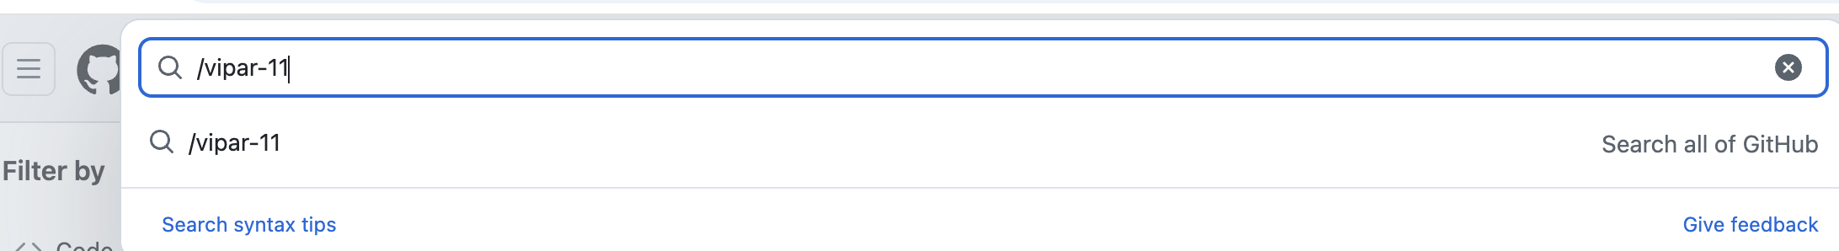
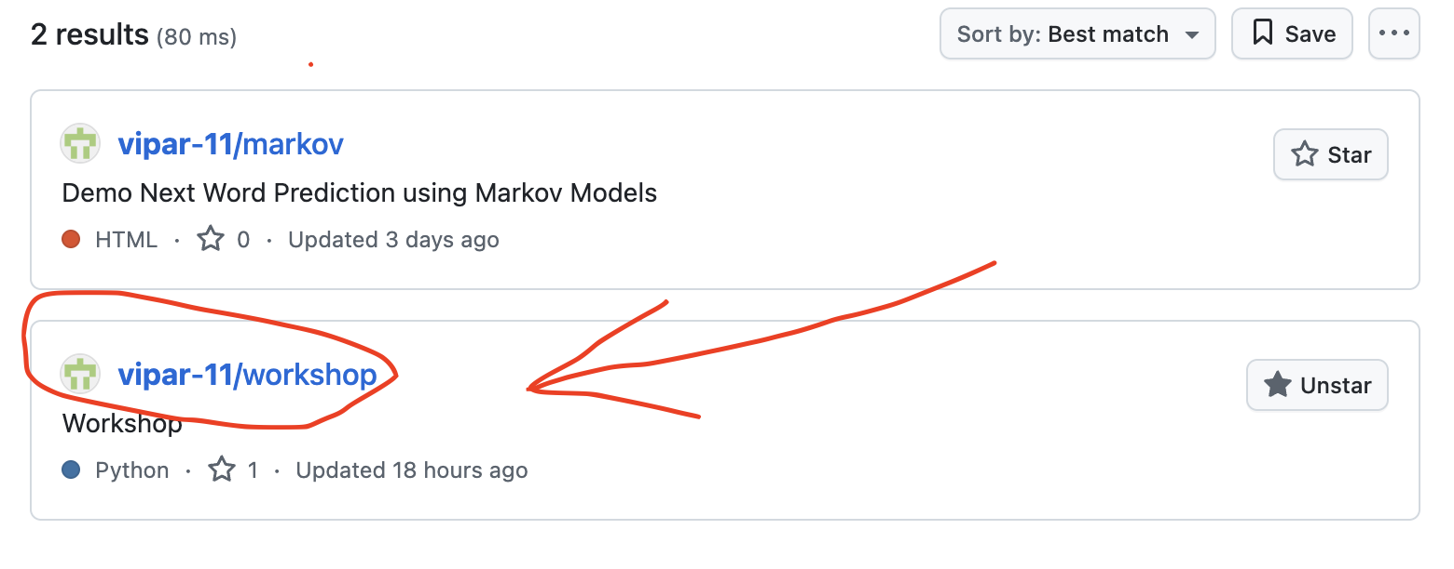
Gitgub Repo
https://github.com/vipar-11/workshop

