Slide 1

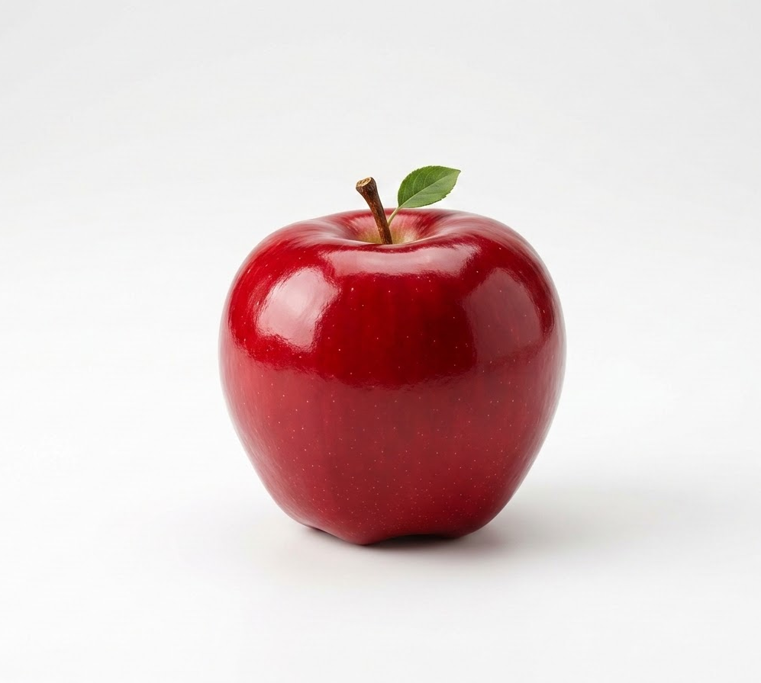
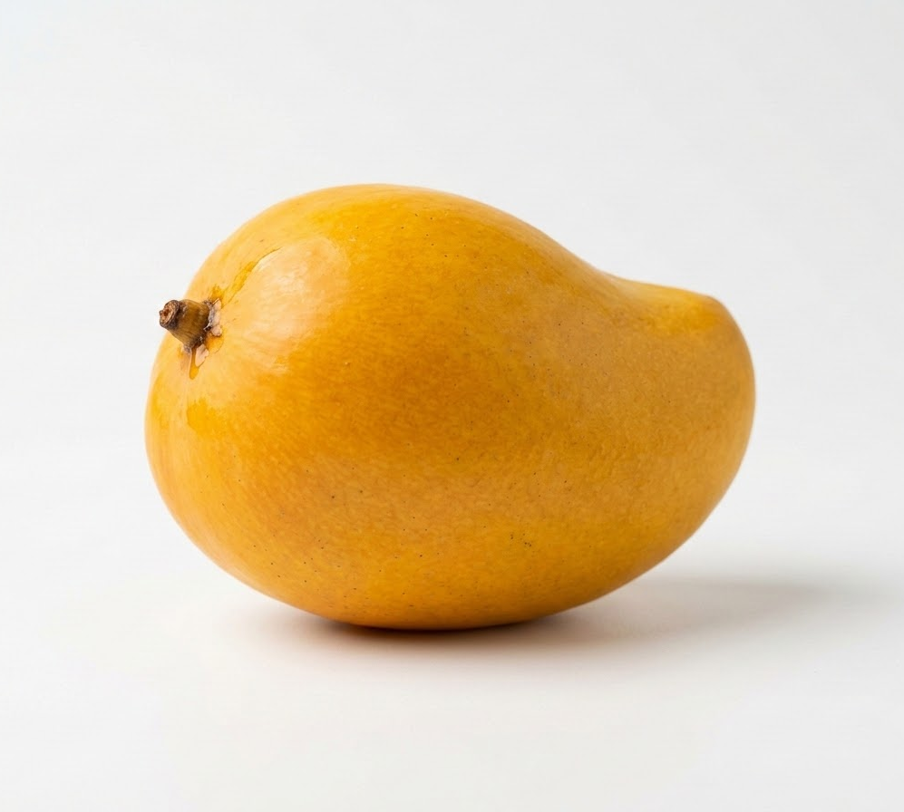
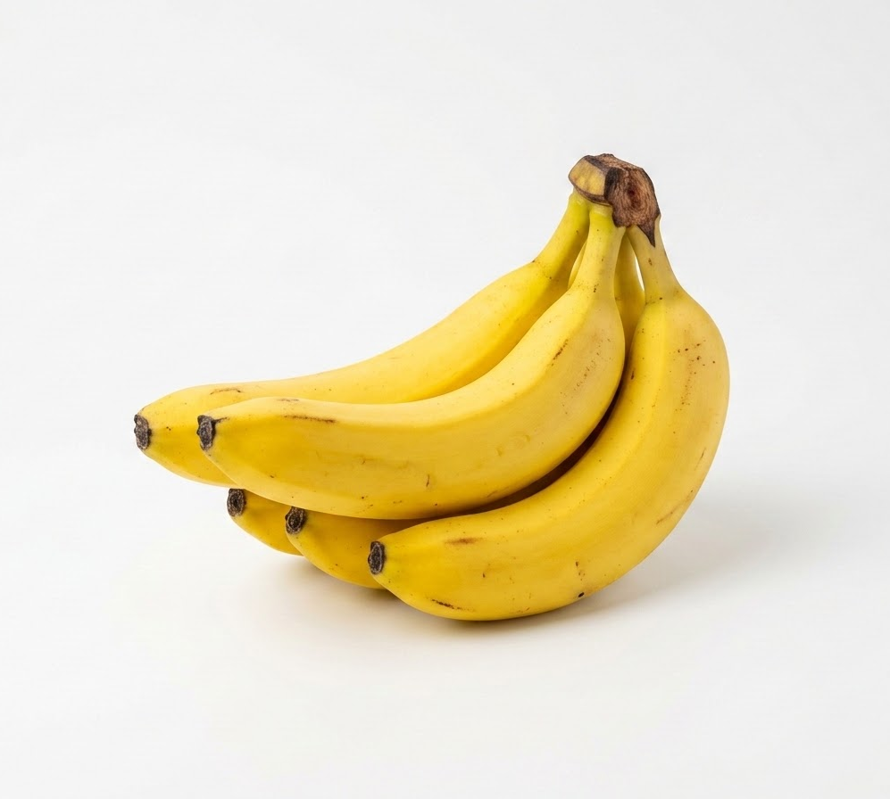
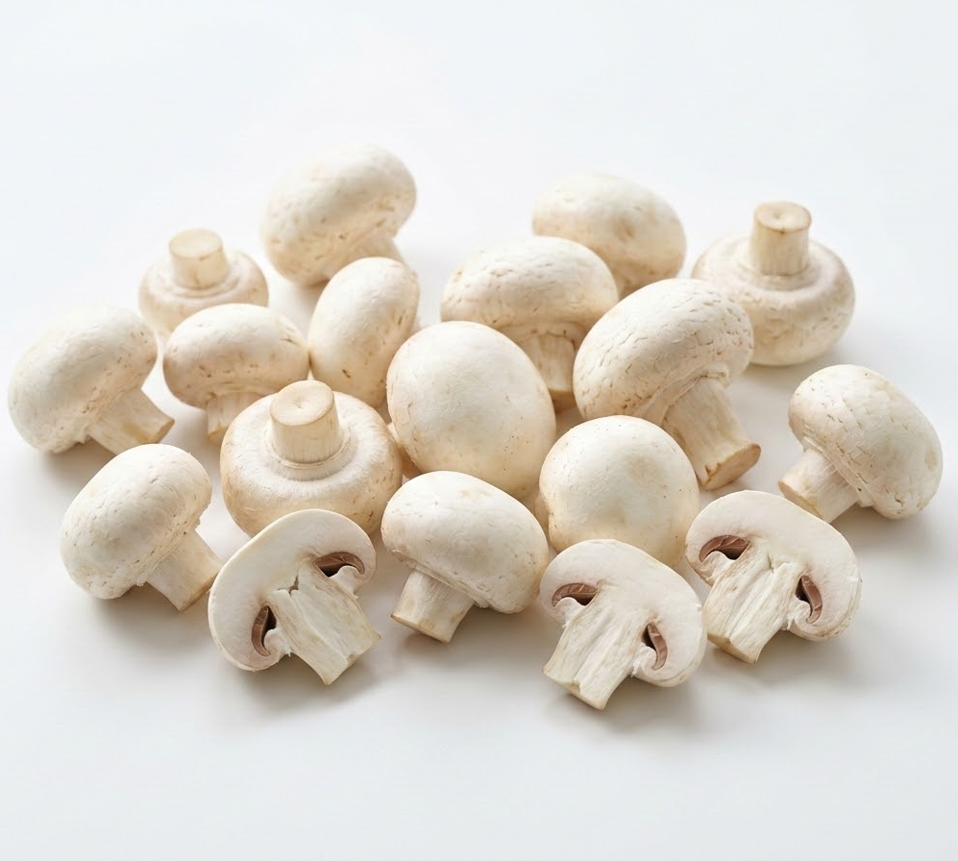
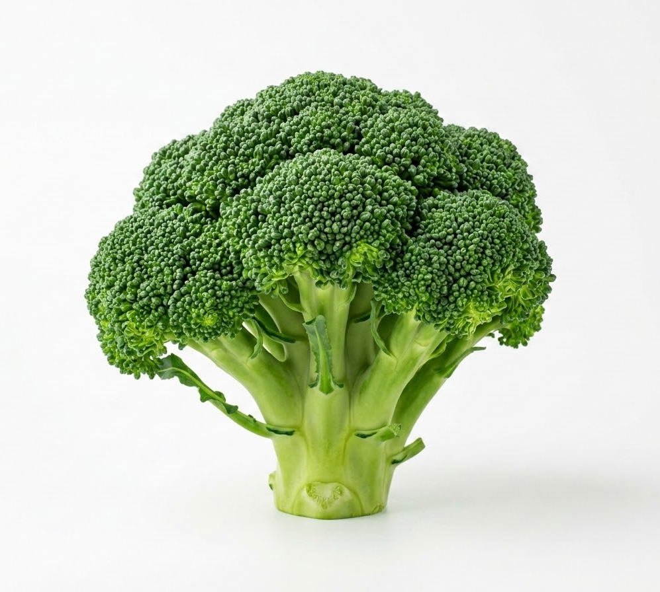
Gourmet Grocery
Fresh Fruit & Vegetable Portal
Kashmir Special
Winter Special
Premium Choice
Farm Fresh
High Nutrient
Fresh Fruit
Crisp Apples
₹50 / kg
Add to Cart
Fresh Fruit
Sweet Mangos
₹345 / kg
Add to Cart
Fresh Fruit
Organic Bananas
₹152 / kg
Add to Cart
Dairy and Eggs
Button Mushrooms
₹299 / pack
Add to Cart
Vegetables
Fresh Broccoli
₹249 / head
Add to Cart

Slide 2
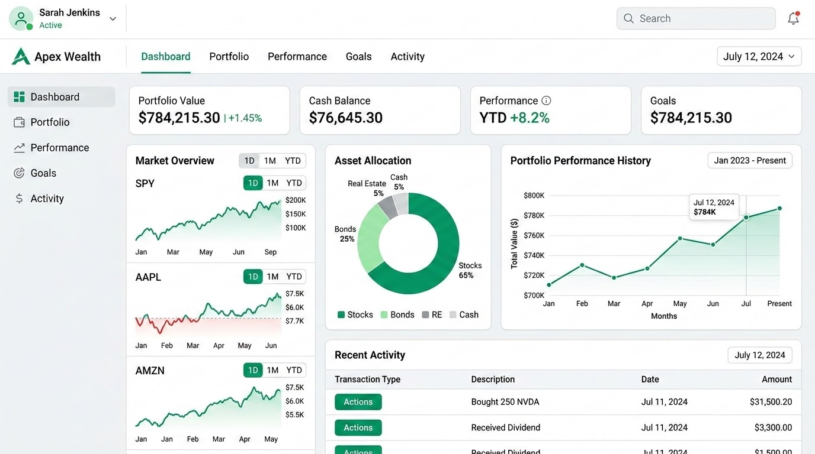
WealthOS Advisor Portal
Client Portfolio Management
Holdings & Allocation
Vanguard S&P 500 ETF (VOO)
Allocation: 45.0% • Value: $148,500
Apple Inc. (AAPL)
Allocation: 20.0% • Value: $66,000
Tesla Inc. (TSLA)
Allocation: 15.0% • Value: $49,500
iShares 20+ Yr Treasury (TLT)
Allocation: 12.0% • Value: $39,600
Cash & Equivalents
Allocation: 8.0% • Value: $26,400

