Slide 1

Blockchain One

Slide 2
Overview
BTC
Bitcoin as a Currency
The Components of the System
Some of the Processes – Mining / Consensus
The Software Protocol
The History
A Transaction Lifecycle
Wallets

Slide 3
BTC / Bitcoin
The 1st Blockchain and Crypto Currency
Created / Appeared in 2009
The Father of Crypto
Speculated to be Created by Satoshi Nakamoto
Wiki Link
All other cryptocurrencies are considered as Alt-Coins

Slide 4


Slide 5



Satoshi Nakamoto
Wiki Link
PsudoName – Not Real Name
Reporters Did approach this individual but he denied ownership
There are possible individuals who may be responsible
Hal Finey (Cryptographic Pioneer)
Nick Szabo (Smart Contracts)

Slide 6
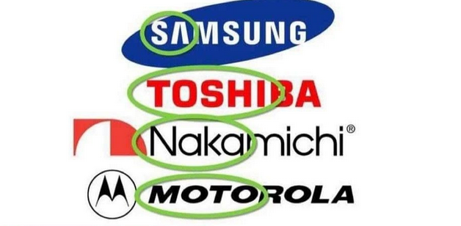
Satoshi Nakamoto
Alternative Theories Suggest :
Some do Know , but the majority do not and may never know.
Notes:
You can do some of your own investigation and come to your own conclusions

Slide 7
In the Beginning
The First Transaction Took Place in 2009.
Jan 3, 2009 6:15 PMUTC
The value of BTC was : $0 and the amount was 50btc
If that transaction took place in Nov 2021 at the height of BTC value, the transaction would be worth 50 X 65,000$
The Genesis Block
Entire Price History
Notes:
We will use https://blockchair.com/ often

Slide 8
What Else Happened at the start ?
P2PFoundation
The Post
The whitepaper
More on WPs and ICOs Later

Slide 9
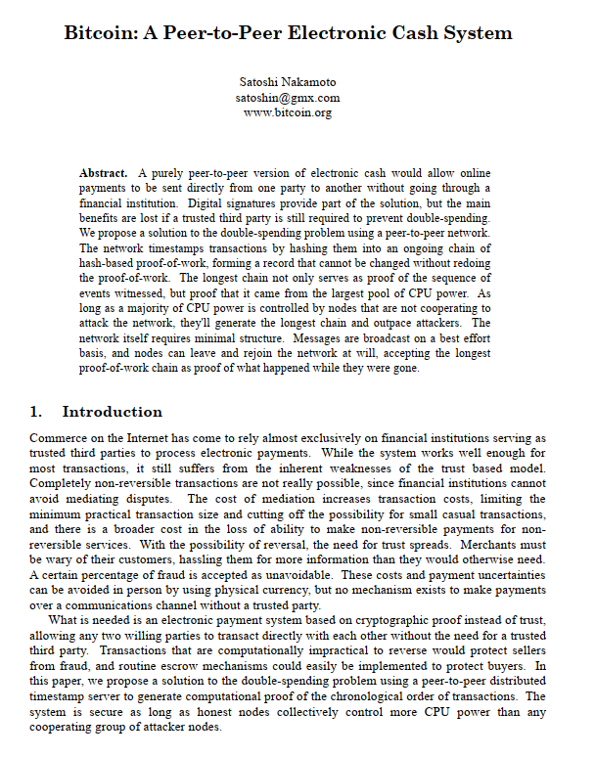

Slide 10
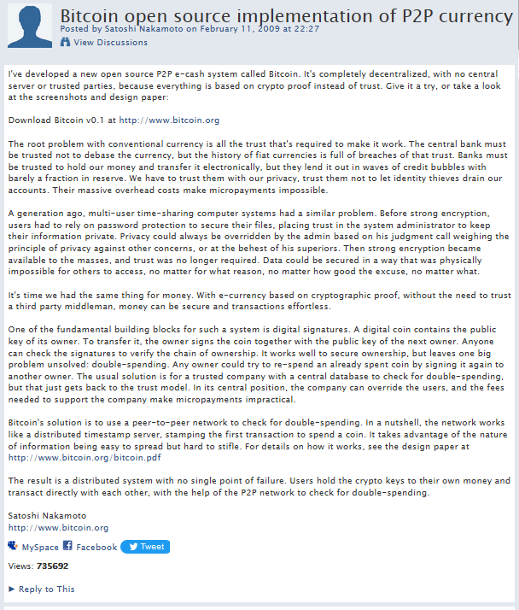

Slide 11
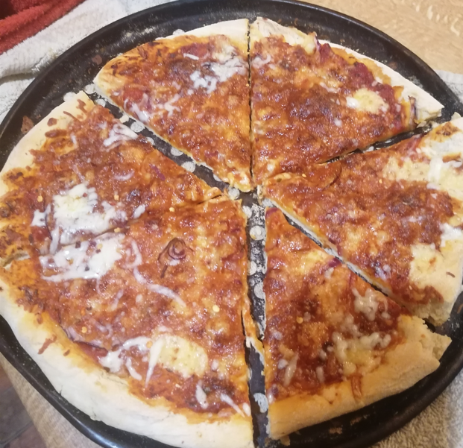
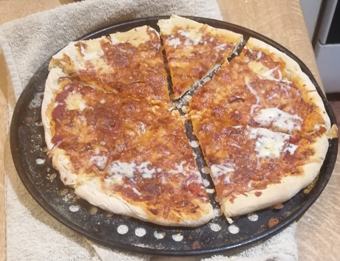
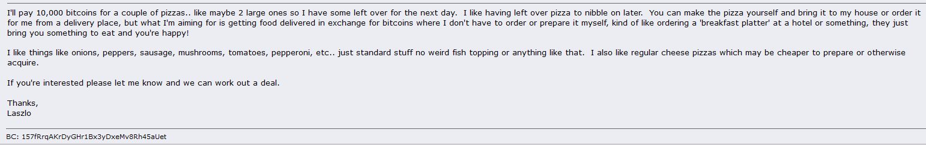
The Humour & Who Could Have Known ?
Bitcoin Pizza Day – May 22nd
In May, 2010 Laszlo Hanyecz set out to buy two large pizzas with bitcoin.
The Post
How Much was it worth Then and how Much is it worth now? Use BC
https://blockchair.com/

Slide 12
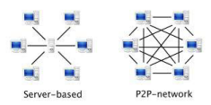
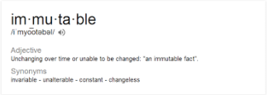
Technical Infrastructure
Peer to Peer (P2P)
Decentralised
Immutable
Distributed, shared ledger of events
What Applications do you think this tech
would be Useful ?

Slide 13
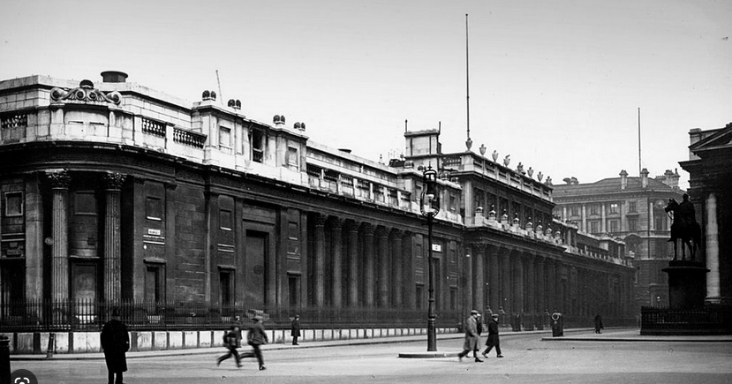
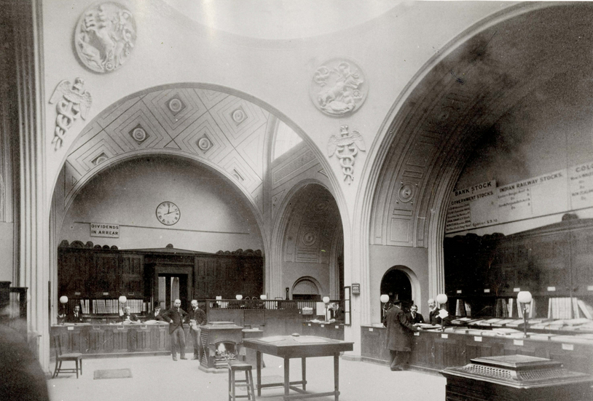
A Ledger
There exists some Issues with ledgers
Susceptible to fraud
Susceptible to human error
Rely on intermediary to prevent double spend e.g. bank, paypal
Full control out of the hands of the consumer
In some cases the power of these
intermediaries can result in over-extensions of power:
Paypal block payments to Wikileaks etc
Notes:
Images Around 1894 / BOE operating from 1734 till 1920 (Demolished)

Slide 14
Cryptographic Beginnings
BTC is a paradigm
A collection of Technologies combined to provide a new tec / service
Distributed Computing
Peer to Peer
Digital Signatures
Consensus
Hashing Algorithms

Slide 15
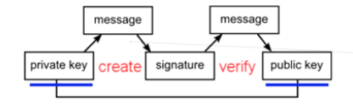
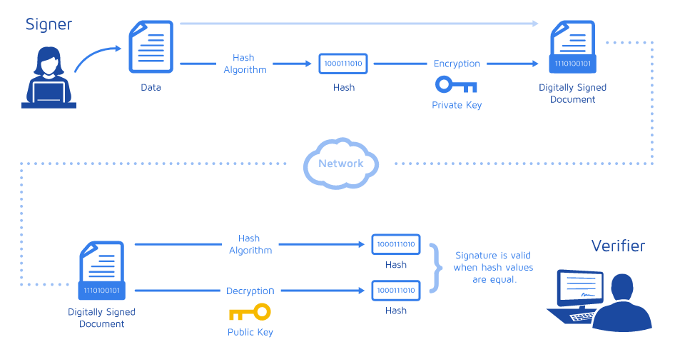
Digital Signature Non Repudiation
Notes:
Image Taken from : https://www.docusign.com/how-it-works/electronic-signature/digital-signature/digital-signature-faq
A mathematical scheme for demonstrating authenticity of digital messages or documents

Slide 16
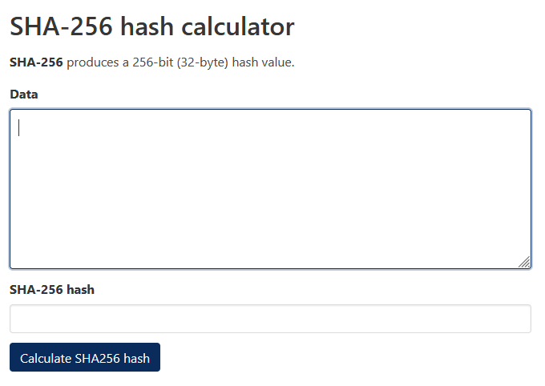
Hashing Demo / BTC Functions Demo
SHA-256
“The SHA (Secure Hash Algorithm) is one of a number of cryptographic hash functions. A cryptographic hash is like a signature for a text or a data file. SHA-256 algorithm generates an almost-unique, fixed size 256-bit (32-byte) hash. Hash is a one way function – it cannot be decrypted back. This makes it suitable for password validation, challenge hash authentication, anti-tamper, digital signatures.”
https://andersbrownworth.com/blockchain/ - Fantastic Resource For Beginners to understand some of the workings

Slide 17
Hashing / SHA
Hashing , given from cryptography is an irreplaceable feature within the BTC Network.
It is used throughout
Verifying Transactions
Ensuring No Modifications / Immutability
Used to Perform Computational work
Those workings are then used for POW , proof of work
Demo of SHA-256 – SHA Calculator

Slide 18
Consensus “To Achieve a Consensus”
BTC uses a POW consensus Mechanism
Proof of Work
There are several Variations of Consensus mechanisms across differing Blockchains.
Ethereum recently converted to a POS , proof of stake.
We will investigate some other Consensus Mechanisms as we progress.
BTC First with POW
Notes:
An Agreement

Slide 19
Proof Of Work
Hashcash was proposed in 1997 by Adam Back and described more formally in Back's 2002 paper "Hashcash - A Denial of Service Counter-Measure".
Proof of Work:
Based on Adam Back’s Hashcash (2002) the PoW involves scanning for a value that when hashed, the hash begins with a number of zero bits.
Miners (which we will discuss in more detail later) confirm proof of work by incrementing a nonce in the block until a value is found that gives the required zero bits to solve the block’s hash.
This PoW also solves the problem of determining representation in majority decision making.
Proof-of-Work is essentially ‘one-CPU-one-Vote’. The majority decision is represented by the longest chain, which has the greatest PoW efforts invested in it.
To modify a past block, an attacker would have to redo the PoW of the block and all blocks after it and then catch up with and surpass the work of the honest nodes.
The likelihood of this diminishes exponentially as subsequent blocks are added.
HashCash PDF

Slide 20
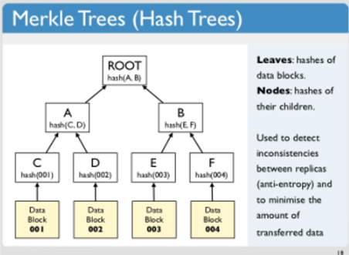

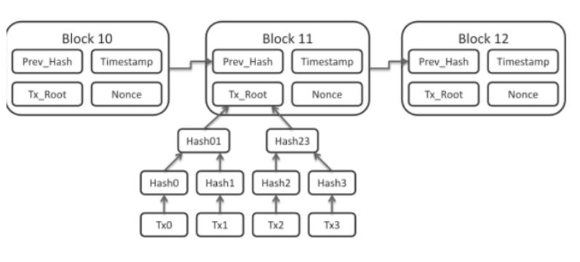
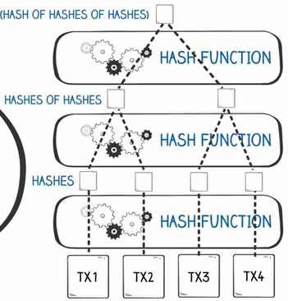
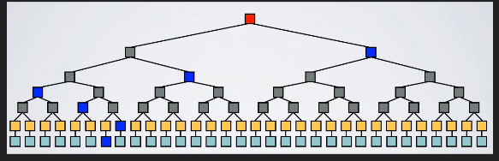

Slide 21
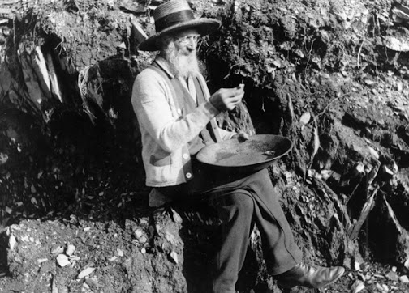
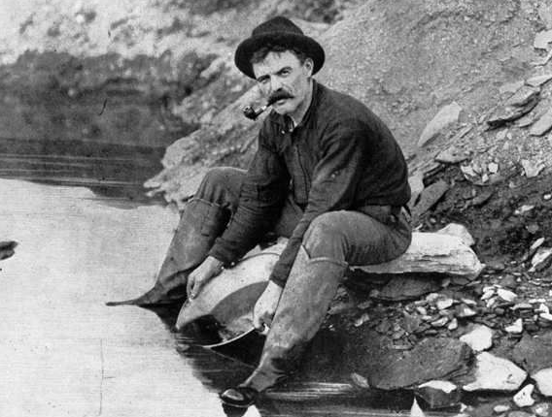
The Miners

Slide 22
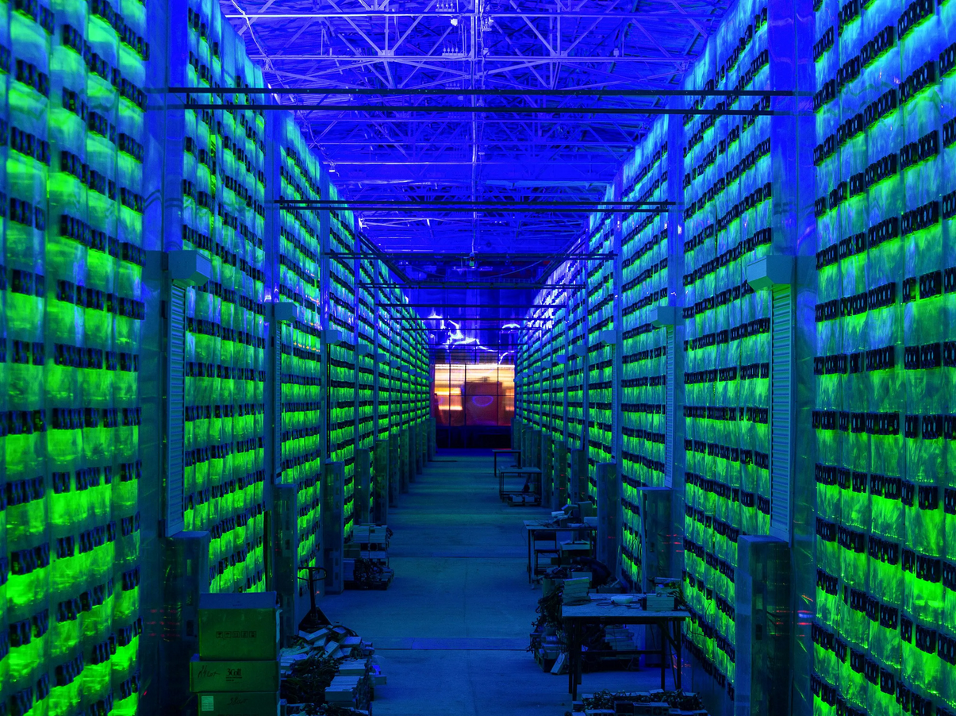

The Miners
Notes:
Solar Mining is a possibility

Slide 23
Mining
Miners validate new transactions and record them on the blockchain, the global, distributed and shared ledger. Blocks are mined every 10 minutes, with a block containing all transactions since the last block was mined. Once the block is added to the blockchain the transactions are confirmed
Miners receive rewards for mining blocks; new coins for creating a new block and transaction fees for the transactions within the block.
The party who successfully mines the block is the party who first solves the Proof-of-Work algorithm
This is the process by which new Bitcoin is added to the money supply. It also serves to protect the network against fraudulent transactions and double-spend and is based upon the key concepts discussed to this point.
Essentially, miners provide processing power to the network in exchange for the opportunity to earn bitcoin as reward.

Slide 24
Difficulty & Rewards
The Current Difficulty Level in BTC :
https://www.coinwarz.com/mining/bitcoin/difficulty-chart
17 Leading Zeros
https://en.bitcoin.it/wiki/Difficulty
The Current Reward :
The current bitcoin block reward is composed of 6.25 newly generated coins per block.
https://buybitcoinworldwide.com/halving/

