Slide 1
What VISA is asking for- is it on the roadmap? CloudLens deploys sensors and vPB to capture unencrypted payloads & forward these to security tools for inspection
vPB?
Zerotier
load balance
Linux¹ source (e.g., pod, worker node, VM)
Nginx Application
Encrypted traffic
Encryption library
1
Unencrypted SSL/TLS payloads are tapped either before they are encrypted (on the egress side) or after they have been decrypted (on the ingress side) by the encryption library (e.g., OpenSSL library)
CloudLens sensor adds synthetic TCP/ IP headers to tapped traffic and then encapsulates traffic in a special Zerotier tunnel for transmission to a CloudLens virtual packet broker (vPB)
CloudLens vPB decapsulates the Zerotier header, load balances traffic and provide the unencrypted SSL payload and synthetic TCP/IP headers to multiple tools, via Zerotier tunnel.
Configuration centrally managed from Keysight Vision Orchestrator (KVO)
Encrypted
traffic
Unencrypted traffic
1
CloudLens Sensor
2
Zerotier
tool Sensor
2
3
Virtual Packet
Broker (vPB)
load balance
Zerotier
Tools
4
Keysight Vision
Orchestrator (KVO)
Tools
Zerotier
tool Sensor
CloudLens Sensor
Zerotier
3
2
Encrypted
traffic
1
Nginx Application
Encryption library
Unencrypted traffic
4
Production traffic
Encrypted traffic
Linux¹ source (e.g., pod, worker node, VM)
Zerotier encrypted
Keysight management traffic
Notes: vPB = virtual packet broker
1. Linux Kernel version 3.10 or higher

Slide 2
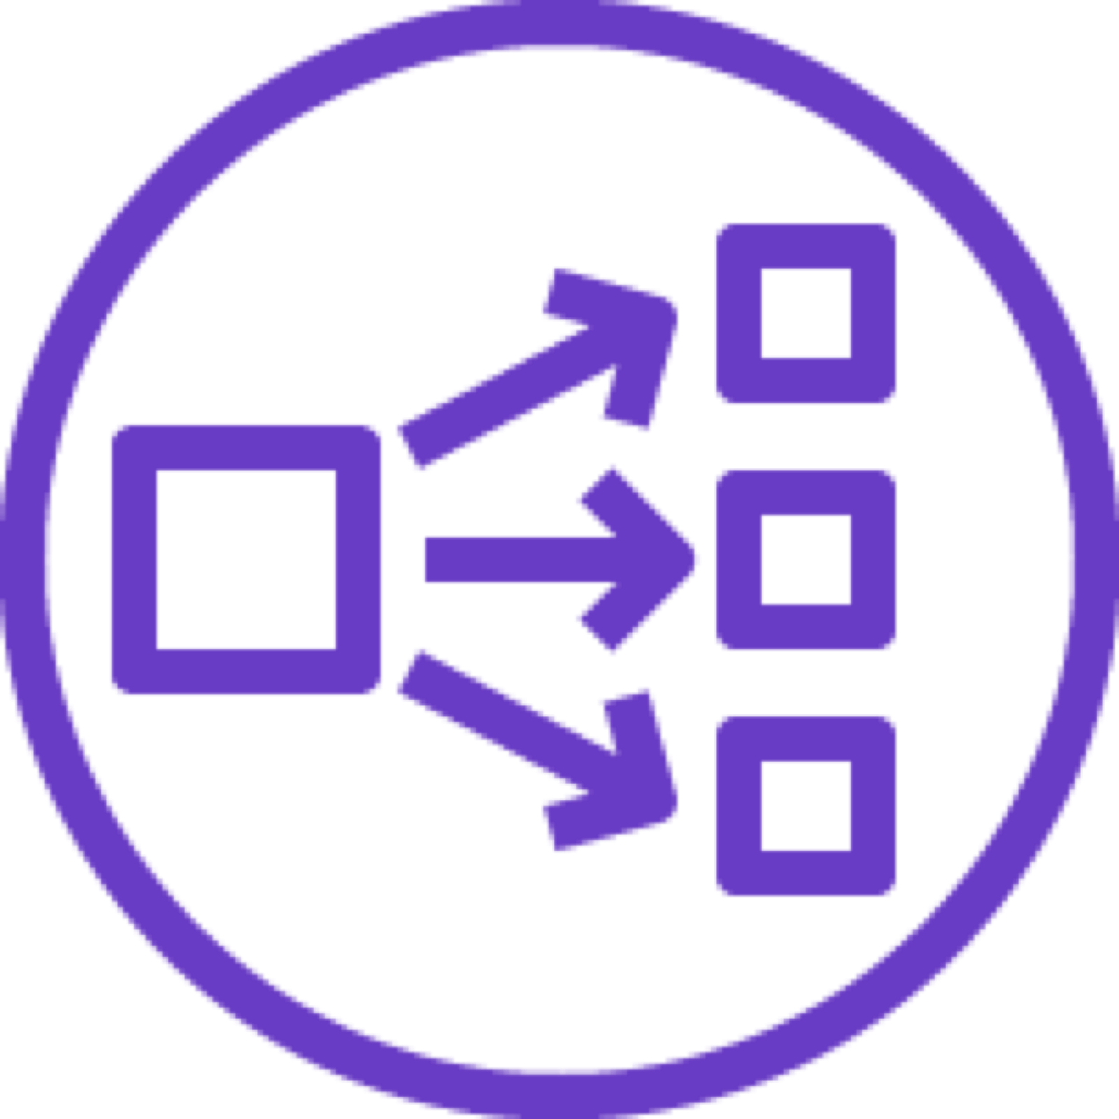
VISA-Load balance tool group CloudLens Manager CloudLens deploys sensors and vPB to capture unencrypted payloads & forward these to security tools for inspection
Linux¹ source (e.g., pod, worker node, VM)
Nginx Application
Encrypted traffic
Encryption library
What algorithm is used to load balance the tool Group?
1
Unencrypted SSL/TLS payloads are tapped either before they are encrypted (on the egress side) or after they have been decrypted (on the ingress side) by the encryption library (e.g., OpenSSL library)
CloudLens sensor adds synthetic TCP/ IP headers to tapped traffic and then encapsulates traffic in a special Zerotier tunnel for transmission to a CloudLens virtual packet broker (vPB)
CloudLens vPB decapsulates the Zerotier header, load balances traffic and provide the unencrypted SSL payload and synthetic TCP/IP headers to multiple tools, via Zerotier tunnel.
Configuration centrally managed from Keysight Vision Orchestrator (KVO)
Encrypted
traffic
Unencrypted traffic
1
CloudLens Sensor
2
Zerotier
Tools
2
3
tool Sensor
Keysight Vision
Orchestrator (KVO)
Loadbalance Tool Group
4
tool Sensor
Tools
CloudLens Sensor
Zerotier
3
2
Encrypted
traffic
1
Nginx Application
Encryption library
Unencrypted traffic
4
Production traffic
Encrypted traffic
Linux¹ source (e.g., pod, worker node, VM)
Zerotier encrypted
Keysight management traffic
Notes: vPB = virtual packet broker
1. Linux Kernel version 3.10 or higher

