Slide 1
WEBGL, AND HOW IT'LL CHANGE THE WAY YOU USE YOUR BROWSER.
Jon Bringhurst - Sept 2010

Slide 2
Web Graphics Library
Non-crappy 3D animation in your web browser
Allows access to the power of your video card

Slide 3
But, I’ve seen 3D in my web browser!
Java Applets
Adobe Flash

Slide 4
Only the best.
It’s OpenGL, but stripped down to the essentials.
It’ll work on cell phones.

Slide 5
Can I get it?
Mozilla’s Firefox
Apple’s Safari
Google’s Chrome
It’ll probably never work in Internet Explorer.

Slide 6
How do I use it?
Learn Javascript.
Read about OpenGL.
Learn more Javascript.
???
Profit!

Slide 7
Hardware accelerated JavaScript
Run things on your CPU (motherboard) and GPU (video card) at the same time.

Slide 8
Step 1
Make a program that generates a list of points in (x, y, z).
Run it on your CPU (motherboard).

Slide 9

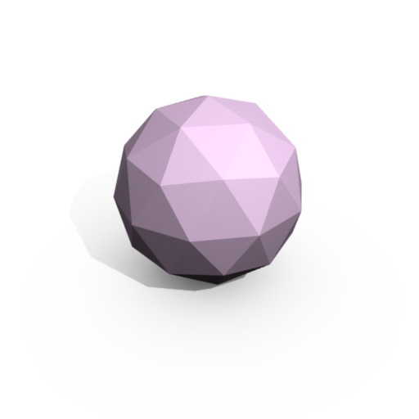
Step 2
Make a program that does rasterization and lighting.
Run it on your GPU (video card).

Slide 10
Step 3
Send the output of the CPU program (motherboard) to the GPU program (video card).
Want animation?
  Send more points to the GPU for each frame.

Slide 11
So, how will it change my browser?
Education
Search for “webgl dancing planets” on YouTube.

Slide 12
Games!
Quake 2/3 are already working in WebGL.
World of Warcraft! (well, not really …yet)

Slide 13
Delivery
No more downloading and installing games.
Just go to a URL.

Slide 14
Only 3D? Is that it?
*yawn* …it’s not 1981 anymore.

Slide 15
CPU (motherboard)
A single long program, working on four or six pieces of data at a time.
Think of a long, long highway, like I-40, four or six lanes wide.

Slide 16
GPU (video card)
Many short programs running at the same time on many different pieces of data.
Think of a short, one mile-lone inner-city highway, *450* lanes wide.

Slide 17
Heavy computation
Speech recognition
Machine learning
Machine vision
CFD (real-time fluid simulations)
FFT (real-time video processing)
Etc….

Slide 18
Not quite there yet
WebGL is just for graphics
Maybe in a few years

Slide 19
Local stuff
LANL’s Roadrunner is a pioneer in using combinations of CPUs and GPUs.
LANL’s Cielo is trying to perfect it.
OpenEye Scientific Software is using GPUs for drug discovery.

Slide 20
My personal WebGL hacking
A program simliar to “Google Earth”, written entirely in Javascript.
http://github.com/fintler/lanyard

