Slide 1


Nonlinear model predictive-based control for Omni wheeled Mobile Robot
VIETNAM NATIONAL UNIVERSITY
UNIVERSITY OF ENGINEERING AND TECHNOLOGY
Bui Duy Nam

Slide 2
TABLE OF CONTENTS
The basic concepts
The Robot modeling
The control problems
3.1. Tajectory Tracking
3.2. Obstacle Avoiding

Slide 3
1. THE BASIC CONCEPTS

Slide 4
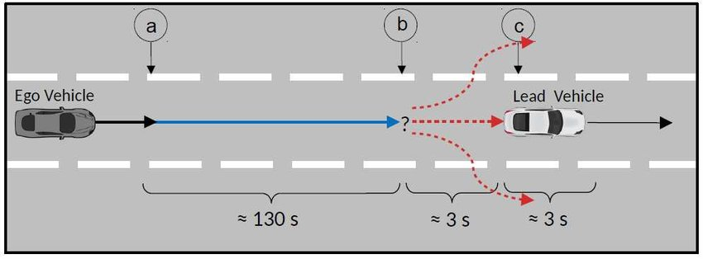
1. THE BASIC CONCEPTS
In case of Self-driving Cars
→ Use a simple model (kinetic, dynamic) of the process to predict its likely future and choose the good control action.

Slide 5
1. THE BASIC CONCEPTS
Disadvantage of other control methods:
+ Linear control methods: no longer effective if the trajectory is a curve.
+ The other control methods: not consider the constraints in the process.
Model Predictive-based Control method
+ Optimize the control signal by processing a series of N future horizon states.
+ Consider the system constraints such as: velocity limit, safe operating.

Slide 6
2. THE ROBOT MODELING

Slide 7
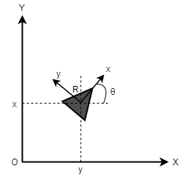
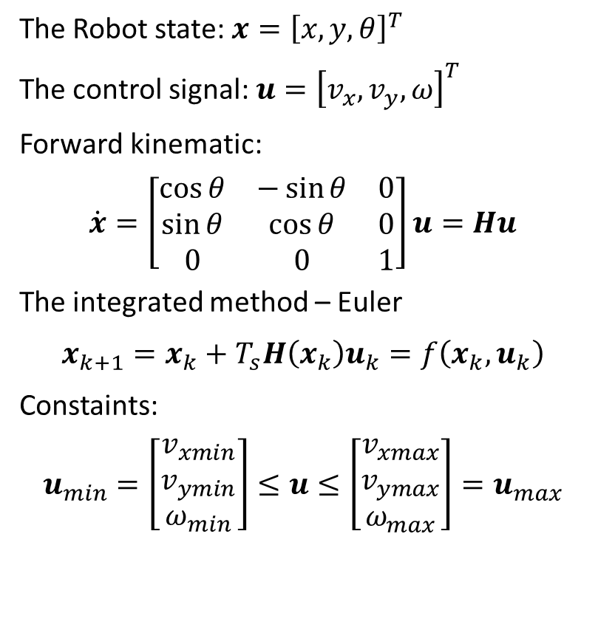
2. THE ROBOT MODELING
The Robot state: $x={\left[x,y,θ\right]}^{T}$
The control signal: $u={\left[v_{x},v_{y},ω\right]}^{T}$
Forward kinematic:
$$\dot{x}=\left[\begin{matrix}\cos{θ} & −\sin{θ} & 0 \\ \sin{θ} & \cos{θ} & 0 \\ 0 & 0 & 1\end{matrix}\right]u=Hu$$
The integrated method – Euler
$$x_{k+1}=x_{k}+T_{s}H\left(x_{k}\right)u_{k}=f\left(x_{k},u_{k}\right)$$
Constaints:
$$u_{min}=\left[\begin{aligned}v_{xmin} \\ v_{ymin} \\ ω_{min}\end{aligned}\right]≤u≤\left[\begin{aligned}v_{xmax} \\ v_{ymax} \\ ω_{max}\end{aligned}\right]=u_{max}$$

Slide 8
3. THE CONTROL PROBLEMS
3.1 Trajectory Tracking
3.2 Obstacles Avoiding

Slide 9
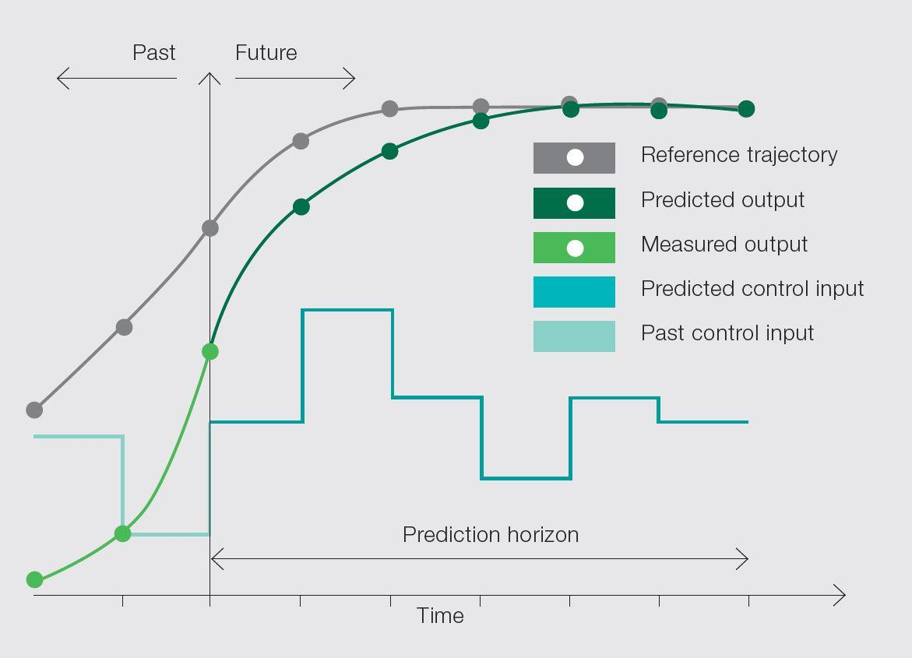
3. THE CONTROL PROBLEMS
The idea of MPC

Slide 10
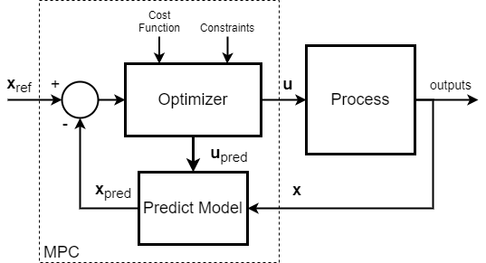
3. THE CONTROL PROBLEMS
Solve of the MPC includes:
1. Predict the output base on model along a time horizon.
2. Optimize the cost function to get the next control signal.
3. Shift the states and controls, the horizon moves toward the future
The block diagram of MPC

Slide 11
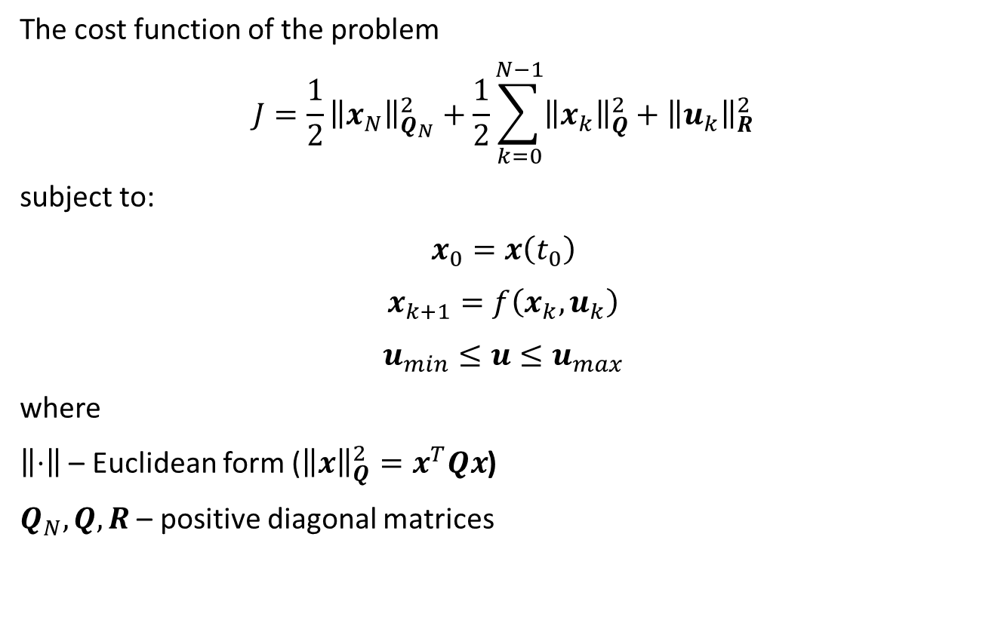
3. THE CONTROL PROBLEMS
The cost function of the problem
$$J=\frac{1}{2}{\left\|x_{N}\right\|}_{Q_{N}}^{2}+\frac{1}{2}\sum_{k=0}^{N−1}{{\left\|x_{k}\right\|}_{Q}^{2}+{\left\|u_{k}\right\|}_{R}^{2}}$$
subject to:
$$x_{0}=x\left(t_{0}\right)$$
$$x_{k+1}=f\left(x_{k},u_{k}\right)$$
$$u_{min}≤u≤u_{max}$$
where
$\left\|⋅\right\|$ – Euclidean form (${\left\|x\right\|}_{Q}^{2}=x^{T}Qx$)
$Q_{N},Q,R$ – positive diagonal matrices

Slide 12

3. THE CONTROL PROBLEMS
3.1. Trajectory tracking problem
The cost function:
$$J=\frac{1}{2}{\left\|{\overline{x}}_{N}\right\|}_{Q_{N}}^{2}+\frac{1}{2}\sum_{k=0}^{N−1}{{\left\|{\overline{x}}_{k}\right\|}_{Q}^{2}+{\left\|{\overline{u}}_{k}\right\|}_{R}^{2}}$$
subject to:
$$x_{0}=x\left(t_{0}\right)$$
$${\overline{x}}_{k+1}=f\left({\overline{x}}_{k},{\overline{u}}_{k}\right)$$
$$u_{min}≤\overline{u}≤u_{max}$$
where $\overline{x}=x_{r}−x;\overline{u}=u_{r}−u$

Slide 13
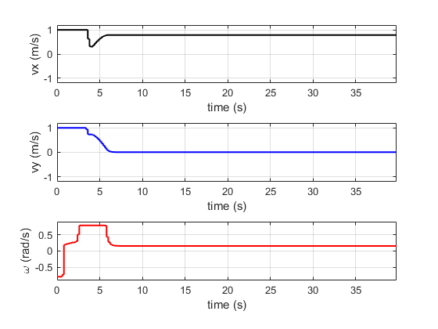
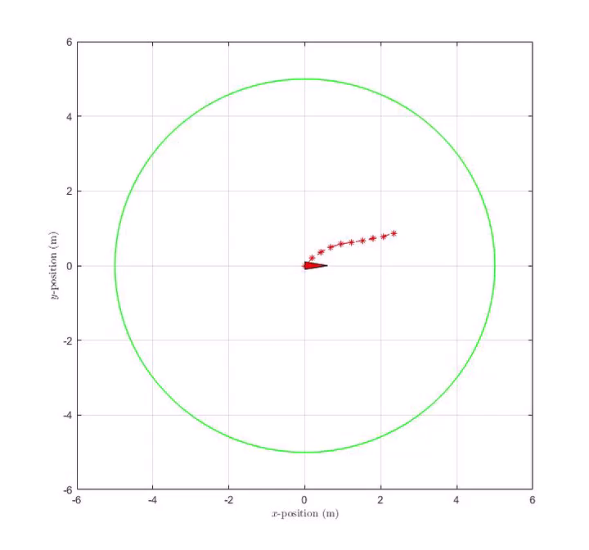
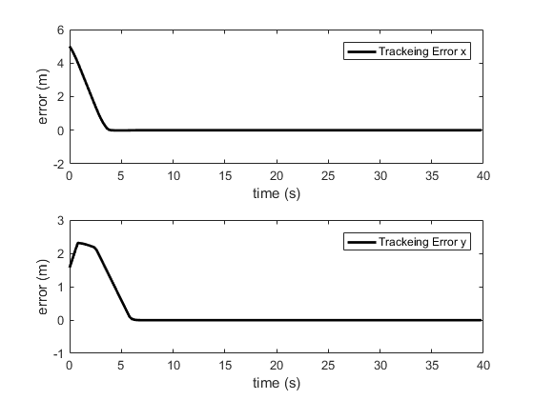
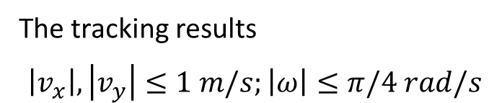
3. THE CONTROL PROBLEMS
3.1. Trajectory tracking problem
The tracking results
$$\left|v_{x}\right|,\left|v_{y}\right|≤1 m/s;\left|ω\right|≤π/4 rad/s$$
Control signals
Tracked error

Slide 14
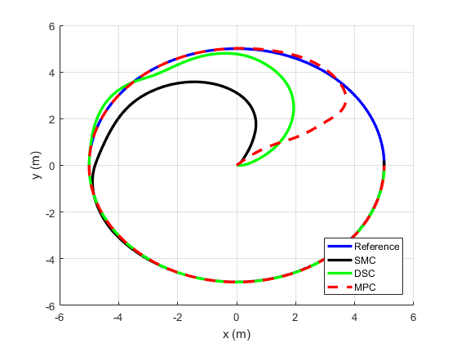
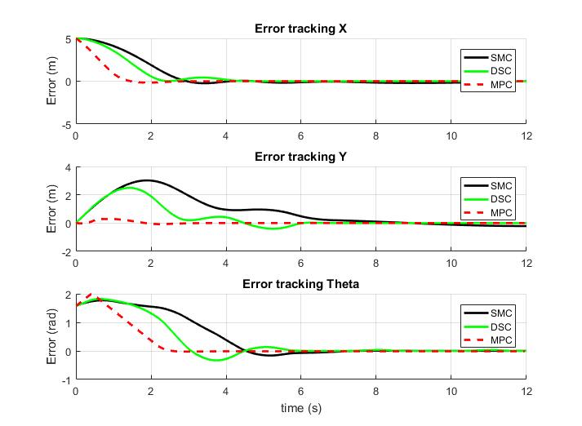
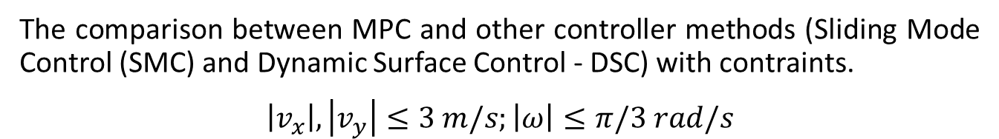
3. THE CONTROL PROBLEMS
3.1. Trajectory tracking problem
The comparison between MPC and other controller methods (Sliding Mode Control (SMC) and Dynamic Surface Control - DSC) with contraints.
$$\left|v_{x}\right|,\left|v_{y}\right|≤3 m/s;\left|ω\right|≤π/3 rad/s$$
Tracked paths
Tracked errors

Slide 15
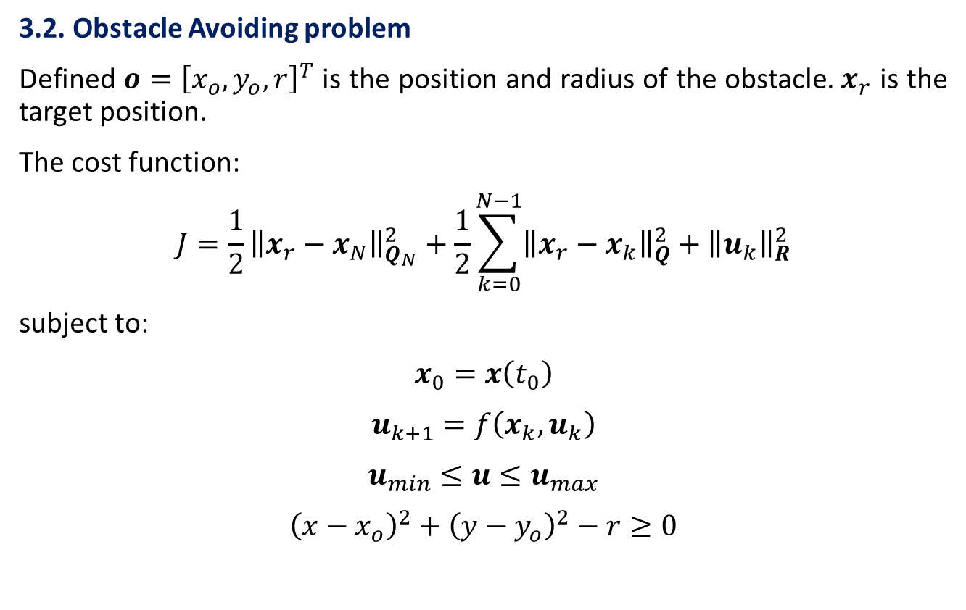
3. THE CONTROL PROBLEMS
3.2. Obstacle Avoiding problem
Defined $o={\left[x_{o},y_{o},r\right]}^{T}$ is the position and radius of the obstacle.$x_{r}$ is the target position.
The cost function:
$$J=\frac{1}{2}{\left\|x_{r}−x_{N}\right\|}_{Q_{N}}^{2}+\frac{1}{2}\sum_{k=0}^{N−1}{{\left\|x_{r}−x_{k}\right\|}_{Q}^{2}+{\left\|u_{k}\right\|}_{R}^{2}}$$
subject to:
$$x_{0}=x\left(t_{0}\right)$$
$$u_{k+1}=f\left(x_{k},u_{k}\right)$$
$$u_{min}≤u≤u_{max}$$
$${\left(x−x_{o}\right)}^{2}+{\left(y−y_{o}\right)}^{2}−r≥0$$

Slide 16
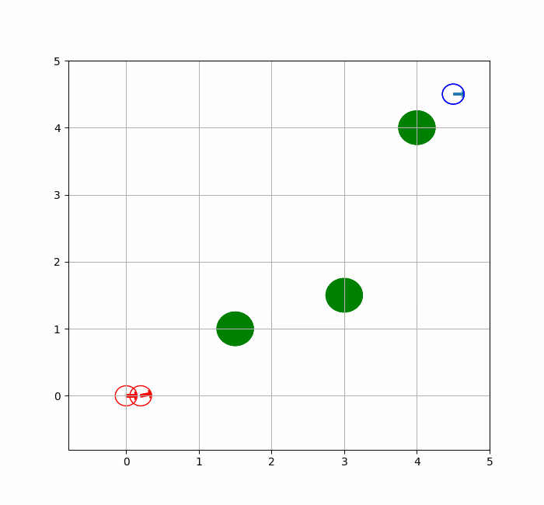
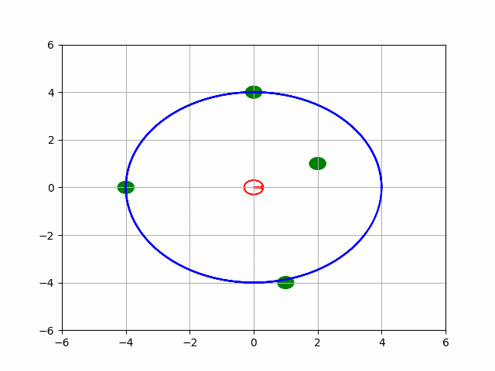
3. THE CONTROL PROBLEMS
3.2. Obstacle Avoiding problem
Move to target position and avoid obstacle
Track the desired path and avoid obstacle

