Slide 1

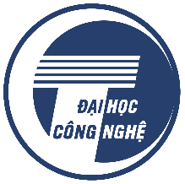
LYAPUNOV-BASED NONLINEAR MODEL PREDICTIVE CONTROL (LNMPC) FOR THE THREE WHEELED OMNI-DIRECTIONAL MOBILE ROBOT
VIETNAM NATIONAL UNIVERSITY
UNIVERSITY OF ENGINEERING AND TECHNOLOGY
Bui Duy Nam

Slide 2
1. THE BASIC CONCEPTS
+ Linear control methods (PID, LQR): Easy to implement but not efficient with nonlinear models.
+ Nonlinear control methods:
- Backstepping control (BSC): Exploits those nonlinear points in the system dynamics and increases the robustness but the 'explosion of terms' phenomena under uncertainty cause the decrease quality.
- Sliding Mode Control (SMC): Insensitive to model uncertainties but the chattering phenomenon can destroy the system.
+ Optimal control (MPC): Handle bounded control signals, constrained conditions but difficult to analyze the system's stability.
-> Lyapunov-based Nonlinear model predictive control (LNMPC) is proposed to prove the stability of MPC.

Slide 3
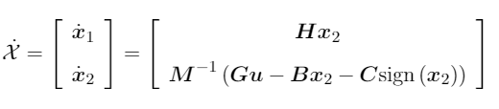
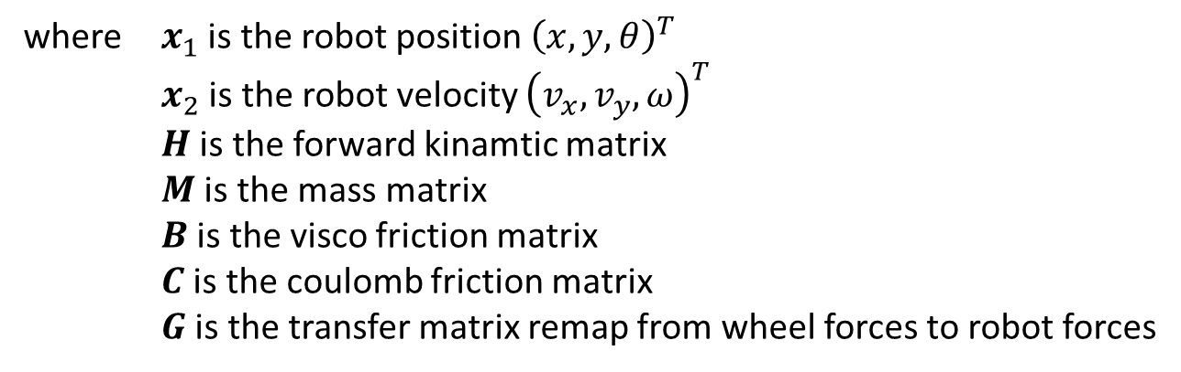
2. THE DYNAMIC MODEL
Dynamic model:
where $x_{1}$ is the robot position ${\left(x,y,θ\right)}^{T}$
$x_{2}$ is the robot velocity ${\left(v_{x},v_{y},ω\right)}^{T}$
$H$ is the forward kinamtic matrix
$M$ is the mass matrix
$B$ is the visco friction matrix
$C$ is the coulomb friction matrix
$G$ is the transfer matrix remap from wheel forces to robot forces

Slide 4
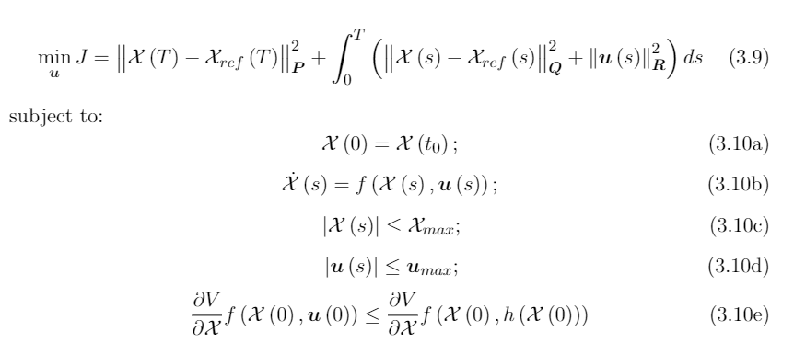
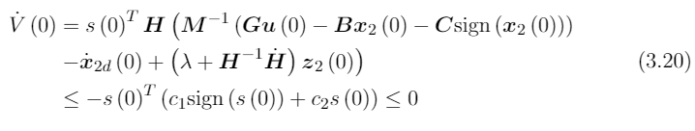
3. THE CONTROLLER DESIGN
LNMPC problem:
Base on the Lyapunov theorem is satisfied via Sliding Mode Control (SMC), 3.10e is

Slide 5
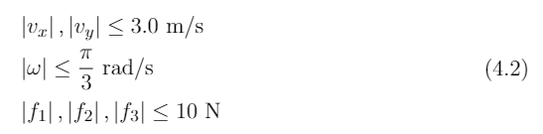
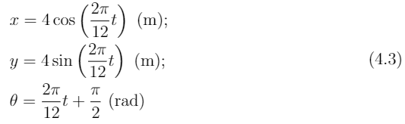
4. RESULTS
The system constraints
The desired trajectory

Slide 6
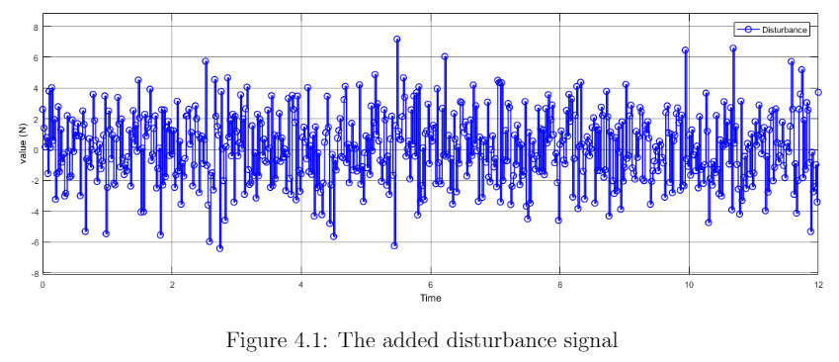
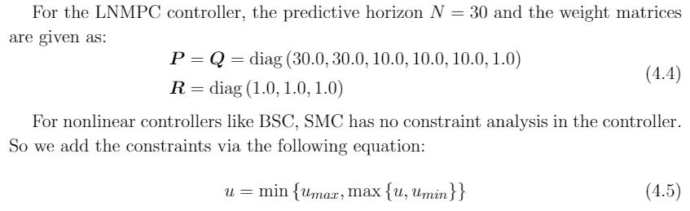
4. RESULTS

Slide 7
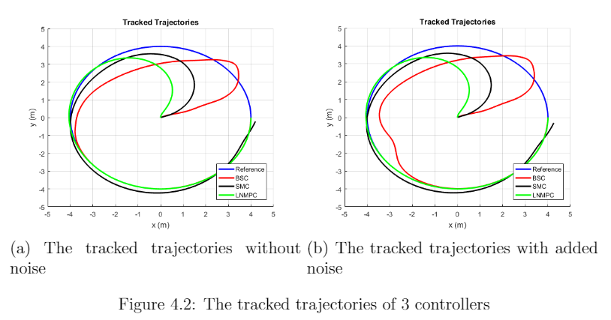
4. RESULTS

Slide 8
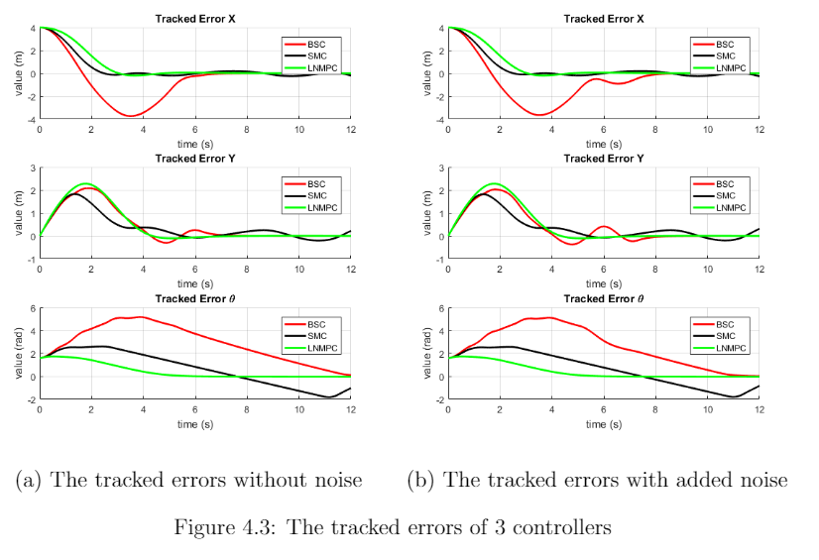
4. RESULTS

Slide 9
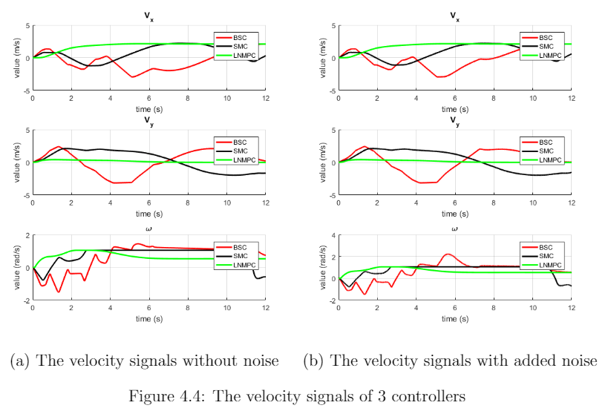
4. RESULTS

