Slide 1
A Capped Tube as an LTI System!
Ruby Spring and Jessica Diller
Signals and System Final Project - Spring 2015

Slide 2
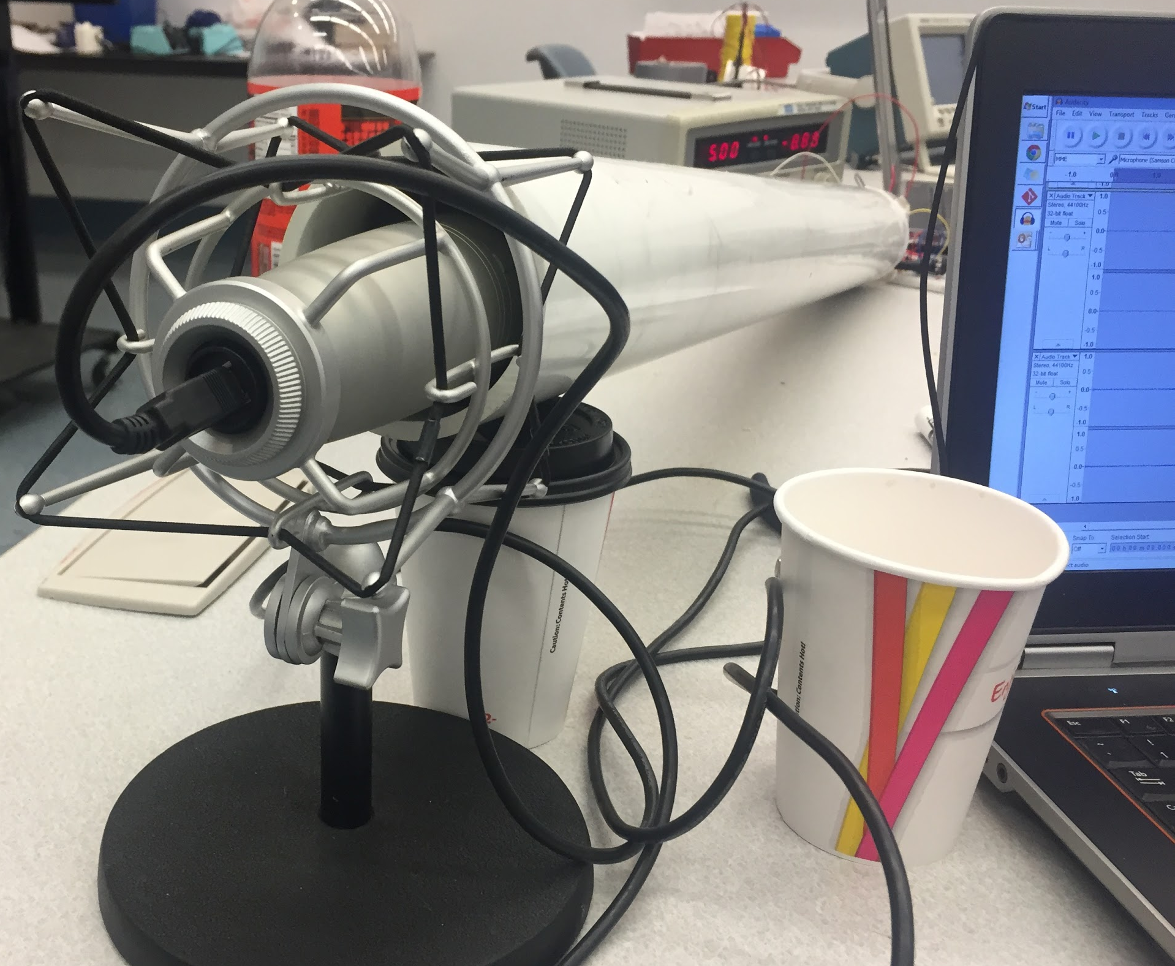
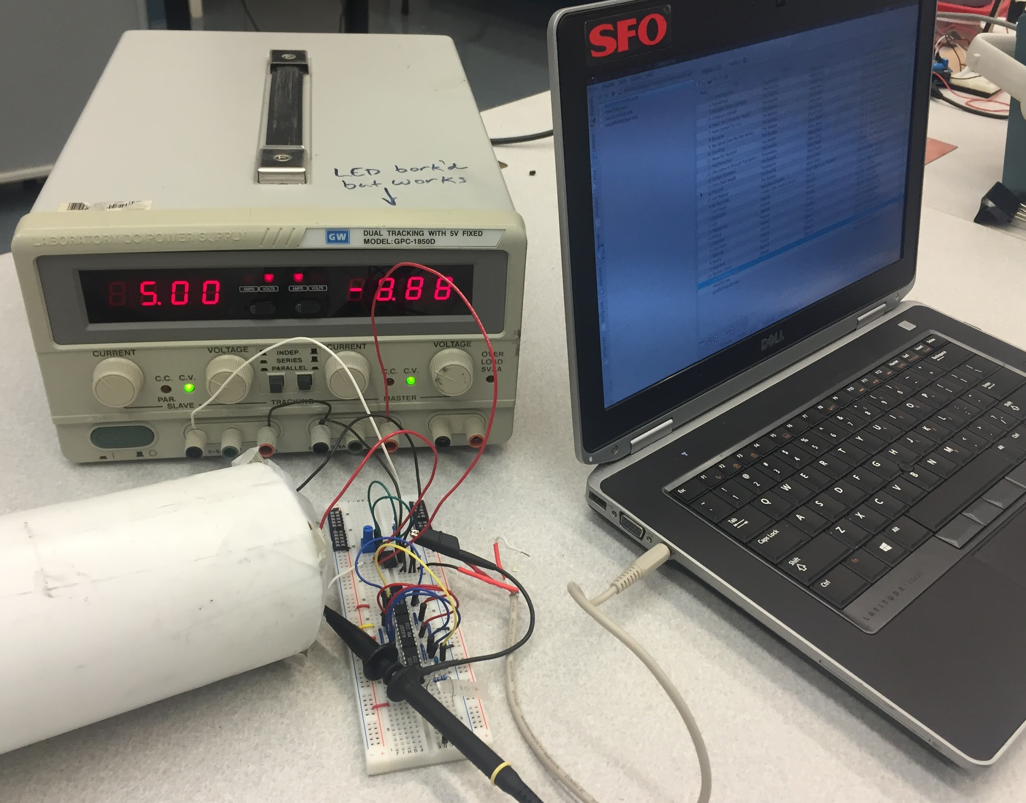
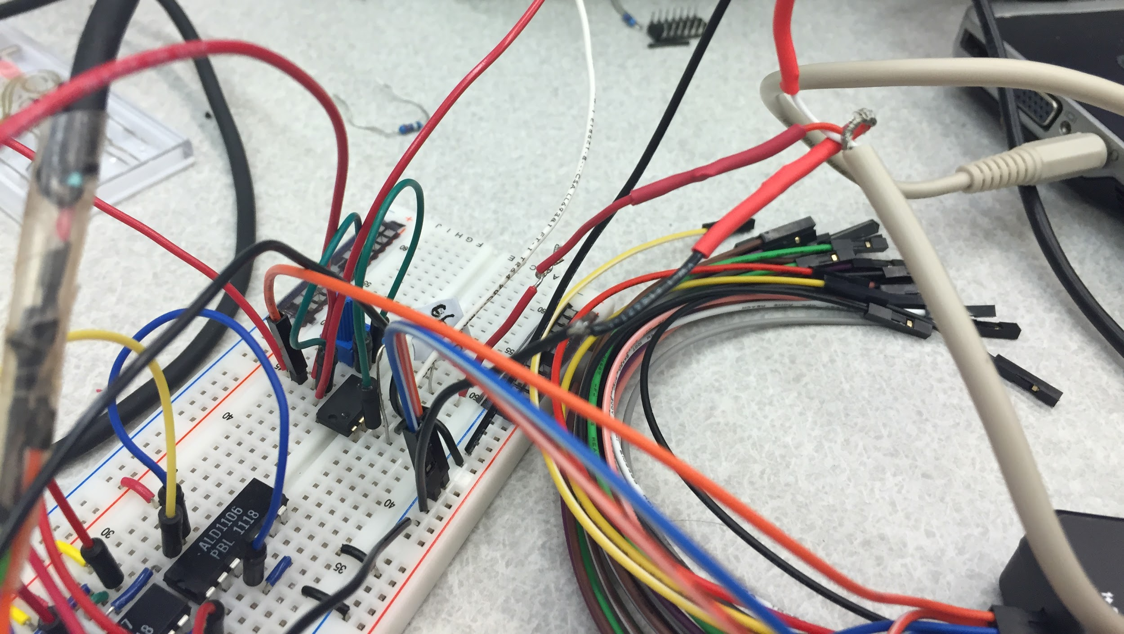
System
Notes:
speaker taped on the end of the tube, large microphone plugs in other end to record, amplification of sound coming from laptop into speaker using an op amp

Slide 3
Experimental Characterization
gunshot (impulse)
exponential chirp
white noise
Initial phase shift caused by the sound delay of tube potentially important (but too tiny for us to analyze).
Notes:
play music and then play music recording in tube

Slide 4
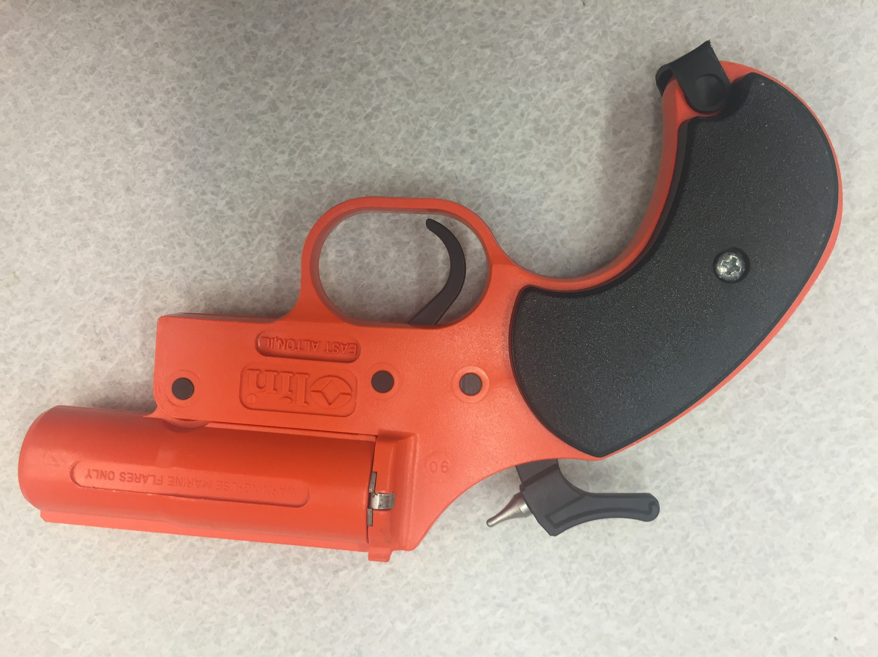
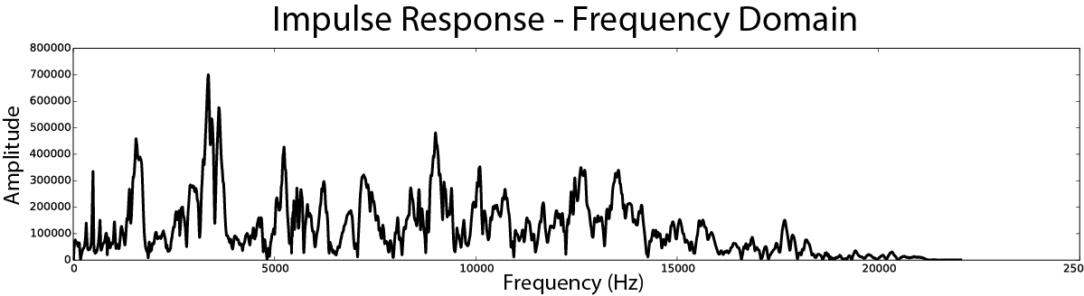
Using an Impulse
The impulse response of the system is the transfer function!
Impulse Maker
Notes:
fired a flare gun into “speaker” tube end, recorded impulse response, convolved that impulse response with sound input, play sound demo

Slide 5
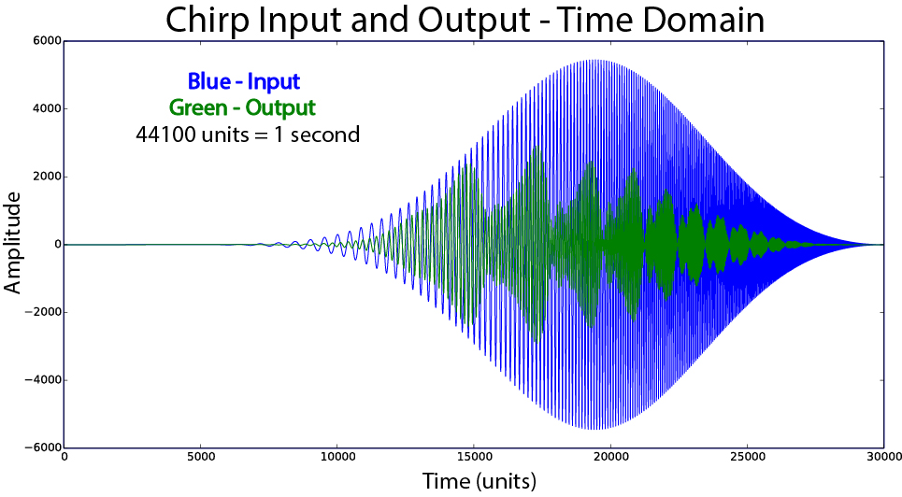
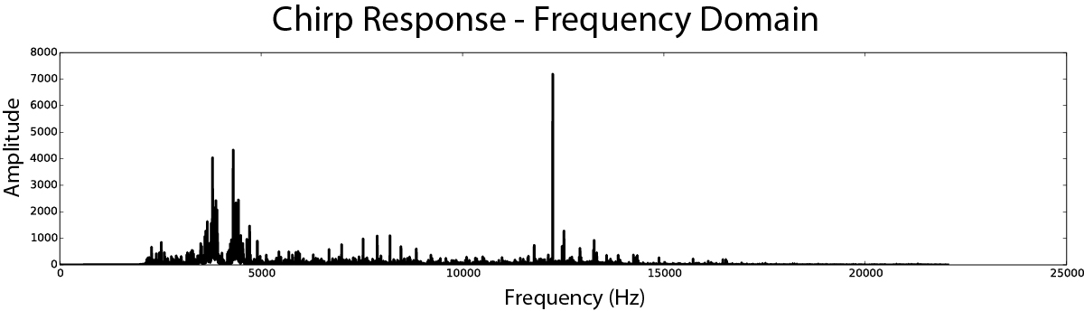
Using an
Exponential Chirp
Testing Frequencies:
~ 20 to 20,000 Hz
Notes:
play sound demo

Slide 6
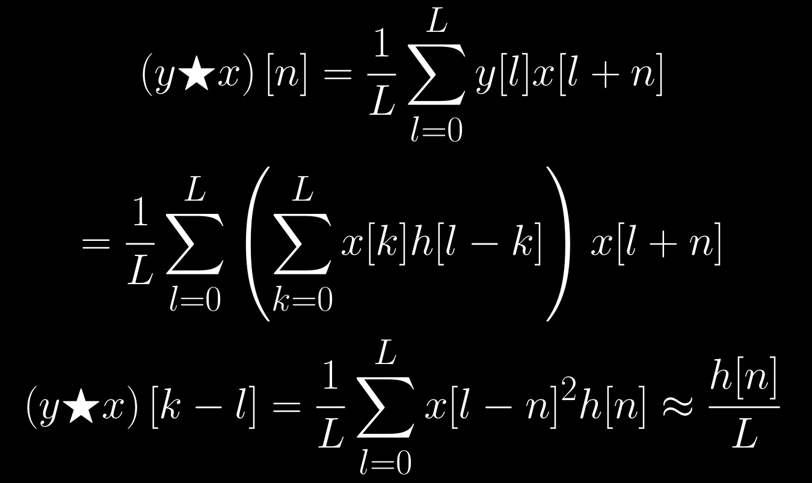
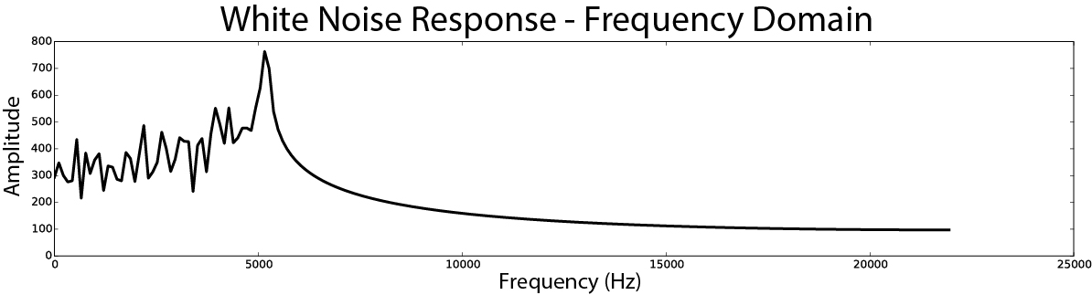
Using
White Noise
Notes:
most common method for testing LTI sound systems and determining responses

Slide 7
