Slide 1
Medifacts
Laura Rodriguez
Nico Aleman
Grace Owens
Bryan Cora
Sabrina Bauman

Slide 2
Members & Info
Laura Rodriguez | rodrigld@mail.uc.edu | 513-328-1923
Nico Aleman | alemanna@mail.uc.edu | 971-832-3205
Grace Owens | owensgr@mail.uc.edu | 513-255-8921
Bryan Cora | corabj@mail.uc.edu | 330-794-3772
Sabrina Bauman | baumansi@mail.uc.edu | 216-889-7429

Slide 3
Abstract
We are seeking to create a platform to be the intersection between doctors and patients. Many times after a diagnosis, the patient is strongly advised to keep from researching their condition on their own. The reason for this is the internet being plagued with misinformation, horror stories, and medical jargon that the layperson can easily misinterpret. Medifacts strives to create a safe space for patients to ask questions and research, all while being counseled by a certified medical professional. Additionally, patients will be able to network with other patients of the same condition, allowing space for comradery and empathy.

Slide 4
User stories
As a patient, I want to be able to ask a question about my condition and get responses from licensed medical professionals.
As a patient, I want to be able to network with other patients with my diagnosis.
As a doctor, I want to be able to provide answers to patients using my expertise.
As a patient, I want to be able to request reading material that is applicable to the questions I have.
As a doctor, I want to be able to provide appropriate and applicable reading material to a patient.

Slide 5
Division of work
Laura
Nico
Grace
Bryan
Sabrina
Backend
Social Networking
Frontend
Database Mgmt./Design
UI/UX Design
Develop web application features:
  Posting
  Searching
  Commenting
Develop user profiles
and user types
Developing the homepage
Developing the patient & doctor view
Allowing users to edit their displayed profile
Developing features to post questions and respond to them
Develop user login/registration
Implement UX and Quality of Life Features
Develop "forum" structure and navigation (search, categories, filtering)
Implement Doctor verification process
Develop user database
Develop platform (flask app, etc).
Implement doctor verification method and storage of forum posts
Design home page UI
Design messaging interface layout/UI
Design doctor/patient view interface/UI
Design user profile view (to be viewed by self and others)

Slide 6
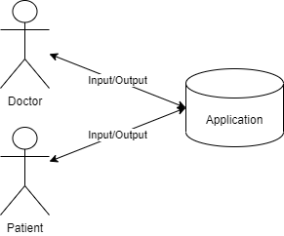
Design diagram 1

Slide 7
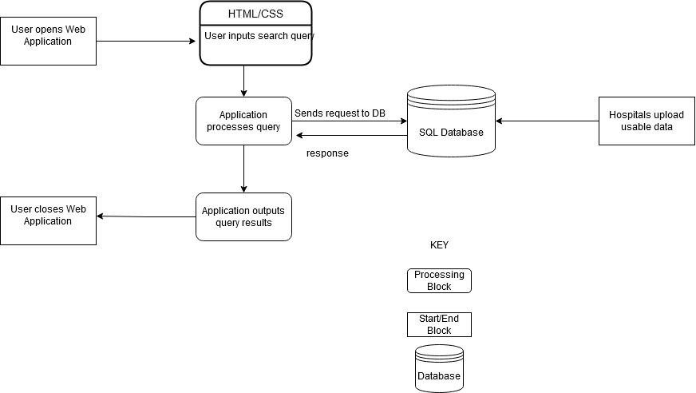
Design diagram 2

Slide 8
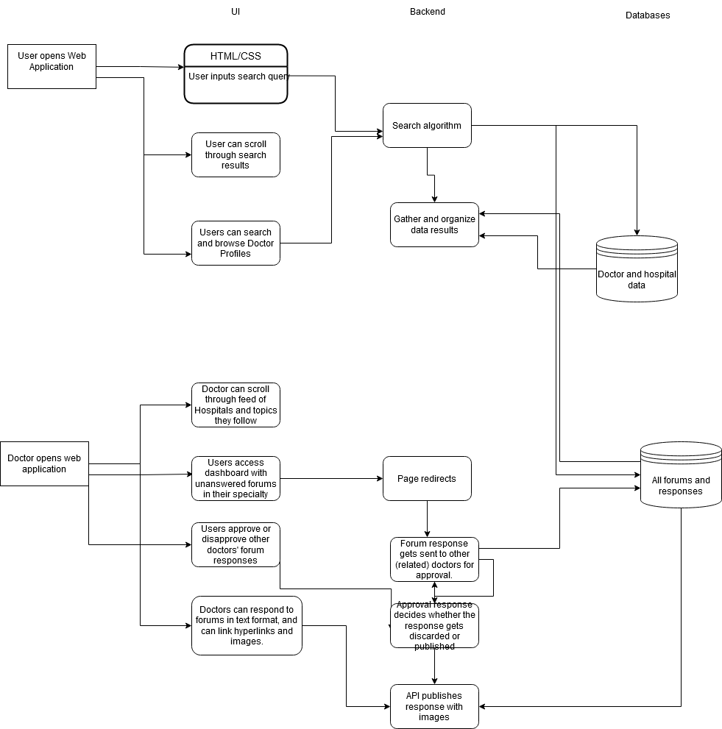
Design diagram 3

Slide 9
Project constraints
LEGALITY
ETHICS
Will be storing patients’ medical and contact information
Will also be storing validation of medical professionals
Of utmost importance to keep the data secure
Users need to feel trust in our platform
Medical conditions can be sensitive subjects for patients
Creating a space that doesn’t allow for the trauma associated with the wild west of the Internet
Allow for users to “block” certain words or phrases
Option to make question/post private

Slide 10
Review of progress
While we have not started the coding of our platform yet, we have created a mockup of what we’d like our platform to look like at completion. Additionally, we have agreed on the tools we will be using to program Medifacts and have individually been becoming acquainted with them.

Slide 11



End of semester goals
Create base platform.
Research:
Stakeholder needs and development tools.
Complete UI Mockup.

Slide 12
Expected demo
We anticipate being able to create a user profile, post a question, respond to a question, attach a document, have verification protocols implemented, and have the privacy features implemented.

Slide 13
THANK YOU

