Slide 1

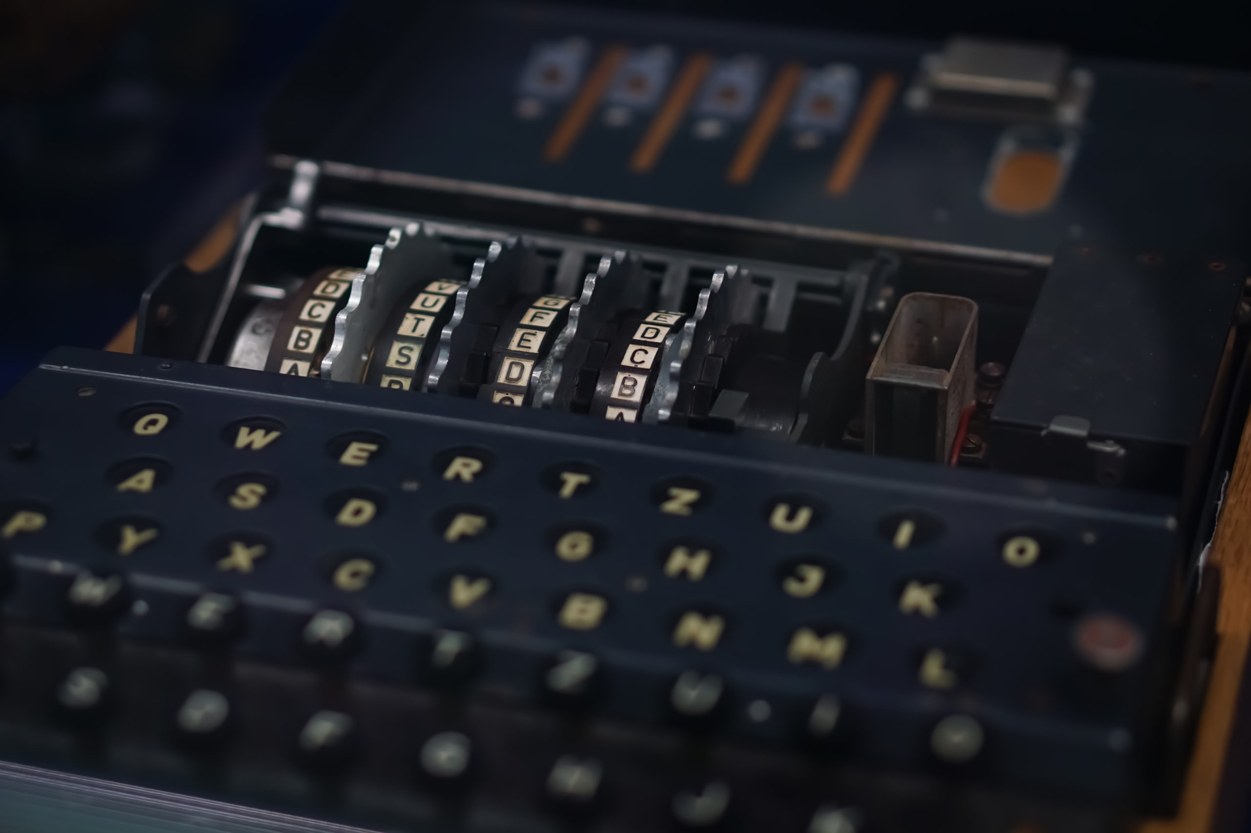


Notes:
Hi. My name is Rion Dutt, and For my project, I decided to research the wii sports Enigma machines.

Slide 2
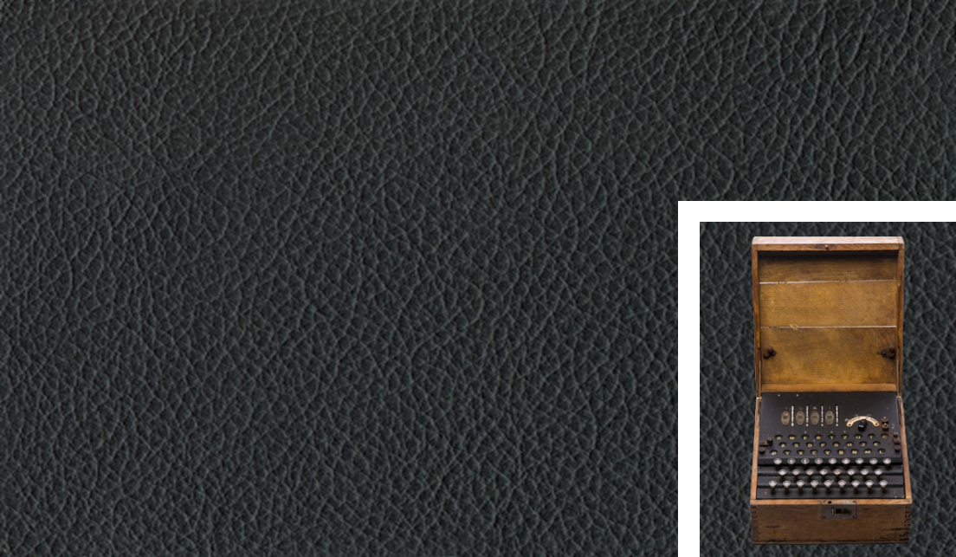
> THE ENIGMA MACHINES
> SERIES OF ENCRYPTION/DECRYPTION CIPHER MACHINES
> USED FOR BOTH MILITARY AND COMMERCIAL PURPOSES
> USED BY AXIS POWERS DURING WWII
> TYPEWRITER SIZED WITH OAK CASE
> FAMOUSLY CRACKED AT BLETCHLEY PARK
Notes:
What were the enigma machines? Well, they were a SERIES OF ENCRYPTION/DECRYPTION CIPHER devices used for military and commercial purposes by axis powers during World War 2, but the invention of the machine dates back to the end of wwi. The machines were typically typewriter sized and encased in a case made of oak wood. Even if you haven’t heard of the machine, you’ve almost certainly heard of Alan Turing, who was instrumental in the cracking of the enigma code at Bletchley Park.

Slide 3
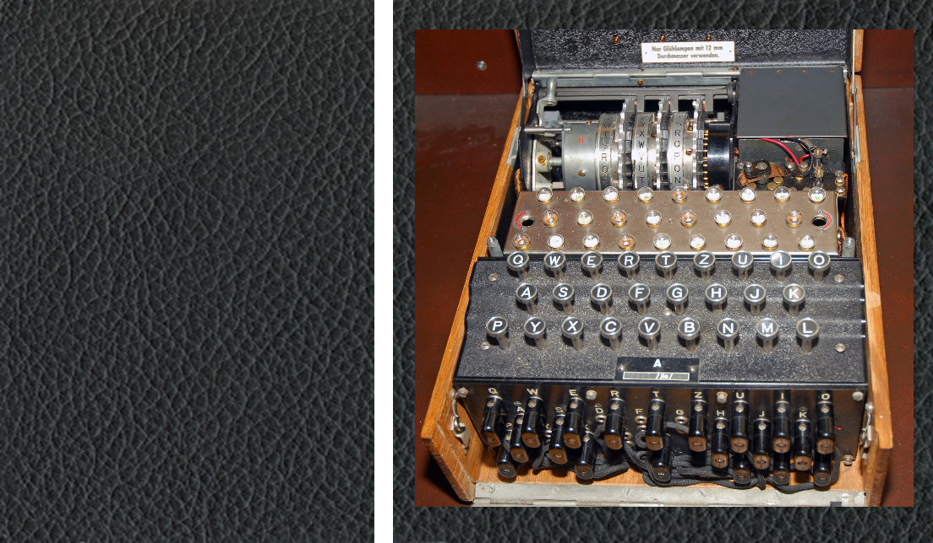
> PARTS
Notes:
parts

Slide 4

> PARTS
> BATTERY
Notes:
This is the battery here in the top right. It used standard commonly available 4.5-volt batteries.

Slide 5

> PARTS
> BATTERY
> KEYBOARD
Notes:
This is the keyboard, the input of the machine.. It featured 26 keys for each letter of the alphabet, and no space or punctuation. In their place, they would use more uncommonly used letters such as X.

Slide 6

> PARTS
> BATTERY
> KEYBOARD
> LAMPBOARD
Notes:
Here’s the lampboard, the output of the machine. 26 keys for each letter of the alphabet, once a character finishes the encryption process, it would light one the corresponding key and the operator would be written down.

Slide 7

> PARTS
> BATTERY
> KEYBOARD
> LAMPBOARD
> ROTORS
Rotor | ABCDEFGHIJKLMNOPQRSTUVWXYZ
Rot 1 | EKMFLGDQVZNTOWYHXUSPAIBRCJ
Rot 2 | AJDKSIRUXBLHWTMCQGZNPYFVOE
Rot 3 | BDFHJLCPRTXVZNYEIWGAKMUSQO
Notes:
These are the rotors, the main bulk of the encryption process. The 3 or 4 rotors would have 26 inputs and 26 outputs, with wires rearranging and reassigning the charges. After a key is pressed, a mechanical pawl rotates the third rotor. Every 26 incrementations of the third rotor, the second rotates. After 26 of #2’s #1 would rotate. This is what made the enigma code so complex. Here’s a little chart I made of the Enigma M3 rotor wirings at a default rotation.

Slide 8

> PARTS
> BATTERY
> KEYBOARD
> LAMPBOARD
> ROTORS
> REFLECTOR
Refl. | ABCDEFGHIJKLMNOPQRSTUVWXYZ
UKW-B | YRUHQSLDPXNGOKMIEBFZCWVJAT
UKW-C | FVPJIAOYEDRZXWGCTKUQSBNMHL
Notes:
Highlighted now if the reflector, the midpoint of the encryption process that I’ll expand on later. Listed are two reflector model wirings, notice the symmetricity.

Slide 9

> PARTS
> BATTERY
> KEYBOARD
> LAMPBOARD
> ROTORS
> REFLECTOR
> PLUGBOARD
Notes:
This here is the plugboard, another, but nonessential layer of encryption. Plugging two points together would take the input letter and assign it to the output letter. If Q and E were connected, a q charge coming through would exit as an E charge, and an E charge passing through would become a Q charge.

Slide 10

> THE ROTORS
> INPUT ON ONE END, OUTPUT ON THE OTHER
> INSIDE EACH ROTOR ARE 26 WIRES
> AFTER EACH KEY INPUT, THE ROTOR WIRINGS WOULD INCREMENT

Slide 11
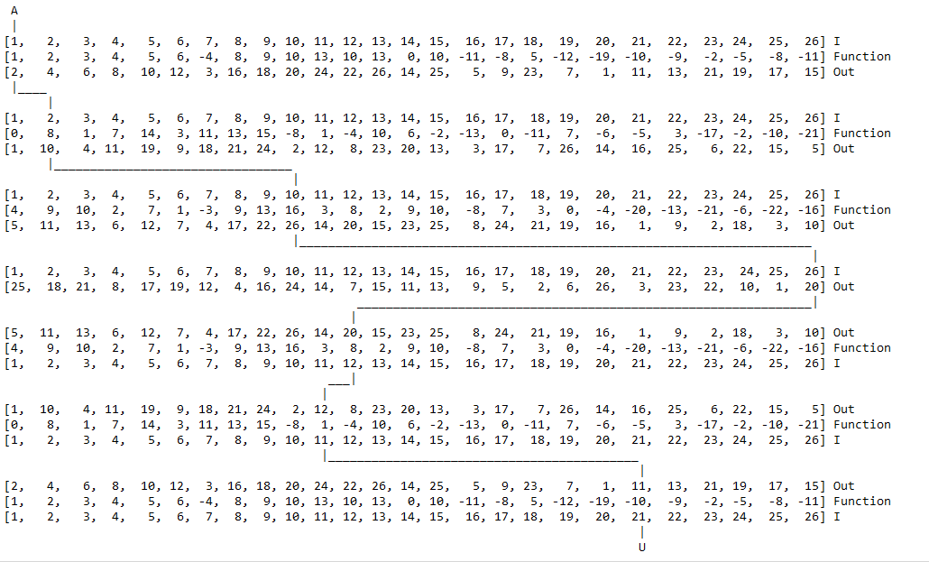
> THE ROTORS
Notes:
Here are some snippets of my 300+ lines of code. Left is encryption, right is update detection. If any of this seems interesting to you, I’d be more than happy to show any of you the code.

Slide 12
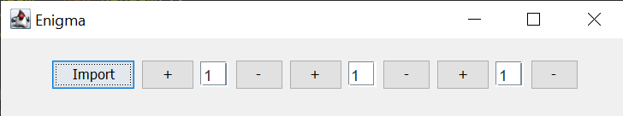
> MAKING MY OWN ENIGMA MACHINE
Notes:
To help familiarize myself with the machine’s inner workings, I decided to code a simulation of it. It features easy to use encryption, authentic wirings, rotor stepping, and rotor setting. It lacks a plugboard for time & sanity reasons, but it’s something I wouldn’t be opposed to adding in the future. The compiled program is free to download, both in a compiled .exe windows executable file, and its source code, for those who’d like to see the work that went into simulating this machine.

Slide 13
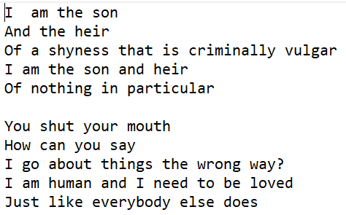
> MAKING MY OWN ENIGMA MACHINE
Notes:
Here are some snippets of my 300+ lines of code. Left is encryption, right is update detection. If any of this seems interesting to you, I’d be more than happy to show any of you the code.

Slide 14
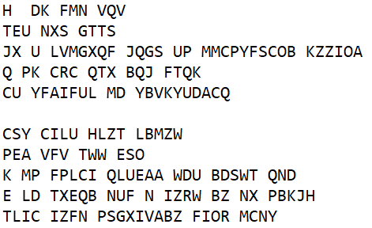
> MAKING MY OWN ENIGMA MACHINE
Notes:
Here are some snippets of my 300+ lines of code. Left is encryption, right is update detection. If any of this seems interesting to you, I’d be more than happy to show any of you the code.

Slide 15
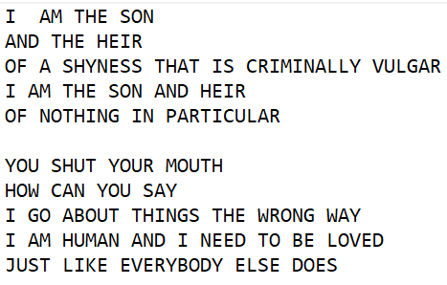
> MAKING MY OWN ENIGMA MACHINE
Notes:
Here are some snippets of my 300+ lines of code. Left is encryption, right is update detection. If any of this seems interesting to you, I’d be more than happy to show any of you the code.

Slide 16
> SOURCES > EVEN THE HARDEST THUGS GOTTA CITE THEIR SOURCES
> GRAPHIC DESIGN:
> Dark brown wood texture background with design space. (n.d.). Rawpixel. Retrieved March 23, 2022, from www.rawpixel.com/image/4062434/photo-image-background-texture-wall.
> Shutterstock. (n.d.). Black leather texture or leather background. Shutterstock. Retrieved March 23, 2022, from www.shutterstock.com/image-photo/black-leather-texture-background-1325880023
> (n.d.). Spymuseum.org. Retrieved March 23, 2022, from https://www.spymuseum.org/exhibition-experiences/about-the-collection/collection-highlights/four-rotor-enigma-machine/.
> Shutterstock. (n.d.). Shutterstock. Retrieved March 15, 2022, from image.shutterstock.com/image-photo/rotor-machine-enigma-encrypting-decrypting-600w-585312218.jpg.
> (n.d.). The National Museum of Computing. Retrieved May 29, 2022, from https://www.tnmoc.org/bh-2-the-enigma-machine.
> INFORMATION:
> Enigma M3, Crypto Museum, 19 Oct. 2021, http://www.cryptomuseum.com/crypto/enigma/m3/
> Owen, Jared. How Did the Enigma Machine Work? YouTube, 11 Dec. 2021, https://youtu.be/ybkkiGtJmkM. Accessed 25 May 2022.
> Enigma History. Cryptomuseum.com. (2012, March 14). Retrieved June 2, 2022, from https://www.cryptomuseum.com/crypto/enigma/hist.htm

