Slide 1

Wildebeest: SGD SVM on Migrating Threads
Application Design for the Lucata Pathfinder-S

Slide 2
Overview
Some conventional architecture limitations
Introduction into SVM and SGD
Hogwild and the origins of Wildebeest
Wildebeest
Design
Execution
Scaling
Comparison to Conventional

Slide 3
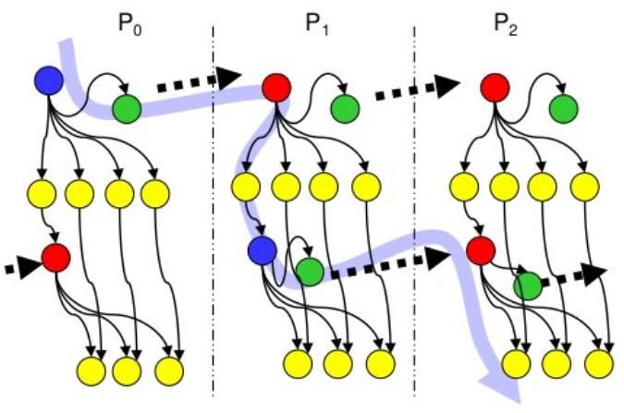
Communication vs Computation
Distributed systems require
inter-process communication
Communication can be synchronous or asynchronous
Message Passing Interface (MPI) most common communication method in HPC.
MPI has significant overhead and degrades overall performance at scale

Slide 4
Conventional Limitations
Cache coherency traffic severely degrade performance
Distributed systems require explicit communication
Process and Thread parallelism comes adds overhead
Can be very difficult to develop highly parallel applications
Many more . .

Slide 5
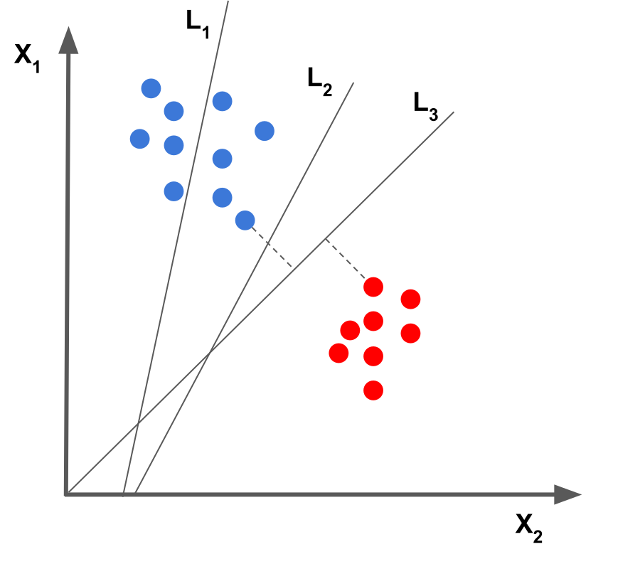
Support Vector Machine (SVM)
SVMs are supervised learning models primarily used data classification and regression analysis
“Training” on samples adjusts the hyperplane.
Iterate through training data to find optimum result (hyperplane)
Learned hyperplane used to predict classification of future data

Slide 6
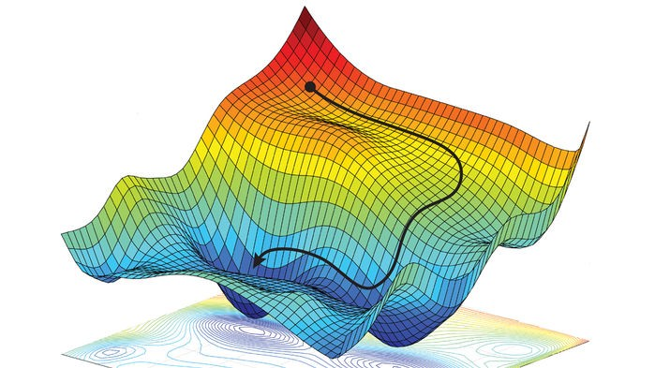
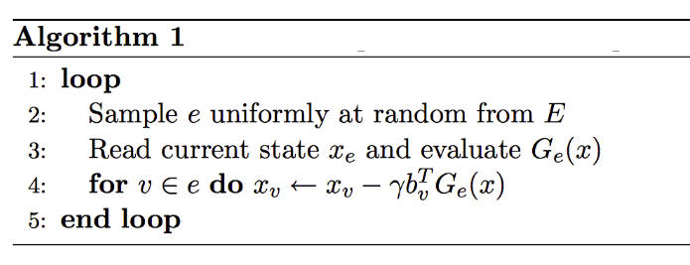
Stochastic Gradient Descent (SGD)
Iterative method which optimizes some objective function (e.g. hinge loss)
Estimates gradient using randomly selected subset of data
Improved performance at expense
of convergence rate

Slide 7
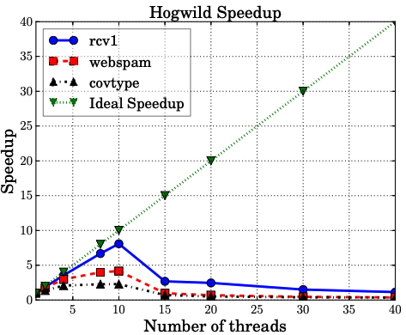
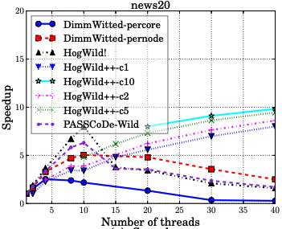
Hogwild Algorithms
Holgwild!:
Lock-Free parallel SGD for Hyper-sparse training data sets
Possible via atomic operations on shared result vector
False sharing and coherency traffic limited thread counts and therefore maximum achievable speedup
Hogwild++:
Computation divided into “clusters”
Reduced sharing decreases invalidation traffic
Depends on Circular propagation of local results to neighbors via token-passing
Poor
Scalability
Hogwild++
Better but
not ideal

Slide 8
Wildebeest
https://github.com/bripage/wildebeest.git

Slide 9
Wildebeest on Pathfinder

Slide 10
Design Considerations
Want to run in a shared environment
Reduce unnecessary memory accesses
Remember its cacheless!
Allow threads to migrate freely throughout the system
But eliminate unnecessary migrations
They aren’t free!
Get better scaling then conventional

Slide 11
Communication vs Computation
Thread migration = communications
Can leverage communication to improve performance
Saturate node/core queues for constant execution
Migrations overlapped with useful computation
Efficiency: Migrations done directly in hardware!

Slide 12
Memory Allocation
Node 0
Node 1
Node 64
mw_malloc1dlong stripes array across all nodes
Utilizes entire PGAS address space
Distributes memory accesses across more hardware
Adjacent elements are on different nodes
0
2
64
65
66
127
127
128
. . .
191
192
193
255
256
257
319
320
321
383
train_c
1
-1
. . .
1
Multiple arrays distributes data, features
have all their data on one node
train_s
0
4
. . .
1637
train_f
3
54
72
21
5
66
8
8
. . .
train_v
0.54
0.721
0.12
0.96
0.88
0.46
0.15
0.63

Slide 13
Thread Spawn
Node 1
T trainer threads spawned
Thread t_i spawned on node n_(N%T)
Threads migrate while training as they
access remote memory addresses.
Distributes workload throughout system
Allows computation to continue while performing inter-node “communication”
Node 0
. . .
Node 64

Slide 14
Thread Spawn: Epoch
1 2 3 4 5 6 7 8 9 10 11 12 13 | long scalar = initial_step_size; Long gamma = initial_step_decay; for (long e = 0; e <= epochs; e++){ if (e > 1){ scalar *= gamma; } for (long t = 0; t < trainers; t++){ cilk_migrate_hint(&train_s[t]); cilk_spawn train(t, scalar); } cilk_sync; }
Scalar update each epoch
(decreases update impact)
Trainers spawned
throughout system
Epoch ends when all
samples have been
evaluated

Slide 15
Training: Overview
1 2 3 4 5 6 7 8 9 10 11 12 | void train(long i, long scalar){ long dist; while(s < s_count){ dist = getDistance(s); if (dist < 1){ full_update(s, scalar); } else { boost_update(s, scalar); } s += trainer_count; } }
Model wrong large retraining
Training loop has 2 distinct phases:
Determine gradient
Decide model update type
dist is distance from current model
scalar is updated each epoch,
decreases as less adjustments is needed
Model correct small “boost”

Slide 16
Training: Gradient
First pass through the system:
To compute sample’s gradient need to
read all sample’s features.
All memory operations for a feature
are on same node
Thread migrates only once per iteration
Model’s class = dist * known class
1 2 3 4 5 6 7 8 9 10 | long getDistance(long s){ long f, dist = 0, di, ltmp; for (j = train_s[s]; j < train_s[s+1]; j++){ f = train_f[j]; ltmp = train_v[j] * model[f]; dist += ltmp; } dist *= train_c[s]; return dist; }
All on
same node

Slide 17
Training: Full Update
1 2 3 4 5 6 7 8 9 10 11 12 13 | void full_update(long s, long scalar){ long f, di, mtmp, ltmp; di = scalar * train_c[s]; for (long j = 0; j < train_s[s]; j++){ f = train_f[j]; ltmp = di * deg[f]; mtmp = model[f] + ltmp; ltmp = scalar * deg[f]; mtmp = mtmp * (1 – ltmp); model[f] = mtmp; } }
Updates are second pass through system.
Current model incorrectly classifies sample.
Update model using samples features
The sample’s features are scaled and their
weight in determining model accuracy used
to adjust model value.
Reuse temp variables to decrease
load/stores from main memory

Slide 18
Training: Boost Update
1 2 3 4 5 6 7 8 9 10 11 | void boost_update(long s, long scalar){ long f, di, mtmp, ltmp; for (long j = 0; j < train_s[s]; j++){ f = train_f[j]; mtmp = model[f]; ltmp = scalar * deg[f]; mtmp = mtmp * (1 – ltmp); model[f] = mtmp; } }
Current model incorrectly classifies sample.
Boosting “nudges” model in the right direction
Requires fewer operations then full_update()
Becomes more common with higher epoch
counts
Reuse temp variables to decrease
load/stores from main memory

Slide 19
Workload Imbalance Avoidance
Node 0
Node 1
Node 64
Possible Node/Core “hot” spots from over-migration
Model is stripped
Model is common write target for EVERY training loop iteration
Remote Stores!
train_c
1
-1
1
train_s
0
4
. . .
1637
train_f
3
54
8
train_v
0.54
0.721
0.63
model
0.874
0.203
0.965
mtmp
Remote Store
(atomic)
model[63] = mtmp;

Slide 20
Running on Pathfinder

Slide 21
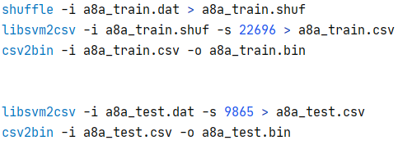
Data Set Preparation
Originally LIBSVM format
Dataset utilities included in repository
Shuffle training samples (optional for training)
Convert LIBSVM to CSV
Convert CSV to Binary (int64_t)
training
testing

Slide 22
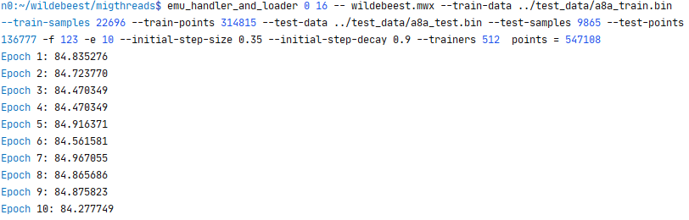
Execution: Single Node
Loads program instructions
to node card
Migrating thread
Code *.mwx
Training/Testing
Data parameters
Post epoch model accuracies

Slide 23
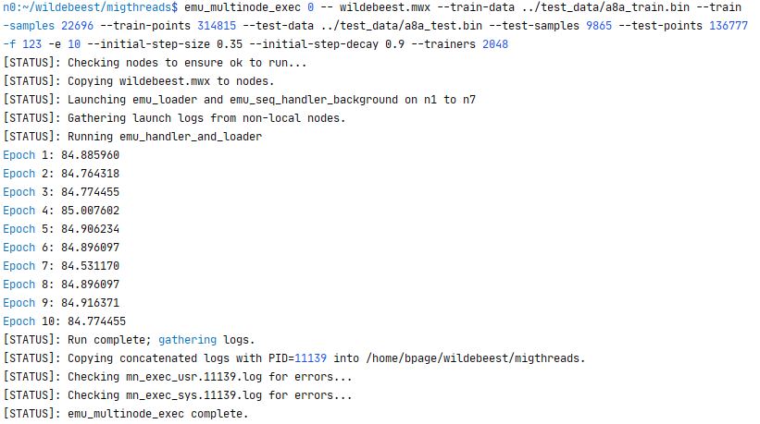
Execution: Multi-node
Loads program instructions
to all node cards
More hardware
More trainers!
Post epoch model accuracies
Run logs gathered from all nodes upon completion (or error)

Slide 24
Comparing to Conventional

Slide 25
Minimal Code Alternations
Pathfinder
Conventional OpenMP
1 2 3 4 5 6 7 8 9 10 11 12 | for (long e = 0; e <= epochs; e++){ if (e > 1){ scalar *= gamma; } for (long t = 0; t < trainers; t++){ cilk_migrate_hint(&train_s[t]); cilk_spawn train(t, scalar); } cilk_sync; }
1 2 3 4 5 6 7 8 9 10 11 12 | for (long e = 0; e <= epochs; e++){ if (e > 1){ scalar *= gamma; } #pragma omp parallel num_threads(trainers) \ shared(scalar, train_s, train_f, train_c, \ train_v, deg, model) private(thread_id) { thread_id = omp_get_thread_num(); train(thread_id, scalar) } }
VS

Slide 26
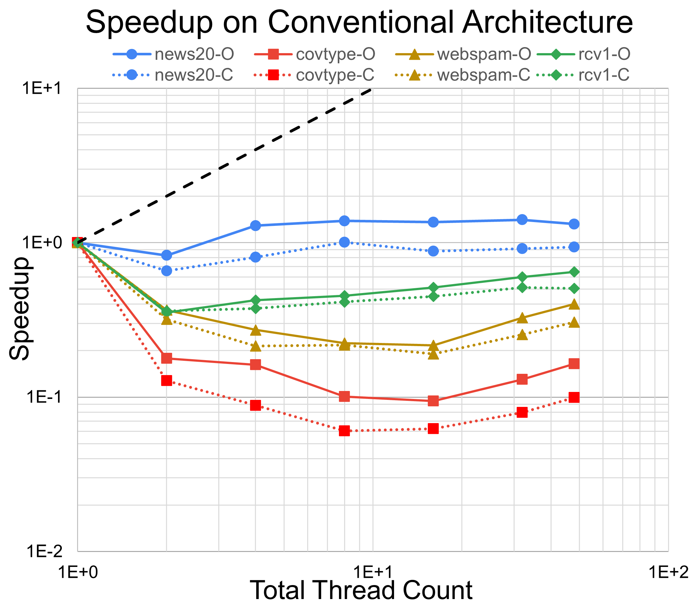
Conventional Scaling
Shared Memory implementation requires minimal code changes and no algorithmic alterations
Tested both OpenMP and Cilk Plus conventional versions
Conventional system achieves poor scalability regardless of thread library

Slide 27
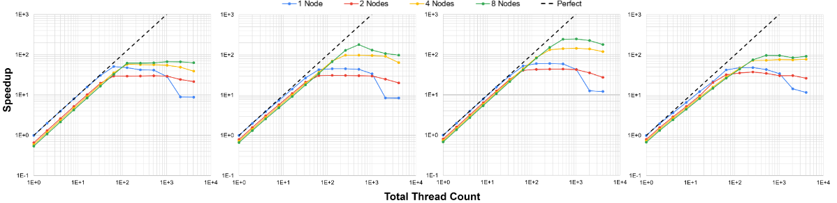
Migrating Thread Scaling
Conventional
Lucata
covtype
webspam
rcv1
news20

