Slide 1
Green Cities Project
Vijitha Samarasinghe, Brianna Papparotto & Jennifer Duffy

Slide 2
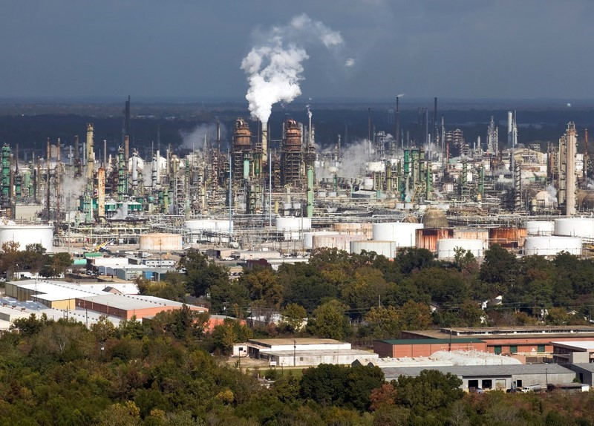

Green and Ungreen Cities
The least green city…
The most green…city!
Left photo by benkrut
Right photo by noblige
(Canva.com)

Slide 3
Green Cities & Standard of Living
Does being a green city influence poverty rates and life expectancy?
Should cities invest in being “green”?
San Francisco, Baton Rouge & Pittsburgh are our three metropolitan study areas.
Data analysis performed for available Census data from 2010 to 2015.

Slide 4

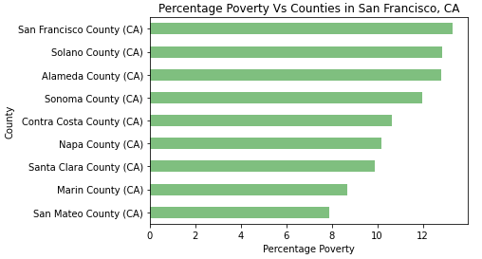
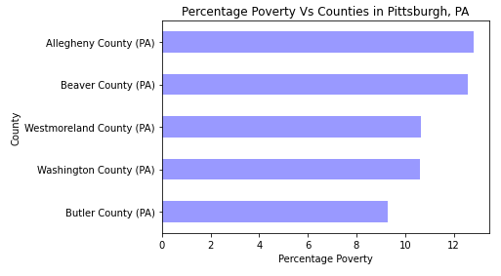
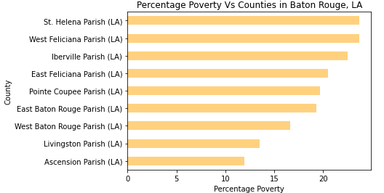
Poverty Rate by County
2010 – 2015 Average
Poverty Rate in US: 14.7%
Source: https://www.statista.com/statistics/200463/us-poverty-rate-since-1990/

Slide 5
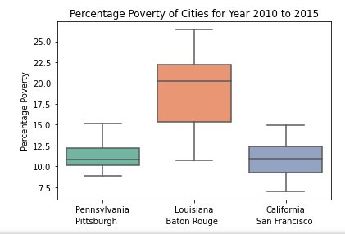
Poverty Rate
Analysis of Variance:
At 95% confidence interval:
p-value = 1.21
p-value > 0.05 (α)
There is no significant difference in poverty rates between the three cities.

Slide 6
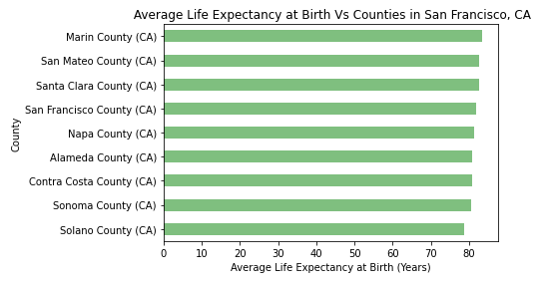
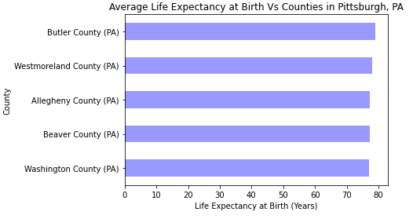
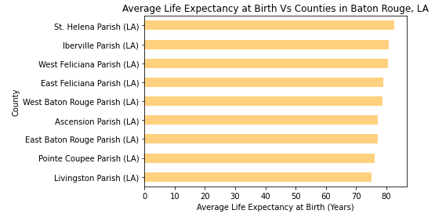
Life Expectancy by County Expectancy
2010 – 2015
Average Life Expectancy at Birth in US: 78.81 Years
Source: https://www.macrotrends.net/countries/USA/united-states/life-expectancy

Slide 7
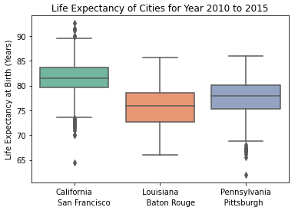
Life Expectancy
Analysis of Variance:
At 95% confidence interval,
p-value = 2.53
p-value > 0.05 (α)
There is no significant difference of Life Expectancy at Birth between three cities.

Slide 8
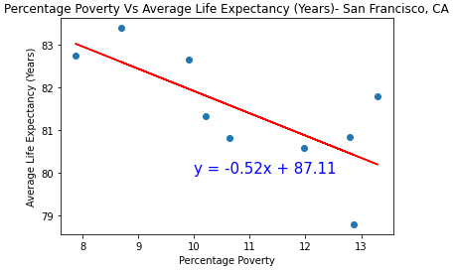
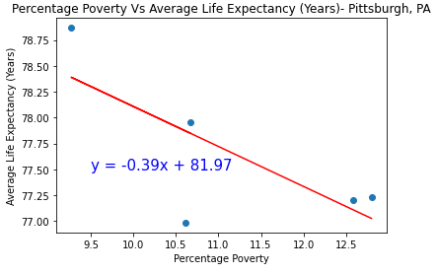
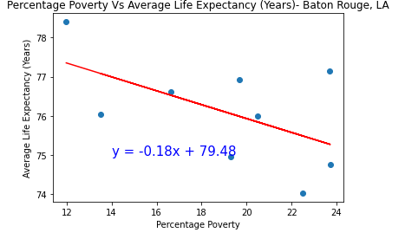
Life Expectancy Vs Percentage Poverty
R² =0.52
R² = 0.55
R² = 0.31

Slide 9
In Conclusion…
No significant difference found in Percentage Poverty or Life Expectancy at Birth in top ranking green city, lowest ranking green city or non green city.
This is a model to analyze poverty or life expectancy for cities in the U.S.
Expanding this project with more cities and more indicators will be the best solution to find accurate correlations between green cities and standards of living.

Slide 10
Resources
https://www.cdc.gov/nchs/data-visualization/life-expectancy/
https://www.macrotrends.net/countries/USA/united-states/life-expectancy
https://www.census.gov/topics/income-poverty/poverty.html
https://wallethub.com/edu/most-least-green-cities/16246

Slide 11
Thank You!

