Slide 1
Green and Ungreen Cities
Where would you rather live?

Slide 2
You Don’t Need to Live Where You Work
What is a green city
What determines quality of life
Life expectancy rates
Median household income
Poverty rates

Slide 3
Green and Ungreen Cities
“To determine the cities promoting an environmentally friendly lifestyle, WalletHub compared the 100 largest cities across 28 key “green” indicators. [This ranges from] greenhouse-gas emissions per capita to number of smart-energy policies and initiatives to green job opportunities.” -wallethub.com
San Francisco, CA is the top green city.
Baton Rouge, LA is the least green city.

Slide 4
Doing Well or ….Not So Well
ADD OUR QUESTIONS/ HYPOTHESES HERE
Should cities invest in being “green”?
San Francisco, Baton Rouge & Pittsburgh are our three metropolitan study areas.
Does being a green city influence median income, poverty rates, and life expectancy?

Slide 5

Median Household Income
REMINDER TO CITE SOURCES OF DATA !!!!!

Slide 6
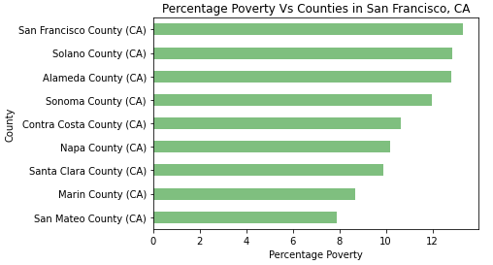
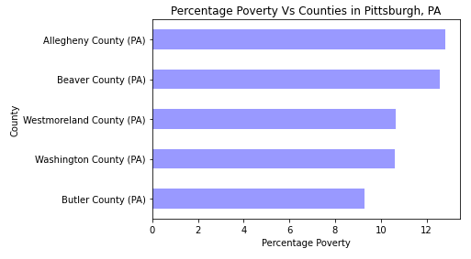
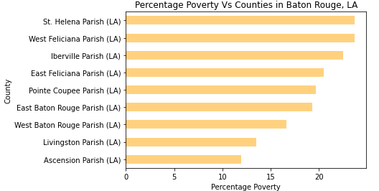
Poverty Rate

Slide 7
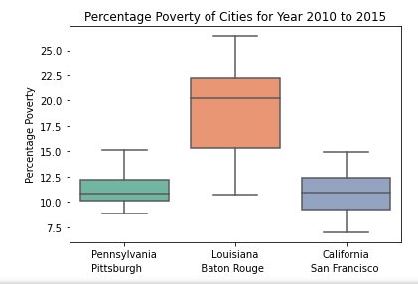
Poverty Rate
ANOVA:
At 95% confidence interval:
alpha = 0.05
pvalue = 1.21
pvalue > alpha
Unable to reject the Null Hypothesis

Slide 8
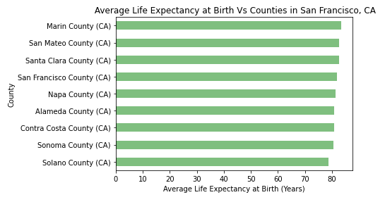
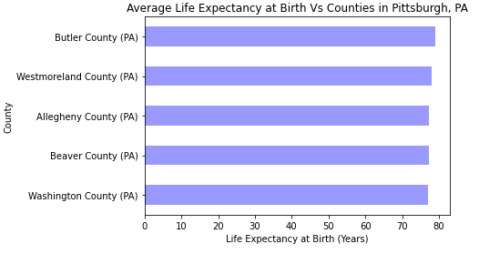
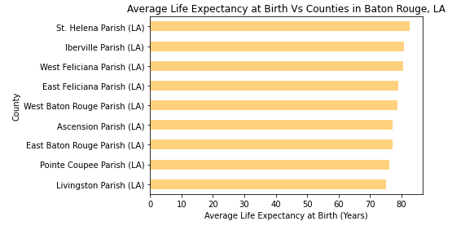
Life Expectancy by County Expectancy

Slide 9
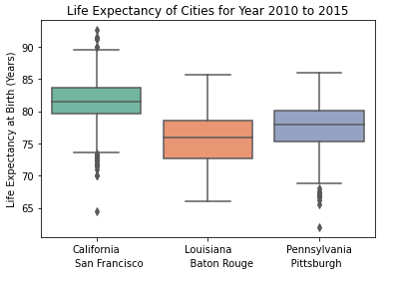
Life Expectancy
The lower quartile of Life Expectancy is: 77.7
The upper quartile of Life Expectancy is: 82.7
The interquartile range of Life Expectancy is: 5.0
Values below 70.2 could be outliers.
Values above 90.2 could be outliers.
ANOVA:
At 95% confidence interval:
alpha = 0.05
pvalue = 2.53
pvalue > alpha
Unable to reject the Null Hypothesis

Slide 10
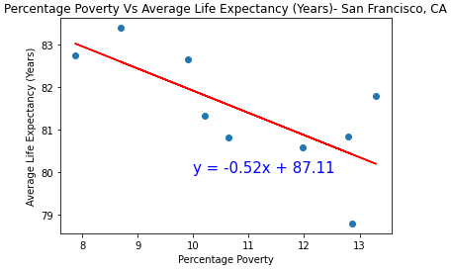
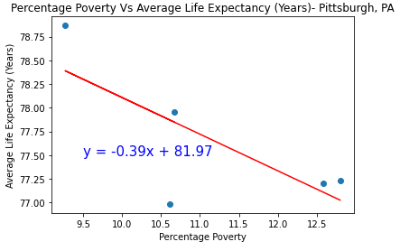
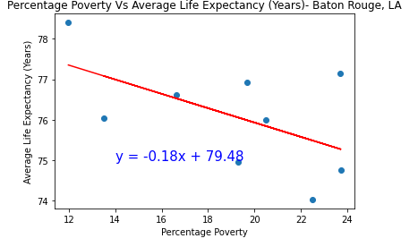
Life Expectancy Vs Poverty
The r-squared value for San Francisco, CA : 0.523
The r-squared value for Pittsburg, PA : 0.55

Slide 11
Conclusion
There no significant difference found in Percentage Poverty or Life expectancy at birth in top ranking green city, lowest ranking green city or non green city during 2010 to 2015 according to census data analysis. This is a model to analyze Percentage Poverty or Life expectancy at birth of cities in United States. Expanding this project with more cities will be the best solution to find the accurate correlation between green citifies and standards of living.

Slide 12
(recap here)
Why be a green city
Quality of life
High life expectancy rates
High household income
Low or eliminated poverty
CALL TO ACTION HERE (further investigation of other quality of life indicators etc)

