Slide 1
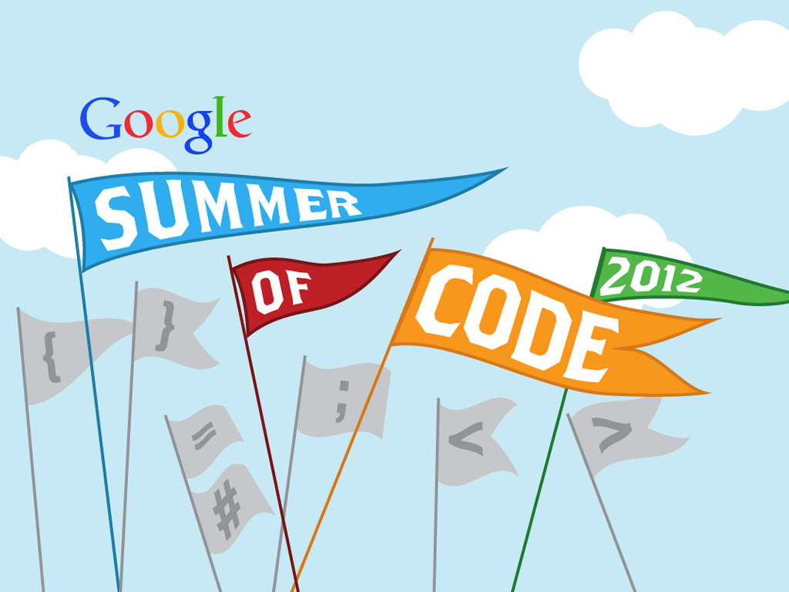
www.google-melange.com

Slide 2
What is Google Summer of Code?
Google Summer of Code is a program designed to encourage college student participation in open source software development.

Slide 3
The Gist
Contribute to open source
Give back to the community
Gain valuable experience
Apply your knowledge
Oh yeah, get a Google stipend

Slide 4
How it works
Find a project that interests you
Discuss your idea and apply
Get accepted
Have fun and code
Pass the evaluations
Stay involved

Slide 5
Participating Projects
Have included projects on:
Operating Systems
Hardware Management
Mobile, Portable, Handheld & calculators
Databases
Programming Languages, Libraries & Compilers
Code Design, Development & Management
Internet & Networks
Video, TV & Photography

Slide 6
Participating Projects
Web Technologies
Content Management
Office Applications & Text Editors
Simulations, Modeling & Neural Networks
Analytical Sciences
Biology and Health Care
Graphics, 3D Rendering, CAD & Animation
Game Development
Mail, Phone & Internet Messaging
Multimedia, Audio, & Music

Slide 7
Stipends
Google will provide a stipend of 5500 USD per accepted student developer, of which 5000 USD goes to the student and 500 USD goes to the mentoring organization.
Accepted students in good standing with their mentoring organization will receive a 500 USD stipend shortly after coding begins.
Students who receive passing mid-term evaluations will receive a 2250 USD stipend shortly after the mid-term evaluation.
Students who receive passing final evaluations will receive a 2250 USD stipend and mentoring organizations will receive 500 USD shortly after the final evaluation deadline.

Slide 8
Google Summer of Code timeline
March 16: List of accepted mentoring organizations published on
  http://www.google-melange.com
March 17-25: Would-be student participants discuss application/project ideas with mentoring organizations.
March 26-April 6: Student application period
April 23: Accepted student proposals announced at
http://www.google-melange.com

Slide 9
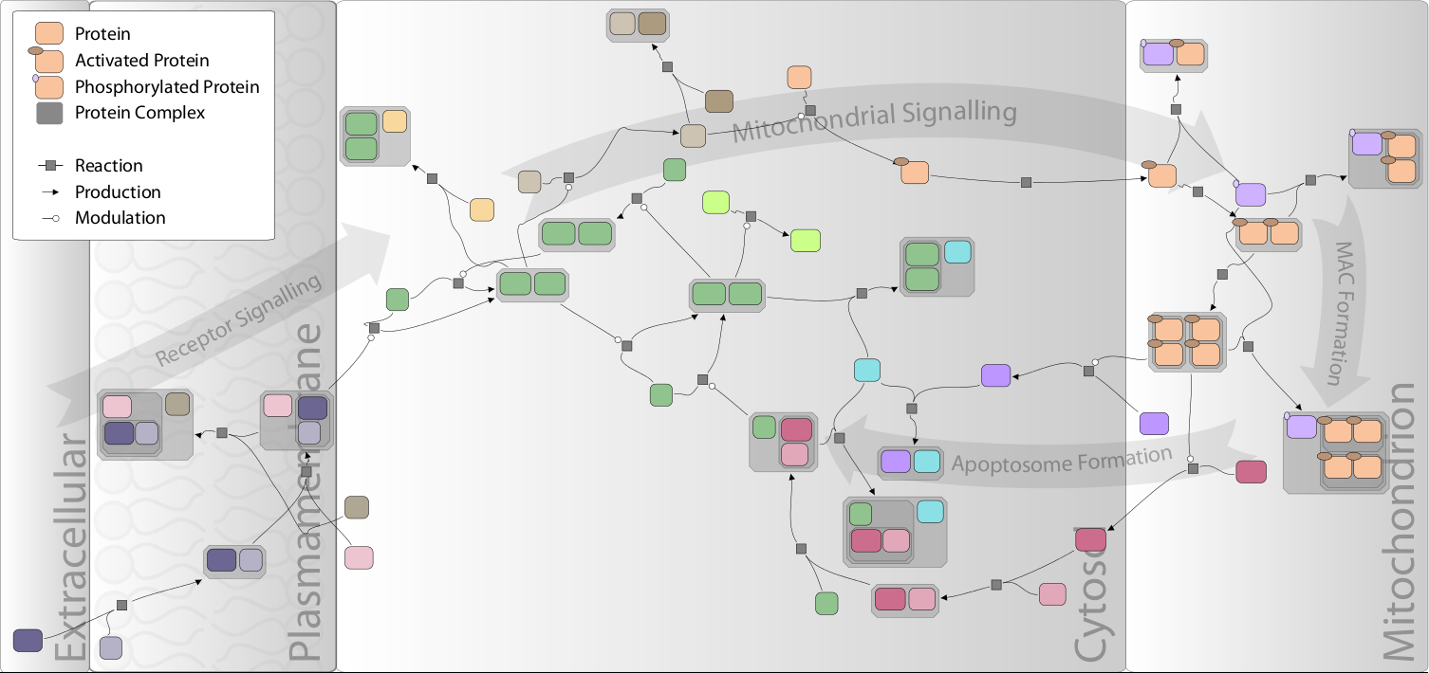
Biographer
http://cheetah.biologie.hu-berlin.de/networkexplorer/

Slide 10
Useful links
Google Summer of Code web page
      http://www.google-melange.com
Google Summer of Code discussion group
      http://groups.google.com/group/google-summer-of-code-discuss
Google Summer of Code student guide
      http://www.booki.cc/gsocstudentguide/

Slide 11

Thanks for your attention
We look forward to
your participation!

