Slide 1
PennDOT Asset Management: Bridges, 2020
Telling Stories with Data, Storyboard

Slide 2
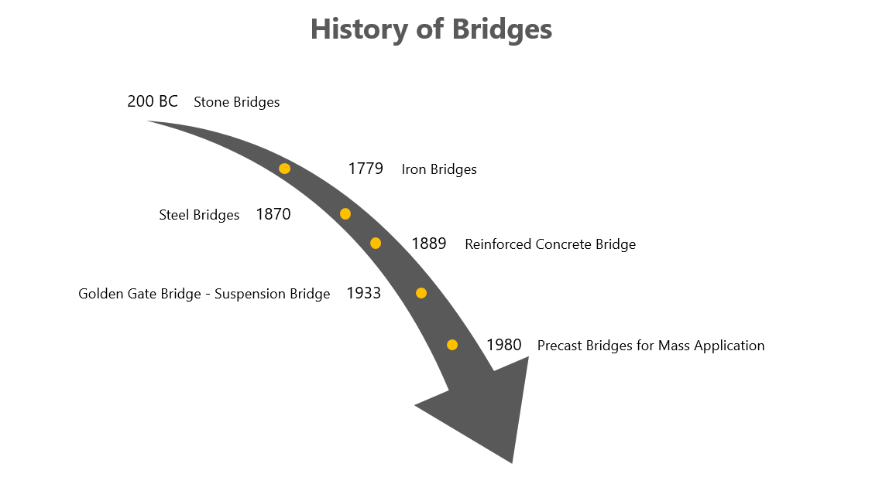
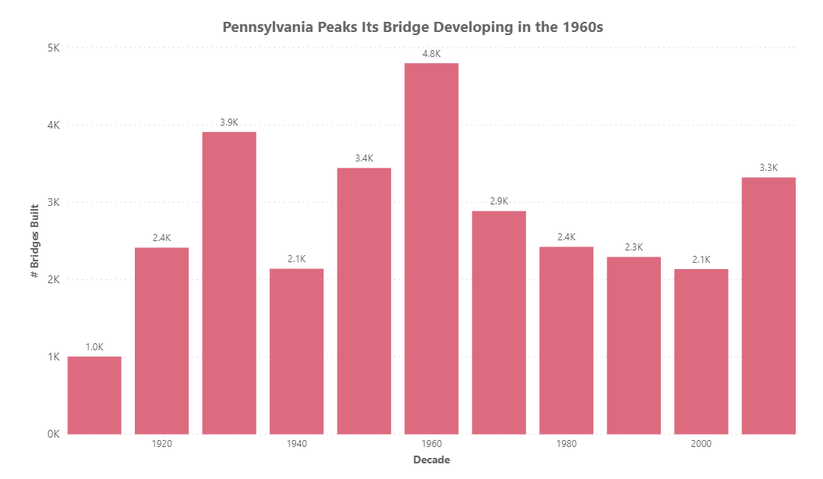
Since the 1900s, Pennsylvania has been investing in its infrastructure made of bridges

Slide 3
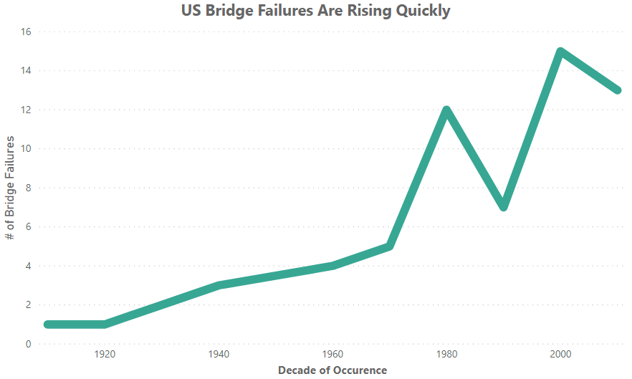
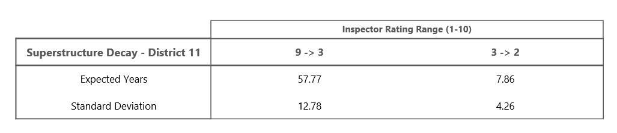
But for that same time period, a trend has started to appear
How fast does it take for bridges to deteriorate?
…
PennDOT employs bridge inspectors to help understand the current health of our bridges
“A significant portion of Pennsylvania’s infrastructure is more than 50 years old and has exceeded its original design life.”
-PennDOT, 2019
With the peak infrastructure development of the 1960s, bridges are starting to reflect their age

Slide 4
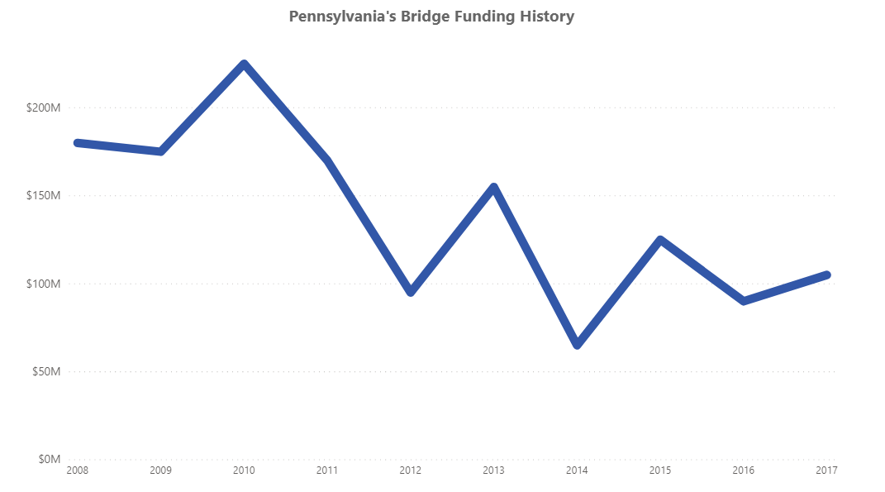
And despite the trend, and initiatives to increase funding in Pennsylvania, spending has not reflected the failure trend
+20%
Forecasted increase for bridges in “Poor” condition by 2030
There is an immediate need to understand the true, real-time health of bridges in Pennsylvania
How should PennDOT adapt to their situation?

Slide 5

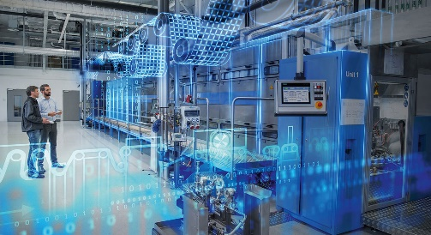
Using Technology….specifically, two methods….
Digital Twins (i.e. replicating real objects in virtual form)
Cognitive Sensors (i.e. sensors reporting live status of bridges)
There is a need to invest in creating an understanding of the live health of Pennsylvania bridges…
Relying on the current practice of inspections every 2-5 years is not enough
The Solution:
Integrating Digital Twin technology with cognitive sensors
Steps:
Identify a bridge
Replicate the bridge in virtual space (dimensions, materials, connections, properties)
Input real-world defects (cracks, corrosion, impact locations, deformations)
Use mathematical equations to simulate future scenarios, confirming bridge integrity
If issues arise, send maintenance crews to fix critical points

Slide 6
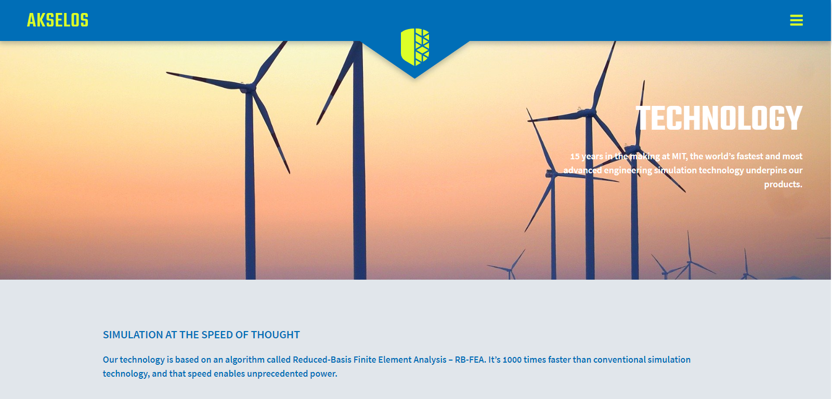
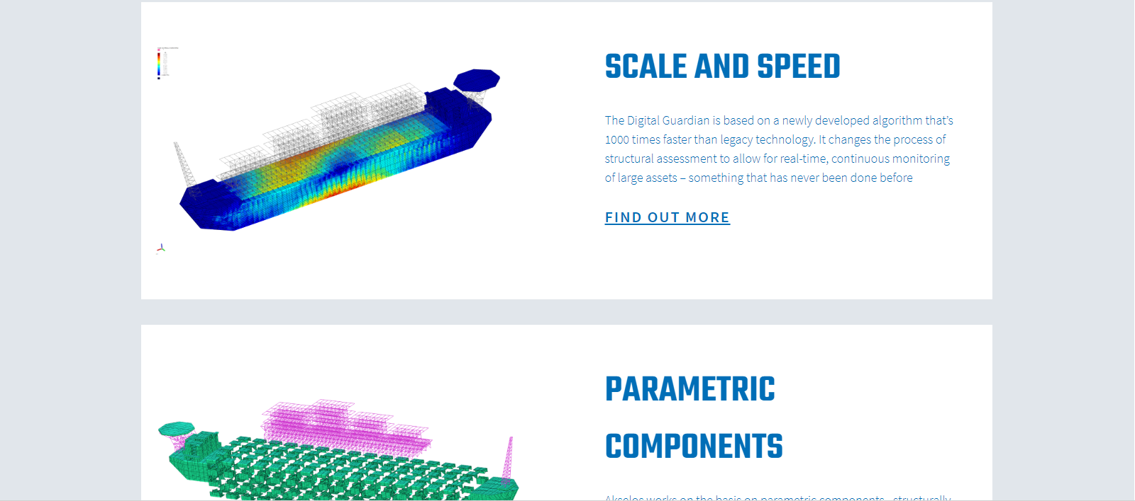
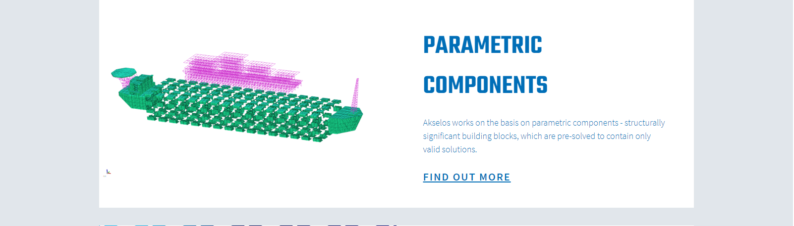
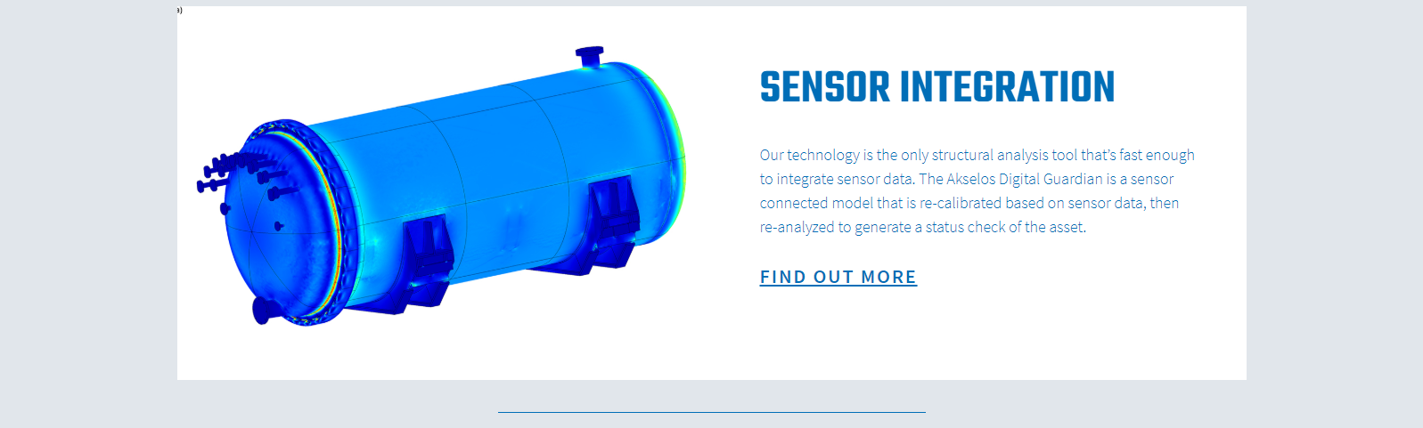

Sound too good to be true? Can humans really replicate the real world with equations?
Truth is, humans have been doing it since M.J. Turner at Boeing in 1950
What is the catch?
Up until recently, the method was entirely completed by hand, taking 2 weeks – 1 month to evaluate
However, MIT has recently developed a way to use cloud computing, reducing the process to minutes
The company is Akeslos

Slide 7
PennDOT’s Pennsylvania target is zero bridge failures. And in order to get there, PennDOT needs to have reliable, live data of bridges.
PennDOT and Bilfinger collectively can understand:
What is the current status of our bridges?
What does the future hold for our bridges?
What can we do now, through innovative asset management, to make sure we have ZERO failures in the future?
Click here to enroll your bridge in the program today

Slide 8
History of Bridges
1779 Iron Bridges
Steel Bridges 1870
1889 Reinforced Concrete Bridge
Golden Gate Bridge - Suspension Bridge 1933
1980 Precast Bridges for Mass Application
200 BC Stone Bridges

Slide 9
Inspector Rating Range (1-10)
Superstructure Decay - District 11 | 9 -> 3 | 3 -> 2
Expected Years | 57.77 | 7.86
Standard Deviation | 12.78 | 4.26
“A significant portion of Pennsylvania’s infrastructure is more than 50 years old and has exceeded its original design life.”

