Slide 1
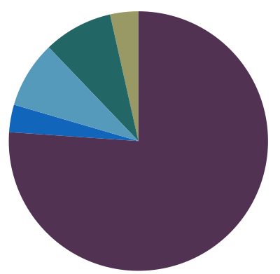
Potential long-
term seed
limitation
4%
9%
8%
3%
76%

Slide 2
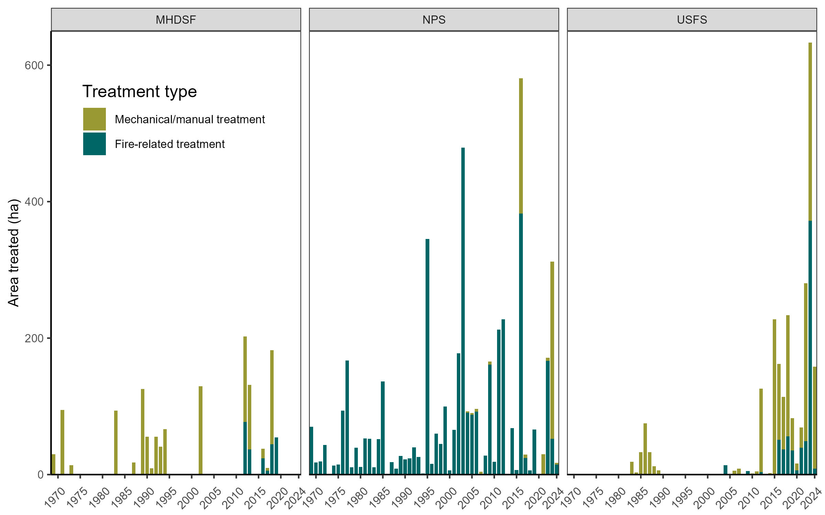
1,031
4,270
4,158

