Slide 1
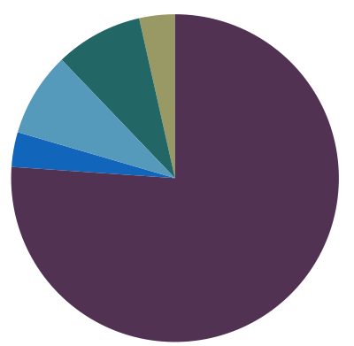
Potential long-
term seed
limitation
4%
9%
8%
3%
76%

Slide 2
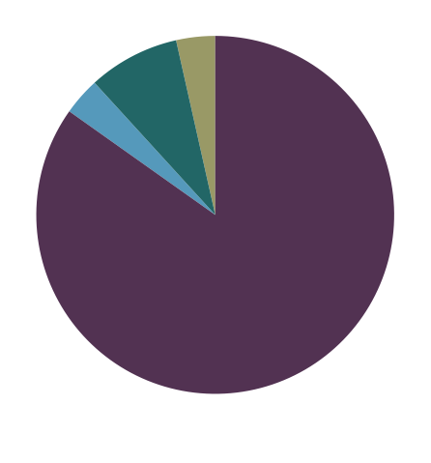
Potential long-
term seed
limitation
4%
8%
3%
85%

Slide 3
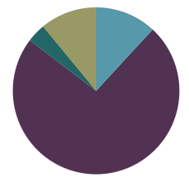
Potential long-
term seed
limitation
11%
12%
4%
74%
 |  | Out ha | In ha | Totes | Out % | In %
4 | Unburned | 0.00000 | 1202.9895 | 1202.9895 | 0.000000000 | 1.0000000
3 | Potential for recent regeneration | 28.63834 | 7416.3395 | 7444.9779 | 0.003846665 | 0.9961533
2 | Moderate risk of inadequate postfire regeneration | 128.97538 | 241.8627 | 370.8381 | 0.347794352 | 0.6522056
1 | High risk of inadequate postfire regeneration | 501.10682 | 612.9674 | 1114.0742 | 0.449796616 | 0.5502034

Slide 4
Potential long-
term seed
limitation
11%
12%
4%
74%
 |  | Out ha | In ha | Totes | Out % | In %
4 | Unburned | 0.00000 | 1202.9895 | 1202.9895 | 0.000000000 | 1.0000000
3 | Potential for recent regeneration | 28.63834 | 7416.3395 | 7444.9779 | 0.003846665 | 0.9961533
2 | Moderate risk of inadequate postfire regeneration | 128.97538 | 241.8627 | 370.8381 | 0.347794352 | 0.6522056
1 | High risk of inadequate postfire regeneration | 501.10682 | 612.9674 | 1114.0742 | 0.449796616 | 0.5502034

Slide 5
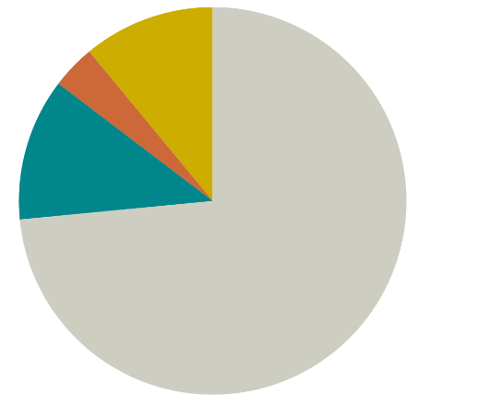
Potential long-
term seed
limitation
11%
4%
12%
74%
 |  | Out ha | In ha | Totes | Out % | In %
4 | Unburned | 0.00000 | 1202.9895 | 1202.9895 | 0.000000000 | 1.0000000
3 | Potential for recent regeneration | 28.63834 | 7416.3395 | 7444.9779 | 0.003846665 | 0.9961533
2 | Moderate risk of inadequate postfire regeneration | 128.97538 | 241.8627 | 370.8381 | 0.347794352 | 0.6522056
1 | High risk of inadequate postfire regeneration | 501.10682 | 612.9674 | 1114.0742 | 0.449796616 | 0.5502034

Slide 6
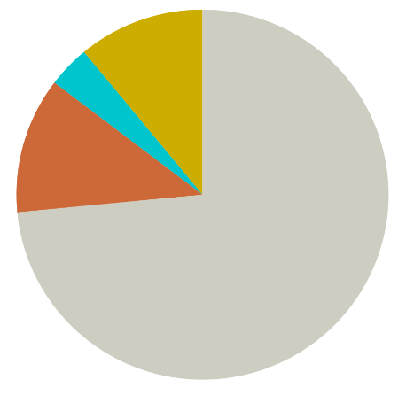
Potential long-
term seed
limitation
11%
4%
12%
74%
 |  | Out ha | In ha | Totes | Out % | In %
4 | Unburned | 0.00000 | 1202.9895 | 1202.9895 | 0.000000000 | 1.0000000
3 | Potential for recent regeneration | 28.63834 | 7416.3395 | 7444.9779 | 0.003846665 | 0.9961533
2 | Moderate risk of inadequate postfire regeneration | 128.97538 | 241.8627 | 370.8381 | 0.347794352 | 0.6522056
1 | High risk of inadequate postfire regeneration | 501.10682 | 612.9674 | 1114.0742 | 0.449796616 | 0.5502034

Slide 7
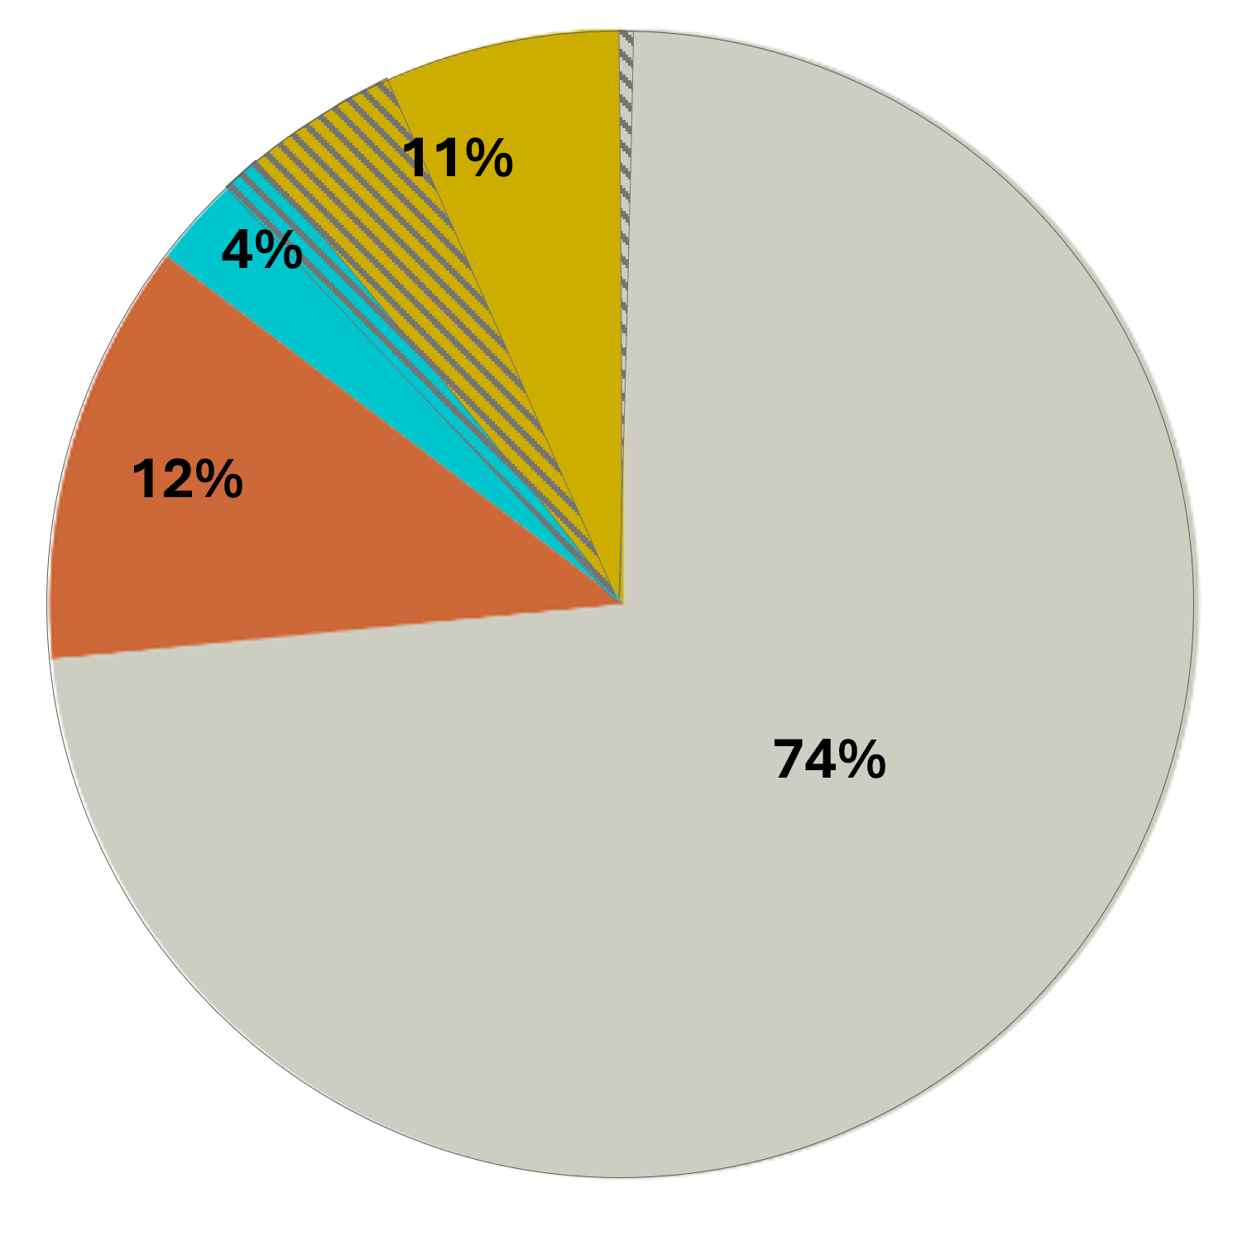
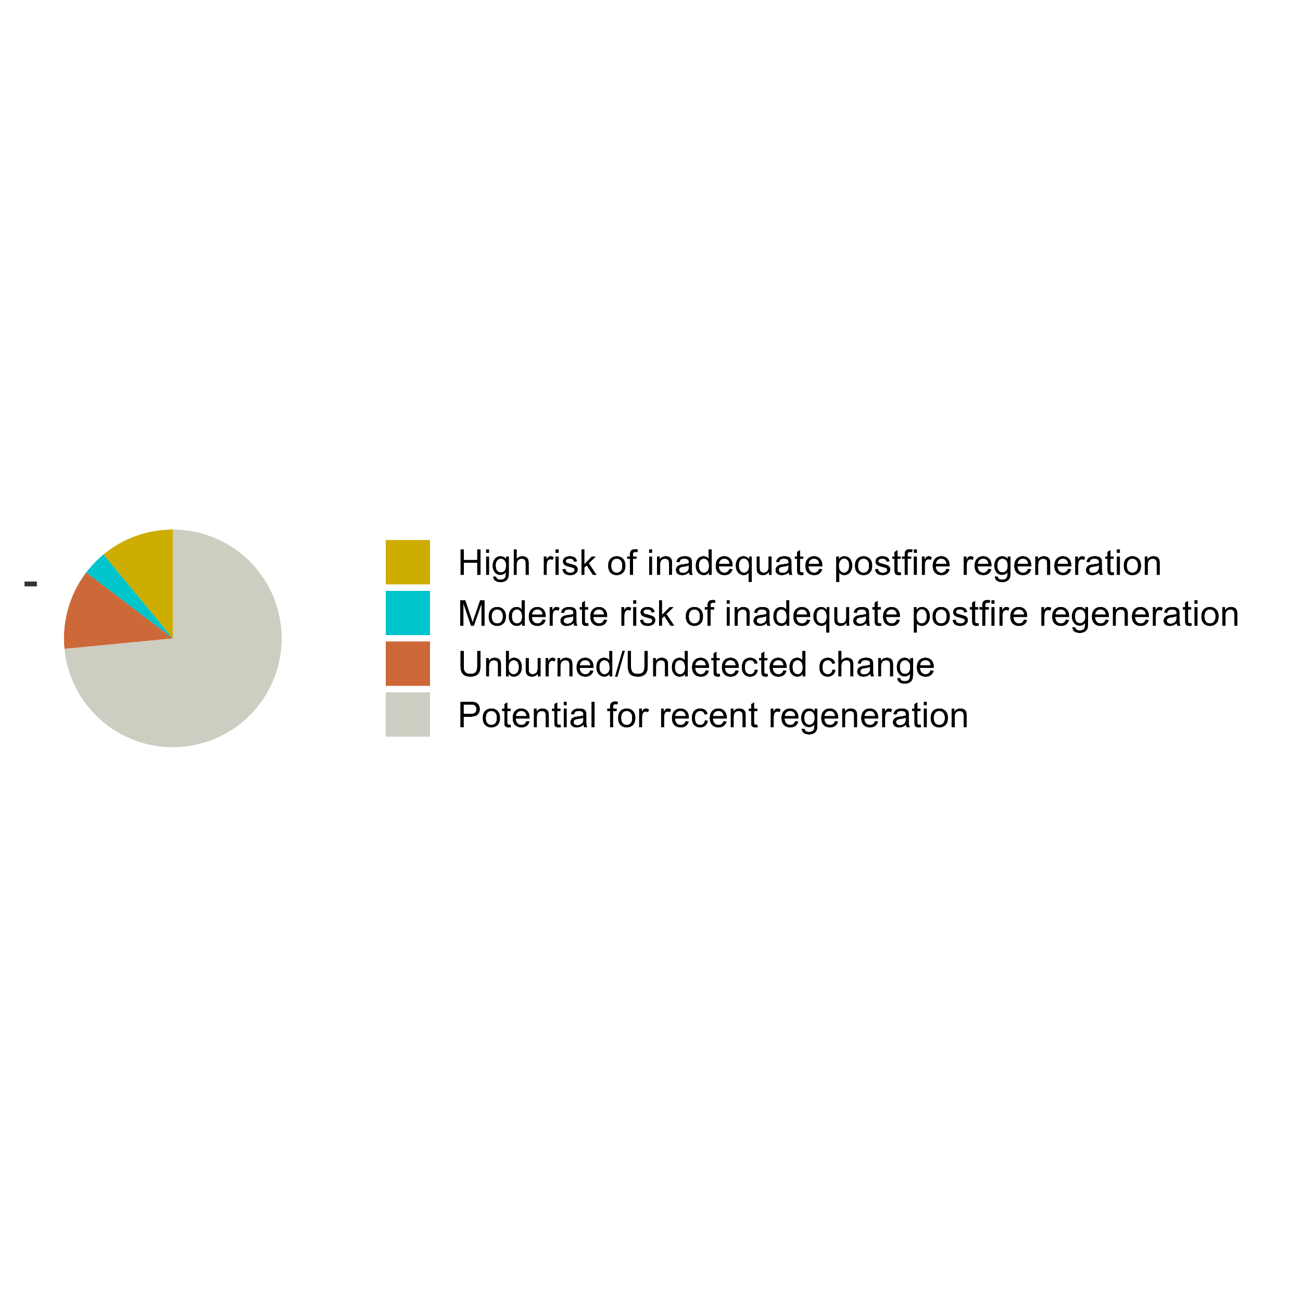
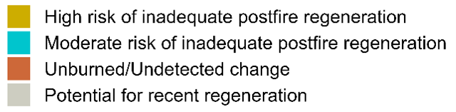

Slide 8
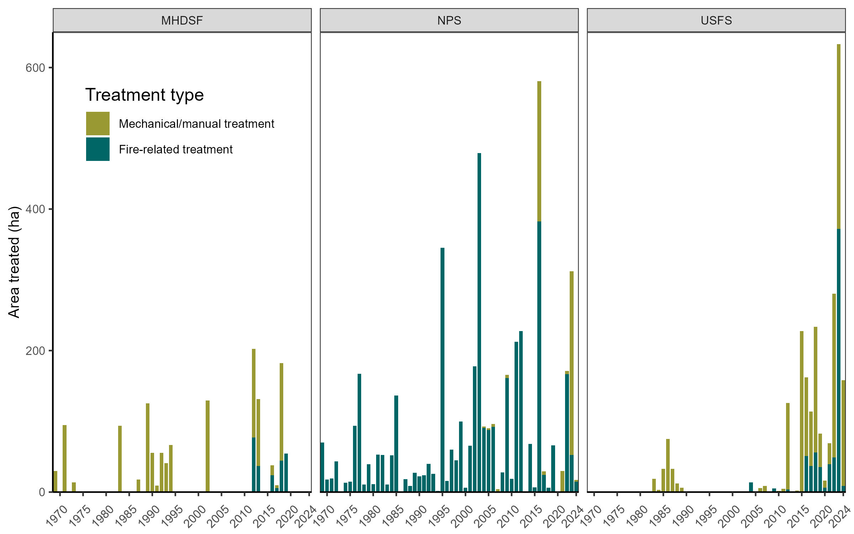
1,031 ha
4,270 ha
4,158 ha

