Slide 1
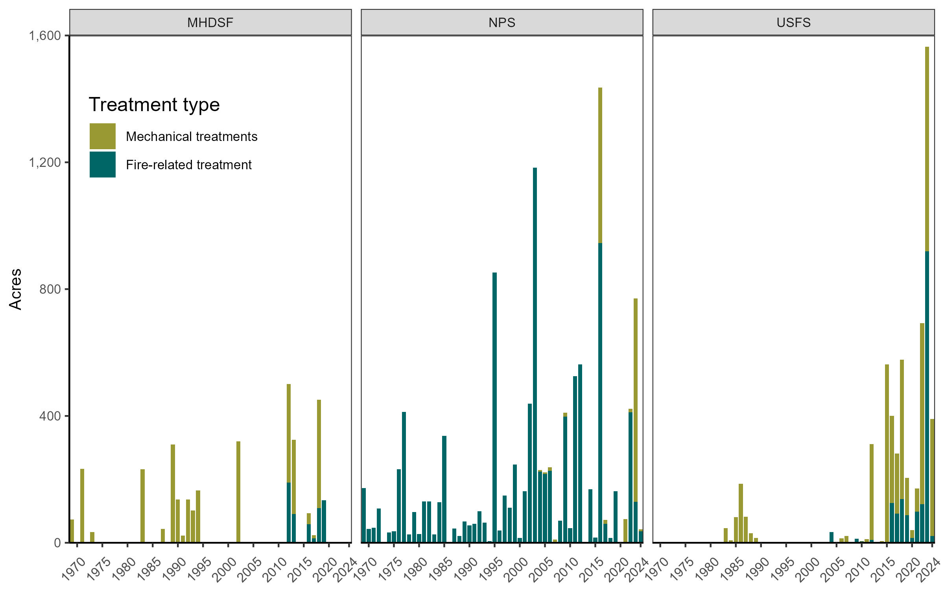
2,548 ac
10,551 ac
10,274 ac

