Slide 1
Extremely low temperature &
dry air
Climate change
(Temperature, Precipitation)
Low
precipitation
Reduced
riverflow
Decreased land fertility &
bio-productivity
Decreased agricultural production &
food supply
Drought
Social unrest
War
Migration
Lack of co-operation &
job scarcity
Dynastic
transition

Slide 2
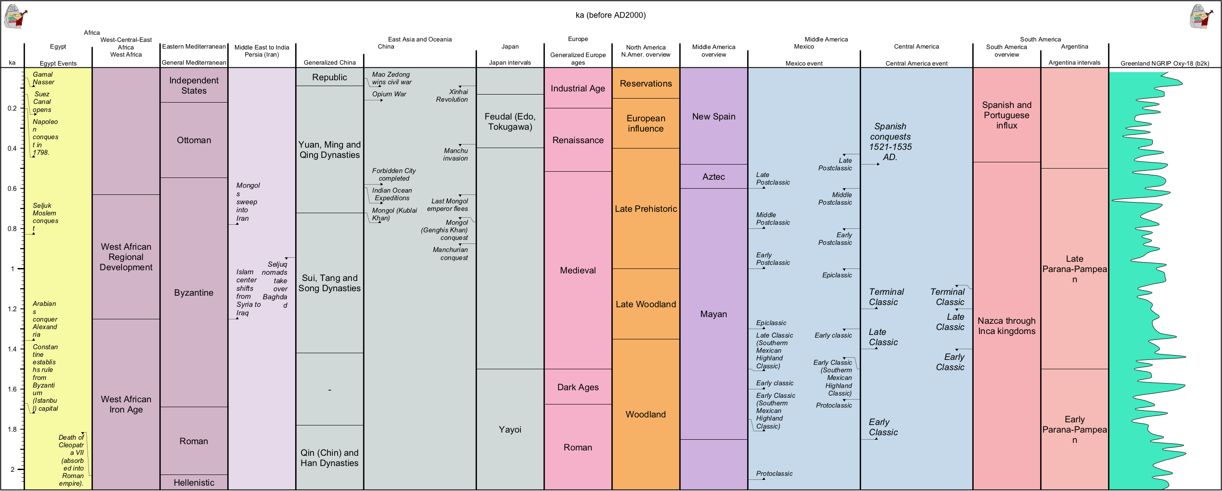
Events during Little Ice Age (1300-1850 AD)

Slide 3
Events during Medieval Warm Period (900-1300 AD)

