Slide 1
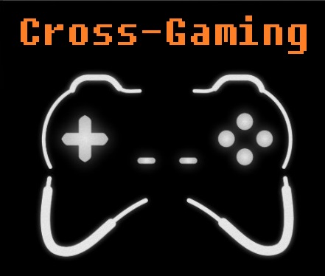
Cross-Gaming Software
Brianna Muleski

Slide 2
What is Cross-Gaming?
A cloud-based software service
Tracks the progression of the gamer
Accessible from any platform with an internet connection
Notes:
Cloud-based software program that is accessible from any platform with an internet connection.
Here’s how it works:
- A user will set up an account, and sync all of their gamer accounts (Origin, XBOX Live, PlayStation Network, Steam)
- They then will play as usual
- Cross-Gaming will track their progression and save it on the cloud.
- When the user plays the game again, from any platform, the game will have all their progression from all platforms updated.

Slide 3
Why Cross-Gaming?
Lack of services that provide a cross-platform gaming experience
No more back-tracking in games
Expanding the gaming industry
Notes:
- Users that play a game on more than one platform are forced to start from scratch, and track their progression separately
- Using Cross-Gaming enables them to play progressively, without having to back-track and redo levels
- With this software, gamers will be more apt to play their favorite games on multiple platforms, expanding the gaming industry

Slide 4
Ages
Notes:
- ages varied widely, from 18 to 74
- those that played video games frequently (at least 3 hours a week) were concentrated in the ages of 18 to 34
- shows that the target audience would be in these ages, because they are most likely to use a gaming software service

Slide 5
Platforms
Notes:
- most used by those surveyed are the Xbox 360 and the Windows PC
- means that the most amount of advertising should be put towards these platforms
- testing the software should be focused on the top platforms as well

Slide 6
Genres
Notes:
most popular gaming genres:
Action role playing games
Shooters
Role playing games
Strategy games
- This means that the most games used with Cross-Gaming would be in these genres
- Testing for games in these genres will have to be intensive
- Advertising should also focus on these genres

Slide 7
Multiple Platform Game Owners
Notes:
- 100% of the people who own a game on more than one platform responded that they would be either likely or very likely to use Cross-Gaming
- This means that gamers who own a game on more than one platform are extremely likely to use the software

Slide 8
Notes:
- Facebook page
great, low-cost way to advertise
get in touch with the customers
- good way to reach the target age group (18-34)

Slide 9
Notes:
- email sent out to known gamers inviting them to participate in the beta test
- best way to troubleshoot problems in the software
- good way to let people know about the product
- attract future customers

Slide 10
Notes:
Bad news letter
- Alerts the customer of insufficient funds
Gives specific methods of resolving the problem
Does not blame the customer

