Slide 1

Computer Architecture and Operating Systems CS 3230 :Assembly Section Lecture 5
Department of Computer Science and Software Engineering
University of Wisconsin-Platteville
Notes:
In segment .text – code sectioned off in different blocks, with labels.
syntax – label1: …
…
…
…
label2:

Slide 2
Unconditional Jumps
Transfer the control flow of the program to a specified instruction, other than the next instruction in sequential execution
It is the equivalent of a C++ goto statement
Syntax: JMP label
label pointing to the address of the target instruction
Example:
top:
.
.
jmp top
Notes:
Used to move between blocks

Slide 3
Compare Instruction: CMP
Syntax: CMP A, B
Action:
Executes A-B without modifying A (non-destructive)
It sets the Flags just as SUB would
Notes:
Can be used to subtract without changing A
Cmp used with if else structures

Slide 4
Comparisons
Unsigned CMP A, B
If (A<B), C=1
If (A>B), C=0
“Z-flag” tested for equality/inequality
Signed CMP A, B
If (“S-flag” XOR “O-flag” == 1) then A<B else A>B
“Z-flag” tested for equality/inequality

Slide 5
Conditional Jumps
A conditional jump instruction branches to a label when specific register or flag conditions are met
Syntax: Jcond label

Slide 6
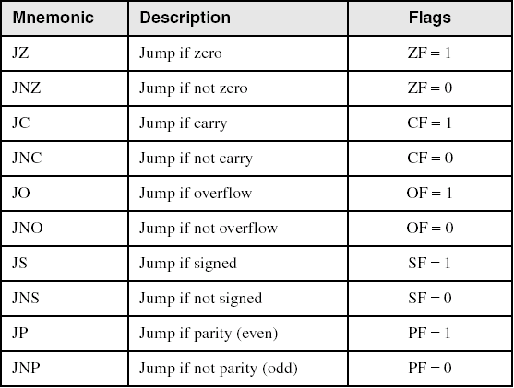
Jumps based on specific flags
6
Notes:
6

Slide 7
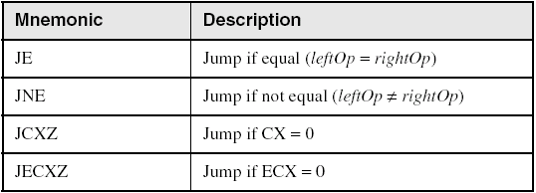
Jumps based on equality
7
Notes:
7

Slide 8
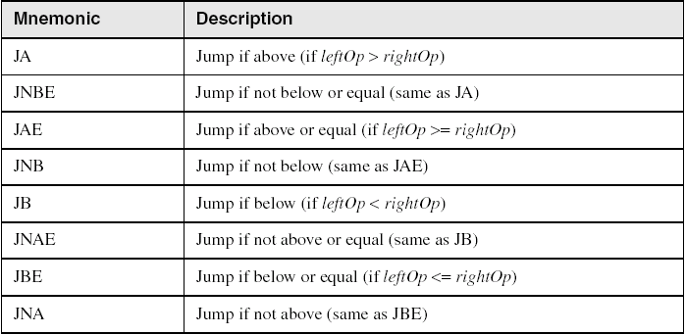
Jumps based on unsigned comparisons
8
Notes:
8

Slide 9
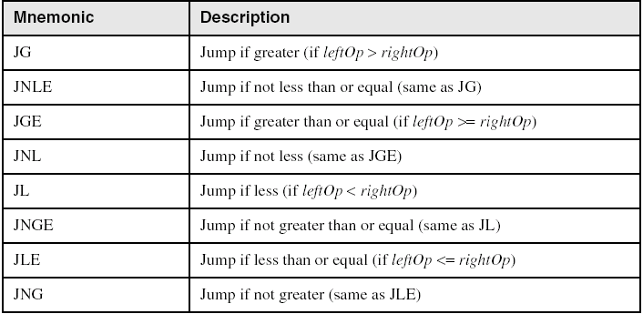
Jumps based on signed comparisons
9
Notes:
9
Example: c++ code: in assembly:
Int x; (assume x is saved at [input1]
Cin >> x; cmp dword [input1], 0
If( x >= 0) jnge false
cout << “Positive”; ; print positive, spate block not needed
Else jmp endif
cout >> “negative”;
false:
; print negative
endif:
….

Slide 10
Examples
Compare unsigned AX to BX, and copy the larger of the two into a variable named Large
mov Large,bx
cmp ax,bx
jna Next
mov Large,ax
Next:
Compare signed AX to BX, and copy the smaller of the two into a variable named Small
mov Small,ax
cmp bx,ax
jnl Next
mov Small,bx
Next:
10
Notes:
10

Slide 11
If then else in assembly
mov ax, [a]
mov bx, [b]
cmp ax,bx
ja true
; false instructions
jmp done
true:
; true instructions
done”
If (a>b) {
/* true instructions */
} else {
/* false instructions */
}

Slide 12
Compound expression with AND
if (al > bl) AND (bl > cl)
X = 1;
This is one possible implementation
cmp al,bl ; first expression...
jbe next ; quit if false
cmp bl,cl ; second expression...
jbe next ; quit if false
mov X,1 ; both are true
next:
12
Notes:
12

Slide 13
Compound Expression with OR
if (al > bl) OR (bl > cl)
X = 1;
This is one possible implementation
cmp al,bl ; is AL > BL?
ja L1 ; yes
cmp bl,cl ; no: is BL > CL?
jbe next ; no: skip next statement
L1:mov X,1 ; set X to 1
next:
13
Notes:
13

Slide 14
Do while in assembly
begin:
; body instructions…
mov ax, [a]
mov bx, [b]
cmp ax,bx
je begin
do {
/* body instructions */
} while (a==b);

Slide 15
While do in assembly
begin:
mov ax, [a]
mov bx, [b]
cmp ax,bx
jne done
; instructions
jmp begin
done:
while (a==b) {
/* instructions */
};

Slide 16
Loop Instruction
Syntax : LOOP label
Combination of CMP and JNZ
Action: decrement the ECX register and
If (ECX != 0) : jump to the specified label
Else :following the LOOP instruction is executed

Slide 17
Example : Simple For loop
mov ecx, 10
begin:
; instructions
loop begin
for (i=10;i>0;i--) {
/* instructions */
}

Slide 18
Nested Loop
If you need to code a loop within a loop, you must save the outer loop counter's ECX value. In the following example, the outer loop executes 100 times, and the inner loop 20 times.
mov ecx,100 ; set outer loop count
L1:
mov count,ecx ; save outer loop count
mov ecx,20 ; set inner loop count
L2:...
loop L2 ; repeat the inner loop
mov ecx,count ; restore outer loop count
loop L1 ; repeat the outer loop
18
Notes:
18

Slide 19
LOOPZ and LOOPE
Syntax:
LOOPE label
LOOPZ label
Action:
ECX ← ECX – 1
if ECX != 0 and ZF=1, jump to label
Application:
Useful when scanning an array for the first element that meets some condition
19
Notes:
19

Slide 20
LOOPNZ and LOOPNE
Syntax:
LOOPNZ label
LOOPNE label
Action:
ECX ← ECX – 1
if ECX != 0 and ZF=0, jump to label
20
Notes:
20

