Slide 1

Computer Architecture and Operating Systems CS 3230: Operating System Section Lecture OS-8 Memory Management (2)
Department of Computer Science and Software Engineering
University of Wisconsin-Platteville

Slide 2
Outlines
Paging
Address Translation
Page Table
Page Table Structure
Shared Pages

Slide 3
Paging
Each process is divided into a number of small, fixed-size partitions called pages
Physical memory is divided into a large number of small, fixed-size partitions called frames
Page size = frame size
Usually 512 bytes to 16K bytes ,lately tends to be 4K
To run a program of size n pages, need to find n free frames and load program

Slide 4
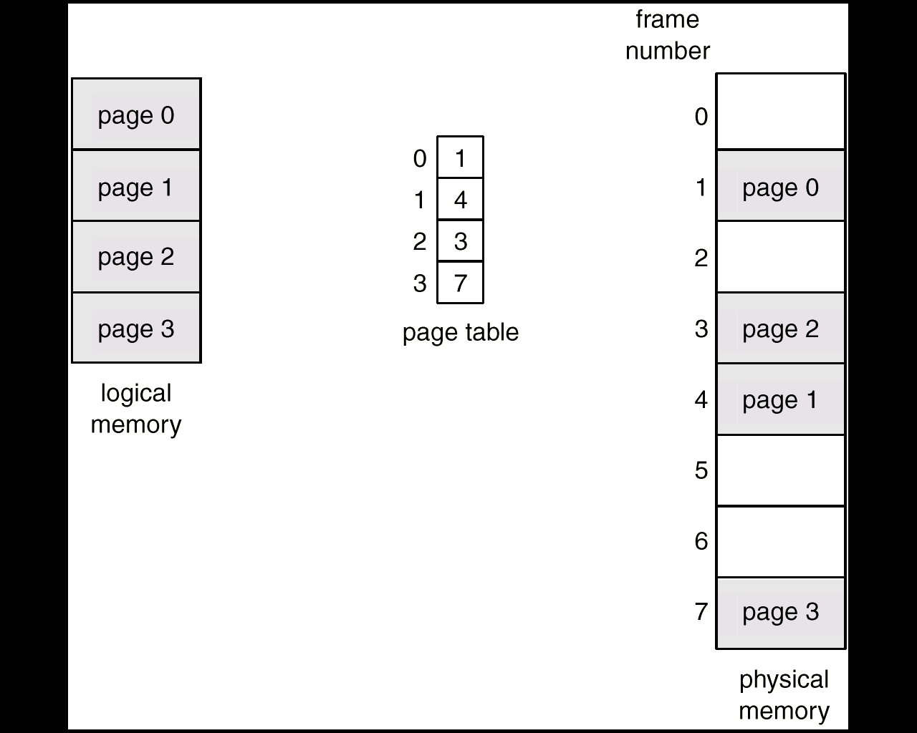
Page Table
Page Table : per process data structure that provides mapping from page to frame
Each page table must fit in one frame /page
Page-Table Base Register (PTBR) points to the page table (physical address of the page table) of the current running process

Slide 5
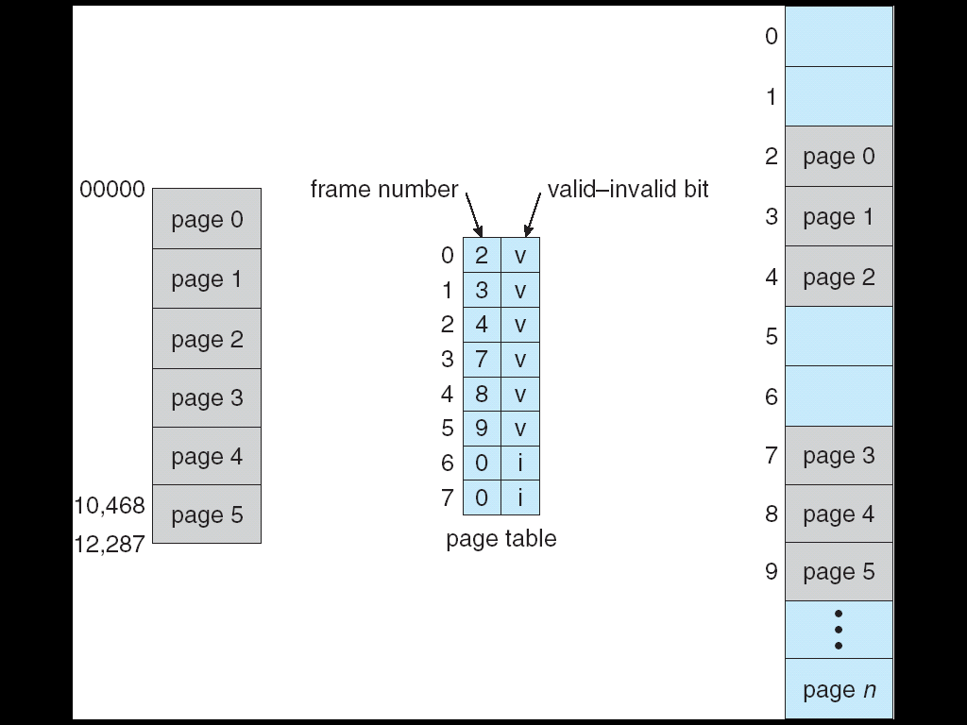
Page Table: Protection
Process may not use the whole page table
Unused portions of the page table are protected by valid/invalid bit
Try to address these pages will result in a trap with “memory protection violation”
Problem: size of page table
Solution: Page-Table Length Register (PRLR) indicates the number of
current valid pages in the table

Slide 6
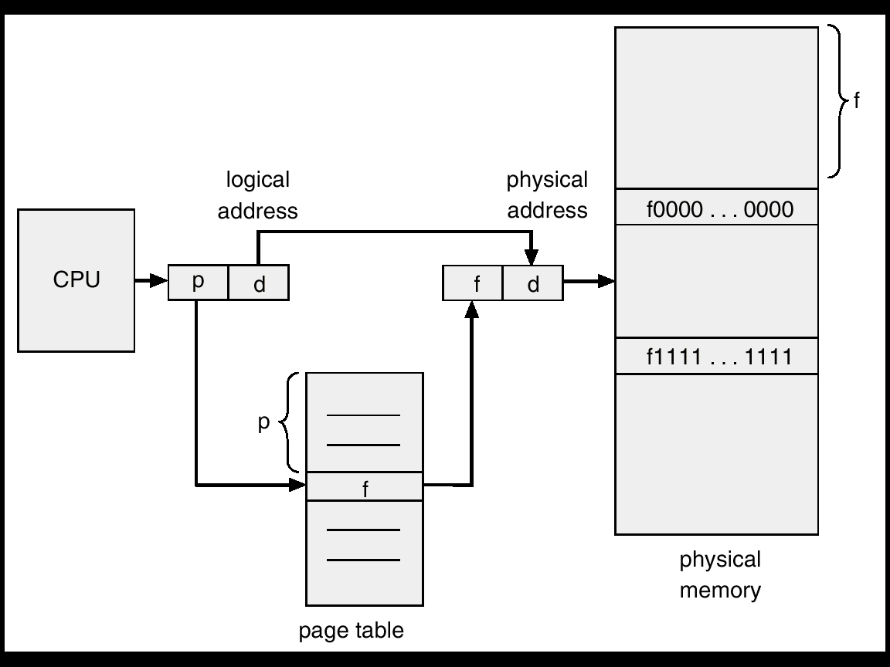
Paging: Address Translation
Logical address (Address generated by CPU) consists of page number and offset from beginning of the page
Physical address consists of frame base address and offset from beginning of the frame
Address Translation Architecture:

Slide 7
Page Table Structure
Problem:
Address space of modern computer system is 2³² to 2⁶⁴
Each page table must fit in one frame /page
However , size of page table is potentially large
As a result , page table searching time is potentially large
Solution:
Hierarchical Paging
Hashed Page Tables
Inverted Page Tables
Notes:
Assume process P1 has 280 pages
Frame size = 100 bytes
Each entry in the page table = 1 byte
Size of page table = 280 bytes
PROBLEM: can’t fit in a single frame
SOLUTION: divide into multiple page tables
Page table 0: 0 -99
Page table 1: 100 – 199
Page table 3: 200 – 280
Save each page in 3 separate frames in memory
Called inner-level tables of P1

Slide 8
Page Table Structure
Hierarchical Paging
Hashed Page Tables
Inverted Page Tables
Notes:
Assume process P1 has 280 pages
Frame size = 100 bytes
Each entry in the page table = 1 byte
Size of page table = 280 bytes
PROBLEM: can’t fit in a single frame
SOLUTION: divide into multiple page tables
Page table 0: 0 -99
Page table 1: 100 – 199
Page table 3: 200 – 280
Save each page in 3 separate frames in memory
Called inner-level tables of P1

Slide 9
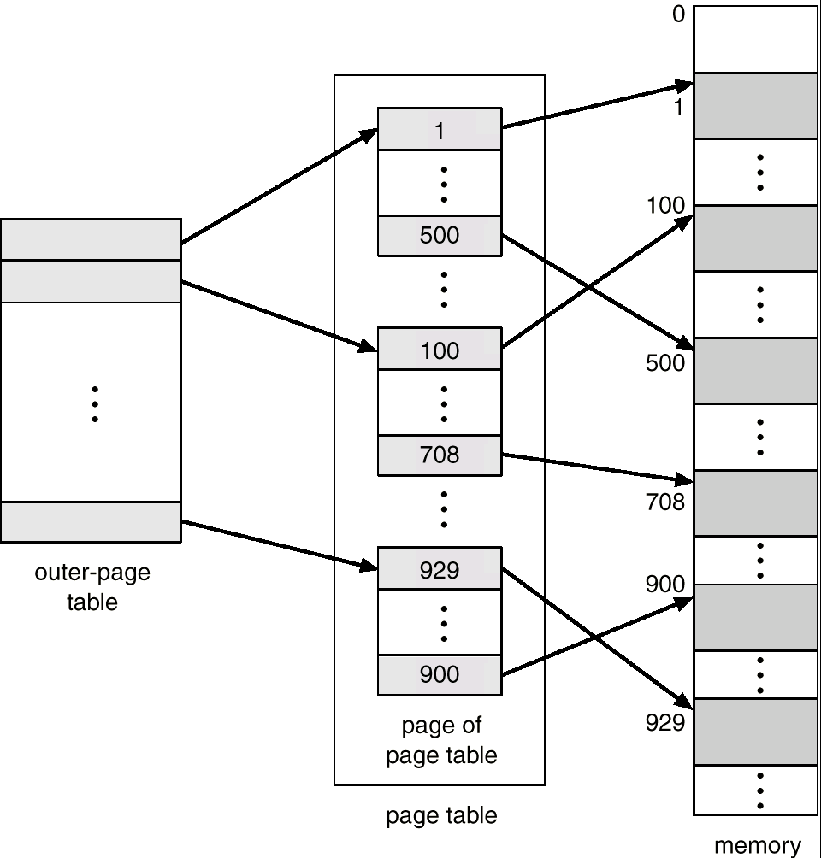
Hierarchical Page Tables
Break up the logical address space into multiple page tables
A simple technique is a two-level page table
Notes:
Assume process P1 has 280 pages
Frame size = 100 bytes
Each entry in the page table = 1 byte
Size of page table = 280 bytes
PROBLEM: can’t fit in a single frame
SOLUTION: divide into multiple page tables
Page table 0: 0 -99
Page table 1: 100 – 199
Page table 3: 200 – 280
Save each page in 3 separate frames in memory
Called inner-level tables of P1
Outer page table: saves where each table is located
Saved in frame in memory
How to find page #180?
180/100 = 1, rem 80 (Divide page # by 100 (side of frame))
Entry at page table 1, number 80
Read entry 80 at page table 1

Slide 10
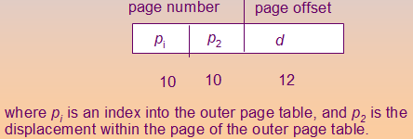
Hierarchical Page Tables
A logical address (on 32-bit machine with 4K page size) is divided into:
a page number consisting of 20 bits
a page offset consisting of 12 bits
Since the page table is paged, the page number is further divided into:
a 10-bit page number
a 10-bit page offset
Thus, a logical address is as follows:
Notes:
Logical address: <page #, offset in the page>
Where page # is broken into p1 and p2
P1 = page table #
P2 = offset within page
Example: write the logical address for offset 10 in page 180?
Logical address: <1, 80, 10>
Internal fragmentation: unused spaces in all allocated pages
Total internal frag.: 20 + 97
20 from page table #2
97 from outer table
Number of frames assigned to P1?
4 + 280
4 for the 3 page tables and one outer table
280 for number of pages
So total is 284
How many bits used for each in logical address?
1. find number of bits for the offset
Frame size + page size = 4K
4 * 2^10 = 2^12 = 12 bits
2. then the remaining divided by 2
P1 = 10 bits
P2 = 10 bits

Slide 11
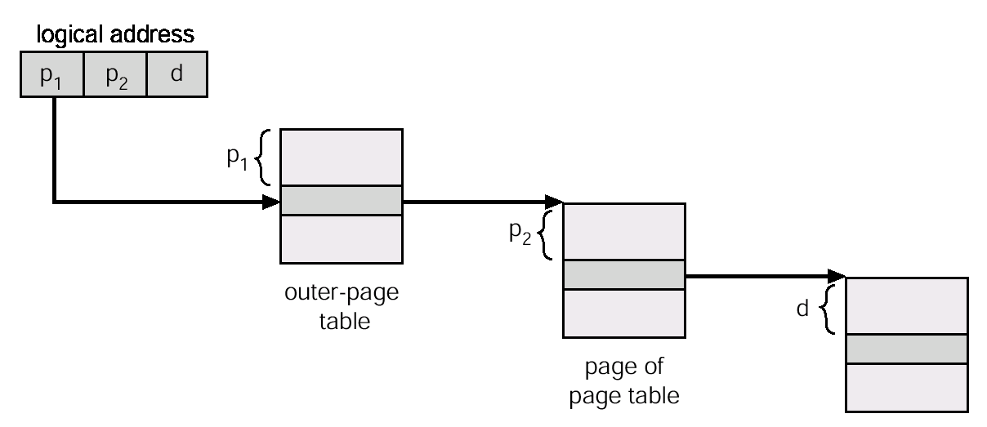
Hierarchical Page Tables

Slide 12
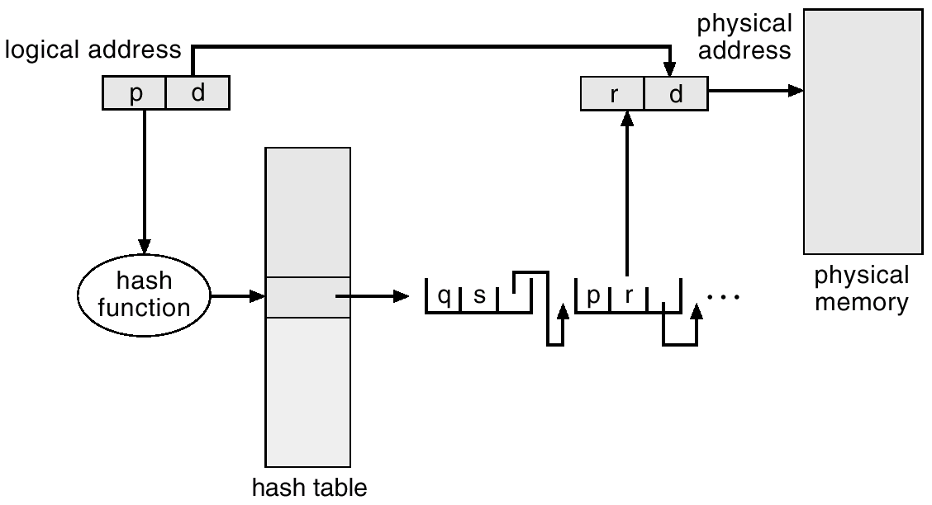
Hashed Page Tables
Used with address spaces > 32 bits and < 64
Hashes logical page number. In case of hash collision, page references are linked structure
Notes:
For every process we have only one page table implemented using the hash.
Example: for the following snapshot of memory, draw the hash table of Pi.
empty
Frame 20 Page 3 of Pi
empty
Frame 60 Page 10 of Pi
Empty
Assume:
Hash(3) = 7
Hash(10) = 7
Page table:
Frame 7 holds both pages

Slide 13
Inverted Page Table
Used with address spaces > 64 bits
Only one (global) page table for all processes
One entry for each frame
Need information about the process that owns that page
Search table to find the frame that logical page refers to
Use hash table to decrease the searching time
Notes:
Index represents frame number instead of page number like old page table
Example:
Memory:
Frame 100: page 0 of p1
Frame 150: page 1 of p2
Frame 170: page 1 of p1
Frame 190: page 0 of p2
Page table: inverted table:
P1: frame 100: PID = 1, Page # = 0
0: 100 (frame where page 0 is saved) frame 150: PID = 2, Page # = 1
1: 170 frame 170: PID = 1, Page # = 1
frame 190: PID = 2, Page # = 0
P2:
0: 190
1: 150

Slide 14
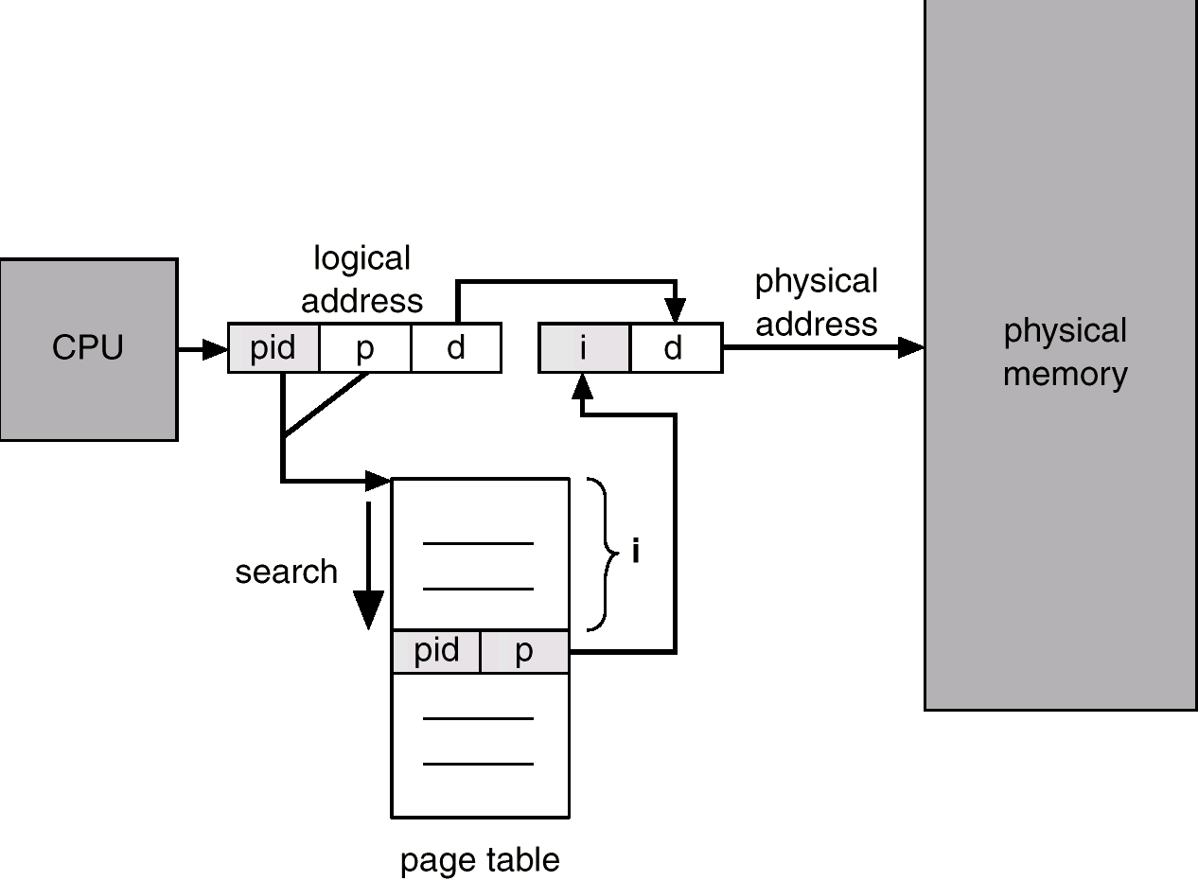
Inverted Page Table

Slide 15
Paging: Memory Access
Problem: every data/instruction access requires two memory accesses
One for the page table and one for the data/instruction
Solution:
fast-lookup hardware cache called associative memory or Translation Look-aside Buffer (TLB)
What happens on context switch (CPU scheduling)?
clear TLB (destroying all info they hold)
Notes:
To access a spot in a given page of process Pi:
CPU generates the logical address of the spot <p, d>
User must access the main memory to read the page table of Pi
Map the logical address to the physical address
Access the main memory using the physical address
Problem: need to use 2 memory accesses
Causes delay, overhead
CPU → cache → main memory
Cache: a small buffer, very fast memory, TLB
TLB:
Once we move Pi from ready state to running state:
Delete all entries in the TLB
Put the entries of the pages that are most frequently used of Pi

Slide 16
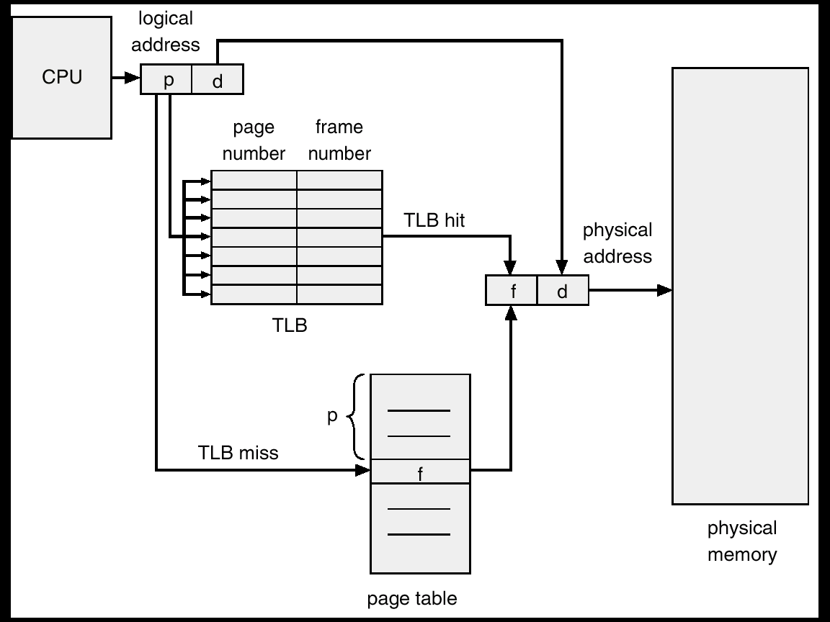
TLB
On page access:
page # is first looked in TLB
if found (cache hit) can immediately access page
if not found (cache miss) have to look up the frame in the page table
Notes:
To access a spot in a given page of process Pi:
CPU generates the logical address of the spot <p, d>
Check if the entry of the page is in the TLB
- if yes: cache hit, no need to go to memory (# of memory access = 1)
- if no: cache miss, access page table in main memory (# of memory access = 2)
Map the logical address to the physical address
Access the main memory using the physical address

Slide 17
Paging: Effective Access Time
Associative TLB Lookup = ε time unit
Assume memory cycle time is 1 microsecond
Hit ratio – percentage of times that a page number is found in the TLB
Hit ratio = α
Effective Access Time (EAT):
EAT = (1 + ε) α + (2 + ε)(1 – α)
= 2 + ε – α
Notes:
- very small value
Miss ratio = 1 – hit ratio

Slide 18
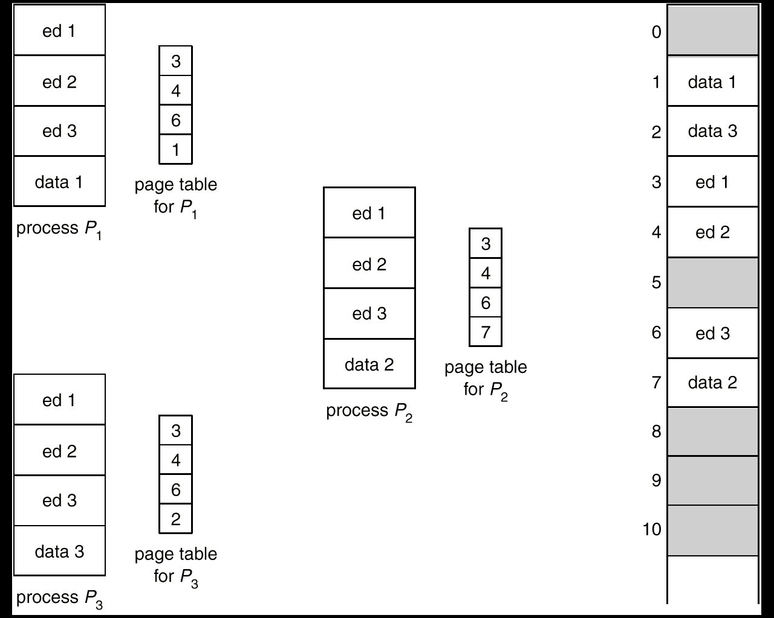
Shared Pages
Paging helps code reusing
One copy of read-only (reentrant) code shared among processes
(i.e., text editors, compilers, window systems)
Shared code must appear in same location in the logical address space of all processes

Slide 19
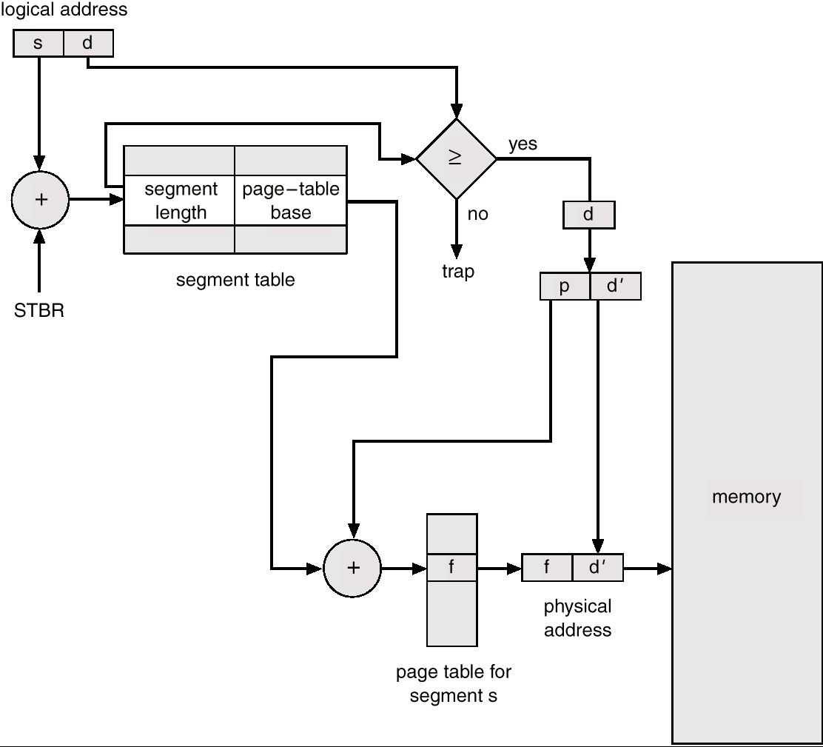
Segmentation with Paging
Problems of external fragmentation and lengthy search times can be solved by paging the segments
Notes:
Difference between segments and pages:
All pages have same size
Segments have different size
Problems:
Pages: internal fragmentation
Segments: external fragmentation
Steps:
Divide the process into segments
Divide each segment into pages
Need both segment table and page table
Logical address of offset d in page x in segment y:
<segment #, page #, offset>
Number of page tables = number of segments (each segment has its own page table)
Don’t need inverted page table, hash page table, or hierarchal page tables because each segment has its own page table

