Slide 1
Project Overview
Objective
Analyse the SCMS Delivery History Dataset
Understand data quality.
Explore numerical and categorical variables.
Identify trends in deliveries.
Find insights about countries, vendors, and shipment values.

Slide 2
Libraries Used
Pandas : Data manipulation
NumPy : Numerical operations
Matplotlib : Visualization
Seaborn : Statistical visualization

Slide 3
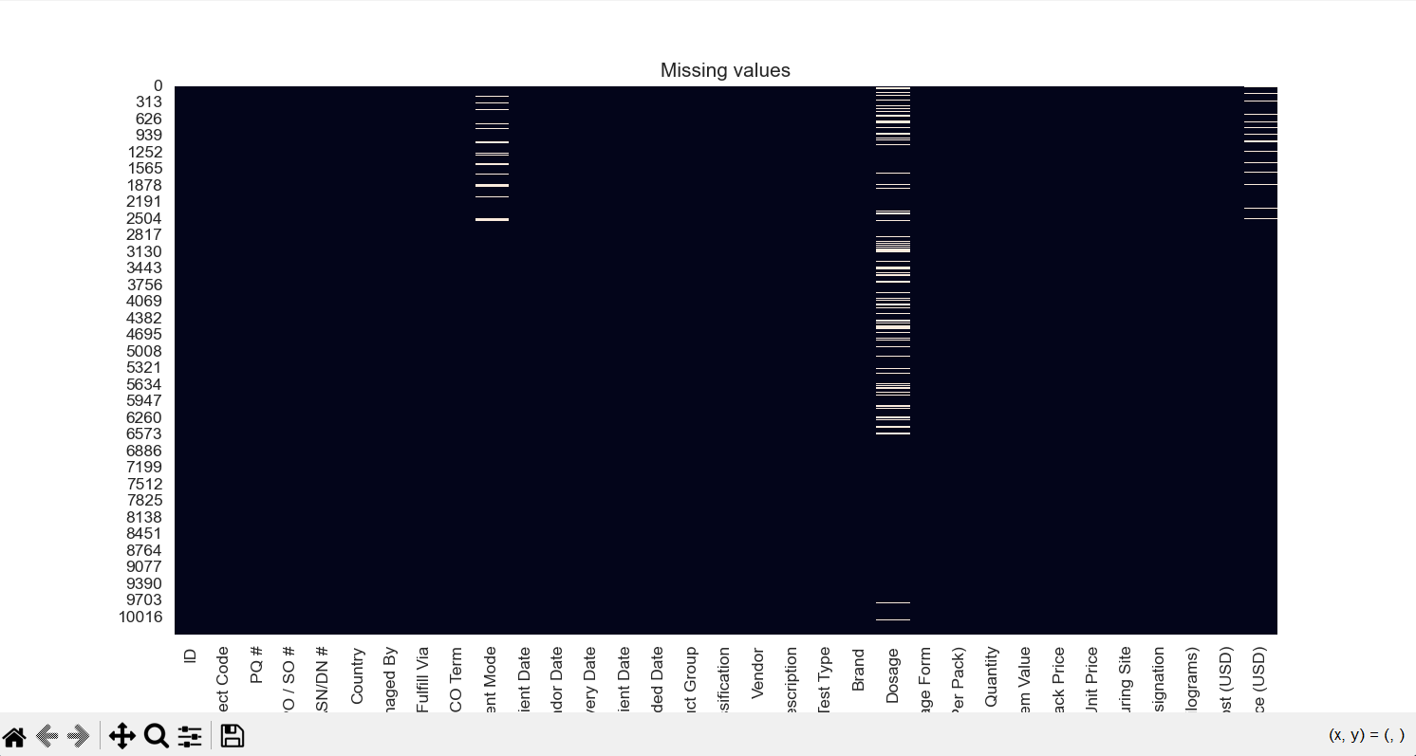
Missing Value Analysis
Observation
Missing values exist mainly in date-related columns.
Most columns are complete.

Slide 4
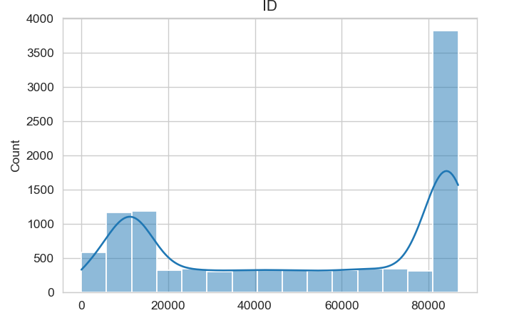
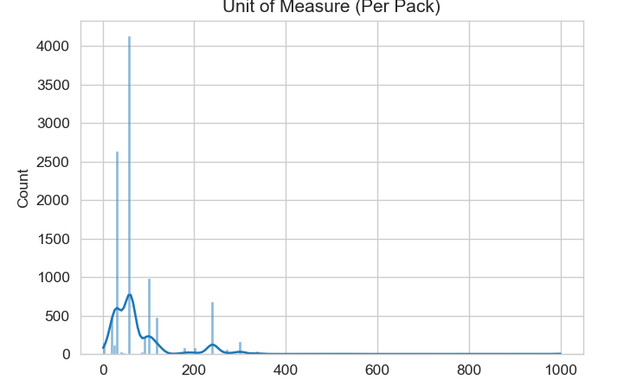
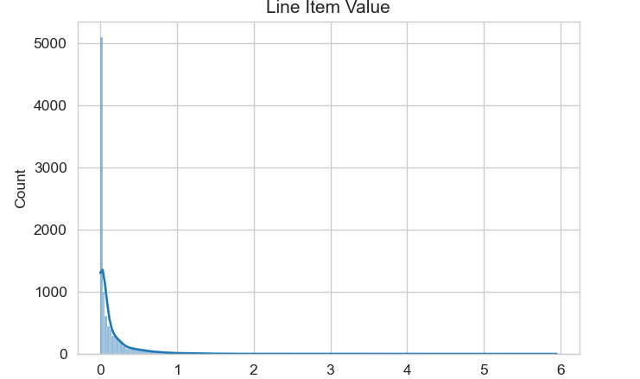
Numerical Data Analysis
Insights
Shipment weight is right-skewed.
Line Item Value has some large transactions.
Freight Cost contains several high-value shipments.

Slide 5
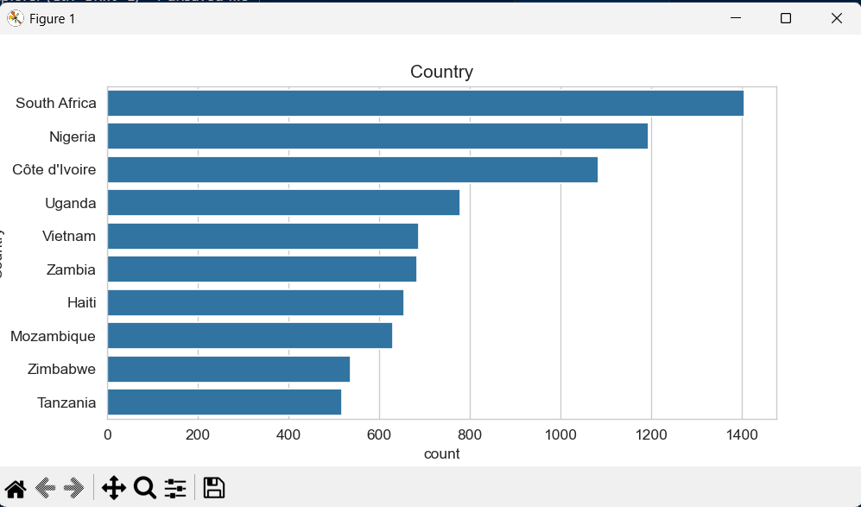
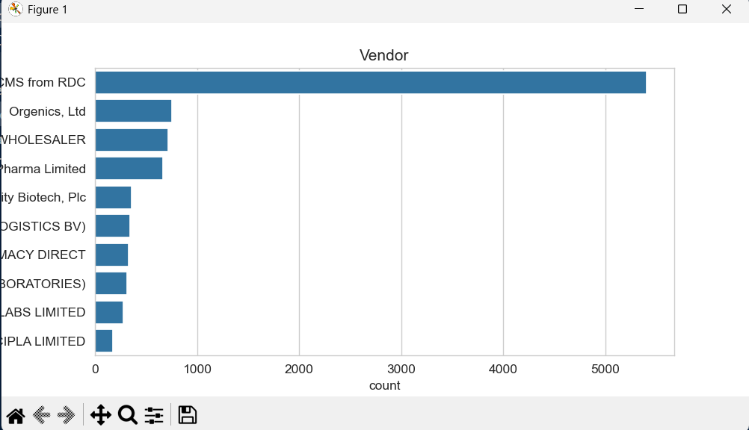
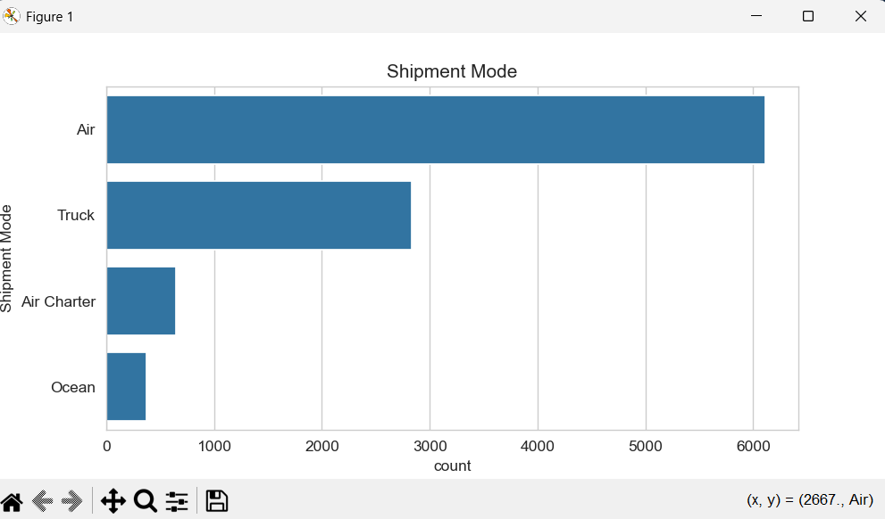
Categorical Data Analysis
Insights
Some countries dominate deliveries.
Few vendors account for most shipments.

Slide 6
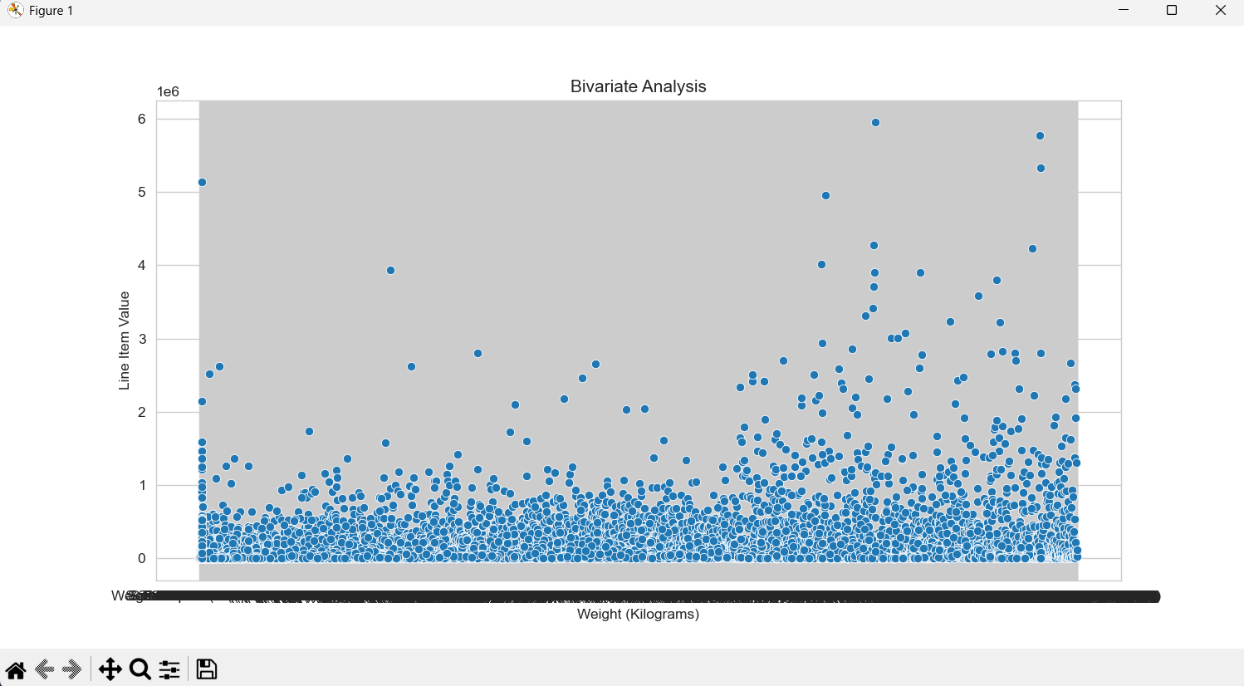
Bivariate Analysis
Observation
Positive relationship between shipment weight and item value.
Some outliers indicate expensive lightweight products.

Slide 7
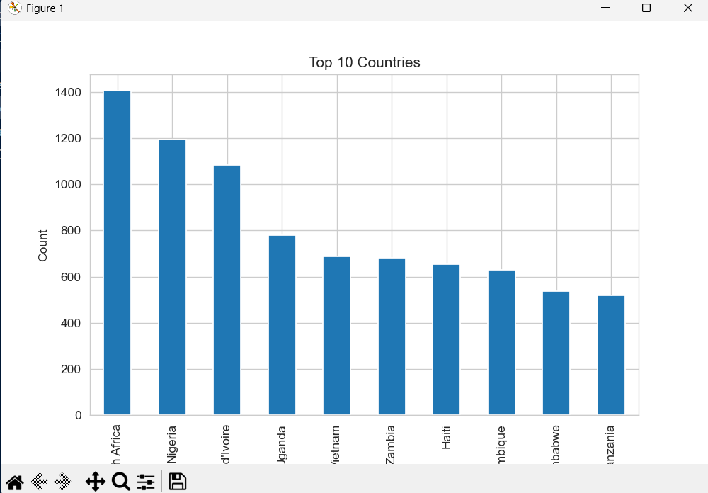
Top 10 Countries
Insights
Highest shipment volume comes from the top 10 countries.
Indicates major operational regions.

Slide 8
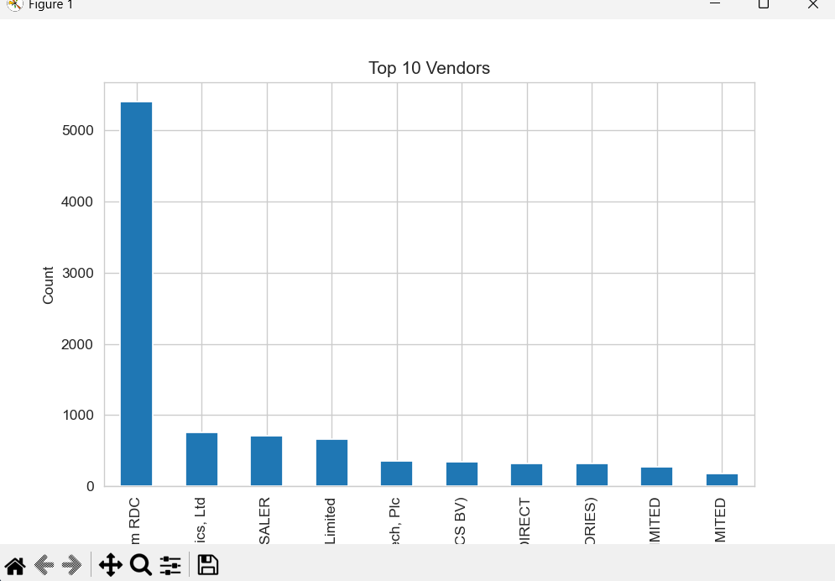
Top 10 Vendors
Insights
Few vendors contribute the majority of deliveries.
Useful for supplier performance analysis.

Slide 9
Future Improvements
Predict Delivery Delays
Develop an Interactive Dashboard
Analyse Delivery Performance
Optimize Vendor Performance
Forecast Shipment Demand
Perform Geographic Analysis

Slide 10
Conclusion
The exploratory data analysis provided valuable insights into shipment patterns, vendor distribution, delivery timelines, and transaction values. The dataset is suitable for further predictive analytics.

Slide 11
Thank You

