Slide 1
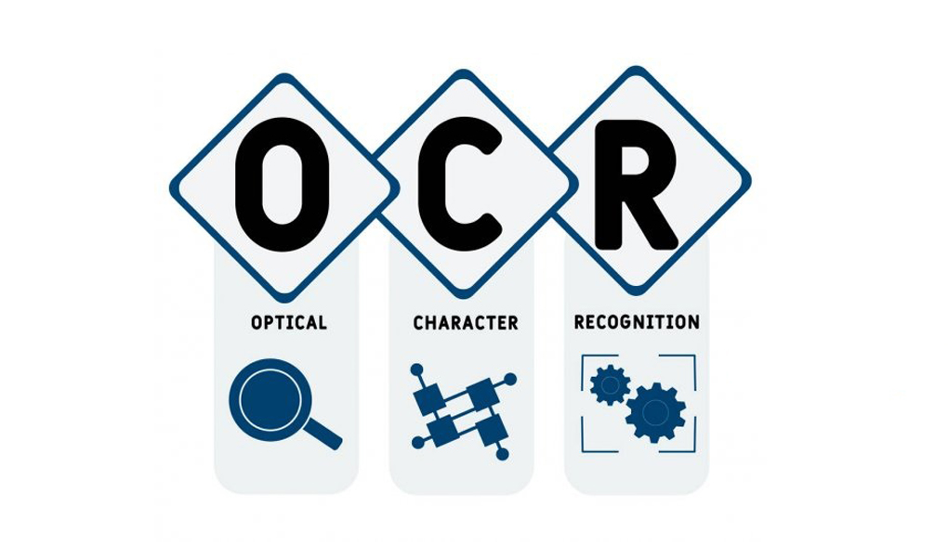
A Handwriting Recognition System with OCR
Name
Department Course Number Section Time Location
DATE
BRISTI HALDER

Slide 2
INTRODUCTION
Name
Department Course Number Section Time Location
DATE
WHAT IS OCR ?
Optical Character Recognition (OCR) is a technology that uses computers to convert images of text into machine-readable text.
Dataset Used:
IAM Handwriting Dataset.
Applications:
in document digitization, license plate recognition, and more.
Notes:
The text can then be processed, stored, or searched digitally.
For ex, OCR is widely used in converting scanned books into eBooks, processing handwritten forms in banks

Slide 3
Problem Statement
Name
Department Course Number Section Time Location
DATE
Handwritten text recognition is a difficult task because people write in different styles, and images often have noise or unclear text or poor lightning conditions.
The goal of this project is to create an OCR system that can accurately read and convert handwritten text into digital format.
Notes:
Recognizing handwritten text is far more complex than printed text because

Slide 4

Dataset Overview
Name
Department Course Number Section Time Location
DATE
Source: IAM Handwriting Dataset.
Data Statistics:
Splitted into 90:5:5 ratio for training, validation and testing
The dataset is a collection of 89000+ handwritten words from over 600 writers, used for training OCR models.
Notes:
RIMES Dataset =Focused on French handwriting
MNIST Dataset= handwritten digits only
CVL Dataset= handwriting in multiple languages but is smaller compared to IAM.
By dedicating 90% to training, the model sees more variations in handwriting patterns.
5% of a large dataset can still represent a significant variety of samples.

Slide 5
Data Preprocessing
Name
Department Course Number Section Time Location
DATE
Steps Taken:
Resized images to fixed dimensions (eg,128x32).
Cleaned labels and created vocabulary.
Converted labels to numeric format using TensorFlow’s StringLookup layer..
Goal:
Prepare images and labels for model training.
Challenges:
Handling noisy data and errors in the dataset.
Notes:
Preprocessing ensures the data is in a format that can be efficiently used by the model.
Images were resized to standardize input sizes.
Labels were cleaned to remove inconsistencies
vocabulary was created to map characters to numeric values

Slide 6
Solutions to the Problems
Name
Department Course Number Section Time Location
DATE
Contrast Enhancement
Improves the visual contrast between characters and the background, making character boundaries clearer for segmentation.
Noise Removal
Reduces unwanted noise such as smudges or background artifacts using filters, enhancing the clarity of the text for accurate analysis.
Binarization
Transforms the image into a binary format, where each pixel is either black or white, simplifying the analysis and character recognition process.
Notes:
One challenge was noisy images—some had smudges or poor lighting. I fixed this by cleaning the data during preprocessing.
Another issue was balancing training and validation loss to avoid overfitting. I used data augmentation (slightly changing images) to make the model handle unseen data better.

Slide 7
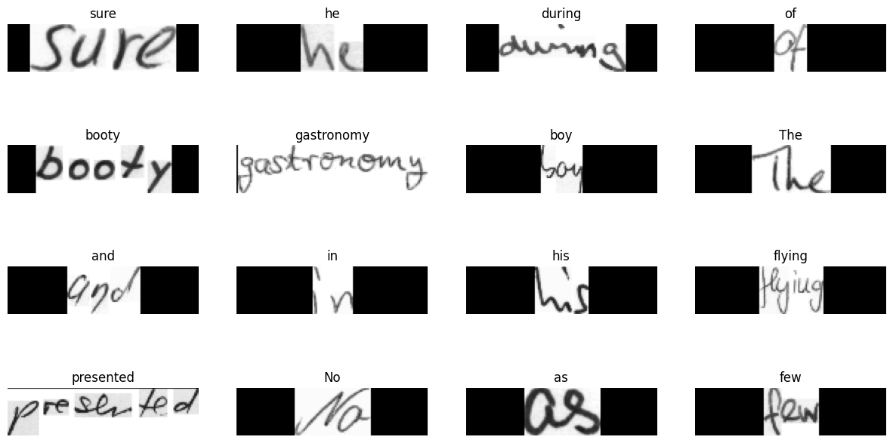
Samples after Resizing without distortion

Slide 8
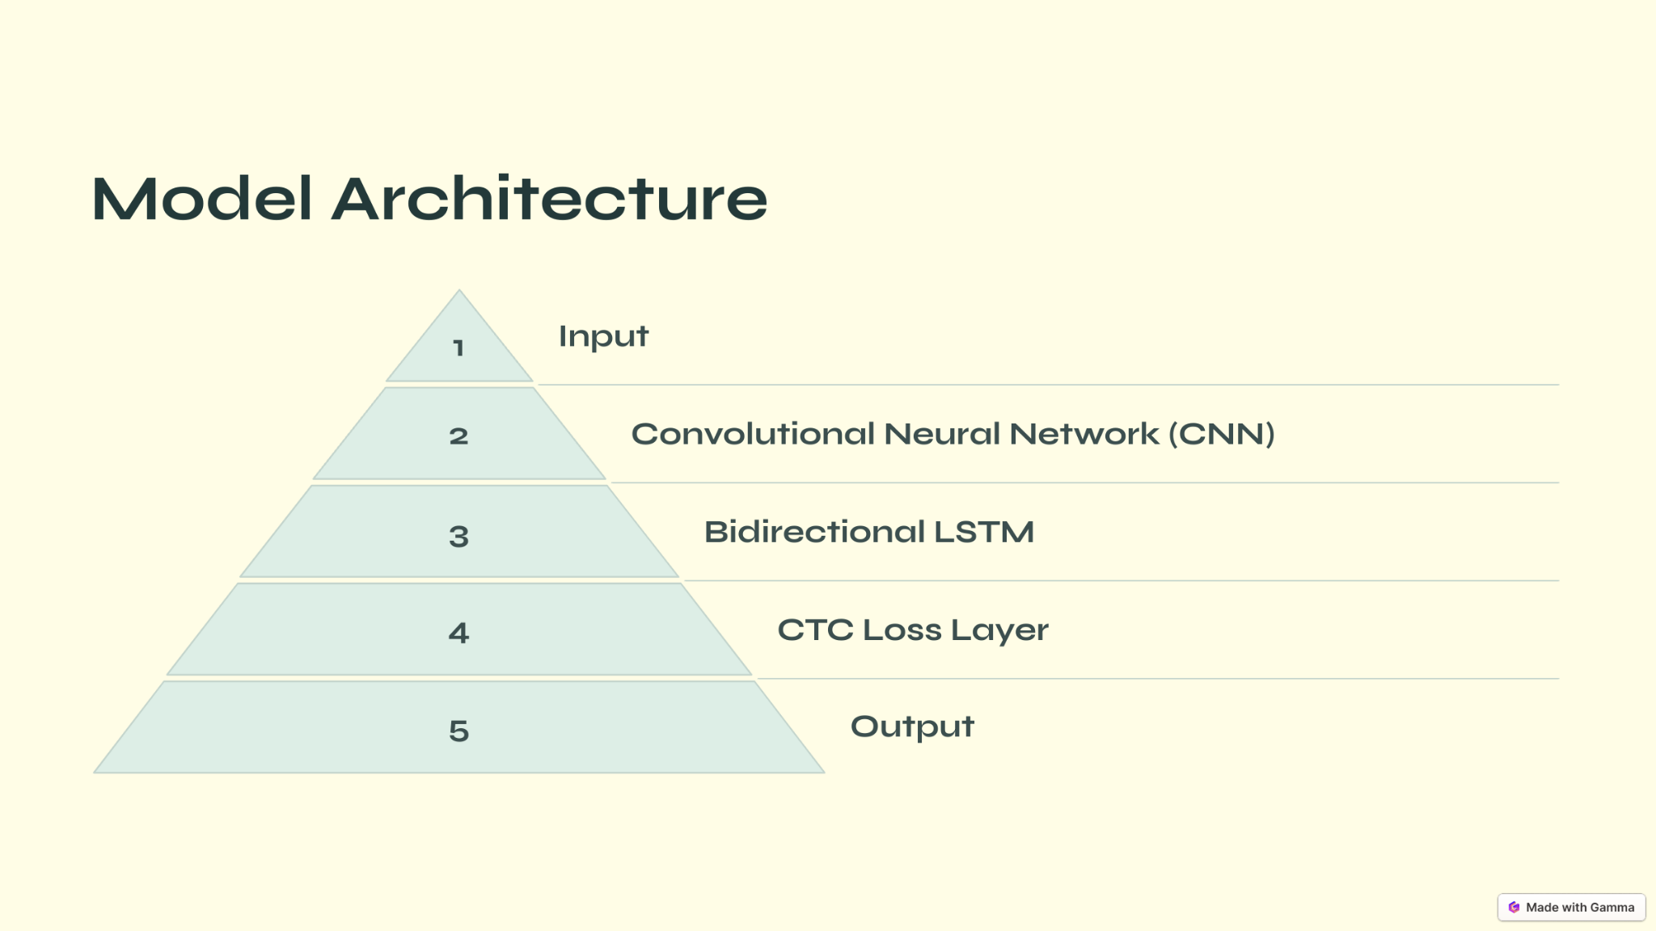
Model Architecture
Name
Department Course Number Section Time Location
DATE
Notes:
The model is based on a deep learning approach, specifically designed for sequential data like text. The architecture combines Convolutional Neural Networks (CNNs) and Recurrent Neural Networks (RNNs) to extract and process features from the input images.
Feature Extraction with CNNs: "The first part of the model uses CNN layers to extract features from the image. These layers detect edges, curves, and patterns that correspond to characters. For example, the model identifies individual strokes in handwriting.
"The next stage involves RNNs, particularly Long Short-Term Memory (LSTM) units, which are used to model the sequential nature of text. Handwritten characters are often connected, and LSTMs help the model understand the temporal relationship between characters.“
CTC Layer for Decoding: "Finally, the Connectionist Temporal Classification (CTC) layer decodes the output sequence without needing exact alignment between input and output.
Why this Architecture?
"This architecture is ideal for handwriting recognition because CNNs efficiently extract features from images, while RNNs and the CTC layer handle the variability and alignment challenges in sequential text recognition.“
Why Do We Use RNNs, LSTMs, and BiLSTMs?
RNNs:
"RNNs are good at handling sequences, like letters in a word, because they remember the previous steps. But they can struggle with long words because they 'forget' the early letters."
LSTMs:
"LSTMs are better because they have a 'memory system' that decides what to keep and what to forget. This makes them great for handling longer words or sentences."
BiLSTMs:
"BiLSTMs go a step further. They read the sequence both forward and backward, which helps when a character’s meaning depends on its neighbors

Slide 9
Training and Evaluation
Name
Department Course Number Section Time Location
DATE
Loss Function:
Connectionist Temporal Classification (CTC) loss.
Training Details:
Batch Size: 64.
Epochs: 10 (use of 50+ epochs would have more time to understand patterns in the data).
Optimizer:
Adam optimizer.
Evaluation Metric:
Edit distance between predicted and actual text.
Notes:
The model was trained using a batch size of 64 over 10 epochs for experimentation. The optimizer used was Adam, which is well-suited for adaptive learning rates. In production, the model would require 50 or more epochs for optimal performance.
CTC loss measures how well the predicted sequences align with the ground truth text. It's particularly effective for tasks where the length of the input and output sequences can vary.
To see how well the model works, we use edit distance. This measures how many changes—like adding, removing, or replacing letters—are needed to turn the model’s output into the correct text. For example, if the predicted word is 'appl' and the actual word is 'apple,' the edit distance is 1 because we need to add an 'e'."
Adam It's great at handling messy data like handwriting and avoids mistakes like learning too much or too little.

Slide 10
Edit Distance
This shows a significant drop in loss func from epoch 1 to epoch 10, indicating that the model is improving and learning from the training data.
Also decrease in val_loss, showing that the model is generalizing well to unseen validation data.
Notes:
Distance : starting high err rate; epoch 10 while the model is still learning, model becomes better at aligning predictions with ground truth
reduction of both training and validation losses without divergence suggests that the model is not overfitting.

Slide 11
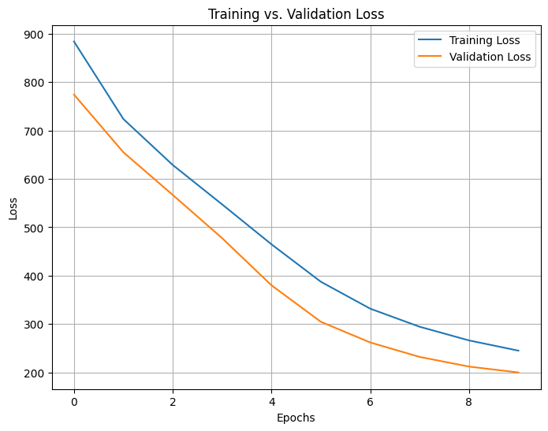
Training Progress - Loss Curve
Name
Department Course Number Section Time Location
DATE
The loss curve shows how much the model is improving during training.
If the loss decreases steadily, the model is learning.
Here, both training loss and validation loss decreased, showing the model understood the training data and worked well on new data too.
The model is effectively minimizing error on the training data.
Notes:
If the validation loss were to increase while training loss decreased, it would suggest overfitting.

Slide 12
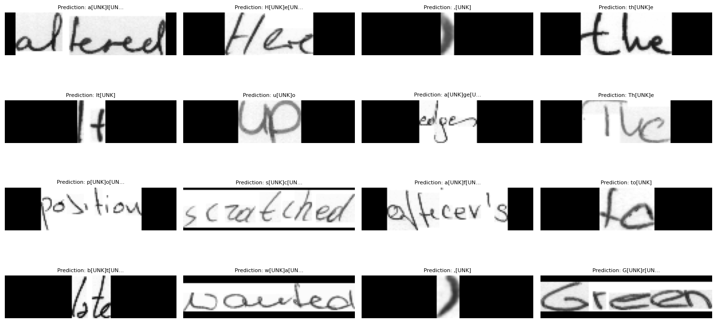
Prediction Results
Notes:
Most predictions match the ground truth.
For images with slight errors, we observe that the model is often able to recognize a significant portion of the text, but small issues like overlapping characters or irregular handwriting can cause discrepancies.

Slide 13
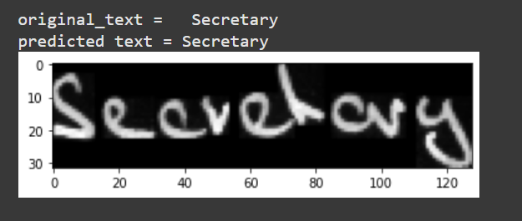
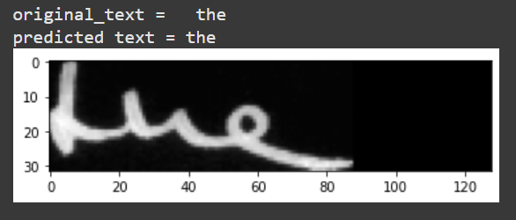
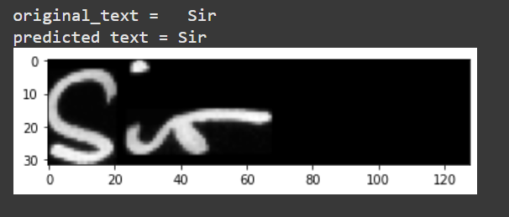
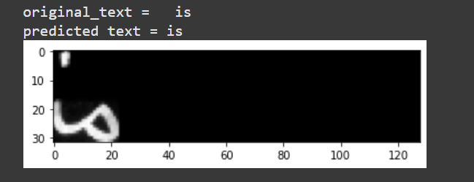
Unseen images
Notes:
The model’s validation loss stayed low, meaning it worked well on data it hadn’t seen before

Slide 14
Conclusion
Name
Department Course Number Section Time Location
DATE
The OCR system successfully recognizes handwritten text from the IAM Handwriting Dataset. Preprocessing steps like cleaning images and enhancing contrast helped improve the results.
Future improvements, like fine-tuning the model or using more training data, handling multi-lingual datasets. could make it even better. This project shows how OCR can help digitize handwritten documents for practical use.

Slide 15
THANK YOU

