Slide 1
Week 1 – Loops
Chapter 4

Slide 2
Objectives
To use while, do-while, and for loop statements to control the repetition of statements (§§4.2-4.4).
To understand the flow of control in loop statements (§§4.2-4.4).
To use Boolean expressions to control loop statements (§§4.2-4.4).
To know the similarities and differences of three types of loops (§4.5).
To write nested loops (§4.6).
To implement program control with break and continue (§4.7).

Slide 3
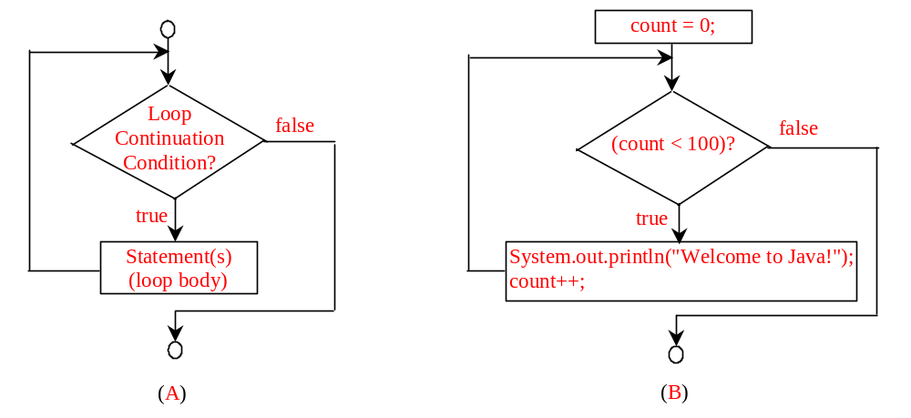
while Loop Flow Chart
while (loop-continuation-condition){
// loop-body;
Statement(s);
}
int count = 0;
while (count < 100) {
System.out.println(
"Welcome to Java!");
count++;
}

Slide 4
Trace while Loop
Initialize count
int count = 0;
while (count < 2) {
System.out.println("Welcome to Java!");
count++;
}

Slide 5
Trace while Loop, cont.
(count < 2) is true
int count = 0;
while (count < 2) {
System.out.println("Welcome to Java!");
count++;
}

Slide 6
Trace while Loop, cont.
Print Welcome to Java
int count = 0;
while (count < 2) {
System.out.println("Welcome to Java!");
count++;
}

Slide 7
Trace while Loop, cont.
Increase count by 1
count is 1 now
int count = 0;
while (count < 2) {
System.out.println("Welcome to Java!");
count++;
}

Slide 8
Trace while Loop, cont.
(count < 2) is still true since count is 1
int count = 0;
while (count < 2) {
System.out.println("Welcome to Java!");
count++;
}

Slide 9
Trace while Loop, cont.
Print Welcome to Java
int count = 0;
while (count < 2) {
System.out.println("Welcome to Java!");
count++;
}

Slide 10
Trace while Loop, cont.
Increase count by 1
count is 2 now
int count = 0;
while (count < 2) {
System.out.println("Welcome to Java!");
count++;
}

Slide 11
Trace while Loop, cont.
(count < 2) is false since count is 2 now
int count = 0;
while (count < 2) {
System.out.println("Welcome to Java!");
count++;
}

Slide 12
Trace while Loop
The loop exits. Execute the next statement after the loop.
int count = 0;
while (count < 2) {
System.out.println("Welcome to Java!");
count++;
}

Slide 13

Example: An Advanced Math Learning Tool
The Math subtraction learning tool program generates just one question for each run. You can use a loop to generate questions repeatedly. This example gives a program that generates ten questions and reports the number of the correct answers after a student answers all ten questions.
SubtractionTutorLoop

Slide 14
Ending a Loop with a Sentinel Value
Often the number of times a loop is executed is not predetermined. You may use an input value to signify the end of the loop. Such a value is known as a sentinel value.
Write a program that reads and calculates the sum of an unspecified number of integers. The input 0 signifies the end of the input.
SentinelValue

Slide 15
Caution
Don’t use floating-point values for equality checking in a loop control. Since floating-point values are approximations, using them could result in imprecise counter values and inaccurate results. This example might print out “data is not zero”.
(data != 0) may be true even though data is 0.
// data should be zero
double data = Math.pow(Math.sqrt(2), 2) - 2;
if (data == 0)
System.out.println("data is zero");
else
System.out.println("data is not zero");

Slide 16
Note – Compare Strings
System.out.println(“Do you want to continue? (Y/N)”);
String answer = scanner.nextLine();
if (“N”.equals(answer)) {
System.out.println(“Goodbye!”);
}

Slide 17
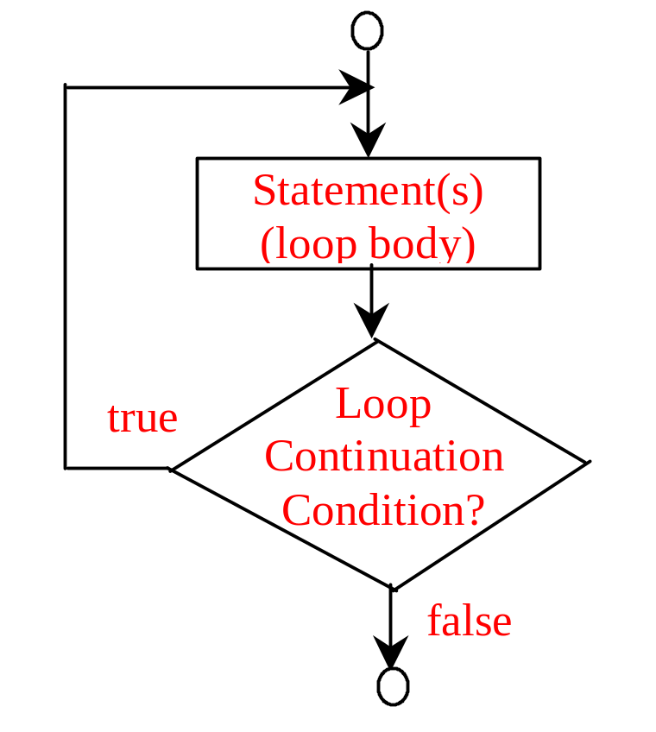
do-while Loop
do {
// Loop body;
Statement(s);
} while (loop-continuation-condition);

Slide 18
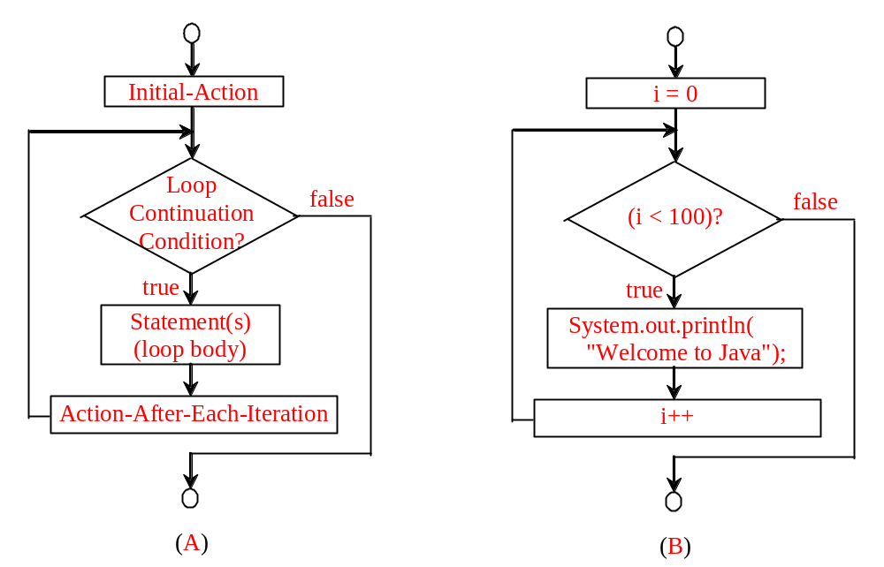
for Loops
for (initial-action; loop-continuation-condition; action-after-each-iteration) {
// loop body;
Statement(s);
}
int i;
for (i = 0; i < 100; i++) {
System.out.println(
"Welcome to Java!");
}

Slide 19
Trace for Loop
Declare i
int i;
for (i = 0; i < 2; i++) {
System.out.println("Welcome to Java!");
}

Slide 20
Trace for Loop, cont.
Execute initializer
i is now 0
int i;
for (i = 0; i < 2; i++) {
System.out.println("Welcome to Java!");
}

Slide 21
Trace for Loop, cont.
(i < 2) is true
since i is 0
int i;
for (i = 0; i < 2; i++) {
System.out.println("Welcome to Java!");
}

Slide 22
Trace for Loop, cont.
Print Welcome to Java
int i;
for (i = 0; i < 2; i++) {
System.out.println("Welcome to Java!");
}

Slide 23
Trace for Loop, cont.
Execute adjustment statement
i now is 1
int i;
for (i = 0; i < 2; i++) {
System.out.println("Welcome to Java!");
}

Slide 24
Trace for Loop, cont.
(i < 2) is still true
since i is 1
int i;
for (i = 0; i < 2; i++) {
System.out.println("Welcome to Java!");
}

Slide 25
Trace for Loop, cont.
Print Welcome to Java
int i;
for (i = 0; i < 2; i++) {
System.out.println("Welcome to Java!");
}

Slide 26
Trace for Loop, cont.
Execute adjustment statement
i now is 2
int i;
for (i = 0; i < 2; i++) {
System.out.println("Welcome to Java!");
}

Slide 27
Trace for Loop, cont.
(i < 2) is false
since i is 2
int i;
for (i = 0; i < 2; i++) {
System.out.println("Welcome to Java!");
}

Slide 28
Trace for Loop, cont.
Exit the loop. Execute the next statement after the loop
int i;
for (i = 0; i < 2; i++) {
System.out.println("Welcome to Java!");
}

Slide 29
Note
The initial-action in a for loop can be a list of zero or more comma-separated expressions. The action-after-each-iteration in a for loop can be a list of zero or more comma-separated statements. Therefore, the following two for loops are correct. They are rarely used in practice, however.
  for (int i = 1; i < 100; System.out.println(i++));
  for (int i = 0, j = 0; (i + j < 10); i++, j++) {
  // Do something
  }

Slide 30

Note
If the loop-continuation-condition in a for loop is omitted, it is implicitly true. Thus the statement given below in (a), which is an infinite loop, is correct. Nevertheless, it is better to use the equivalent loop in (b) to avoid confusion:

Slide 31
Example: Using for Loops
Problem: Write a program that sums a series that starts with 0.01 and ends with 1.0. The numbers in the series will increment by 0.01, as follows: 0.01 + 0.02 + 0.03 and so on.
TestSum

Slide 32
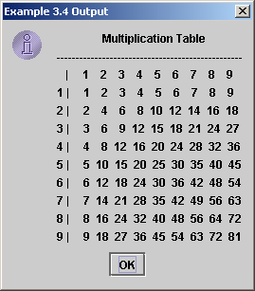
Nested Loops
Problem: Write a program that uses nested for loops to print a multiplication table.
TestMultiplicationTable

Slide 33


Which Loop to Use?
The three forms of loop statements, while, do-while, and for, are expressively equivalent; that is, you can write a loop in any of these three forms. For example, a while loop in (a) in the following figure can always be converted into the following for loop in (b):
A for loop in (a) in the following figure can generally be converted into the following while loop in (b)

Slide 34
Recommendations
Use the one that is most intuitive and comfortable for you.
In general, a for loop may be used if the number of repetitions is known, as, for example, when you need to print a message 100 times.
A while loop may be used if the number of repetitions is not known, as in the case of reading the numbers until the input is 0. A do-while loop can be used to replace a while loop if the loop body has to be executed before testing the continuation condition.

Slide 35
Caution
Adding a semicolon at the end of the for clause before the loop body is a common mistake, as shown below:
Syntax Error
for (int i=0; i<10; i++);
{
System.out.println("i is " + i);
}

Slide 36
Caution, cont.
Syntax Error
Similarly, the following loop is also wrong:
int i=0;
while (i < 10);
{
System.out.println("i is " + i);
i++;
}
In the case of the do loop, the following semicolon is needed to end the loop.
int i=0;
do {
System.out.println("i is " + i);
i++;
} while (i<10);
Correct

Slide 37
Exercise:
Finding the Greatest Common Divisor
Problem: Write a program that prompts the user to enter two positive integers and finds their greatest common divisor.
Solution: Suppose you enter two integers 4 and 2, their greatest common divisor is 2. Suppose you enter two integers 16 and 24, their greatest common divisor is 8. So, how do you find the greatest common divisor? Let the two input integers be n1 and n2. You know number 1 is a common divisor, but it may not be the greatest commons divisor. So you can check whether k (for k = 2, 3, 4, and so on) is a common divisor for n1 and n2, until k is greater than n1 or n2.
GreatestCommonDivisor
Run

Slide 38
Exercise: Finding the Sales Amount
Problem: You have just started a sales job in a department store. Your pay consists of a base salary and a commission. The base salary is $5,000. The scheme shown below is used to determine the commission rate.
      Sales Amount Commission Rate
      $0.01–$5,000 8 percent
      $5,000.01–$10,000 10 percent
      $10,000.01 and above 12 percent
Your goal is to earn $30,000 in a year. Write a program that will find out the minimum amount of sales you have to generate in order to make $30,000.
FindSalesAmount
Run

Slide 39
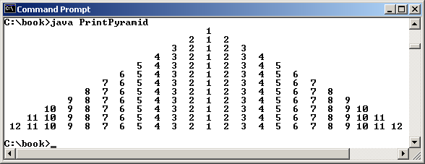
Exercise:
Displaying a Pyramid of Numbers
Problem: Write a program that prompts the user to enter an integer from 1 to 15 and displays a pyramid. For example, if the input integer is 12, the output is shown below.
PrintPyramid
Run

Slide 40
Using break and continue
Examples for using the break and continue keywords:
TestBreak.java
TestBreak
TestContinue.java
TestContinue

Slide 41
TestBreak.java
public class TestBreak {
/** Main method */
public static void main(String[] args) {
int sum = 0;
int number = 0;
while (number < 20) {
number++;
sum += number;
if (sum >= 100)
break;
}
System.out.println("The number is " + number);
System.out.println("The sum is " + sum);
}
}

Slide 42
TestContinue.java
public class TestContinue {
/** Main method */
public static void main(String[] args) {
int sum = 0;
int number = 0;
while (number < 20) {
number++;
if (number == 10 || number == 11)
continue;
sum += number;
}
System.out.println("The sum is " + sum);
}
}

Slide 43
Exercise: Displaying Prime Numbers
Problem: Write a program that displays the first 50 prime numbers in five lines, each of which contains 10 numbers. An integer greater than 1 is prime if its only positive divisor is 1 or itself. For example, 2, 3, 5, and 7 are prime numbers, but 4, 6, 8, and 9 are not.
Solution: The problem can be broken into the following tasks:
  For number = 2, 3, 4, 5, 6, ..., test whether the number is prime.
  Determine whether a given number is prime.
  Count the prime numbers.
  Print each prime number, and print 10 numbers per line.
PrimeNumber
Run

