Slide 1
ProjectF3
Team 27
Brain Tumor Classification
using Convolutional Neural Networks
Britanya Wright Arun Gaonkar Sai Harsha Nadendla
Notes:
Hi, We are team 27 and for this project we are working on the topic Brain Tumor Detection using convolutional neural networks. My name is
Harsha and working with me on this topic are Arun and Britanya.

Slide 2
Motivation / Problem
Affects over 700,000 people within the United States.
Caution and care has to be taken in the accuracy of the diagnosis, treatment, and planning to increase the life expectancy of that patient.
Radiologists and clinical experts are tasked with detection and identification.
To reduce the introduction of human error we use Machine Learning for automatic classification.
Notes:
Our motivation for picking this topic is because brain tumor is one of the most hostile diseases in the world with over 700,000 cases in
the United States alone. The diagnosis has to be accurate to prevent any fatal error in treatments and increase the life expectancy of the
patient. Generally the MRI scans are evaluated by human doctors like radiologists or neurosurgeons for detection and this could lead to a
few problems like the presence of a shadow which makes the tumor identification complex or the time it takes to identify the tumor
correctly. So, to reduce these human errors, machine learning can be used for automatic classification.

Slide 3
Task
Implement CNN model with the ability to detect brain tumors in Images.
Baseline : CNN model used in paper[1] with 84% validation accuracy.
Proposed:
CNN to get better accuracy.
Faster R-CNN for Image segmentation to identify the location of the tumor.
[1] Abiwinanda N., Hanif M., Hesaputra S.T., Handayani A., Mengko T.R. (2019), Brain Tumor Classification Using Convolutional Neural Network
Notes:
For this project we have a baseline model that uses CNN with a validation accuracy of 84%. In our implementation we plan to use a better,
optimal CNN model with the ability to detect the kind of tumor in the image and we plan to further implement Faster RCNN on top of it
to identify the location of the tumor using image segmentation.

Slide 4
Dataset
3,565 raw MRI images found in Kaggle*.
Each Image is of different sizes.
Varying tumor location with size and different types.
3 different tumor types : Glioma, Meningioma, and pituitary; + 1 for No tumor.
Resized image shape 3 x 300 x 300
* source : https://www.kaggle.com/sartajbhuvaji/brain-tumor-classification-mri
Notes:
We got our dataset from kaggle and this dataset contains 3565 raw images with tumors in different locations of the brain. The dataset
is broadly classified into 4 categories - Glioma, Meningioma, Pituitary and no tumor. Each image is of varying sizes and we reshaped it
into 3 channels with dimension 150 x 150.

Slide 5
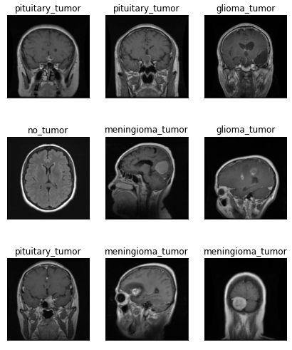
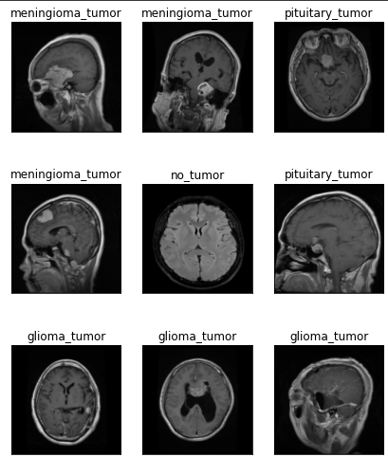
Sample Images
Notes:
Now we look at some of the sample images randomly chosen from the dataset. As you can see the images are labelled as the 4 categories
mentioned before. - G,M,P,NT.

Slide 6
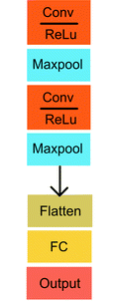
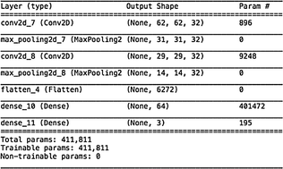
Baseline Model (CNN): Parameters
Notes:
We chose to use a paper for our baseline model [6]. This paper experiments with five different variations of CNN architectures to conclusively find a high-performing model for brain tumor classification. Throughout the paper, they experiment with hyperparameter manipulation to affect the validation and training accuracy and loss. Across all their models, they chose to consistently use the adam optimizer.
The model we chose to use as our base model was their best-performing CNN architecture. The CNN architecture is as followed:
This model is split into many layers. Their first layer is a convolution layer with ReLu activation followed by a max-pooling layer. This order is repeated two times before then being flattened. This is followed by two fully connected layers.

Slide 7
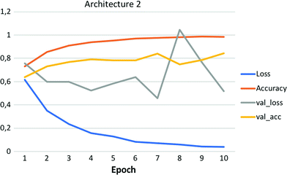
Baseline Model (CNN): Performance
Overall Performance:
Validation accuracy: 84.19%
Training Accuracy: 98.51%
Notes:
The implementation of the architecture produces four parameters that determine the success of the model. Success is defined as a model able to accurately classify the input image by matching its label to the image. The four parameters are the loss and accuracy of the training and validation set. Accuracy is the percent of current guesses. Loss is the error for inaccurate predictions.
This model resulted in an 84.2% validation accuracy and a 98.51% training accuracy. The validation and training loss showed a decreasing trend with respect to the number of epochs as they increased. This model had medium performance due to the validation loss not showing a perfect decrease pattern.

Slide 8
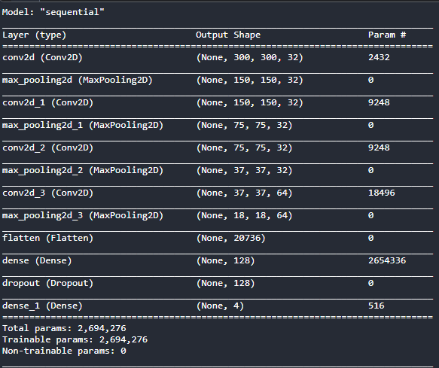
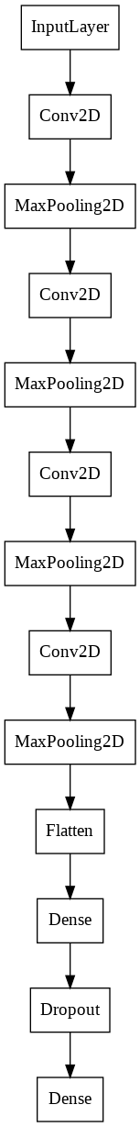
Proposed CNN Model: Parameters
Notes:
Similar to the baseline model, we chose to use the adam optimizer in the learning process because of its ability to handle sparse gradients on noisy problems. We chose to include 4 convolution layers. In addition, we added a dropout layer with a rate of 0.5 sandwiched between 2 dense layers. The CNN architecture flow chart can be seen on the right.

Slide 9
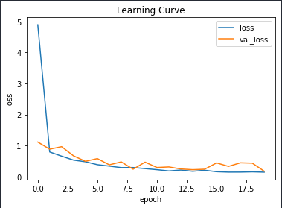
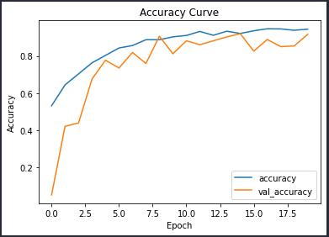
Proposed CNN Model: Performance
Overall Performance:
Validation accuracy: 91.68%
Training Accuracy: 94.39%
Notes:
From the plot, what we can see is that,
The training loss and validation loss is decreasing continuously as the epochs are increasing.
The final loss for validation is around 0.38 and
for training it is 0.13.
From the accuracy curve, we can see that
Training accuracy and validation accuracy is increasing for
Every epoch of training. So our model is a ‘Good fit’ for the data.
The overall validation accuracy is 91.68% and
the training accuracy is 94.39%.

Slide 10
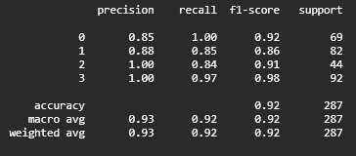
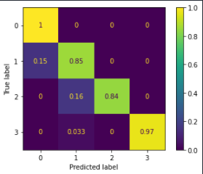
Proposed CNN Model: Performance
Class Encoding and Accuracy:
0 - Glioma - 100%
1 - Meningioma - 85%
2 - No-Tumor - 84%
3- Pituitary - 97%
Notes:
Here we have the confusion matrix and the classification report.
Accuracy of glioma class is 100% and
For others it is slightly lower.
Meningioma is identified with the accuracy of 85%
And pituitary with 97%.
For no tumor, it is 84%.

Slide 11
Conclusion
Comparison | Baseline CNN | Proposed CNN
Input image size | 62 x 62 | 150 x 150
Output Classes | 3 | 4
No. of Convolutional layers | 2 | 4
Dropout Layers | 0 | 1
Final Training Accuracy | 98.51 % | 94.39 %
Final Training Loss | 0.03 | 0.13
Validation Accuracy | 84.19 % | 91.68 %
Validation Loss | 0.55 | 0. 38
Notes:
Here we have the comparison between two models.
One key difference is that of the image resolution and also output classes. In the baseline model, no tumor is not predicted. We included that in our model, and hence we have four classes.
We have 2 additional convolutional layers, with different filter size than the baseline model.
We also have a dropout layer, we added this to reduce the overfitting.
After training the model, we saw some more differences.
Baseline model is better when compared with training loss and accuracy.
But the proposed model is better for the testing the model.
Comparing these two CNN models,
We can say the proposed CNN model is better than the CNN model.
We have proposed to implement image segmentation using faster RCNN.
But due to dataset constraints that,
that did not have labelled annotations and bounding boxes, which is necessary for faster rcnn.
So we were not able to complete the mask rcnn and image segmentation of brain tumors.

Slide 12
Thank you...

