Slide 1

Game Apps Install Project
Mobile Apps Installs on Google Platform

Slide 2


OVERVIEW
Project Objective
The aim of this project is to analyze patterns in gaming data revolving around the pricing of gaming apps in the Google Play store
We will review different factors within the data to determine the validity of our hypothesis
We will also take another look at the data with a supplemental comparison of the same game data in the Apple app store.

Slide 3

MAIN HYPOTHESIS AND OTHER QUESTIONS
Is there a correlation between game price and rating?
Is there a correlation between installs and game price?
Compare reviews within each category - are there any categories with higher reviews than others?
Is there a correlation between the price of the app and the last update?
Grouping by content rating - what are the differences in number of installs per rating group?
Join google and apple store data and compare ratings, price and number of reviews? Are apps more likely to be “successful” on google vs apple? Or vice versa?

Slide 4


DATA SOURCES
CSV Data Sets were sources from kaggle.com which is an open source site to gather data resources
Main Data Set
https://www.kaggle.com/gauthamp10/google-playstore-apps
Supplemental Data Set
https://www.kaggle.com/tristan581/17k-apple-app-store-strategy-games

Slide 5

PROBLEM
CLEANING THE DATA
We wanted to only use the Game Category in the Google Play Store data set which was a field with Category_Sub Category.
We also had some anomalous data within our data set of overly high app price as well as very large install numbers.
When reviewing last updated the date was formatted in a way we could not use directly.

Slide 6

SOLUTION
To extract the Category of GAME from our data set we created a new dataframe with only the Categories we were interested in.
To address the anomalous data we identified the outliers and then removed them for charting purposes.
We had to extract day, month and year into separate columns so we could plot the data.

Slide 7

PRICE VS RATING
Is there a correlation between game price and rating?
Identified outlier data and removed from set

Slide 8
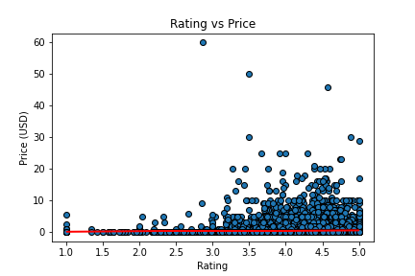
PRICE VS RATING
Through linear regression we could see a relation between price and rating indicated

Slide 9
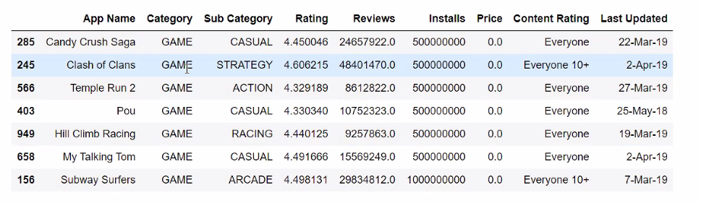
PRICE VS INSTALLS
Is there a correlation between game price and installs?
Identified outlier data and removed from set

Slide 10
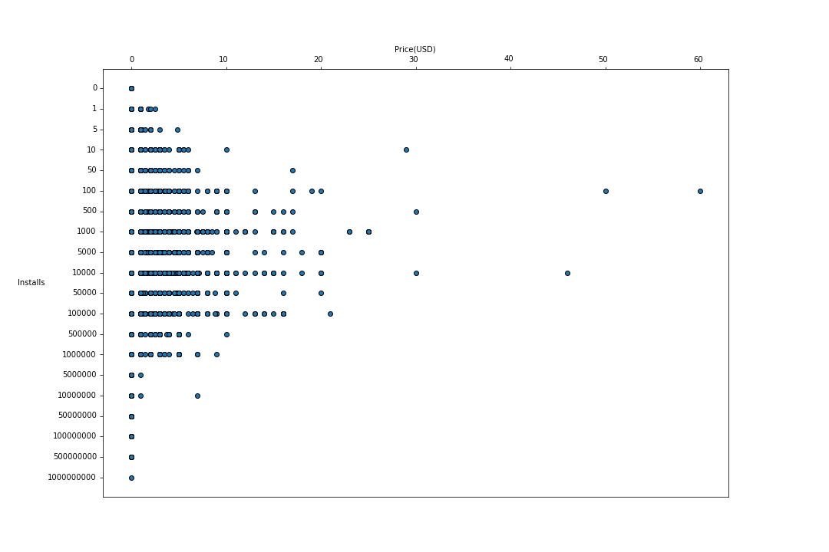
PRICE VS INSTALLS
Density from 0 to 10 indicates a correlation between app price and number of installs

Slide 11
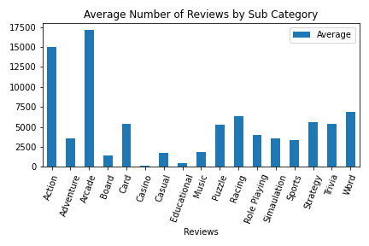
AVERAGE REVIEWS BY SUB CATEGORY
Are there Sub Categories with higher reviews than the others?
Arcade and Action show the highest number of reviews and Casino and Educational show the lowest number of reviews

Slide 12
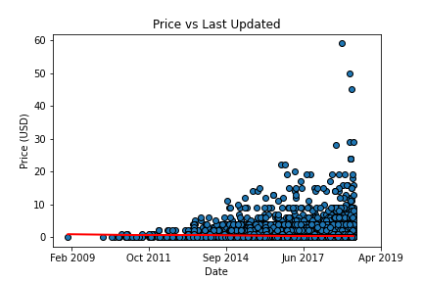
PRICE VS LAST UPDATED
Is there a correlation between game price and when it was last updated?
We wanted to see if the price of the app effected when it was last updated. Based on our dataset we are not seeing a strong correlation between the two.

Slide 13
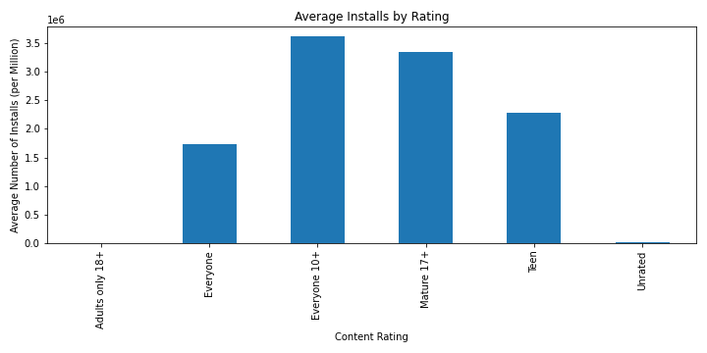
AVERAGE INSTALLS BY CONTENT RATING
Are there differences in the number of installs by Content Rating?
10+ and 17+ show the highest average number of installs and unrated and Only 18+ show the lowest average number of installs

Slide 14
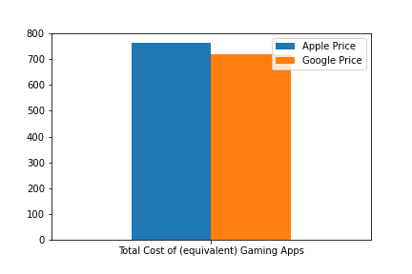
Google vs Apple Total Price
This graph is displaying the total price of the similar gaming apps between Apple and Google data

Slide 15
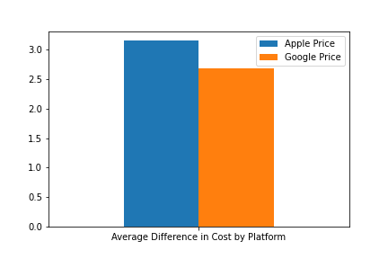
AVERAGE DIFFERENCE IN COST BY PLATFORM
On average a customer will pay $.47 more for a gaming app in the Apple store than Google Play Store

Slide 16
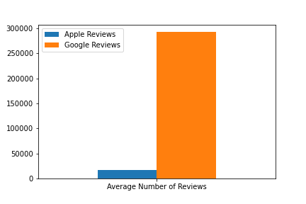
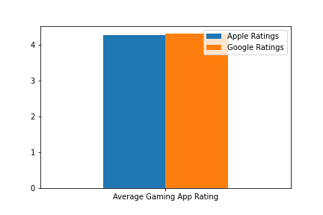
AVERAGE NUMBER OF REVIEWS VS AVERAGE RATING
On average a gaming app in the Google Play Store will have 275,554 more reviews than a gaming app in the Apple Store

Slide 17
OUR FINDINGS
Is there a correlation between game price and rating?
We determined there was a correlation between game price and rating
Is there a correlation between installs and game price?
Yes, we found the majority of installs were free games
Compare reviews within each category - are there any categories with higher reviews than others?
We identified categories with the highest and lowest number of reviews
Is there a correlation between the price of the app and the last update?
We found there was no correlation within our dataset to support this inquiry
Grouping by content rating - what are the differences in number of installs per rating group?
We identified content ratings with the highest and lowest number of average installs
Join google and apple store data and compare ratings, price and number of reviews? Are apps more likely to be “successful” on google vs apple? Or vice versa?
We found games on Apple to be $.47 higher than Google, Google had more reviews than Apple, Average reviews were similar between platforms
We were trying to see if free games had more installs than paid games. We proved that with our data reflecting the majority of games were at $0 price.

Slide 18

UNANSWERED QUESTIONS
What would we do if we had more time on this project?
We would locate a dataset containing the in-app purchases data to determine the true revenue of free apps.
We would like to compare the number of installs per category.
If we could locate a dataset with geographic information we would like to review that information.

Slide 19





OUR TEAM SLIDE
Group #2 – Meet the Team
Allen Broce
Brittany Chin
Cindy Brady
Data Cleaning – GitHub Collaboration – Sub Category Plots
Data Cleaning – GitHub Manager – Price Plots
Data Cleaning – GitHub Collaboration - Presentation
Conner Mixon
GitHub
Data Cleaning – GitHub Collaboration – Content Plots
Sometimes a Silent, Sometimes Very Vocal Team Member

Slide 20

THANK YOU!

