Slide 1
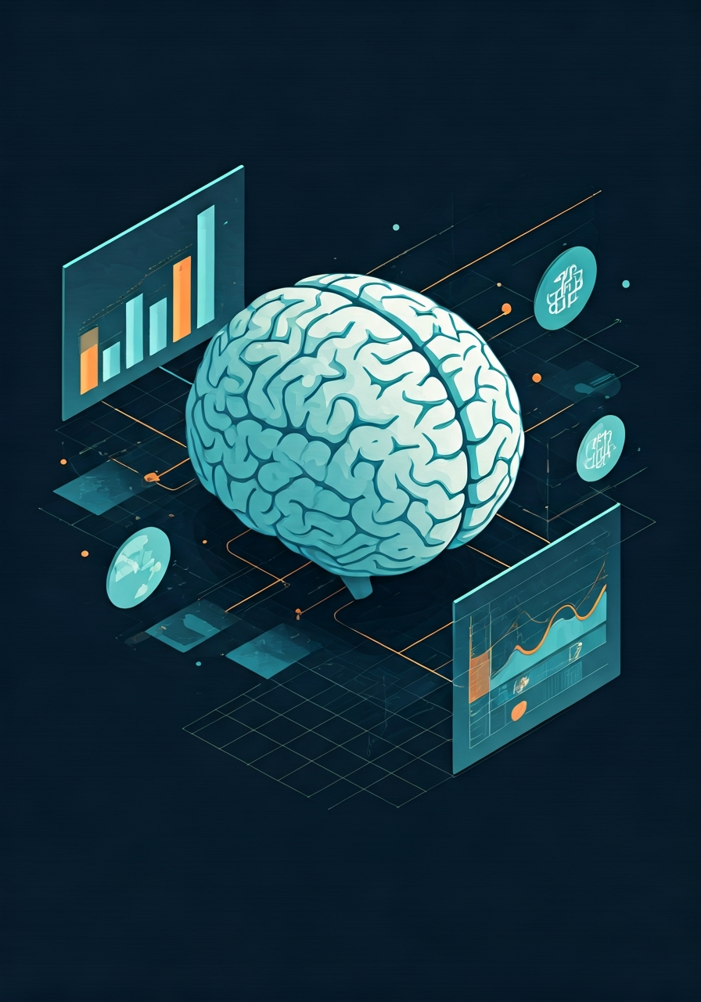
Predicting Student Performance

Slide 2
The Challenge: Why Do Students Struggle?
Identifying At-Risk Students
Early detection of students facing academic difficulties is crucial for timely intervention.
Understanding Contributing Factors
Complex interplay of academic, social, and personal elements influences performance.
Proactive Support
Moving beyond reactive measures to implement preventative strategies and personalized guidance.

Slide 3
LINEAR REGRESSION
Linear regression is a foundational, supervised machine learning algorithm that models the relationship between a dependent (target) variable and one or more independent (feature) variables by fitting a straight line, known as the regression line, to the data. It predicts continuous numerical outcomes by minimizing the distance between predicted and actual values.

Slide 4
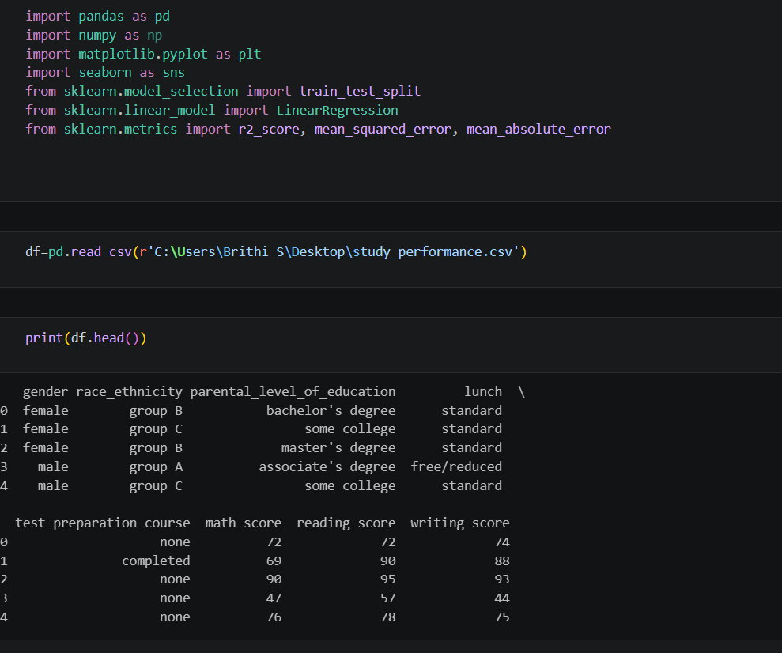
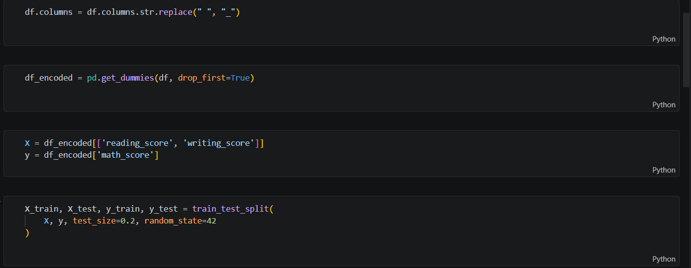
SCREEN SHOTS OF THE CODE
IMPORTING LIBRARIES AND PERFORMING OTHER OPERATIONS

Slide 5
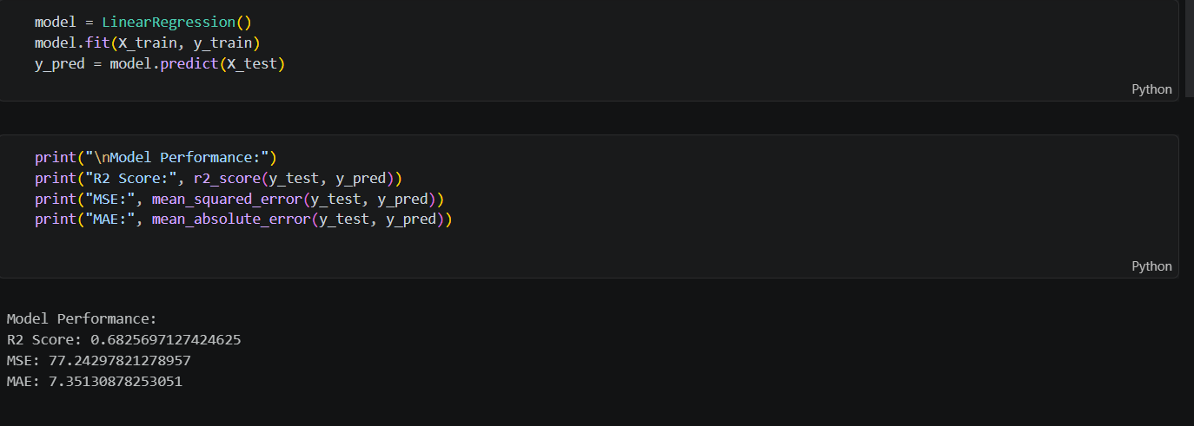
R2SCORE

Slide 6
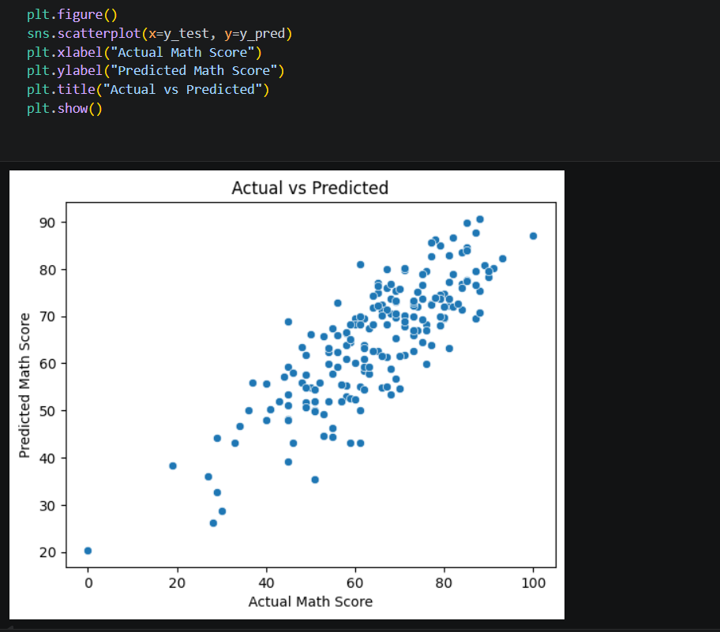
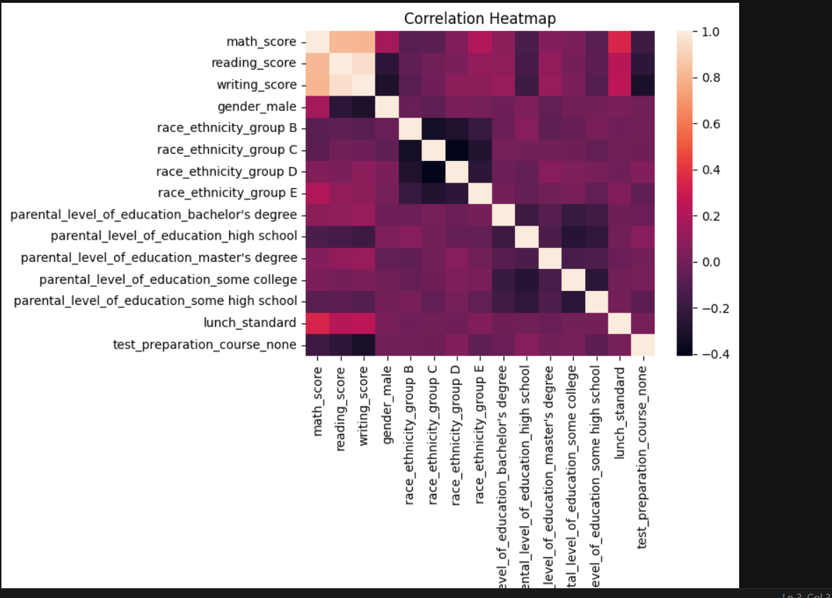
GRAPHS
SCATTERPLOT AND HEATMAP

Slide 7

Impact & Future: Improving Outcomes and Personalized Learning
Early Intervention
Empowering educators to support students before academic challenges become critical.
Tailored Learning Paths
Customizing educational content and strategies to meet individual student needs.
Enhanced Resource Allocation
Optimizing the deployment of educational resources for maximum impact.

