Slide 1
Definitions of risk data: Domestic fires
England
Definition: Number of domestic fire incidents per person within a neighbourhood (‘Middle Layer Super Output Area’ – a region containing 5,000 – 15,000 people). Fire incidents are from the financial year 2017/18; population counts are from estimates for 2017.
Source: Home Office (data)
Notes: It would be preferable to calculate the rate of fires by number of occupied dwellings (rather than number of people) but this data was not available.
Wales
Definition: Number of domestic fires incidents per occupied dwelling within a Fire & Rescue Authority (FRA; which contain multiple Local Authorities).
Fire incidents are from the financial year 2017/18; dwellings data are from financial year 2016/17.
Source: Stats Wales
Notes: There are only three FRAs in Wales, so this is not geographically precise data. We will attempt to access data for smaller neighbourhoods via a Freedom of Information request.
Scotland
Definition: Number of domestic fires incidents per occupied dwelling within a neighbourhood (‘Intermediate Zone’ – a region containing 2,500 – 6,000 people). Fire incidents are from financial year 2017/18; dwellings data are from 2018.
Source: Scottish Fire and Rescue Service
NI
Data not publicly available. We will attempt to access this via a Freedom of Information request.

Slide 2
Definitions of risk data: Flooding
England
Definition: Number of people living in a neighbourhood (‘Middle Layer Super Output Area’ – a region containing 5,000 – 15,000 people) at high risk (>1% per year) of flooding.
Source: Environmental Agency
Wales
Definition: Number of people living in a neighbourhood (‘Middle Layer Super Output Area’ – a region containing 5,000 – 15,000 people) at high risk (>1% per year) of flooding.
Source: Natural Resources Wales
Scotland
Data are not publicly available. We have applied for a licence from the Scottish Environment Protection Agency and they are currently processing our request.
NI
Definition: Number of people living in ‘Areas of Potential Significant Flood Risk’ and ‘Transitional Areas of Potential Significant Flood Risk’, within a neighbourhood (‘Super Output Area’ – a region containing 300 – 6,000 households).
Source: Department for Infrastructure

Slide 3
Definitions of risk data: Asylum seeker displacement
Whole UK
Definition: Number of people seeking asylum who receive Section 95 support within Local Authorities in Q4 2018.
Source: Home Office
Note: This data is only available at Local Authority level. We will try to access more detailed neighbourhood-level data via, e.g., a Freedom of Information Request.

Slide 4
Definitions of risk data: Migrant destitution
England, Wales and Scotland
Definition: Somebody is destitute when they lack two or more of these essentials over the past month because they couldn’t afford them:
Shelter (slept rough for one or more nights)
Food (ate fewer than two meals a day for two or more days)
Heat (unable to heat their home for five or more days)
Light (unable to light their home for five or more days)
Clothing (does not have appropriate clothing for the weather)
Basic toiletries (does not have soap, shampoo, toothpaste or toothbrush)
A person is also considered destitute if their income is so extremely low that they are unable to purchase these essentials for themselves.
This measure looks at destitution among migrants (not just asylum seekers but also EU/EEA nationals) without complex needs.
Source: Joseph Rowntree Foundation
NI
No data available.

Slide 5
Definitions of risk data: Loneliness
Whole UK
Definition: This is, more accurately, a ‘loneliness prescription index’. It is a measure of how frequently medications for conditions where loneliness is a risk factor (Alzheimer’s disease, depression, hypertension, social anxiety, and insomnia) are prescribed compared to the number of people in an area. This loneliness index is calculated for neighbourhoods (‘Middle Layer Super Output Area’ – a region containing 5,000 – 15,000 people).
Source: ONS Data Science Campus; NHS Digital

Slide 6
Definitions of risk data: Healthy life expectancy at birth
Whole UK
Definition: Average healthy life expectancy at birth for males and females within each Local Authority. This estimates the number of years a person can expect to live in “very good” or “good” health (based on their own perceptions of their general health).
Source: ONS

Slide 7
Definitions of risk data: Health deprivation
England
Definition: The ‘Health Deprivation and Disability’ domain from the Index of Multiple Deprivation, from 2015. Deprivation scores are available for neighbourhoods (‘Middle Layer Super Output Area’ – a region containing 5,000 – 15,000 people). Health deprivation in England is comprised of: years of potential life lost; comparative illness and disability ratio; acute morbidity; and mood and anxiety disorders.
Source: Ministry of Housing, Communities & Local Government
Wales
Definition: The ‘Health’ domain from the Welsh Index of Multiple Deprivation, from 2014. Deprivation scores are available for neighbourhoods (‘Middle Layer Super Output Area’ – a region containing 5,000 – 15,000 people). Health deprivation in Wales is comprised of: limiting long-term illness; all-cause death rate; cancer incidence; low weight single births.
Source: Welsh Government
Scotland
Definition: The ‘Health’ domain from the Scottish Index of Multiple Deprivation, from 2016. Deprivation scores are available for neighbourhoods (‘Intermediate Zone’ – a region containing 2,500 – 6,000 people). Health deprivation in Scotland is comprised of: standardised mortality ratio; emergency stays in hospital; proportion of population prescribed drugs for anxiety, depression or psychosis; hospital stays related to alcohol misuse; hospital stays related to drug misuse; the “Comparative Illness Factor”; low birth weight.
Source: Scottish Government
NI
Definition: The ‘Health and Disability’ domain from the Northern Ireland Multiple Deprivation Measure, from 2017. Deprivation scores are available for neighbourhoods (‘Super Output Area’ – a region containing 300 – 6,000 households). Health deprivation in Northern Ireland is comprised of: preventable death ratio; physical health-related benefit ratio; ratio of cancer registrations; emergency admissions; low birth rate; children’s dental extractions; people on multiple prescriptions on a regular basis; people with a long-term health problem or disability; a “combined mental health indicator”.

Slide 8
Definitions of risk data: Digital exclusion
Whole UK
Definition: Digital exclusion is a combination of infrastructure, percentage of people who are offline, percentage of people lacking Basic Digital Skills, and percentage of people not using Basic Digital Skills.
The infrastructure metric is made up of two sets of data: household broadband speeds; and the household availability of 4G mobile data.
Offline refers to the percentage of people who have never used the internet or last used the internet more than 3 months ago.
The Basic Digital Skills data shows the percentage of adults that say they have all five Basic Digital Skills. The combined digital indicator has been calculated using the 11 survey questions that were used to measure these 5 skill categories. Basic Digital Skills have been tracked using a survey based on Go ON UK’s Basic Digital Skills framework.
Use of Basic Digital Skills refers to the percentage of adults who say they have used all five skills in the last three months.
Source: The Tech Partnership
Note: This data is only available at Local Authority level.

Slide 9
Definitions of risk data: Living alone
Whole UK
Definition: The proportion of one-person households and lone parent households compared to the total number of households within a neighbourhood (Lower Layer Super Output Area in England and Wales, Data Zone in Scotland, and Super Output Area in Northern Ireland).
Source:
England and Wales: census table QS112EW (Household composition - People)
Scotland: census table QS112SC (Household composition - People)
Northern Ireland: census table QS110NI (Household Composition - Usual Residents)

Slide 10
Geographical levels for which risk data are available in each country
Risk | England | Wales | Scotland | NI
Fires | Neighbourhood | FRA | Neighbourhood | —
Floods | Neighbourhood | Neighbourhood | — | Neighbourhood
Displacement | LAD | LAD | LAD | LAD
Migrant destitution | LAD | LAD | LAD | —
Loneliness | Neighbourhood | Neighbourhood | Neighbourhood | Neighbourhood
Healthy life expectancy | LAD | LAD | LAD | LAD
Health deprivation | Neighbourhood | Neighbourhood | Neighbourhood | Neighbourhood
Digital exclusion | LAD | LAD | LAD | LAD
Living alone | Neighbourhood | Neighbourhood | Neighbourhood | Neighbourhood
All destitution | LAD | LAD | LAD | —
Multiple deprivation | Neighbourhood | Neighbourhood | Neighbourhood | Neighbourhood
‘Neighbourhood’ refers to small geographical areas, each containing between 5,000 – 15,000 people (in England and Wales), 2,500 – 6,000 people (in Scotland), or 300 – 6,000 households (in Northern Ireland). The technical terms are Middle Layer Super Output Area (England, Scotland and Wales) and Super Output Area (NI).
LAD = Local Authority District. These contain multiple ‘neighbourhoods’.
FRA = Fire & Rescue Authority. These contains multiple LADs.

Slide 11
Calculating risk within geographical regions
Areas (neighbourhoods, Local Authorities, and Fire & Rescue Authorities) were given a score between one (high risk) and five (low risk) using the ‘Jenks natural breaks classification method’. Areas with a score of five for any given risk can be broadly considered among the 20% most at risk within the country.
Risks were calculated separately for each UK nation, since the definitions of each risk differs between nations.
The maps showing multiple, overlapping risks within each nation are based on areas with high risks (i.e. a score of five) in more than one domain. We have also provided maps showing the detail of each type of risk separately.

Slide 12
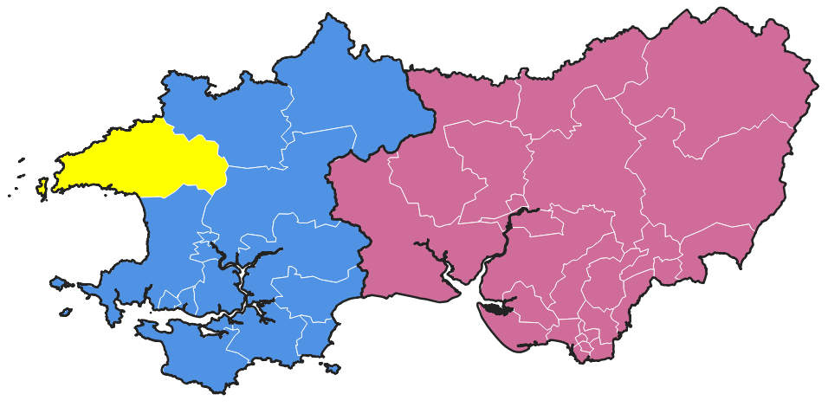
How risk was calculated for Local Authorities (and Fires & Rescue Authorities in Wales)
Asylum seeker displacement data is recorded for Local Authorities but not the smaller neighbourhoods for which we have other risk data. Similarly, domestic fires in Wales are recorded for Fire & Rescue Authorities (large areas containing multiple Local Authorities). To aggregate neighbourhood-level risks (e.g. for flooding) into these higher-level geographies, we selected the highest-scoring risk.
This means that a Local Authority will be given a score of one (highest risk) if any of its constituent neighbourhoods have a score of one. In the example here, the blue Local Authority will be classed as high-risk (score = 1) because one of its neighbourhoods (highlighted yellow) is high-risk. The red Local Authority will be given a score of two because its riskiest neighbourhood is two.
4
5
2
5
4
1
2
4
3
2
4
4
3
1
4
3
3
1
4

Slide 13
Potential additions to the risk maps
Disasters and Emergencies
Flooding – Scotland
Domestic fires – NI; Wales (at a more local level than Fire & Rescue Authority)
High-likelihood/impact risks identified Local Resilience Forums
Terrorism risks
Extreme weather
Wildfires
Displacement and Migration
No. people receiving Government support (at a more local level than Local Authority)
Trafficking hotspots
Health Inequalities
Unmet need for social care
Frailty (older people only?)
Connectedness
Belonging
Social capital
Crime data (e.g. anti-social behaviour or public order offenses)?
Connectivity in cities and towns
Social fragmentation
Locations of charities
Access to healthy assets and hazards

