Slide 2
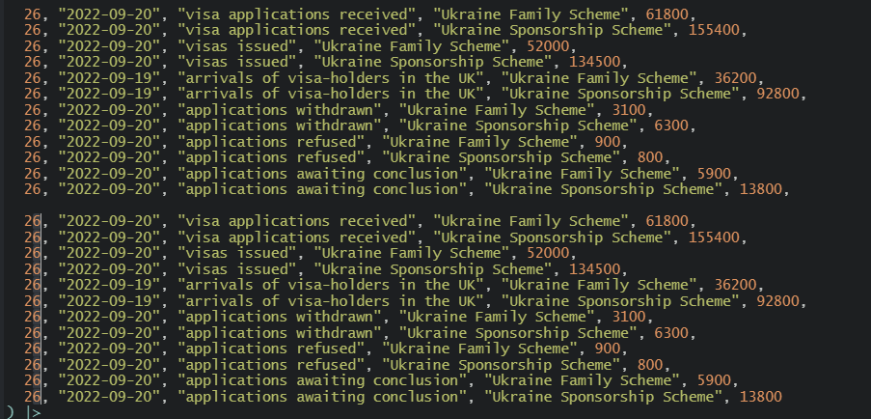
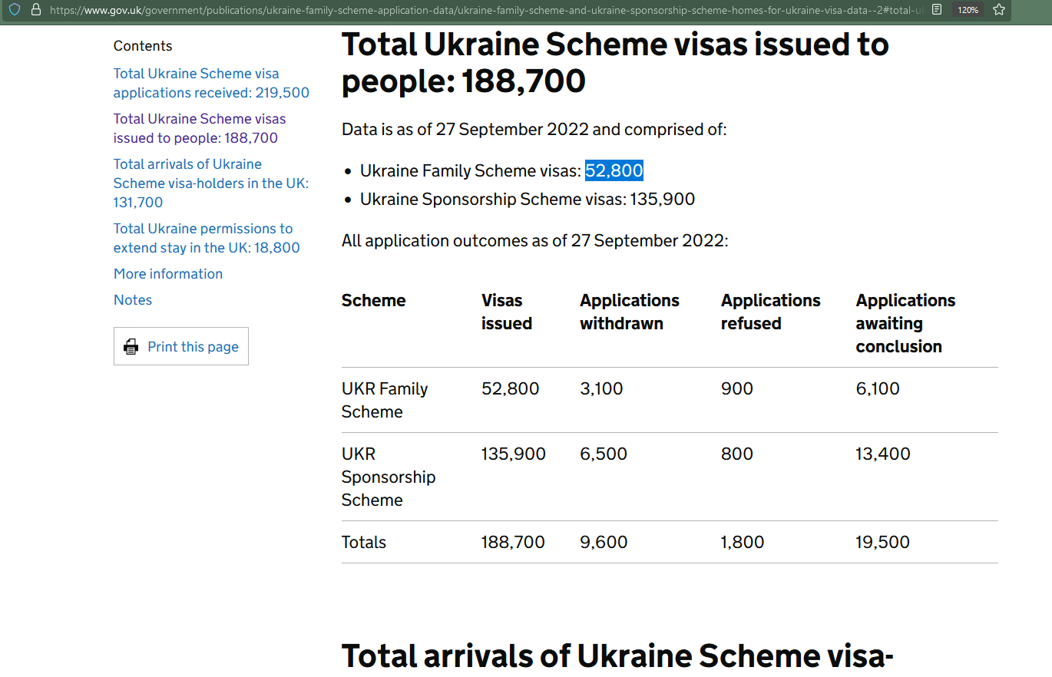
1. Make a copy of last week’s scraped data
3. Update the figures from the latest data
2. Increment the number in the first column and update the dates to match the current week’s date on the govt webpage. Note that arrivals are one day behind the other data.

