Slide 1

Project Proposal and Design enhancements
By: Britney Hurley

Slide 2
My Project
For a little background:
Original course: CS-360 Mobile Architecture and Programming
Initial Program Design: Warehouse Inventory Application
Software Needed: Android Studio, All Add-Ons Installed, Viewing on a 'Medium Phone API 35'

Slide 3
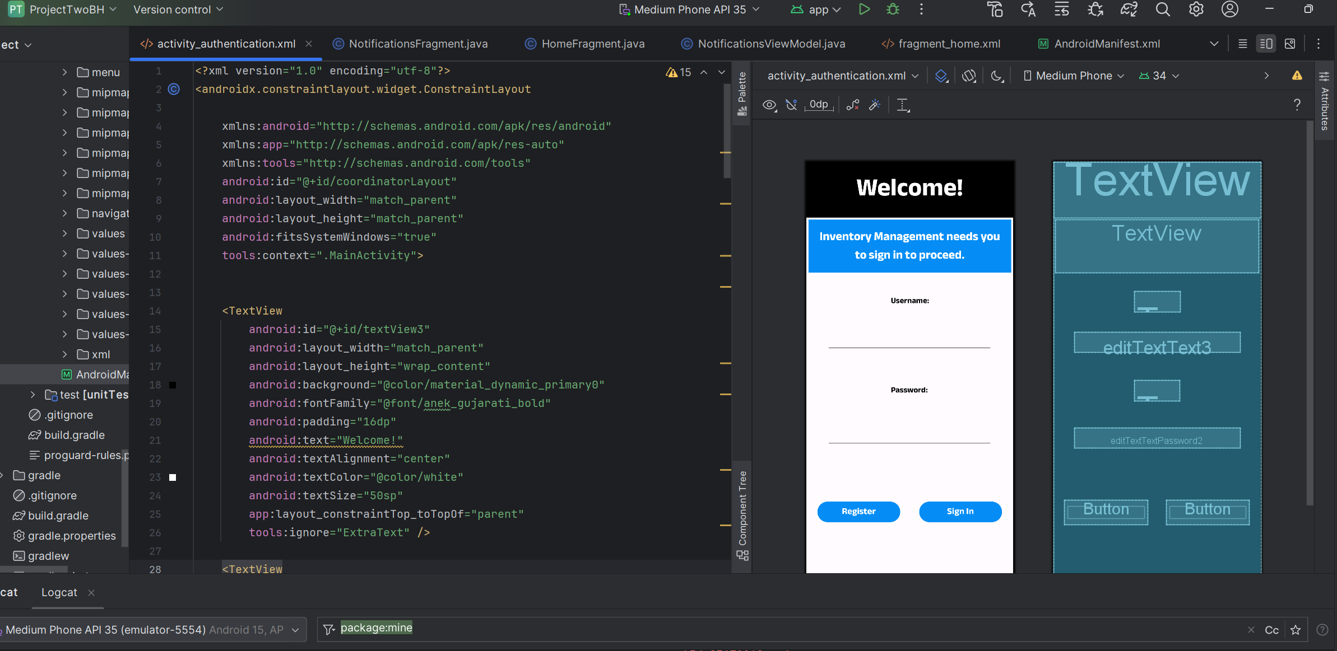

Slide 4
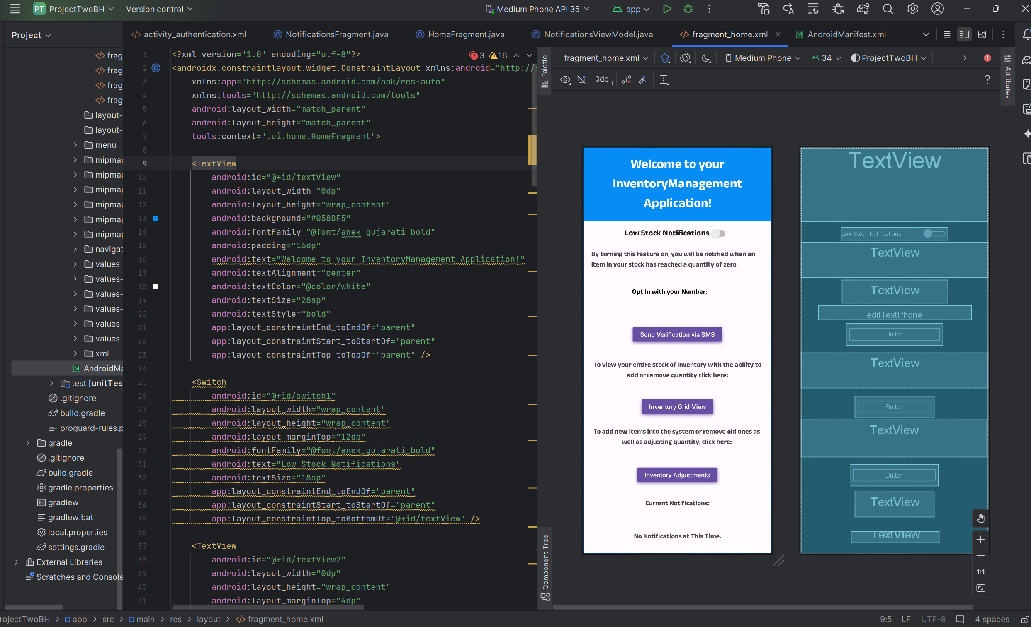

Slide 5
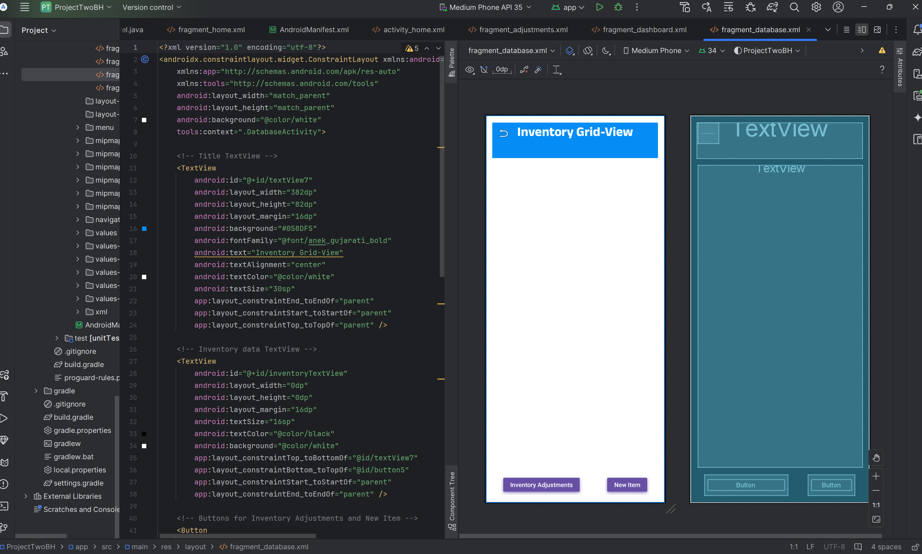

Slide 6
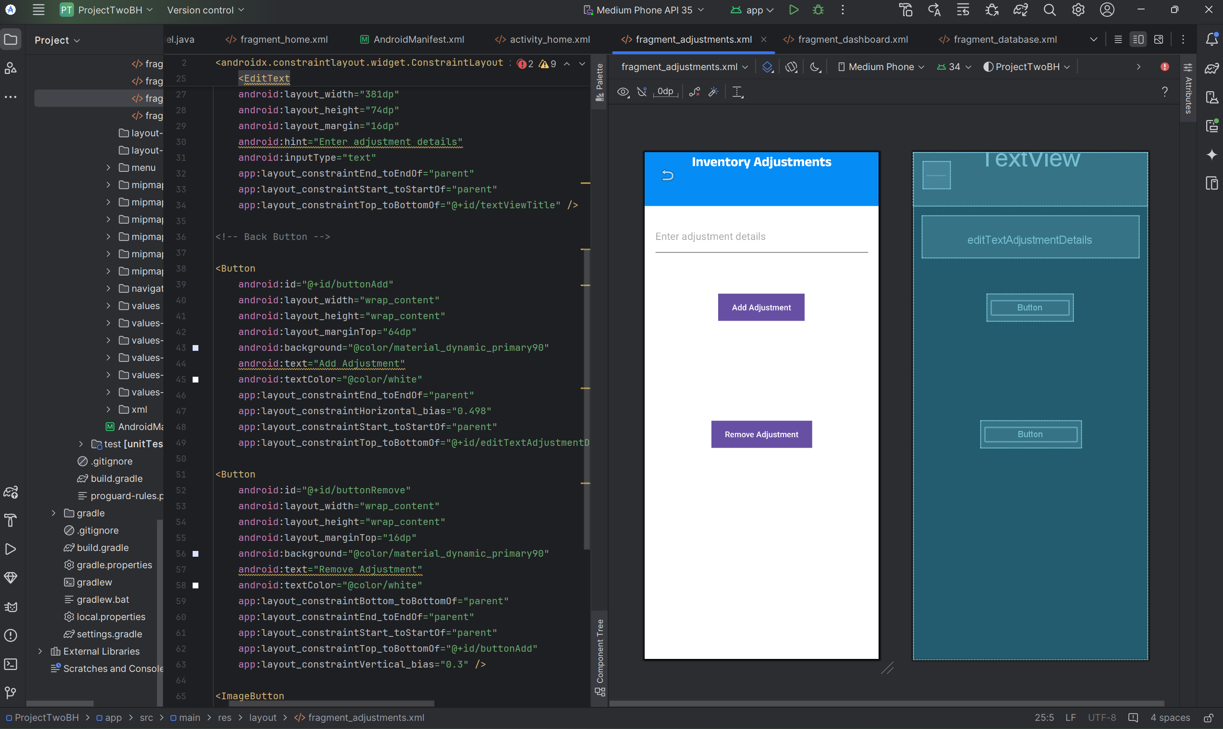

Slide 7
code review
What does the code currently do?
Allows a user to register/authenticate.
Sends low stock notifications via SMS.
Provides a grid-view of inventory once data is entered.
Allows for inventory adjustments to be made.

Slide 8
Code review (Checklist)
Pros:
Beginning to correctly implement the design.
Complexity is kept to a minimum for future scalability.
Well structured;
Comments are included and easy to maintain
Repetition isn't evident

Slide 9
Code Review (checklist)
Cons:
Pathways do not reach desired places each time.
Unused pages are evident due to incorrect pathway assignments.
App force closes due to incorrect pathway assignments.
Errors within code to be fixed;
Pathway assignments
Button sizing and accessibility

Slide 10
Enhancement one
Category One: Software Design and Engineering
Enhancement Proposal: Implement a theme switch.

Slide 11
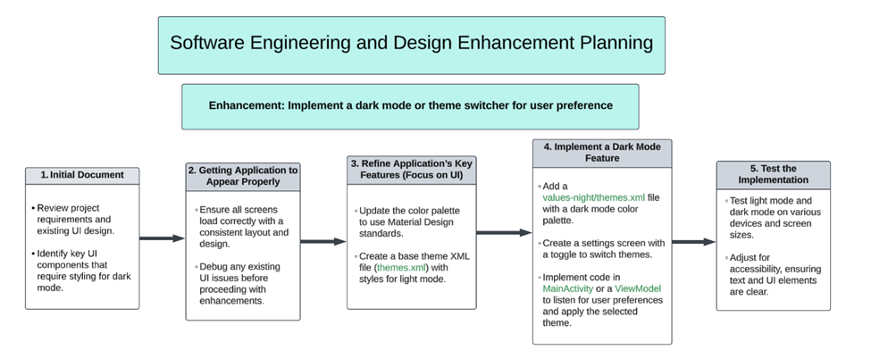
Progress to get to enhancement one

Slide 12
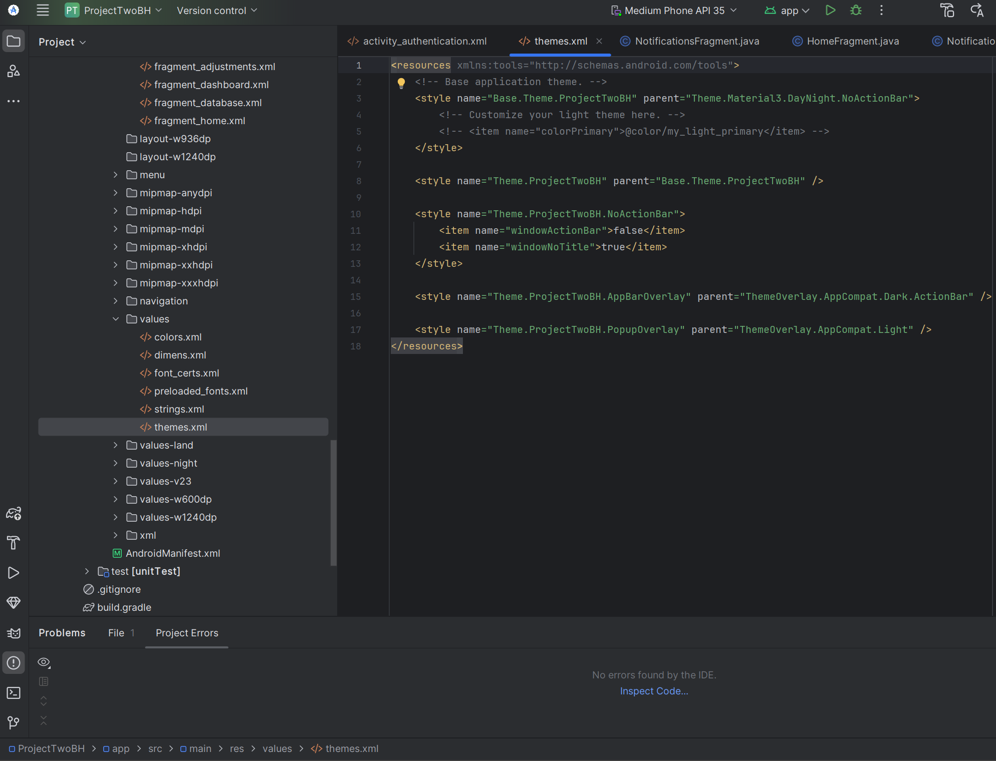
Changes
To implement this enhancement:
Fix implementation and pathway errors to assist the application in becoming more seamless
Work within the res/values/themes.xml file
Add code for different themes
Add switch/setting for theme swap within the application

Slide 13
Enhancement two
Category Two: Algorithms and Data Structures
Enhancement Proposal: Implement a Sort/Search Feature.

Slide 14
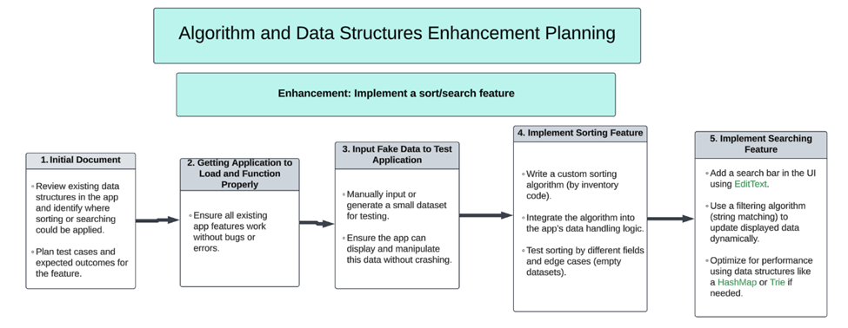
Progress to get to enhancement two

Slide 15
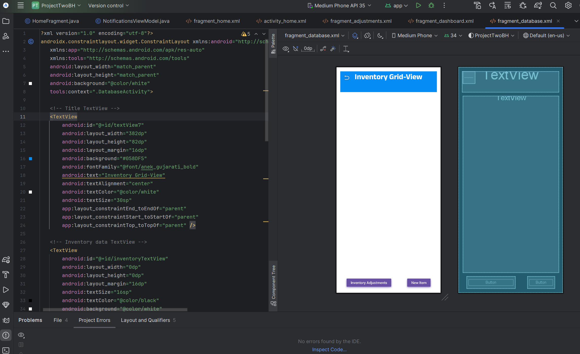
Changes
To implement this enhancement:
Fix implementation and pathway errors to assist the application in becoming more seamless.
Work within the res/layout/fragment_database.xml file.
Swap the textView box for inventory items to a RecyclerView (for displaying dynamic data).
Implement code to handle sorting, searching and loading the data into the RecyclerView.

Slide 16
Enhancement three
Category Three: Databases
Enhancement Proposal: Implement Prepopulated Editable Data.

Slide 17
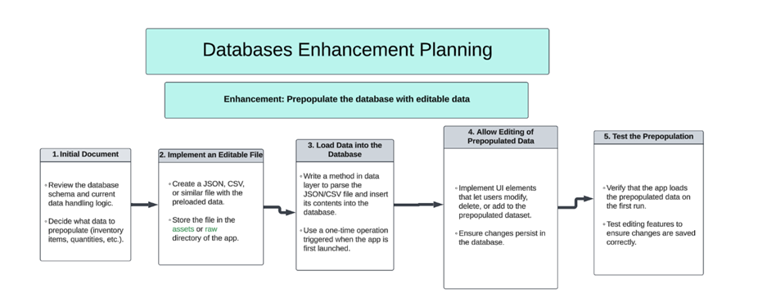
Progress to get to enhancement three

Slide 18
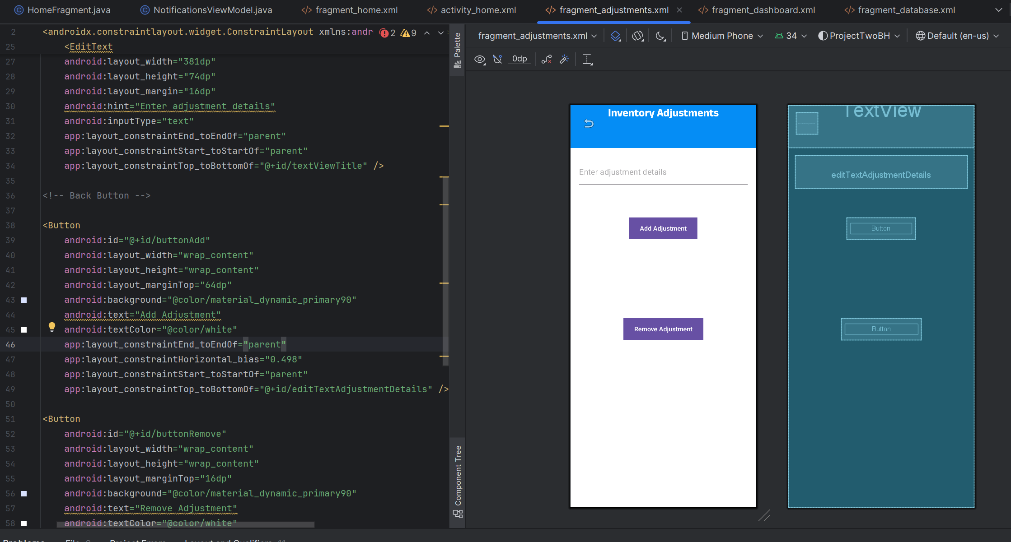
Changes
To implement this enhancement:
Fix implementation and pathway errors to assist the application in becoming more seamless.
Repurpose res/layout/fragment_adjustment.xml (Inventory Adjustment Screen) for adding new items and editing existing ones.
Update a database helper to support the adjustment of items.
Pass data between fragments to enable seamless transitions.

