Slide 1
From Search to Sale
Optimizing Customer Engagement and Product Discovery at JD.com
A Data Analyst Portfolio Project
By: Britney Graham
09/01/2026
Notes:
Hello, and thank you for taking the time to review my analysis.
This project, From Search to Sale, examines search and shopping behavior using a public http://JD.com dataset.
My objective was to determine how recorded engagement and purchase activity vary across categories, brands, shops, products, and search queries, and then translate those patterns into useful business recommendations.
I completed the project using Python for data preparation and exploratory analysis, PostgreSQL and SQL for structured analysis and validation, and Tableau for visualization and stakeholder reporting.
An important theme throughout this project is distinguishing what the data actually demonstrates from what would require additional data or testing

Slide 2
The Business Question
The goal of this presentation is to answer the following question:
How can JD.com use recorded search and shopping behavior to identify engagement patterns, compare purchasing performance, and prioritize opportunities for product, marketing, and seller improvement?
Objectives
Analyze engagement and purchase patterns.
Compare categories, brands, shops, products, and queries.
Identify areas warranting further investigation.
Translate findings into actionable recommendations.
Notes:
I approached the project from a business decision-making perspective rather than simply asking what statistics I could calculate.
The central question was: where do we see substantial recorded shopping engagement without comparable purchase activity?
I analyzed the data across several dimensions, including categories, brands, shops, products, and search queries.
The purpose wasn’t to claim that a particular factor causes customers not to purchase. Instead, I wanted to identify patterns that could help stakeholders decide where deeper investigation would be most valuable.
That creates a progression from descriptive analysis, to prioritization, to investigation, and ultimately to testing potential improvements.

Slide 3
Dataset Composition
Interaction | # of Records | Share of Positive Interactions
Clicks | 223,909 | 69.94%
Add to Cart | 75,407 | 23.55%
Purchases | 20,816 | 6.50%
Total | 320,132 | 100%
Additional Scope | # of Records
Unique Query Records | 110,393
Unique Products | 237,814
Unique Brands | 47,757
Categories | 4,777
This table summarizes the distribution of interaction labels
Notes:
The final analytical dataset contains 320,132 recorded positive shopping interactions.
Of those, 223,909 are clicks, 75,407 are add-to-cart interactions, and 20,816 are purchases.
The dataset also covers more than 110,000 unique query records, approximately 238,000 products, nearly 48,000 brands, and 4,777 categories.
One important scope consideration is that this dataset contains positive interaction labels. Non-interaction observations were excluded from the processed analytical dataset.
That affects how the metrics should be interpreted, particularly Purchase Share, which I’ll explain next.

Slide 4
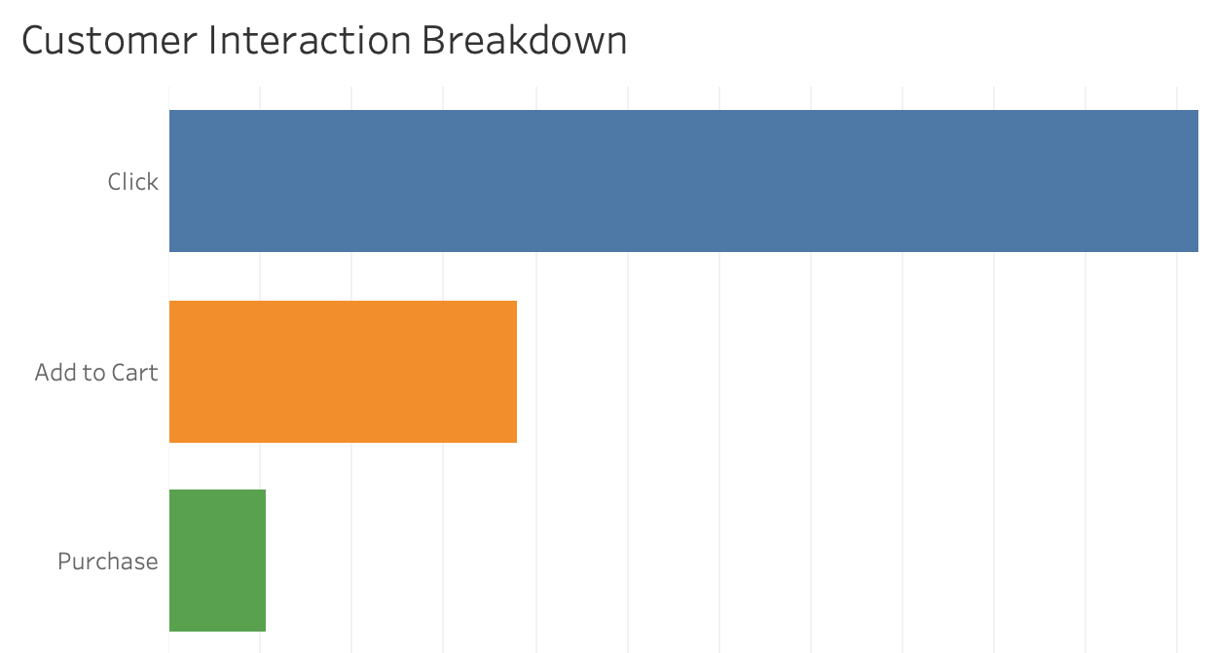
Understanding Purchase Share
Purchase Share is not Traditional Conversion Rate
Notes:
One of the most important decisions in this project was how to describe the primary metric accurately.
Purchases represent 6.50% of all recorded positive interactions. I refer to this as Purchase Share.
I intentionally do not call it a conversion rate.
A traditional conversion rate would normally require a denominator such as impressions, visitors, or sessions. Those aren’t available here.
The records also cannot be connected into individual customer journeys. Therefore, the clicks, cart additions, and purchases shouldn’t be interpreted as sequential funnel stages.
For example, I cannot conclude from these numbers alone that a customer clicked, added something to their cart, and then abandoned the purchase.
Instead, Purchase Share provides a consistent descriptive benchmark for comparing segments within this dataset.

Slide 5
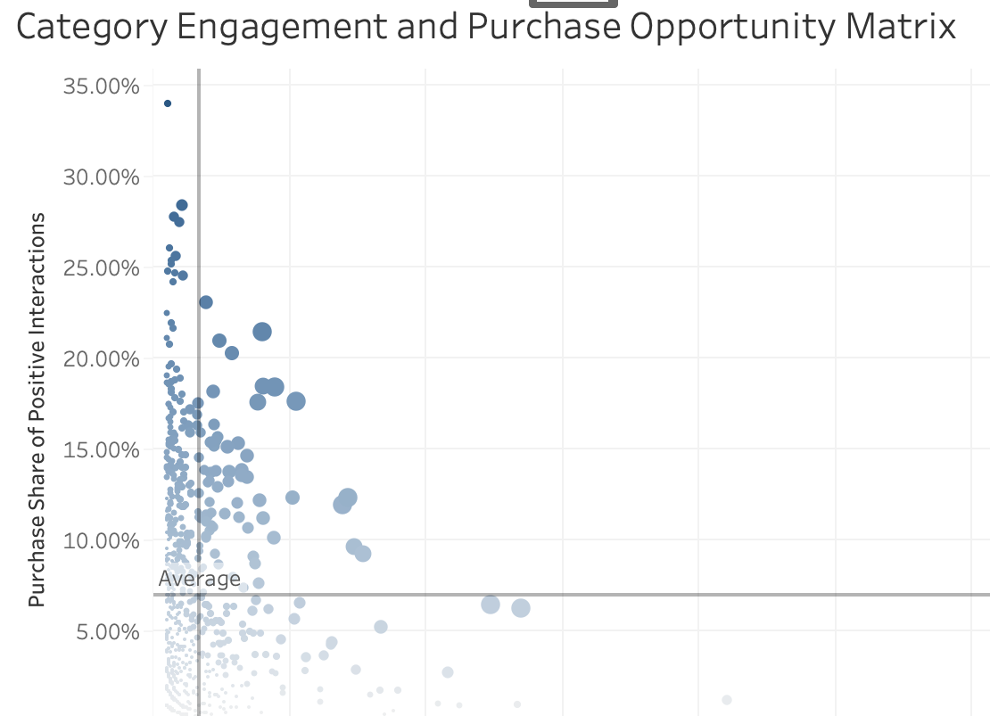
Where Should Stakeholders Investigate First?
High Engagement
+
Below-Benchmark Purchase Share
=
Priority For Investigation
Notes:
Rather than simply ranking segments by Purchase Share, I combined purchase activity with interaction volume.
A segment with an unusually high Purchase Share based on only a handful of interactions may not be particularly important from a business perspective.
Instead, I focused attention on segments with meaningful interaction volume but Purchase Share below the broader benchmark.
These segments are particularly useful as diagnostic priorities because they’re already generating engagement.
However, it’s important not to describe these segments as losing customers or causing abandonment. The current data doesn’t establish that.
What it tells stakeholders is where further investigation could potentially produce useful insights.

Slide 6
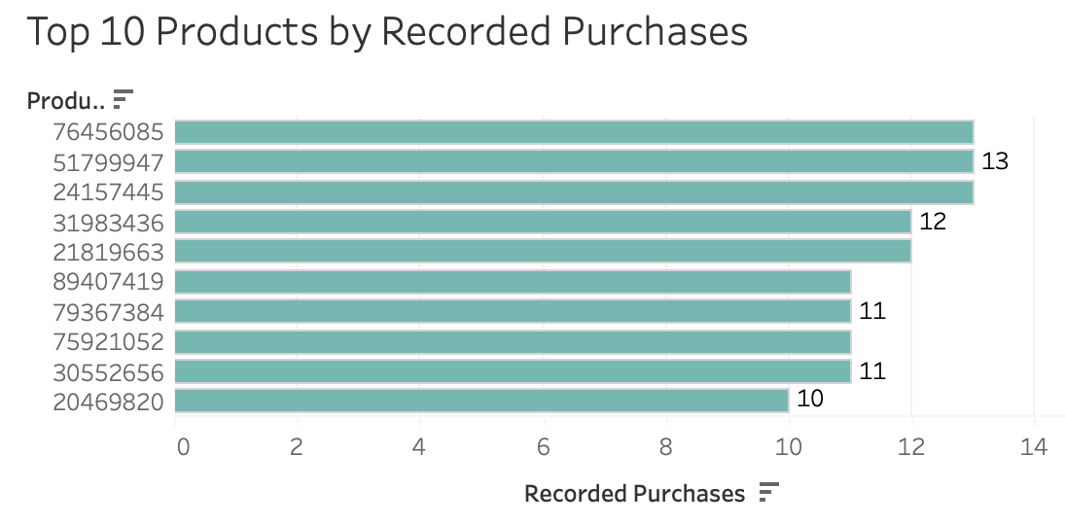
Product Discovery Deserves Deeper Investigation
Focus on:
High volume products and queries
Strong Purchase Share performers
High-Engagement / Lower-Purchase Share segments
Potential product-discovery opportunites
Notes:
I also examined product and search-query performance to identify patterns closer to the product-discovery experience.
This allows stakeholders to identify which queries and products generate substantial activity and compare their Purchase Share.
Search queries with high engagement but relatively low Purchase Share can become candidates for investigating search relevance, product assortment, pricing, availability, or how results are presented.
There is an important limitation at the individual-product level. The dataset is highly sparse, with many products represented by very few records.
Because of that, I would avoid making major business decisions based on an individual product’s Purchase Share without sufficient interaction volume.
In my analysis, I use minimum-volume thresholds when examining stronger product-level Purchase Share results to reduce the influence of extremely small samples.

Slide 7
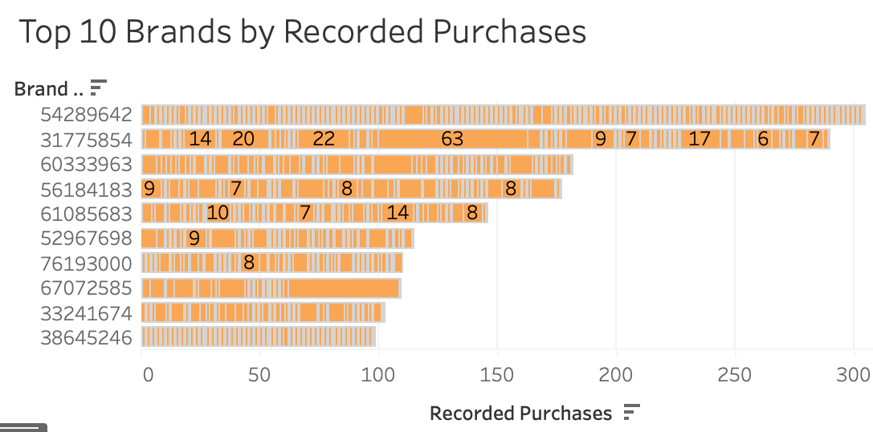
Performance Varies Across Brands and Shops
Evaluate:
Engagement volumes
Purchase volume
Purchase Share
318,356 identified shop interactions
1,776 records with unidentified shop ID excluded
Notes:
The brand and shop analyses provide another way to identify both potential opportunities and stronger-performing benchmarks.
I compared engagement volume, purchase volume, and Purchase Share rather than relying on a single metric.
For the shop analysis, I identified a data-quality consideration that required special handling.
There were 1,776 records where the shop identifier was negative one, indicating an unidentified shop.
I retained those records in the overall dataset but excluded them specifically from shop-level performance comparisons.
That leaves 318,356 interactions associated with identified shops, including 20,751 purchases.
This prevents an unknown shop category from distorting comparisons among identifiable shops while preserving the records for the overall analysis.

Slide 8
Four Primary Diagnostic Areas
1. Product Information
Images
Descriptions
Specifications
Reviews
. 2. Pricing & Availability
Price competitiveness
Promotions
Inventory
3. Search Relevance
Query-result alignment
Product ranking
4. Fulfillment & Purchase Experience
Shipping
Delivery
Checkout
Notes:
Once priority segments have been identified, the next question is what stakeholders should investigate.
I would begin with four areas.
First is product information, including descriptions, specifications, imagery, reviews, and other trust signals.
Second is pricing and availability. Customers may engage with a product but encounter an unattractive price, insufficient promotion, or inventory limitations.
Third is search relevance. High query engagement paired with weaker purchase activity may warrant examining whether the results adequately reflect customer intent.
Finally, fulfillment and the purchase experience could be investigated, including shipping costs, delivery expectations, and checkout friction.
These are intentionally framed as hypotheses. The existing dataset does not establish any of them as causes.

Slide 9
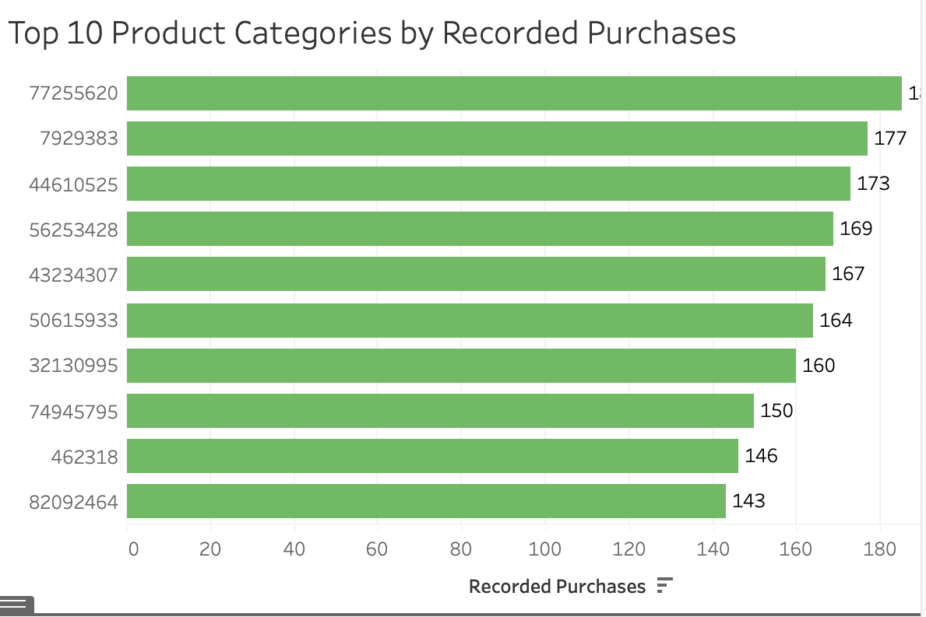
From Insight to Action
1 - Prioritize
Identify high-engagement / low-Purchase-Share segments.
2 - Diagnose
Investigate product, search, pricing, inventory and fulfillment factors.
3 – Test
Implement targeted changes and measure results
Notes:
My recommendation is to turn these findings into a three-stage analytical process.
First, prioritize. Use interaction volume and Purchase Share together to select a manageable number of categories, brands, shops, or queries for further analysis.
Second, diagnose. Examine additional variables that aren’t present in the current dataset, including pricing, inventory, product information, search-result positioning, shipping, and customer-journey information.
Stronger-performing comparable segments could also be used as internal benchmarks to identify meaningful differences.
Third, test. Once there is evidence supporting a particular hypothesis, implement targeted changes using controlled testing where possible.
This approach prevents the organization from jumping directly from correlation or descriptive patterns to expensive business changes without first establishing stronger evidence.

Slide 10
What Would Unlock Deeper Analysis?
Search Impressions
Search-result positions
Timestamps
Privacy-protected session IDs
Linked cart, checkout and order data
Price & discounts
Inventory
Shipping & delivery information
Returns & cancellations
Customer feedback
Current data tells us where to look. Additional data can help explain WHY.
Notes:
My recommendation is to turn these findings into a three-stage analytical process.
First, prioritize. Use interaction volume and Purchase Share together to select a manageable number of categories, brands, shops, or queries for further analysis.
Second, diagnose. Examine additional variables that aren’t present in the current dataset, including pricing, inventory, product information, search-result positioning, shipping, and customer-journey information.
Stronger-performing comparable segments could also be used as internal benchmarks to identify meaningful differences.
Third, test. Once there is evidence supporting a particular hypothesis, implement targeted changes using controlled testing where possible.
This approach prevents the organization from jumping directly from correlation or descriptive patterns to expensive business changes without first establishing stronger evidence.
The current dataset is useful for identifying where interesting patterns exist, but several additional fields would substantially increase its business value.
Search impressions and result positions would allow actual search-performance measures.
Timestamps and privacy-protected session identifiers would allow interactions to be connected into journeys.
Linked cart, checkout, and order data would allow proper measurement of progression and abandonment.
Pricing, promotions, inventory, shipping, returns, and customer-feedback data would then help test explanations for the patterns.
The distinction I would emphasize to stakeholders is simple: the current analysis tells us where to look. Additional data would help us understand why those patterns exist.

Slide 11
Limitations and Decision Boundaries
What The Analysis Supports
Performance comparison
Pattern identification
Opportunity prioritization
Hypothesis development
What it does not establish
Traditional conversion rates
Customer abandonment
Complete customer journey
Causality
Lost revenue or ROI
Seasonal effects
Notes:
These limitations are important because they define which decisions can reasonably be supported by the analysis.
The project can support comparative performance analysis, identify patterns, prioritize areas for investigation, and generate hypotheses.
It cannot establish traditional conversion rates because impressions and sessions aren’t available.
It cannot establish customer abandonment because individual records aren’t linked into customer journeys.
It also cannot establish causality, lost revenue, profitability, ROI, or seasonal effects.
I consider these limitations part of the analytical result rather than simply weaknesses in the project. Clearly defining what the evidence can and cannot support helps prevent stakeholders from making decisions based on conclusions the data doesn’t actually demonstrate.

Slide 12
The Analysis Identifies Where JD.com Should Look Next
320,132 Positive Interactions Analyzed
6.50% Overall Purchase Share Benchmark
Priority Segments identified through engagement + Purchase Share
Recommended Next Decision Select priority segments > acquire supporting data > diagnose > test intervention
Notes:
The central takeaway from this project isn’t simply that Purchase Share is 6.50%.
The greater business value comes from establishing a framework that allows stakeholders to compare that benchmark across categories, brands, shops, products, and search queries.
By combining engagement volume with Purchase Share, the analysis identifies areas that warrant deeper investigation without overstating what the available data proves.
My recommended next decision would be to select a small number of the highest-priority segments, obtain the additional behavioral and operational data needed to investigate them, and develop specific hypotheses for testing.
That would move the organization from descriptive analysis toward evidence-based optimization.

Slide 13
Appendix A
Raw Dataset > Python (cleaning & EDA) > PostgreSQL / SQL (analysis & validation) > Tableau (visualization > Business Recommendations
Quality Checks
320,132 records validated
0 derived-field inconsistencies
16,575 exact duplicate rows identified
Duplicate sensitivity analysis performed
SQL / Python headline metrics reconciled
Notes:
For anyone interested in the technical methodology, I used Python and Jupyter Notebook for cleaning, exploratory analysis, and validation.
I then loaded the cleaned dataset into PostgreSQL and built SQL views for category, brand, shop, product, and query performance.
I independently validated the headline metrics in SQL, including the 320,132 total records and the interaction distribution.
The quality review also identified 16,575 exact duplicate rows.
I did not automatically delete them because the dataset doesn’t provide timestamps or a unique event-level identifier that would allow me to distinguish accidental duplicates from legitimate repeated interactions.
Instead, I conducted a sensitivity analysis. Removing the exact duplicates changed Purchase Share only from approximately 6.50% to 6.63%, so the headline interpretation remained materially stable.
This allowed me to preserve the original observations while transparently testing the impact of the duplicate assumption.

Slide 14
Appendix B
Metric | Definition
Total Interactions | Recorded positive interaction records
Clicks | Records labeled as clicks
Cart Additions | Records labeled as add-to-cart
Purchases | Records labeled as purchases
Purchase Share | Purchases / Recorded positive interactions
Unique products | Distinct product IDs
Unique Query Records | Distinct query record IDs
Notes:
These are the primary definitions used consistently throughout the project.
The most important is Purchase Share. It represents purchases divided by all recorded positive interactions.
Maintaining that terminology consistently across Python, SQL, Tableau, the report, and this presentation prevents the metric from being confused with a conventional conversion rate.
The other metrics are primarily counts or distinct counts derived from the anonymized identifiers in the source dataset.

