Slide 1
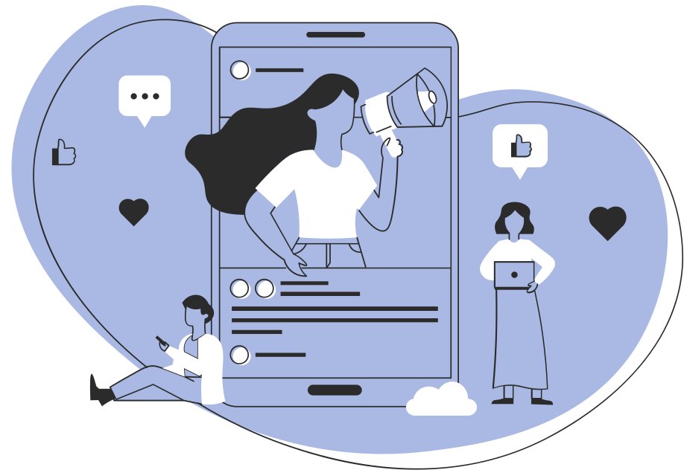
CS 147: SYSTEMIC JUSTICE AND EQUITY
Needfinding
Nancy, Lainey, Britney, Fernanda

Slide 2

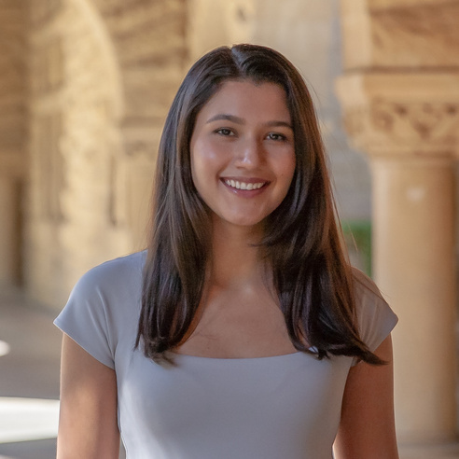
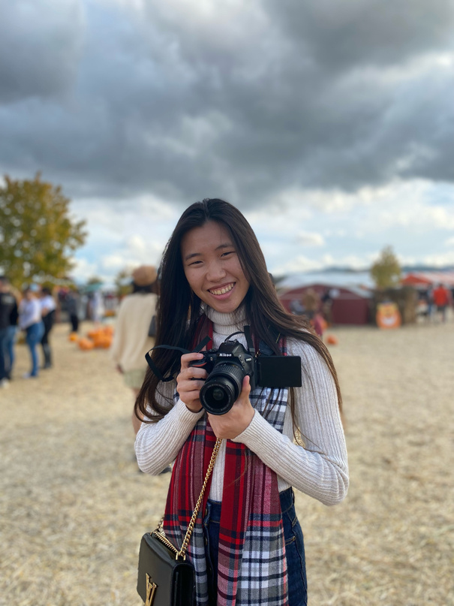
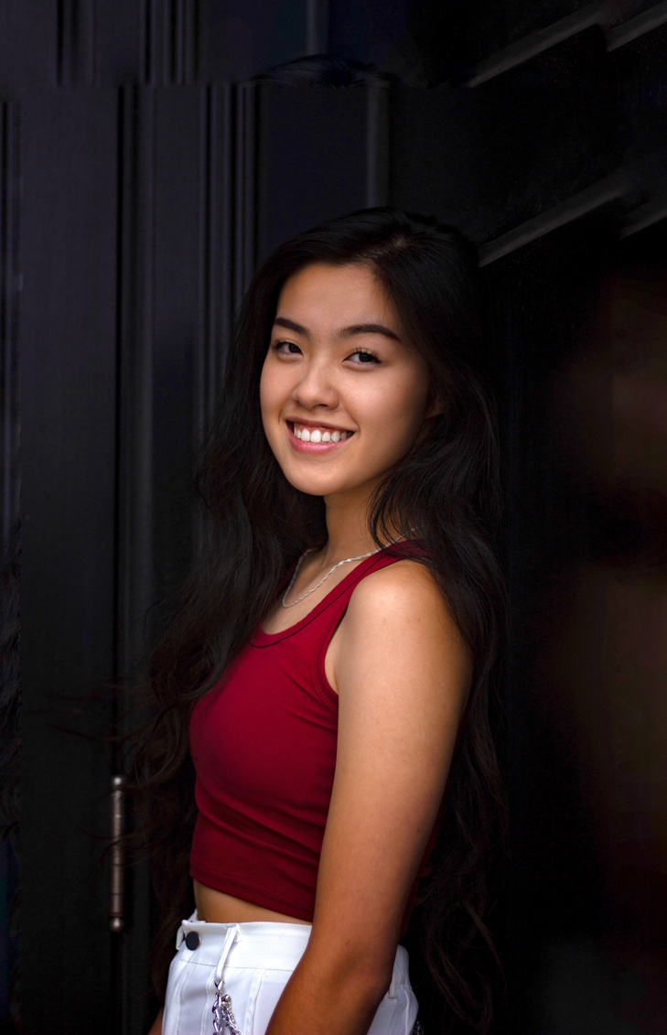
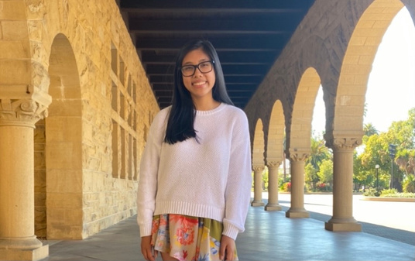
Who We Are
Fernanda Kramer
Lainey Wang
Britney Tran
Nancy Hoang
Senior
SymSys HCI
Junior
Economics
Sophomore
CS HCI
Junior
CS HCI

Slide 3


Interviewee
Selection Process
What we looked for:
Diverse age range
Diverse experience
WHY DID WE CHOOSE WHO WE CHOSE?
Diverse involvement

Slide 4
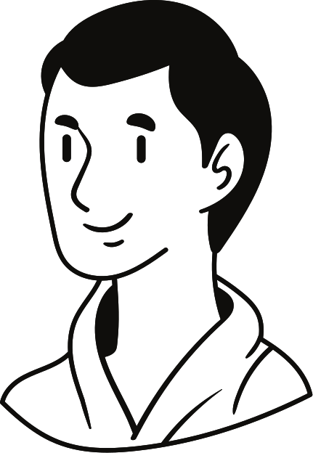


Participants
Justin
Sophie
Trish
Direct Marketer for
Nonprofit Charities
Bay Area, CA
Law Student
at Santa Clara University
Sunnyvale, CA
Info Science Major
at UT Knoxville
Nashville, TN

Slide 5

What we asked
When you think of the term systemic justice issue(s) what comes to mind?
Have you been involved in any organizations/projects to engage with this interest?
Describe a time when you wanted to see change in something but couldn’t do anything about it.
How do you think systemic justice has evolved?
How does this issue make you feel?

Slide 6
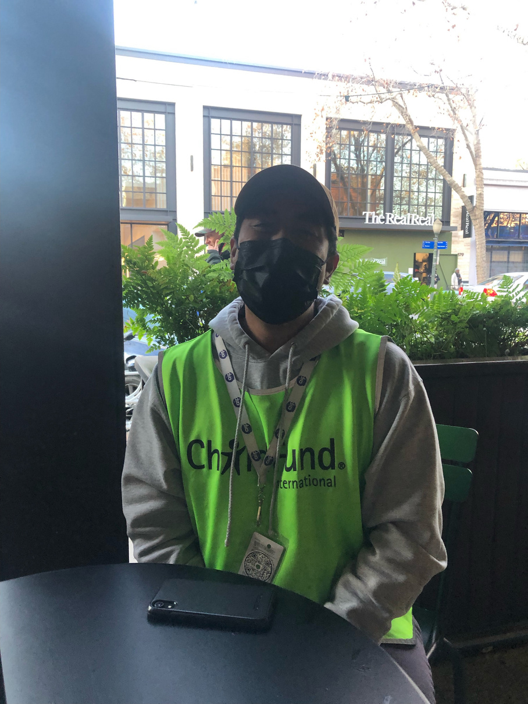
"[Being called a racial slur] was more wild than it was demeaning because I hadn't ever been called that..."
Justin
extreme user

Slide 7
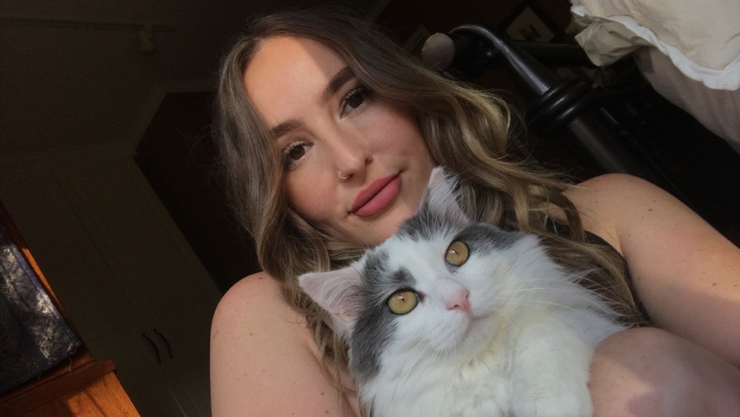
"Something, especially in criminal justice, that people lose sight of is that these are people, real people. Whether they did or didn't do it, they're an individual that has a heart and emotions and feelings..."
Sophie
extreme user

Slide 8
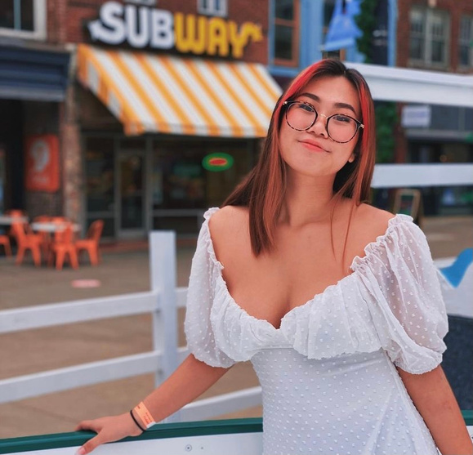
"You look like you'll be successful
so I don't want to do
anything that will jepordize this.
I'll just let you go..."
Trish

Slide 9
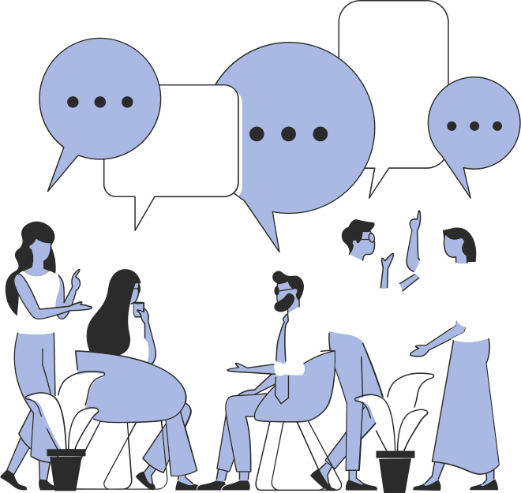
EMPATHY MAPS

Slide 10



he identifies more with the term "systemic injustice"
social justice should be done for the safety of the people you love
friends help him find new books that broaden his worldview
Volunteering takes him back to his childhood
thinks its cool to have direct interactions
he does not approach people
our education system needs more equal opportunities
thinks the biggest priority for his job is providing charities with the consistent means to budget and plan
Says that due to the current events, getting resources have been difficult
systemic injustice starts at a young age
One-time donations are difficult for charities because they are highly unpredictable
Wonders what are long-term ways people are actually doing to help with issues
he enjoys sharing Filipino music
need to tell kids "what's going on" in a more comprehensive way
"doing this job kind of was a pull back to what I used to do as a kid and I got to apply real life like personal skills"
cultures should be shared
he thinks that people should want to be involved, not coerced
engaging in social justice is selfless
he shouldn't speak too much about things he doesn't understand
being called racial slur felt "more wild than demeaning"
SAYS
THINKS
DOES
FEELS
experiencing racism in texas made him more aware, he was shocked/had a sudden realization of its presence/severity
Feels like impact is made through exposure to diversity
works in nonprofit marketing
passionate about child care related issues
wants to break the cycle of poverty
educates himself by having conversations with other people with different experiences
volunteered a lot with mom as a kid
he waits outside for hours waiting to talk about charity
Justin
Feels like the best way to help is through self education
wants to make a difference for lives of kids in developing countries
read Race Matters
felt more associated with systemic inustice rather than systemic justice
that racism is other-worldly to him and that he had a glimpse of other people's experiences
reacts in an unexpected way to being called a racial slur
Is crowd sourcing funding
Talks to over 30 people a day
felt uncomfortable standing up for himself when he was called a racial slur as a waiter
Helps with a charity that asks fora $1 donation a day for kids in need
gets 3-4 people to donate
fortunate to have the experience living in the bay area with less racism

Slide 11

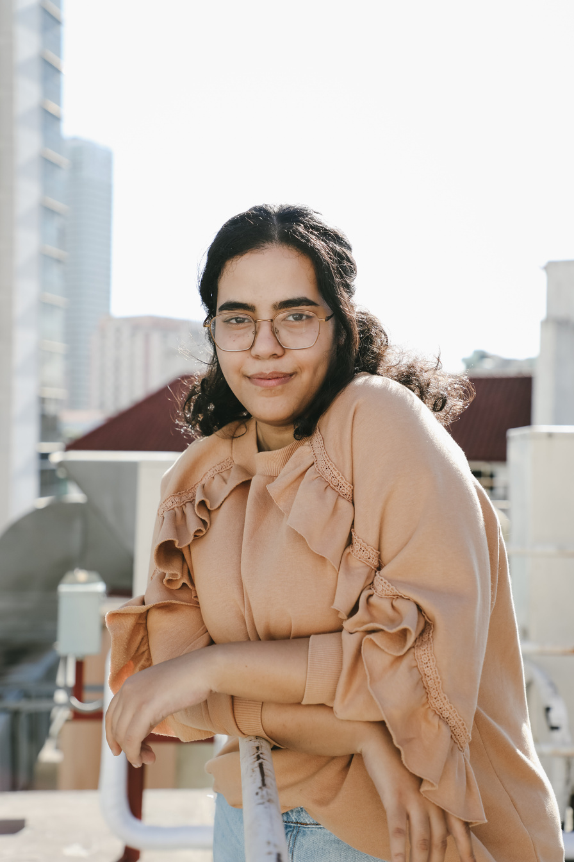
the best way to make change is to have small conversations with people, judgment free
she says segregated schools is an issue
she feels the responsibility of addressing social problems, especially with her priviledge
she thinks more community outreach is necessary
it is difficult to get the data on homelessness encampments
homelessness is an issue that is rarely discussed
She believes her privilege equips her better to help people
thinks that over time laws have changed and helped, but not really
She thinks helping others create a meaningful life
faulty medicine has locked people up
her dad is very conservative
homeless people are overlooked
her white privilege keeps her from being affected by systemic inequities
lack of judgment can help people overcome differences
having your parents pay for college is a privilege
she's been able to be involved because her dad paid for college
it is hard for change to happen because everyone wants different thing
"being able to volunteer is based on wealth"
she says that social justice organizations are not accessible
merit is based on white people's definition of merit
systemic issues do not pertain to her because she is Irish
people approach conversations surrounding systemic justice with preconceived judgments, making them ineffective
it can be difficult to talk to here family about systemic inequities
her accomplishments are partly due to her white privilege
medical field needs more accountability for their mistakes
SAYS
THINKS
DOES
went to BLM protests and signed petitions
FEELS
She decided to study criminal justice in law school
did a research project on homelessness
angry because lazy and faulty medicine is getting people incarcerated
She wants to build a meaningful life
excited because there is much to be done
she feels passionate about the social issues
joins the International Council of Islamic Relations
Sophie
she works on projects related to wrongful incarceration from faulty medicine (Shaken Baby Syndrome)
She feels empowered and excited to help people
joins the Northern California Innocence Project
met recently released people who were wrongfully incarcerated for 10+ years
upset that systemic inequities affect the criminal justice system
helpless at BLM protests and seeing people still dying
She feels like change is doable
researched dynamic between women and LGBTQ+
She worked in an org that help people who were wrongfully incarcerated
signs an NDA for the Northern California Innocence Project
responsible to respect people's privacy in discussining systemic inequities
there should be more conversation about how women and LGBTQ+ interact
saddened that people don't think of formerly incarcerated people as real people
felt humbled after meeting people who were formerly incarcerated

Slide 12

she did not have any explicit trauma related to discrimination
media algorithms are starting to encourage women in STEM
she does not have the traumatic experiences to claim being affected by systemic justice
"not sure if its the men or their experiences"
people who are not willing to be educated will not listen (even in higher ed)
marketing is very gendered and that creates a barrier at a young age (legos for men)
that education is tied to systemic justice in that people who are uneducated will not listen
More women centric STEM programs would help with the divide
Feels overwhelmed by social media
that she is not educated enough to speak on things
She grew up in a diverse enough community that she feels more educated
"google and its algorithm makes everything an echo chamber"
she'll come across as ignorant or uninformed if she talks about systemic justice issues
Socioeconomic ties in strongly with racial issues
thinks education can help
The government controls a lot of the power
uneducated people are more likely to be prejudice
She needs to unplug herself to destress
talked about a story of when her friend was stopped with weed, but then let go because he was white
she's different
SAYS
THINKS
DOES
FEELS
She supports rallies and general fundraisers
like she didn't belong
seen more girls in STEM
went into UTK programming as the only Asian woman
belittled by the men and powerless to stop them
Trish
She feels like what she is doing is not enough
experienced people yelling hateful things at her at start of COVID
still questioned her judgement towards male classmates
enjoys video games, dev for video games, graphic design
Initially judgement on news is clouded by strong or polarized biases
uses social media
culture shock
met people who have never met someone like her
burnt out by all the petitions and movements
switched to info science because better courses and belittling experience with males
has to unplug sometimes to destress from all the online stuff
Feels like there are not any news outlets that are unbiased
started out as CS major
doesn't feel like she's educated enough to speak about the internet
felt belittled by male programming classmates

Slide 13








Exploring Domains
WHAT ISSUES WERE PREVALENT IN OUR INTERVIEWS?
Wrongful Incarceration
Sexism in Tech
Access to Education
Political Polarization
Religious and racial discrimination
Distribution of Resources
Housing and food insecurity

Slide 14

Insights
Tensions
Contradictions
Surprises
Being a women in tech
Having family members that disagree with your values and opinions on systemic inequity
Feeling like your privilege takes you out of the space
Feeling too uneducated to make an impact
Being harassed and claiming to not have gone through traumatic events
Wrongfully incarcerated people are still treated as criminals in society
Despite the passion behind their work, participants are desensitized
One can heavily involved in system justice organizations without having any personal ties
Charity marketing only reaches 4-6 people a day out of 30 spoken to

Slide 15


Summary
1.
2.
3.
Racial discrimination was central to systemic inequities amongst the participants
Participants believe in the possibility of change but do not think that we are close to solving systemic inequity
There is a sense of privilege in being able to enact change in the community
4.
5.
6.
Participants seemed desensitized towards the issues, but were still motivated to make change
Everyone mentioned education and exposure as part of the solution to systemic inequity
People feel less comfortable discussing or sharing their opinions when they are not well educated on the topic.

Slide 16
THANK YOU

