Slide 1

TheGivingTree
Low-fi Prototyping & Pilot Usability Testing
Lainey Wang, Britney Tran, Nancy Hoang, Fernanda Kramer
CS 147
Systemic Justice and Equity

Slide 2
TheGivingTree
Team Mission Statement
Our mission is to help donors donate easily and effectively to the causes they care about and track their donations over time.

Slide 3
TheGivingTree
Value Proposition
Make your donations go further.

Slide 4
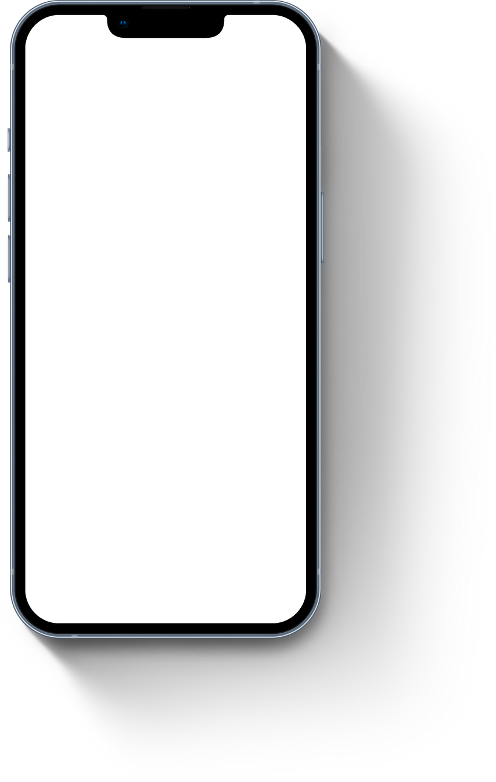






Selected Interface
01
Balances display size for functionality & allowing users to donate on-the-go.
Familiar visual interface
Broader reach and increased accessibility
02
03

Slide 5
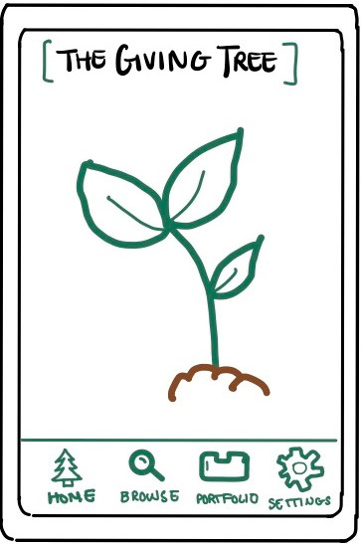
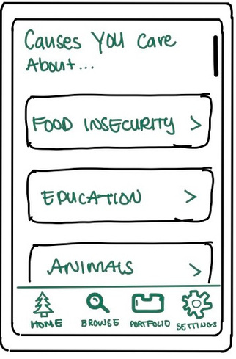
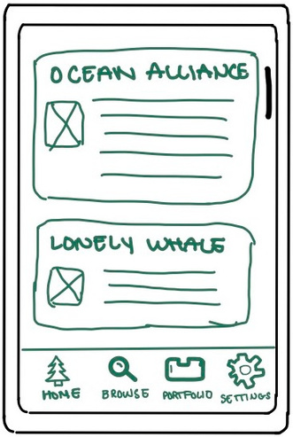
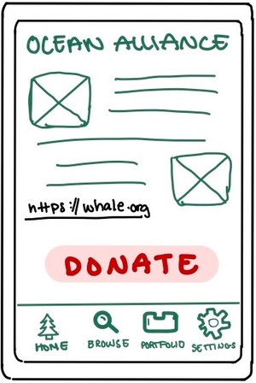
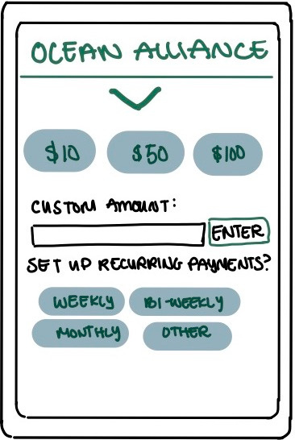
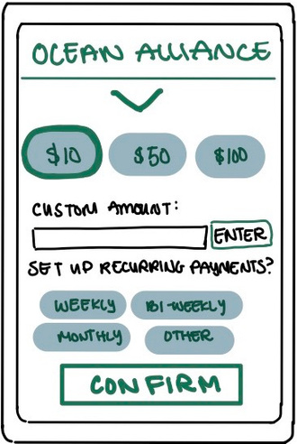


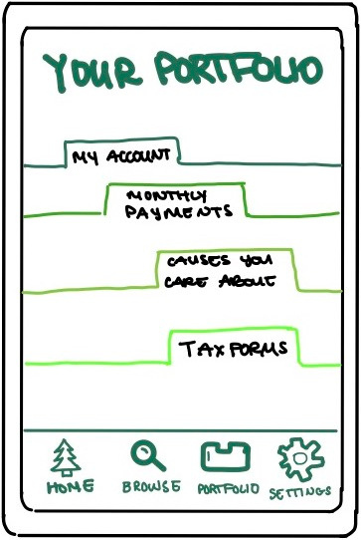
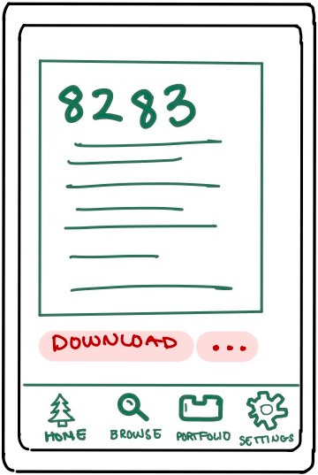
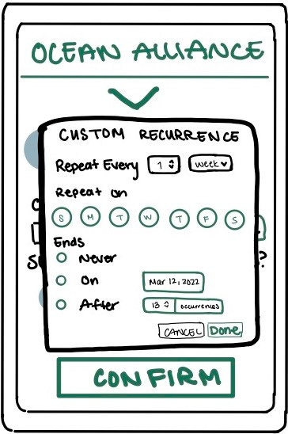
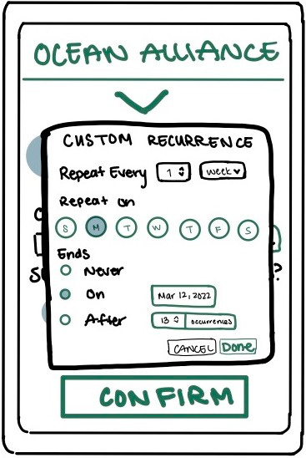
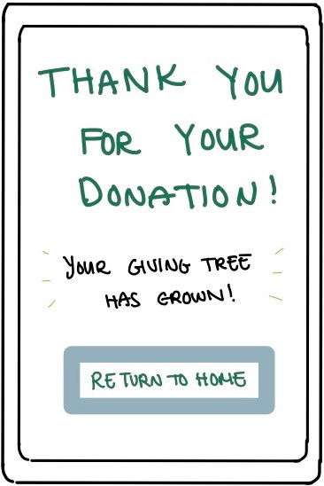
Low-Fi Prototype Structure
MARVEL APP

Slide 6
Simple Task: Donate to a charity
Home
Browse Causes
Browse Charities
Charity for Animal Rights
Donation Options
Choose $10
Thank You
"Can you show me how you would go about donating $10 dollars to Ocean Alliance, an Animal Rights organization?"

Slide 7
Medium Task: Set Up Recurring Donations
Donation Options
Choose Donation Frequency
Confirm Choice
Thank You
"Can you show me how you would set up recurring donations to Ocean Alliance for every Monday up to and including March 12th?"

Slide 8
Complex Task: Download Tax Form 8283
Home
Portfolio
Tax Form 8283
"Can you show me how you would go about finding and downloading the Tax Form 8283 for Charitable Donations?"

Slide 9





Experimental Method
PARTICIPANTS
P1
P3
P5
50s, East-Asian male
Geo-engineer
Less familiar with technology Does not donate very often
Early 20s, White male
Stanford student
Very familiar with technology Does not donate very often
20s, East-Asian female
College Student
Very familiar with technology
Does not donate very often
P2
P4
Late 20s, Latino male
Bartender
Very familiar with technology
Does not donate very often
40s, White female
Social worker
Medium familiarity with technology
Donates very often

Slide 10

Experimental Method
USABILITY GOALS
KEY METRICS
Efficiency: minimal task completion time
Robustness: minimal error rates and users can recover from errors
Time to complete each task
Number of times per task the participant presses the wrong button or a non-button

Slide 11
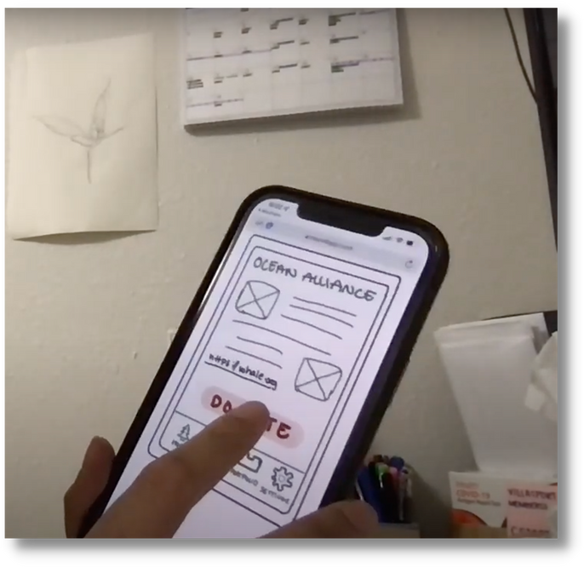
Experimental Method
PROCEDURE
01
Explain the scenario for the app, share and demo the prototype
Ask the participant to open the prototype link on their phone and to hug their laptop (so the camera is recording the phone) so we can see what happens
Give participants one task at a time, and ask them to think aloud as they accomplish the tasks. Time participants for each task and observe for critical log
After all tasks are completed, give participant a short exit interview
02
03
04

Slide 12
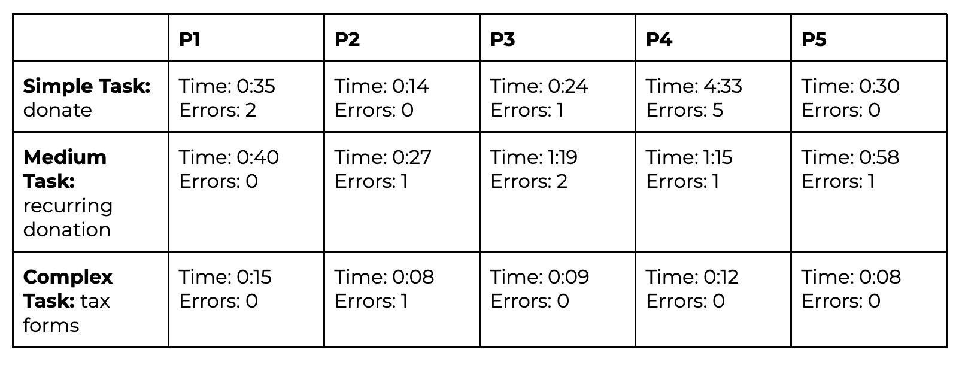

Results
Overall, efficiency and robustness was lowest for the medium task: setting up recurring donations.

Slide 13
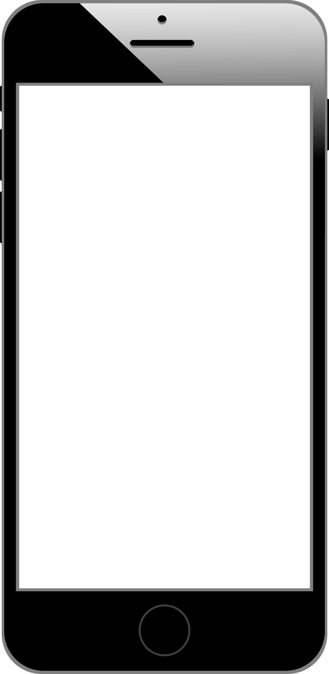
RESULTS
Feedback
Home Screen
Some were confused about the relationship between the sprout and donations.
One wanted to be able to find causes directly from the home screen
Navigation Bar
Some were confused about Portfolio icon functionality.
All correctly identified intended functionality of Home, Browse, and Settings icons.
Some appreciated the familiarity in organization.

Slide 14
RESULTS
Feedback
Finding and Donating to an Organization
Some liked the straightforwardness and simplicity of finding organization to donate to.
Some wanted a search bar to quickly find a specific organization.
All found making a one-time donation intuitive.
Recurring Donations
All struggled picking between using the weekly vs custom calendar options.
All found setting up recurring donations unintuitive.

Slide 15
RESULTS
Feedback
Portfolio
Most liked the filing system layout.
One user expected the Tax Form to be in Settings instead.
Other
One user wanted back buttons and the ability to swipe between screens.
One user wondered where they would input bank information.

Slide 16
Suggested UI Changes
01
02
03
Visual Design
Content Design
Interaction Design
Add more visual cues to make the functionality of the tree and portfolio clear.
Add a search bar in the Browse section to look up a cause or organization.
Remove the ability customize donations beyond weekly, bi-weekly, and monthly payments.
Add back buttons + ability to swipe between screens.

Slide 17
Summary
03
Three Tasks
Simple: Donate to a charity
Medium: Recurring donations
Complex: Download Tax Form
01
Mission Statement
To help donors donate easily and effectively to the causes they care about and track their donations over time.
04
Feedback
Users enjoyed the simplicity of the design.
Most of the app was intuitive.
Users struggled with setting up recurring donations, and found the task unintuitive.
02
Mobile Interface
Chosen for familiarity, balance between screen size and functionality, and increased reach and accessibility.
05
UI Changes
Clarity for the Home Screen Tree and Portfolio icon.
Search bar in Browse.
Remove recurring donations.

Slide 18
Thank You
https://hci.stanford.edu/courses/cs147/2022/wi/projects/SystemicJusticeAndEquity/theGivingTree

