Slide 1
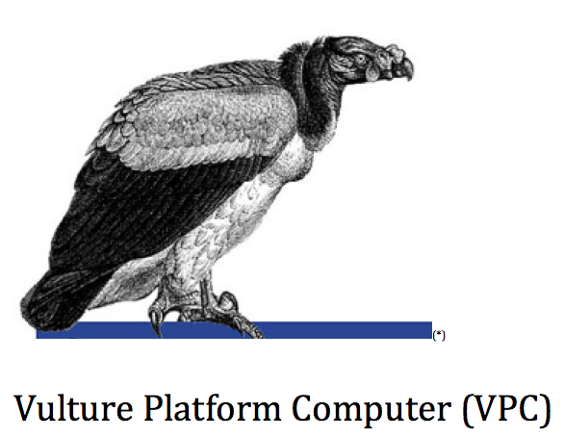

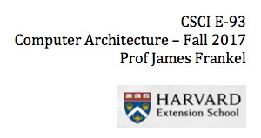

Slide 2
Why Vulture?
Why not?
Eagles and hawks are widely used and overrated
It is the mascot of my Brazilian soccer team -Flamengo
etc

Slide 3
What is Vulture Platform Computer?
A 32-bit word computer, designed and implemented for academic purposes
Instructions 32 user registers and 2 protected registers (IR and PC)
16-bit memory addressable (FPGA limitation)
27 Assembler Instructions, largely inspired on MIPS
One FSM, 12 states
Intended novel feature: hardware interruption (not implemented)

Slide 4
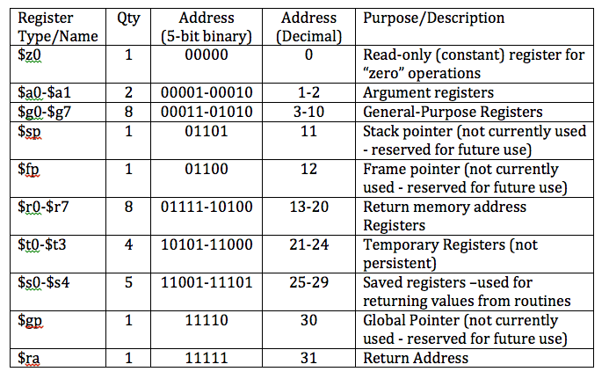
VPC Registers

Slide 5
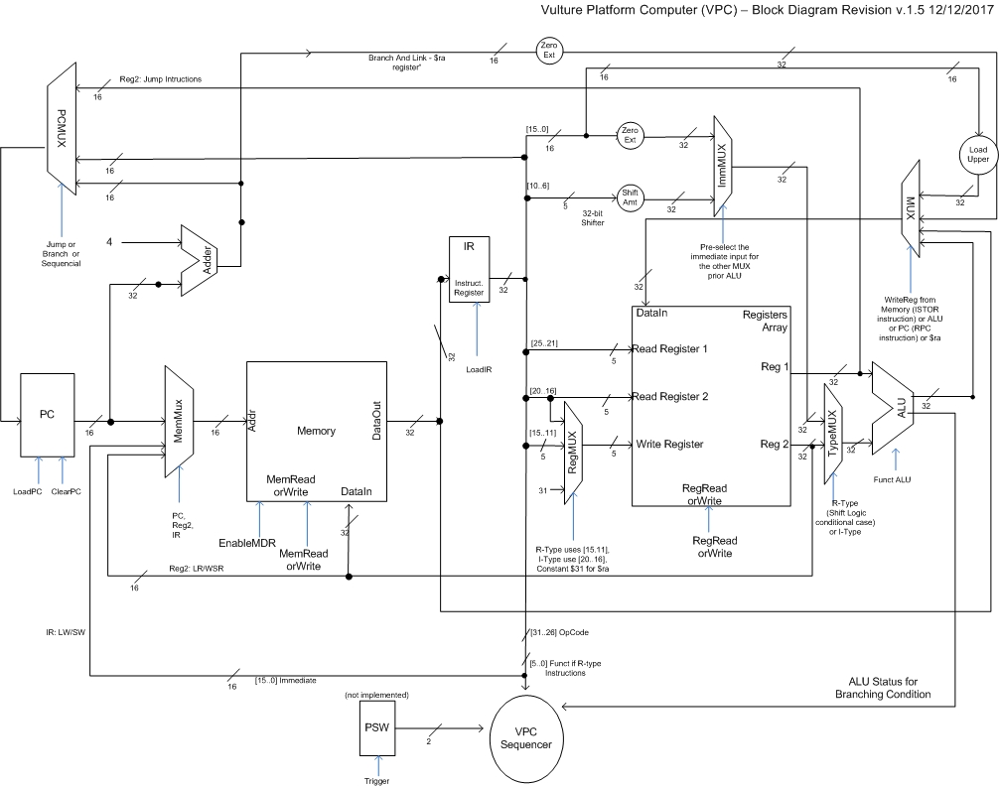
Block Diagram

Slide 6
VPC Finite State Machine
Initial ->
FetchAwaitMemoryInstruction ->
FetchReadingInstruction ->
ParseIntruction (next state depends of the instruction type)
ExecuteInstruction ->
ExecuteInstruction2 -> FetchAwaitMemoryInstruction
WriteBackAwaitMemory (previous state ParseInstruction)
WriteBackWriting
Written -> ExecuteInstruction
FetchAwaitMemoryUserData (previous state ParseInstruction)
FetchReadingUserData
FetchedUserData -> ExecuteInstruction

Slide 7
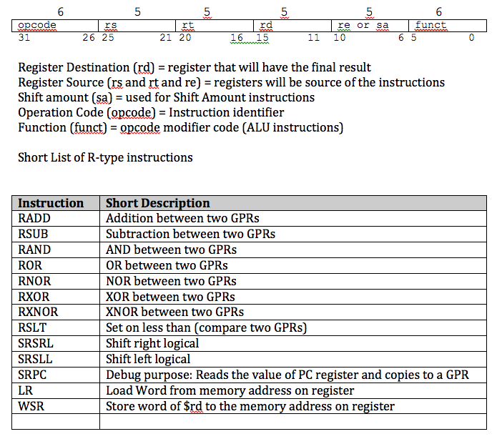
VPC Instructions R-type

Slide 8
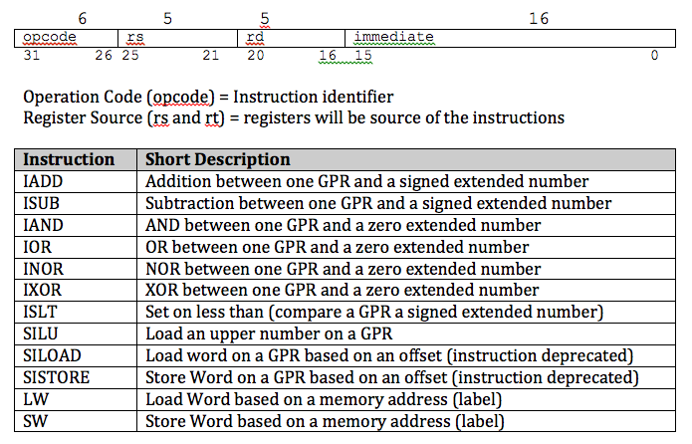
VPC Instructions I-type

Slide 9
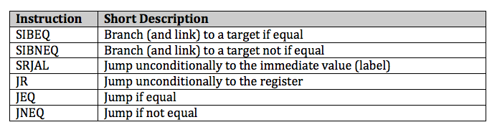
VPC Instructions J-type

Slide 10


VPC Compiler Directives
Labels (before any block of code)
Address
Ascii

Slide 11
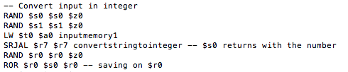
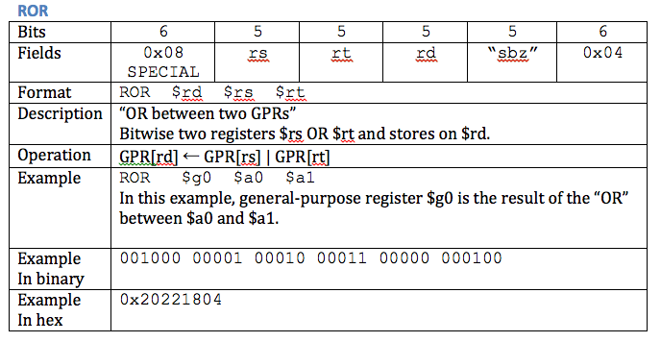
VPC Assembler Code Snippet

Slide 12
VPC Assembler Compiler
rbrito$ java -jar target/vpc-assembler-1.1-SNAPSHOT.jar reg_sample.asm
ERROR: VPC Compiler could not parse the line: unknown instruction. line 2
ERROR: VPC Compiler could not parse the line: unknown instruction. line 7
ERROR: VPC Compiler could not parse the line: unknown instruction. line 10
ERROR: VPC Compiler found 3 parse errors. Aborting
rbrito$ vi reg_sample.asm
rbrito$ java -jar target/vpc-assembler-1.1-SNAPSHOT.jar reg_sample.asm
DEPTH = 32768;
WIDTH = 16;
ADDRESS_RADIX = HEX;
DATA_RADIX = HEX;
CONTENT
BEGIN
0000 : 4C00 ; -- SIBEQ points to label main, decimal value of 4
0001 : 0004 ;
0002 : 0401 ;
0003 : 0001 ;

Slide 13
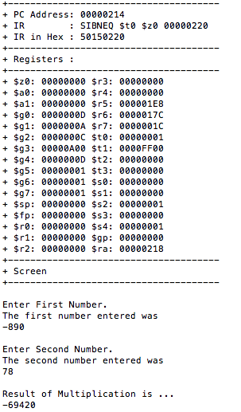
VPC Emulator

Slide 14
https://www.youtube.com/watch?v=gvAxTfBhVyo&t=13s VPC Demo

