Slide 1

Final Project Credit Card Fraud Detection: A Simple Neural Network compared to Google’s AutoML Service
Brito, Rafael
CSCI E-89 Deep Learning, Spring 2019
Harvard University Extension School
Prof. Zoran B. Djordjević

Slide 2
Google Cloud Platform AutoML
https://cloud.google.com/automl/

Slide 3
Problem Statement and Rationale of Case Study
Banks are required to continuously develop/deploy technology to detect fraud more accurately.
The same corporations do not have necessarily know-how and/or agility (time-to-market) to deploy state-of-the-art Machine Learning models.
Currently there are solutions that require minimum effort to develop/deploy Machine Learning models such as the newest AutoML service (Beta) from Google Cloud Platform (GCP).
This case study compares the efficacy of credit card fraud detection between a Keras “home-grown” Simple Neural Network versus AutoML.

Slide 4
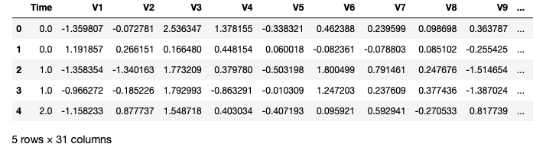
Credit Card Fraud Dataset
Kaggle Public Dataset: https://www.kaggle.com/mlg-ulb/creditcardfraud with 66MB compressed, 150MB uncompressed.
Data is transactions made by credit cards in September 2013 by european cardholders. The dataset is highly unbalanced, 492 frauds out of 284,807 transactions with frauds account for 0.172% of all transactions.
For confidentiality purposes most of features are not identified - they are labeled as V1, V2,.., V28 – and their values are already normalized.
“Time” and “Amount” features are not scaled/normalized.

Slide 5
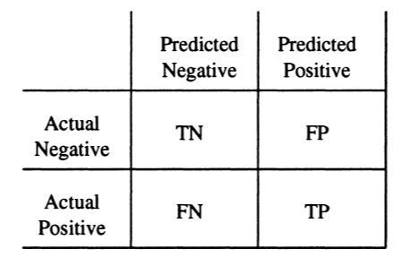
Imbalanced Dataset
Imbalanced dataset requires some extra attention;
Only 0.172% of all transactions are positive for fraud: not advisable to train using the dataset “as is” (model will be biased to negative for fraud).
For best results, we need to create subsample with a 50/50 ratio of fraud and non-fraud transactions and use for training.
Confusion matrix is a key metric for imbalanced dataset (https://www3.nd.edu/~dial/publications/chawla2005data.pdf) :

Slide 6
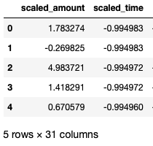
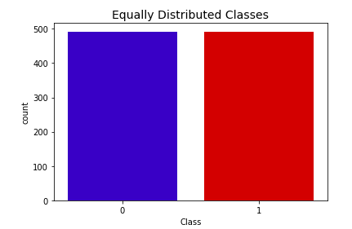
Pre-Processing Dataset
Scaled “Amount” and “Time” used sklearn RobustScaler
Created a subset undersample with 984 entried, 50% with fraud and 50% non-fraud. Saved as creditcard-subset-distributed.csv

Slide 7

Interpreting Data
Used https://www.kaggle.com/janiobachmann/credit-fraud-dealing-with-imbalanced-datasets for reference.
Correlation Matrix with seaborn: V17, V14, V12 and V10 are negatively correlated. V2, V4, V11, and V19 are positively correlated.
ATTENTION: Correlation Matrix must be done using the under sample (not the entire dataset)

Slide 8

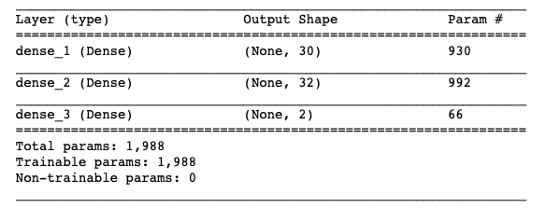
Simple Neural Network
Since the goal is compare with Google AutoML, we opted to a simple neural network (https://www.kaggle.com/janiobachmann/credit-fraud-dealing-with-imbalanced-datasets )
Remembering the training sample is extremely small: it took seconds to be completed on 2013 Mac Air

Slide 9
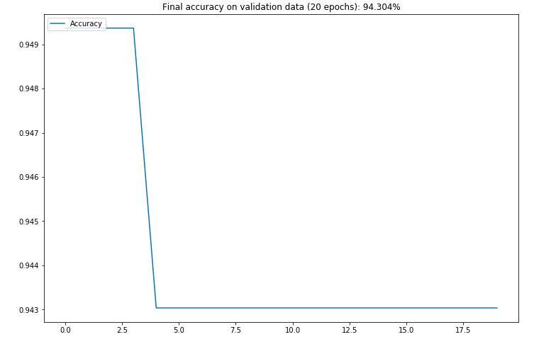
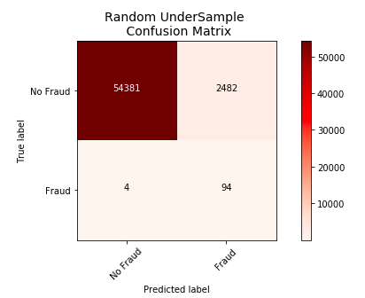
Results of Simple Neural Network
There were 2482 false positives (4.5%) and 4 false negative (4%).

Slide 10
How I ran it on AutoML (Step 1)
Loaded entire Dataset on Bigquery: PURPOSELY NO PRE-PROCESSING

Slide 11
How I ran it on AutoML (Step 2)
Follow the Flow of AutoML: Import Data

Slide 12
How I ran it on AutoML (Step 3)
Follow the Flow of AutoML: Select the Target (in this case, “Class”)

Slide 13
How I ran it on AutoML (Step 4)
Follow the Flow of AutoML: Analyze.
It took 30 minutes and generated correlation features. ISSUE: The differences from our home-grown solution were considered: V7, V3 and V5 showed as per Google. V2, V4, v11 did not show.

Slide 14
How I ran it on AutoML (Step 5)
Follow the Flow of AutoML: Training. It took 5 hours to be completed (first 6 hours are free).

Slide 15
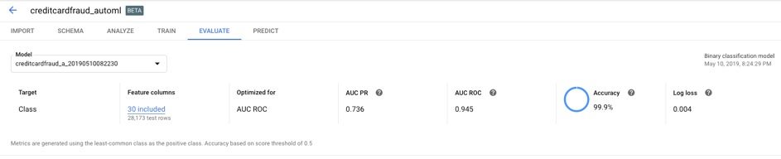
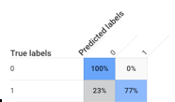
How I ran it on AutoML (Step 6)
Follow the Flow of AutoML: Evaluate

Slide 16
Conclusion
Google AutoML was better on false positives (0% versus 4.5%)
Home-grown Simple NN was much better on false negatives (4% versus 23%)
(Lots of) Room to improve on both solutions:
On Google AutoML: training with subsample with 50/50 for fraud
On Simple RNN: Using SMOTE technique and/or more elaborate Neural Network models
Although 23% on false negatives is a bad score, keep in mind there was “zero” coding and “zero” data pre-processing on Google AutoML. If Google improves the processing of imbalanced data, it will show a strong option for corporations to quickly deploy and use ML models without any know-how.

Slide 17
Bonus: Easy Deployment of the Model
With AutoML, the model can be automatically deployed and accessible from the internet as a microservice over REST API, requiring “zero” instrastructure

Slide 18
YouTube URLs
On following links, I created videos to explain this use case:
Two minute (short video, high-level): https://youtu.be/LL-xICch1d8
15 minutes (long video, more details): https://youtu.be/R27Q3H0rRk4

