Slide 2
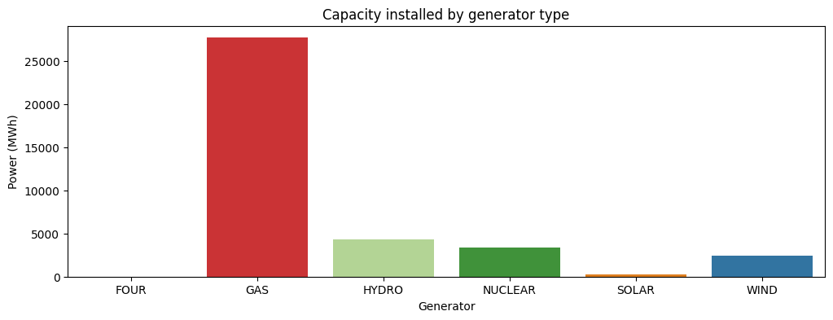
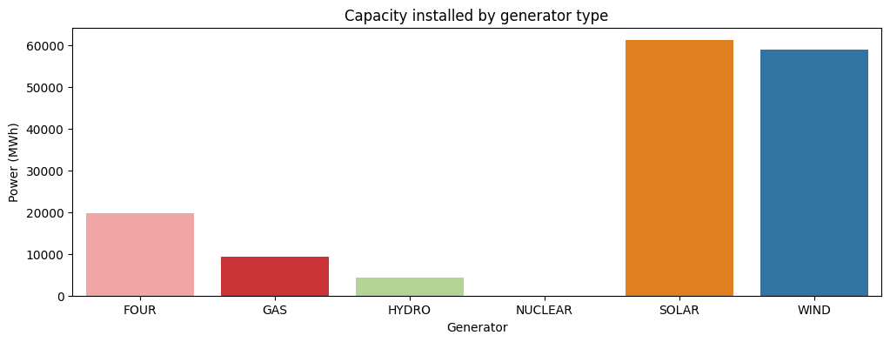
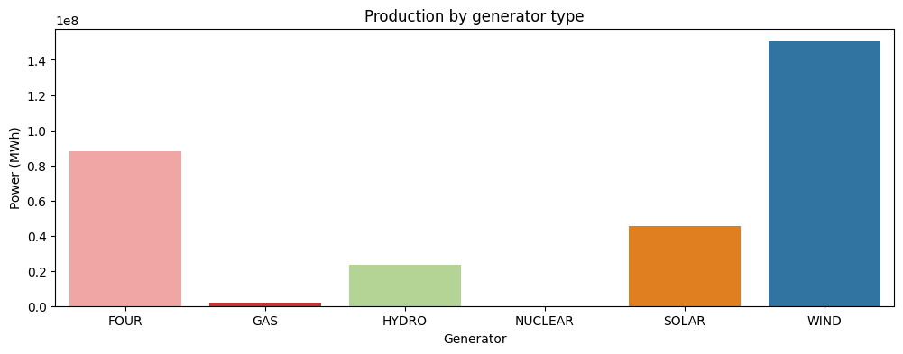
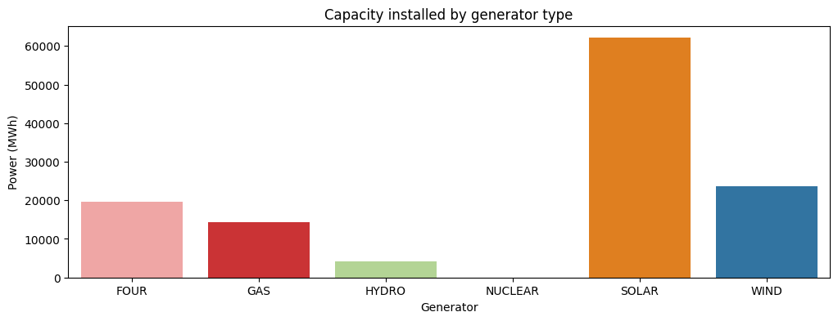
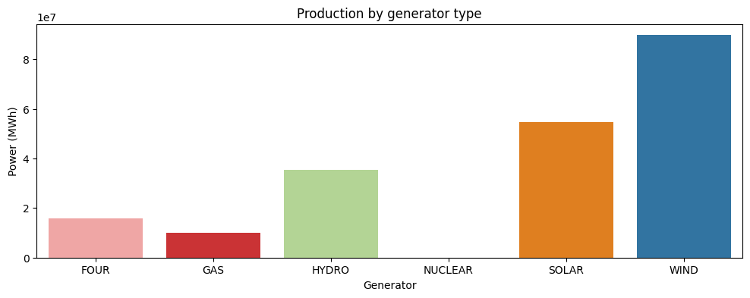

Slide 3
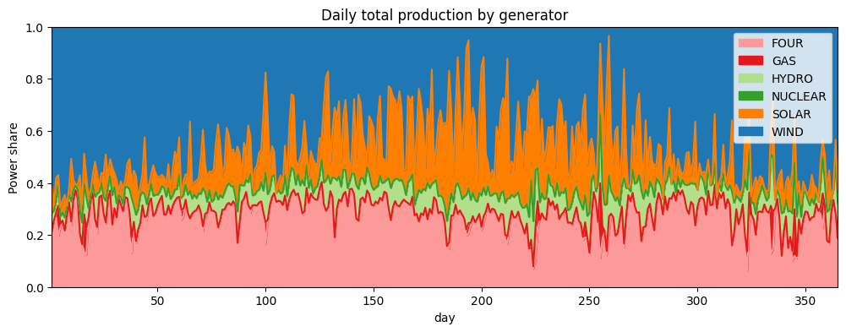
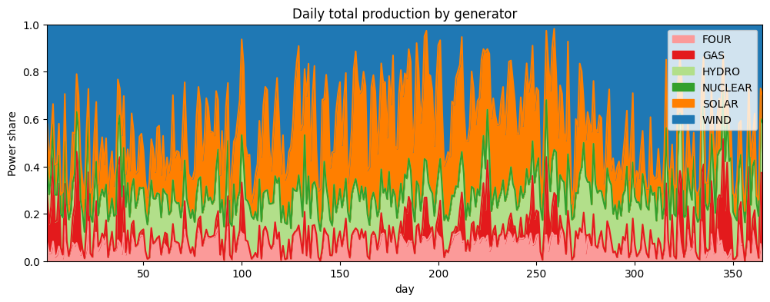

Slide 4
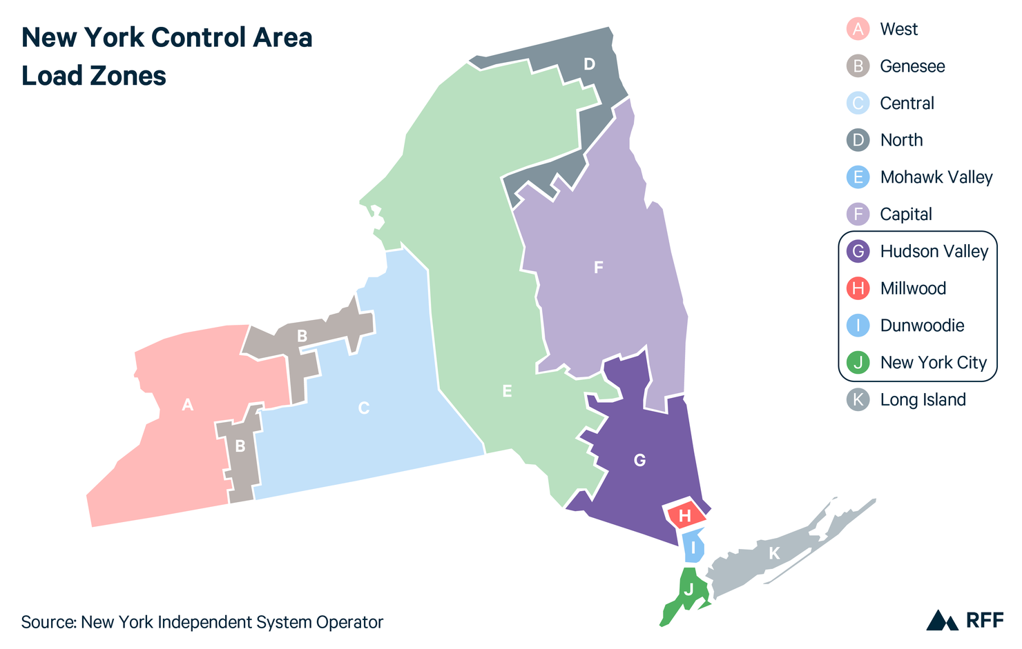
Line | Avg. Flow | Max Flow
AB | 50% | 19%
BC | 78% | 56%
CE | 45% | 11%
DE | 56% | 30%
EF | 79% | 62%
EG | 92% | 86%
FG | 61% | 21%
GH | 51% | 2%
HI | 43% | 0%
IJ | 71% | 43%
IK | 90% | 81%
JK | 99% | 97%
Line | Avg. Flow | Max Flow
AB | 76% | 57%
BC | 67% | 23%
CE | 27% | 2%
DE | 53% | 15%
EF | 51% | 17%
EG | 97% | 93%
FG | 45% | 3%
GH | 49% | 2%
HI | 41% | 0%
IJ | 64% | 38%
IK | 90% | 78%
JK | 97% | 94%

Slide 5
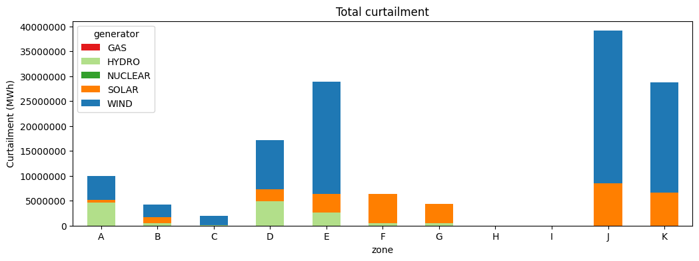
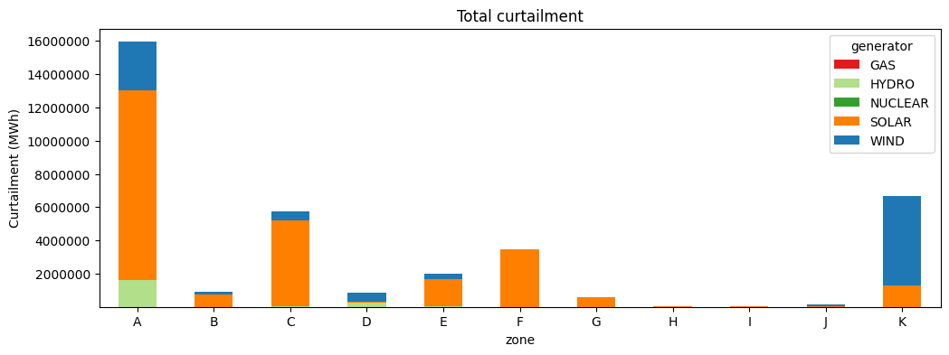

Slide 6
