Slide 1
Wildfire Events National Aeronautics and Space Administration Earth Observatory Natural Event Tracker (NASA EONET)
By Brittany Minor and Amanda Matheu

Slide 2
Wildfire Event Questions
What time of year do the most wildfires start?
Where do the most wildfires occur?
How many wildfires occur on average in a year?

Slide 3
Data Limitations
The EONET data collection began in 2015, so there are only a few years of complete data
The EONET data seems to skew towards reporting on United States data
No information about the scale or size of the fire event nor the economic or environmental impact

Slide 4
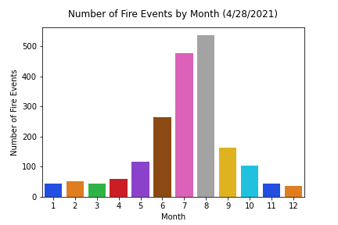
What time of year do the most wildfires start?
Most frequent: August
Average month: July
One Standard deviation: May - Sep

Slide 5
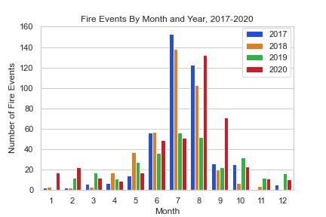
What time of year do the most wildfires start?
Most complete data was between 2017-2020
Most fires occurred in 2020

Slide 6
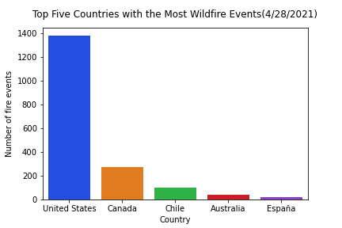
Where do the most wildfires start?
Most fires occurred in the USA
Distribution: Right skewed
Notes:
52 countries total but the vast majority only had one fire, Spain only has 22 fires and it’s top 5
Other data sources indicate that there are many more fires in Russia but the data is not included
Also of note Russia, China and Brazil are all in the top 5 countries (with the US and Canada) by land mass but Russia, China and Brazil aren’t even top 5 in our data

Slide 7
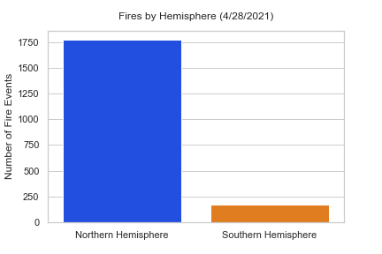
Where do the most wildfires start?
Far more fires in the Northern Hemisphere
More occupied land mass in Northern Hemisphere
Notes:
Most wildfires are caused by humans, 84% in the US

Slide 8
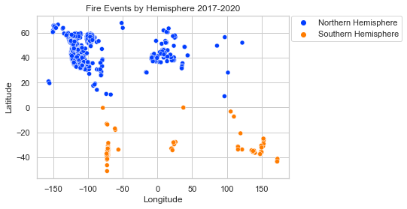
Where do the most wildfires start?
Wildfires clustered in western North America
Another cluster around Europe
Notes:
https://apnews.com/article/49f74a56b5564cae8d49f3022223d003
NASA has called Africa the “fire continent” that’s home to at least 70% of the 10,000 fires burning worldwide on an average August day, though the agency says the number of fires is consistent from year to year.
Not reflected in the data

Slide 9
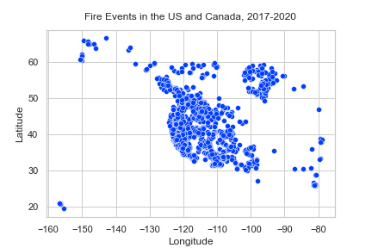
Where do the most wildfires start?
Most fires reoccur in the same places
Primarily along the western US and Manitoba to British Columbia, Canada
Notes:
Latitude 40 is Colorado
35, -105 is New Mexico
28, -98 is Texas
Below 50 latitude is Washington
Manitoba is the most eastern cluster and British Columbia is the most western cluster

Slide 10
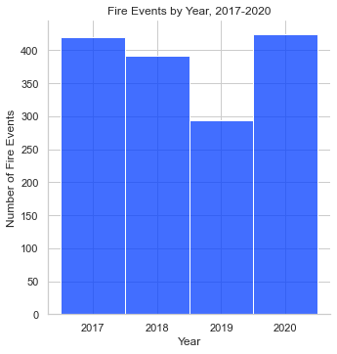
How many wildfires occur on average in a year?
Average wildfires per year between 2017-2020: 382

Slide 11
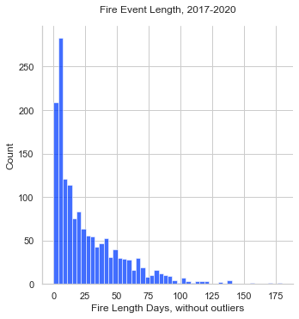
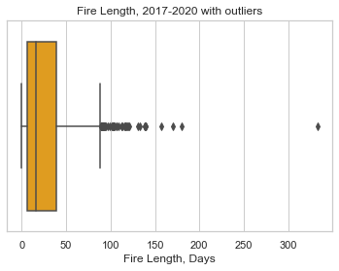
Bonus: How long were the fires on average?
Notes:
Note: all fires have a min of 0 and a max of 333.
Mean number of days: 25, median days: 16, mode days: 4

Slide 12

Free templates for all your presentation needs
For PowerPoint and Google Slides
100% free for personal or commercial use
Ready to use, professional and customizable
Blow your audience away with attractive visuals

