Slide 1
MEMORY
H. Go, J. Lee, B. Sim, T. Sithganesan

Slide 2
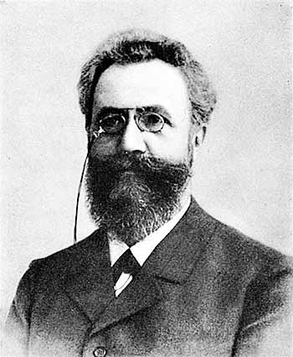
Brief History
Hermann Ebbinghaus
(1850-1909)
Notes:
https://upload.wikimedia.org/wikipedia/commons/9/92/Ebbinghaus2.jpg
http://plugandplaymin.plugandplaydesig.netdna-cdn.com/wp-content/uploads/2015/02/serial_position_effect.png
https://cdns3.trainingindustry.com/media/30782434/forgetting-curve_485x284_500x293.jpg

Slide 3
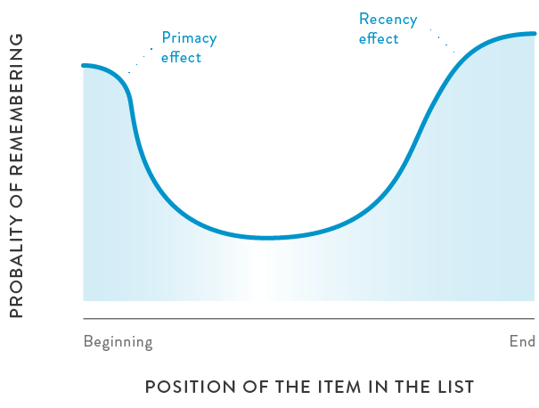
Brief History
Serial Position Effect
Primacy
Recency
Notes:
https://upload.wikimedia.org/wikipedia/commons/9/92/Ebbinghaus2.jpg
http://plugandplaymin.plugandplaydesig.netdna-cdn.com/wp-content/uploads/2015/02/serial_position_effect.png
https://cdns3.trainingindustry.com/media/30782434/forgetting-curve_485x284_500x293.jpg

Slide 4
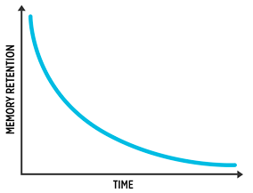
Brief History
Forgetting Curve
Notes:
https://upload.wikimedia.org/wikipedia/commons/9/92/Ebbinghaus2.jpg
http://plugandplaymin.plugandplaydesig.netdna-cdn.com/wp-content/uploads/2015/02/serial_position_effect.png
https://cdns3.trainingindustry.com/media/30782434/forgetting-curve_485x284_500x293.jpg

Slide 5
The Model
SIMPLE
(Scale Independent Memory, Perception, Learning)
Gordon D.A. Brown, Nick Chater, Ian Neath in 2007

Slide 6
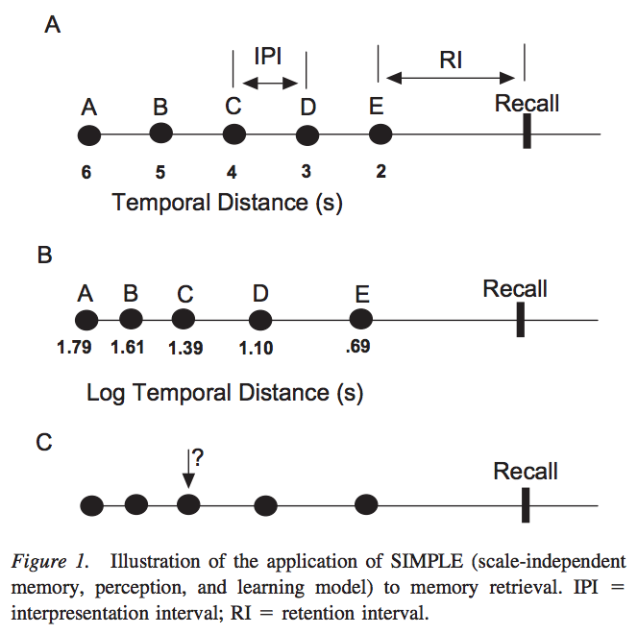
Model Assumption 1

Slide 7
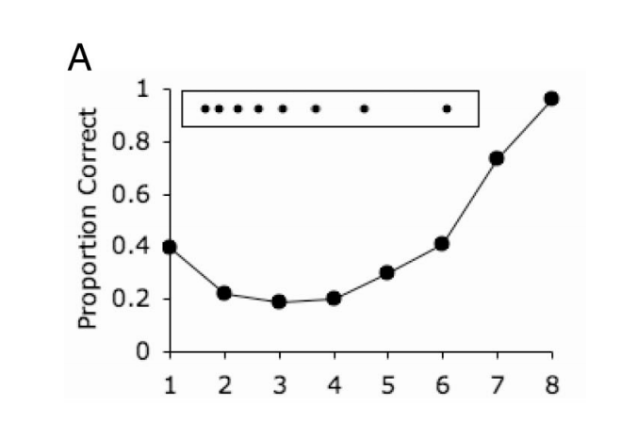
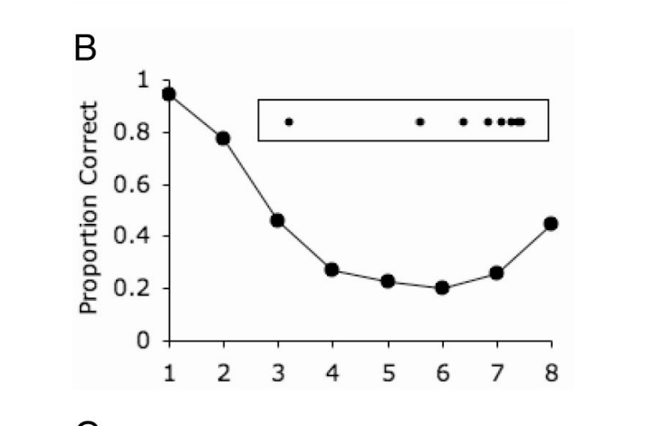
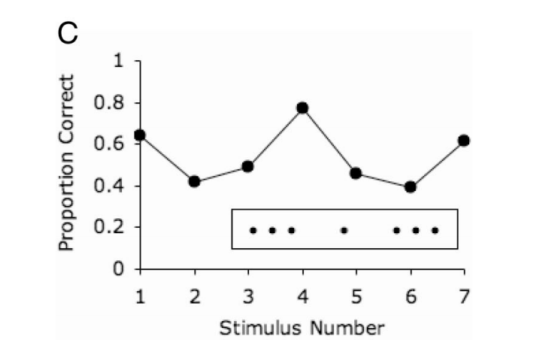
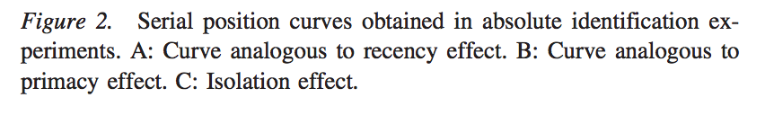
Model Assumption 2

Slide 8

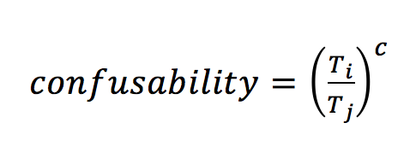
Model Assumption 3
OR

Slide 9
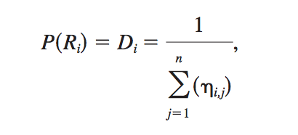
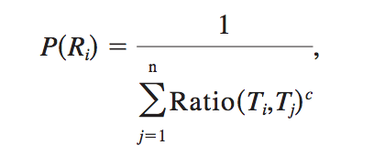
Model Assumption 4
(2)
OR
(3)

Slide 10
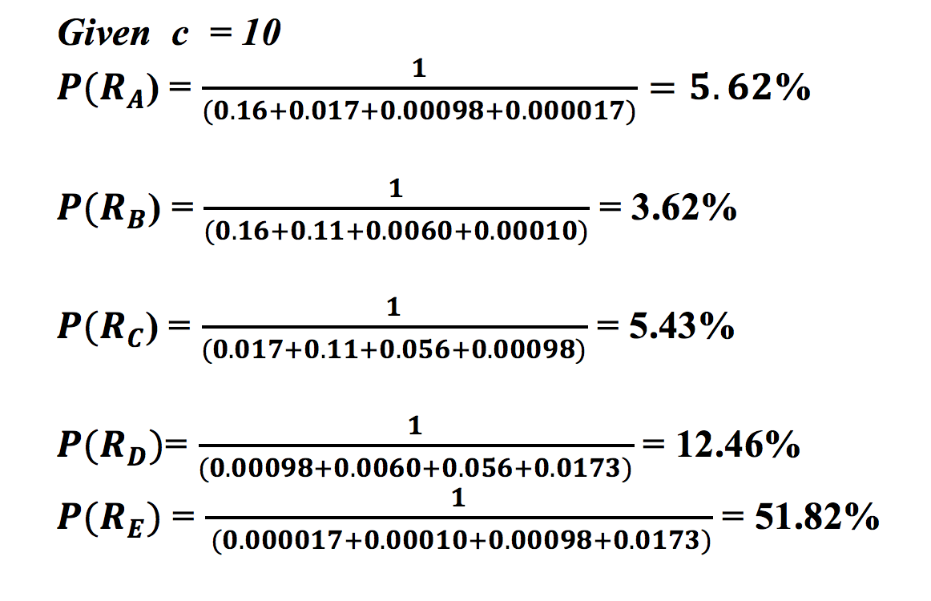
Model Assumption 4 (example)

Slide 11
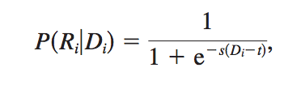
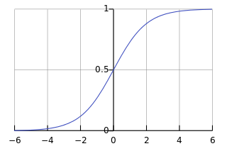
Model Assumption 4 (continued)
(4)

Slide 12
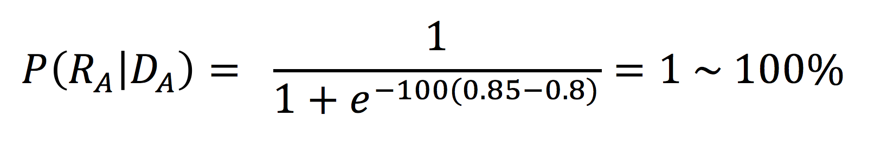
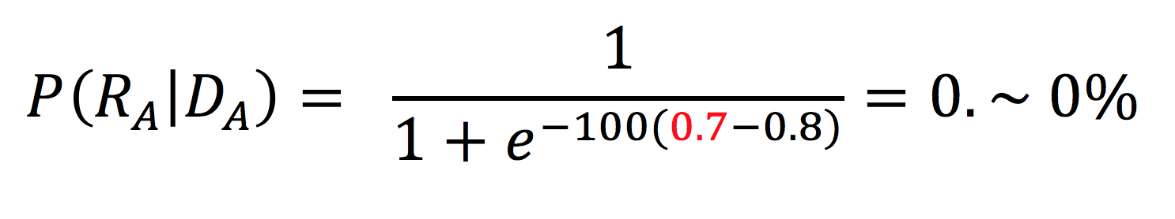
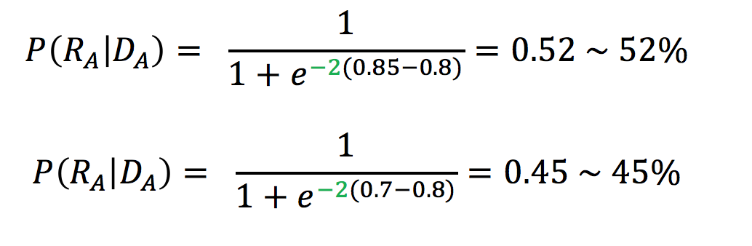
Model Assumption 4 (example)

Slide 13
Limitations of the Model Assumptions
An important limitation of this model is that it does not accommodate rehearsal processes.
By implementing rehearsal, we should be able to see a greater primacy effect.

Slide 14
Implementing Rehearsal
dR - the time between a group of rehearsed words and the subsequent presentation of a word
Rehearsal Lag - the lag between the presentation of a word and the start of rehearsal
Rehearsal Time - the time it takes to rehearse one word

Slide 15
Implementing Rehearsal
1
2
3
4
5
1
1
2
1
2
3
1
2
3
dR
dR(n) = c*( ( d(n) - d(n+1) ) - (Rehearsal Lag + Rehearsal Time*n) )

Slide 16
Implementing Rehearsal
d(1)
d(2)
1
2
3
4
5
1
1
2
1
2
3
1
2
3
dR
dR(1) = c*( ( d(1) - d(2) ) - (Rehearsal Lag + Rehearsal Time*1) )

Slide 17
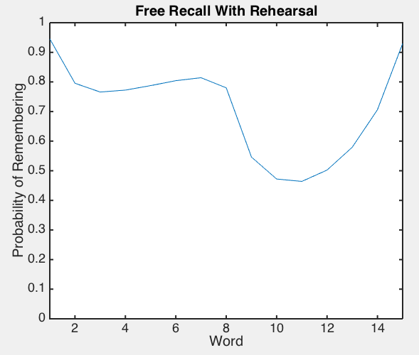
Implementing Rehearsal

Slide 18
Amnesia & Alzheimer’s Disease
Amnesia = trouble learning new information/forming new memories
(- LTM & - primacy)
AD = impairs short-term memory in earlier stages. Long-term memory may be retained longer
(- STM & - recency)

Slide 19
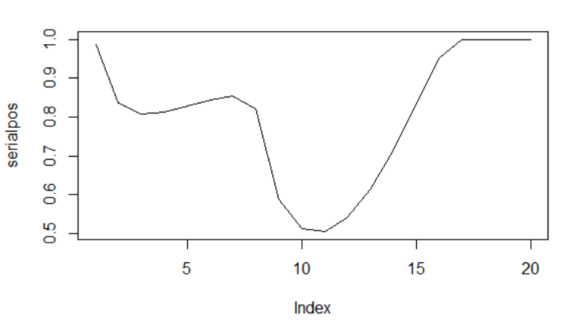
Predictions?

Slide 20
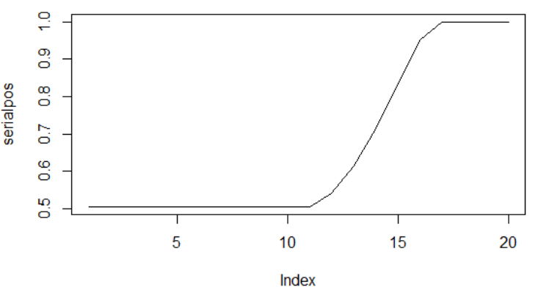
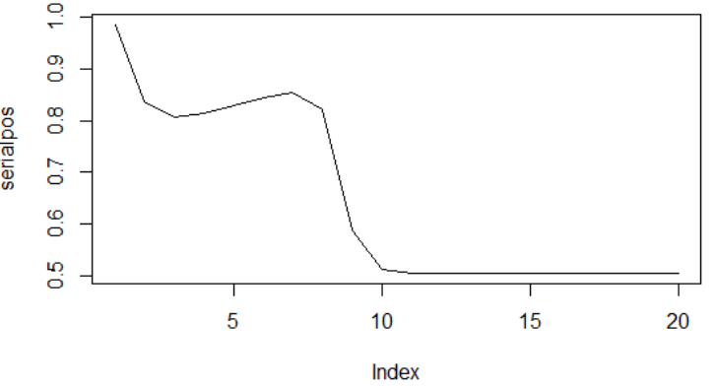
Healthy
Amnesia
AD

Slide 21
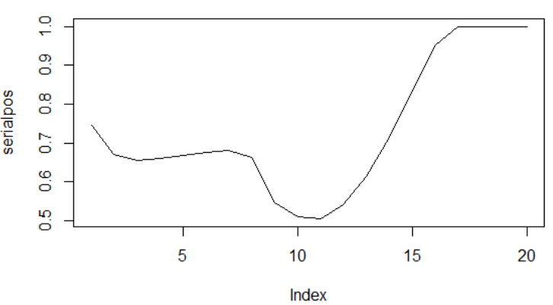
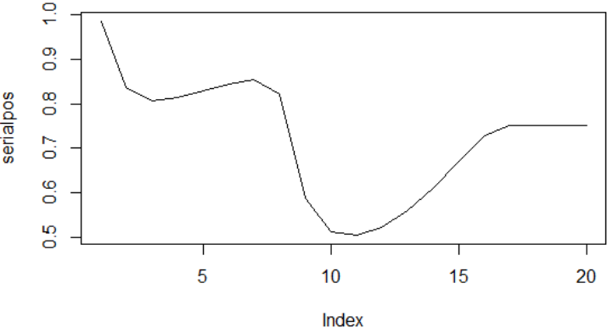
Healthy
Amnesia
AD

Slide 23
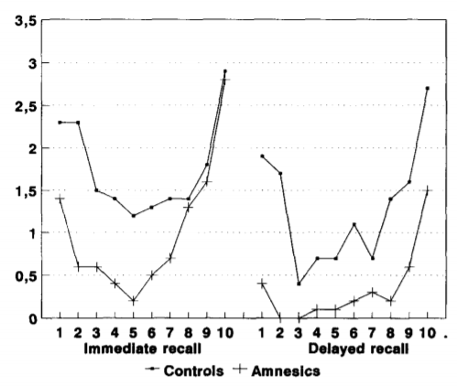
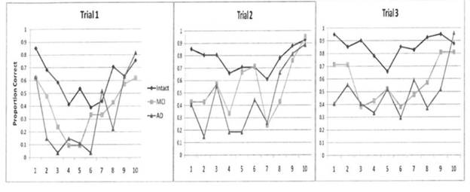
Adaptation to Research Findings

Slide 24
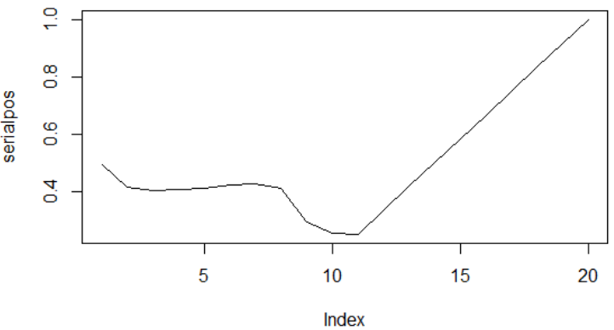
Healthy
Amnesia/
AD

Slide 25
References
Original paper:
https://www.researchgate.net/publication/6201023_A_Temporal_Ratio_Model_of_Memory
Brief History Images:
https://upload.wikimedia.org/wikipedia/commons/9/92/Ebbinghaus2.jpg
http://plugandplaymin.plugandplaydesig.netdna-cdn.com/wp-content/uploads/2015/02/serial_position_effect.png
https://cdns3.trainingindustry.com/media/30782434/forgetting-curve_485x284_500x293.jpg

