Slide 1
CMS Application
Brittany Vasquez

Slide 2
Purpose of the CMS Application
You can monitor your staff forms, staff policies, company inventory, and upcoming training for your IT Department

Slide 3
Instructions for Installation
You will need a server to import SQL file that is inside the zip folder (WAMP Server, SQL Server)
You can find instructions inside zip folder under ‘instructions’ text file

Slide 4
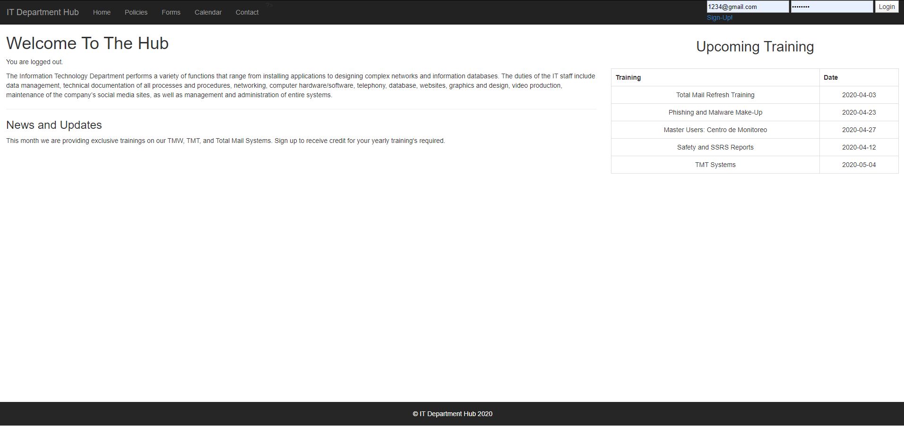
Home Page
You can edit the information according to your company style, it offers a login feature for users only required

Slide 5
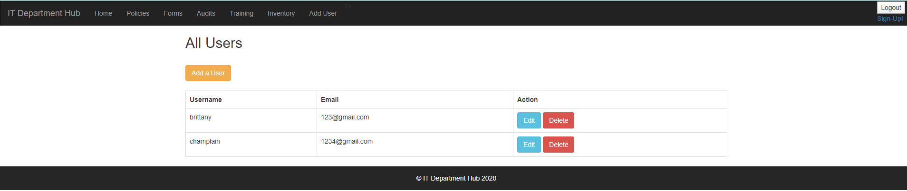
How to Add a User
Use the dbuserlogininfo that will contain the user access to login, head to ‘ADD USERS’ and add a new user for yourself or click on SIGN UP

Slide 6
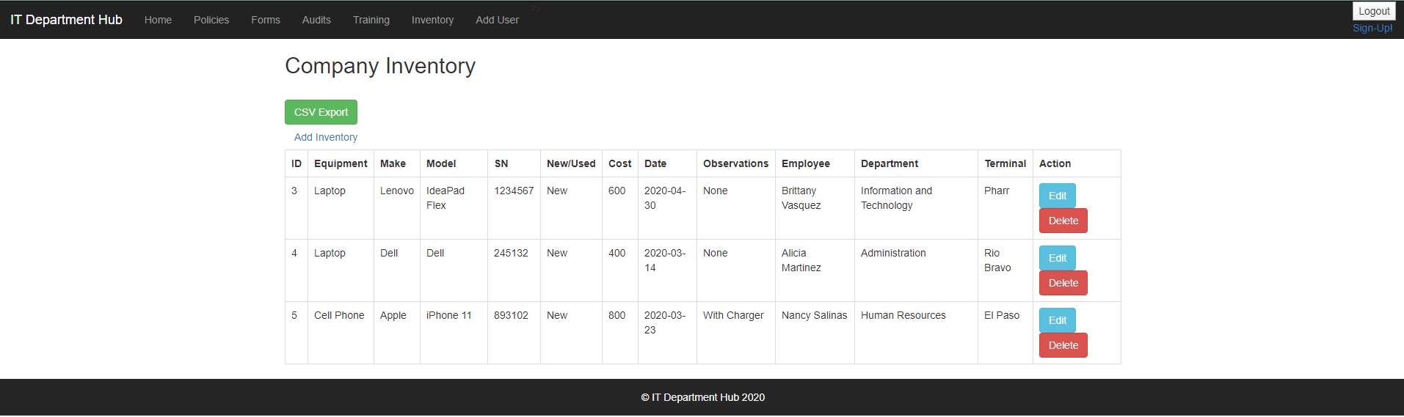
Inventory Feature
You can easily export your inventory for printing purposes, or monitoring what inventory you have on site

Slide 7
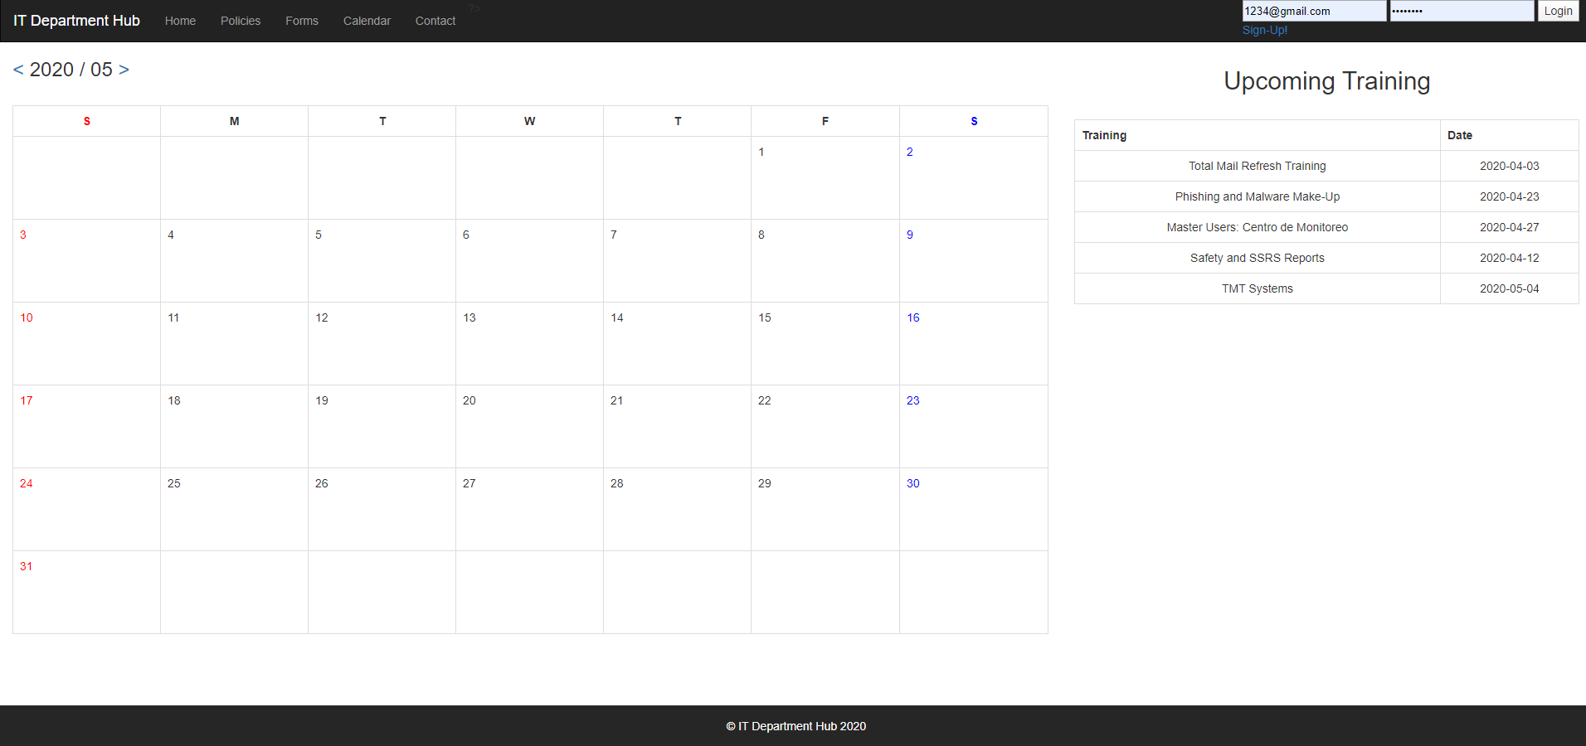
Calendar and Upcoming Training
You can find a custom PHP calendar that can also be modified to add events for the upcoming training

