Slide 1
5’ UTR
ORF1
ORF2
3’UTR
5’
3’

Slide 2
An RNA-Seq read
5’
L1 element
3’

Slide 3
L1 element in green,
Transcriptome data will be mapped to L1 regions
This shows RNA aligning to DNA
RNA-Seq reads
5’
L1 element
3’

Slide 4
Gap in reads
RNA-Seq reads
5’
L1 element
3’

Slide 5
Reads might have a gap, meaning that when this element was transcribed, the transcript would be alternatively spliced,
RNA-Seq reads
Consensus sequence
5’
L1 element
3’

Slide 6
Split reads
5’
L1 element
3’

Slide 7
5’
3’
DNA
Exon
Intron
5’
3’
Pre-mRNA
Mature mRNA
5’
3’
Alternatively spliced Pre-mRNA
Mature mRNA

Slide 8
5’
3’
DNA
5’
3’
5’
3’
5’
3’
Intron retention
5’
3’

Slide 9
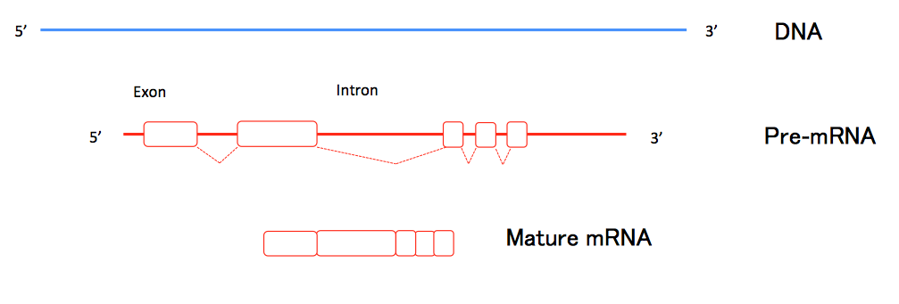

Slide 10
Non-coding – repetitive sequence
5’
3’
Non-coding – Upstream element
Non-coding - Intergenic
5’
3’
5’
3’
L1
ORF1
ORF2
5’ UTR
3’UTR
5’
3’
5’
3’
3’
Coding - Intronic
Coding - Exonic

Slide 11
Methylation
X chromosomes
- Methyl group

