Slide 1
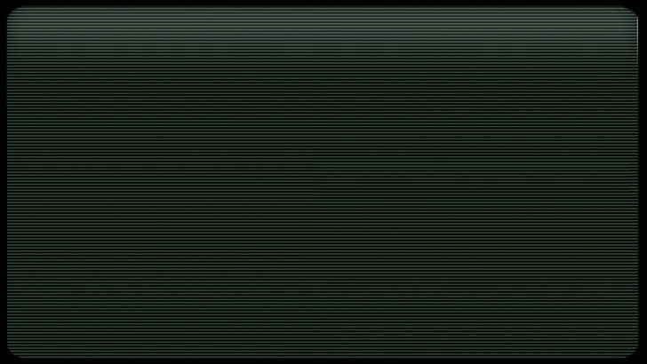

Echoes of Anna
A Decision-Based Text Adventure Game
< Brittany Woodard >< SE 2200 Software Engineering >< December 2025 >
Notes:
This project focuses entirely on storytelling, emotion, and player agency rather than typical RPGs. It’s really meant to be more of an experience than a game, which has steadily become a more solid genre of game in recent years.

Slide 2
What Exactly is This Game?
A choice-driven narrative RPG where your decisions matter.
Tone Driven Atmosphere
Branching Dialogue
Emotional Consequence
Replayability
Notes:
Emphasize “I wanted every choice to actually do something.” Mention inspiration: text adventures, interactive fiction, branching storytelling, passion for writing.

Slide 3
The Problem
There are two common issues story-based RPGs face:
Choices don’t change anything
Stories can feel predictable or shallow
Feels like time and effort are wasted
Notes:
connect to why you personally wanted meaningful branching. (Games where you have to pick between saving 2 character and whoever you save dies anyway, etc)

Slide 4
Project Goals
Make choices meaningful
Build tension through emotional consequence
Utilize Ink + Figma to clearly visualize branching
Keep the UI simple + immersive
Create a polished Act I prototype
Notes:
Explain how you approached complexity in a solo-dev project. As I really started outlining what I wanted for this project, even boiled down as simple as I could make it, I landed on focuses on Act I as a sort of proof of concept.

Slide 5
What Makes Echoes of Anna Unique?
Consequence stacking
Variable-based reactions
Ambiguous emotional beats
Replayability via narrative
curiosity
trust
autonomy
Notes:
Talk about your “triangle” variables and how they shape future dialogue without revealing everything.

Slide 6
Core Gameplay Functions
Start Game → Enter Name
Branching dialogue system
Process choices + consequences
Save/Load + auto-save at key moments
Settings for accessibility (text size + volume)
* Functional Requirements
Notes:
Mention how these functions guided the prototype structure. Note that Ink made the dialogue system and choice/consequence tracking very straightforward

Slide 7
Quality Goals
Readability first
Fast response time
Very stable
Low resource use
Accessible UI
* Non-Functional Requirements
Game Font -White Rabbit
Notes:
Explain why readability mattered so much (your game is entirely text). Talk about matching the theme of the game while still being legible. Mention possible font options in a full release

Slide 8
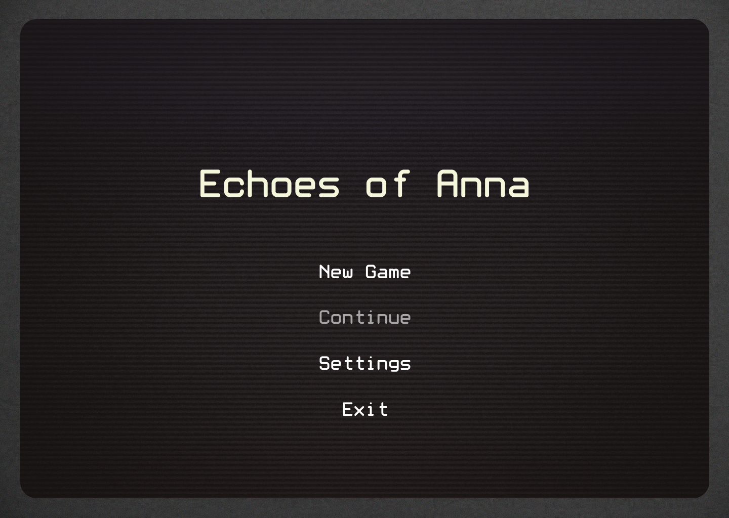
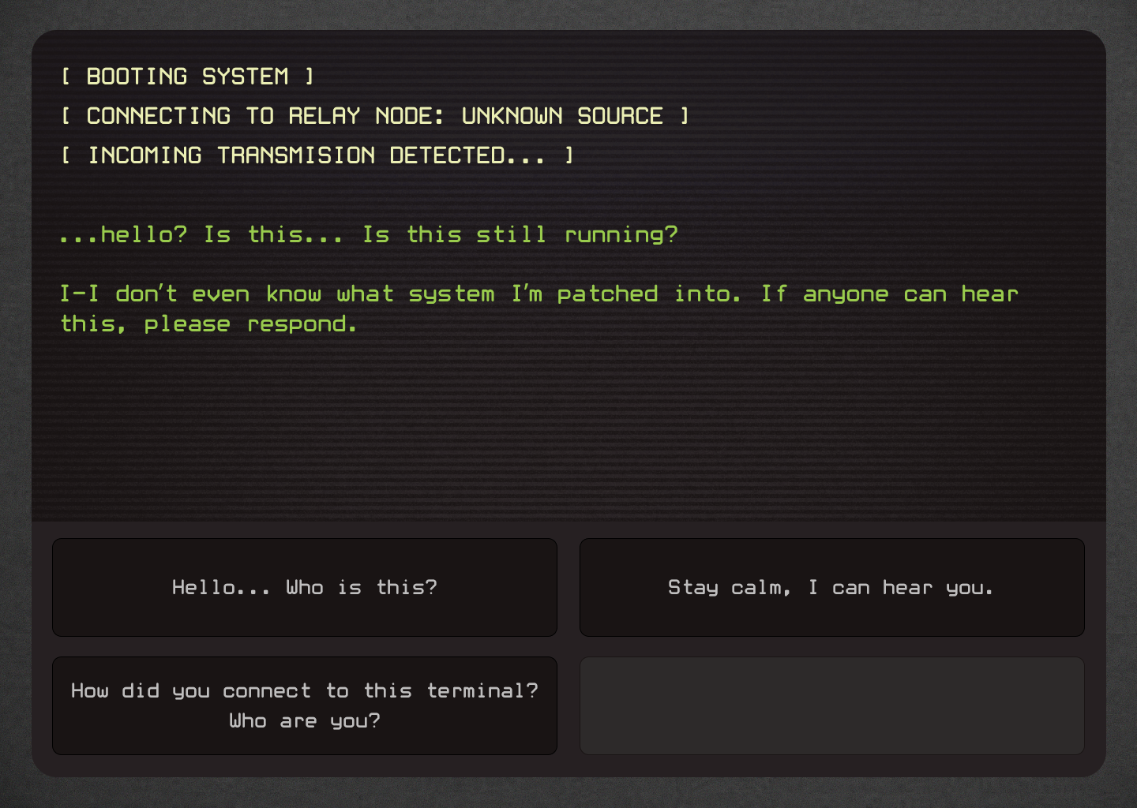
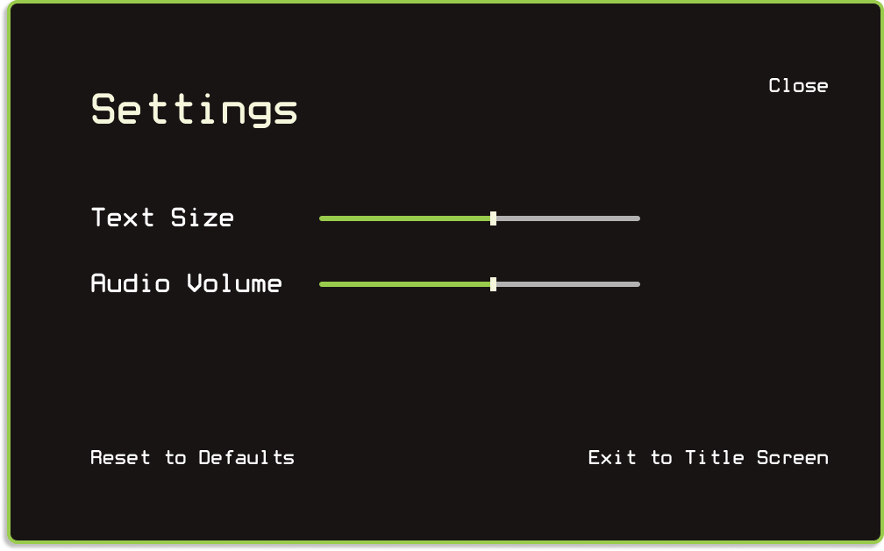
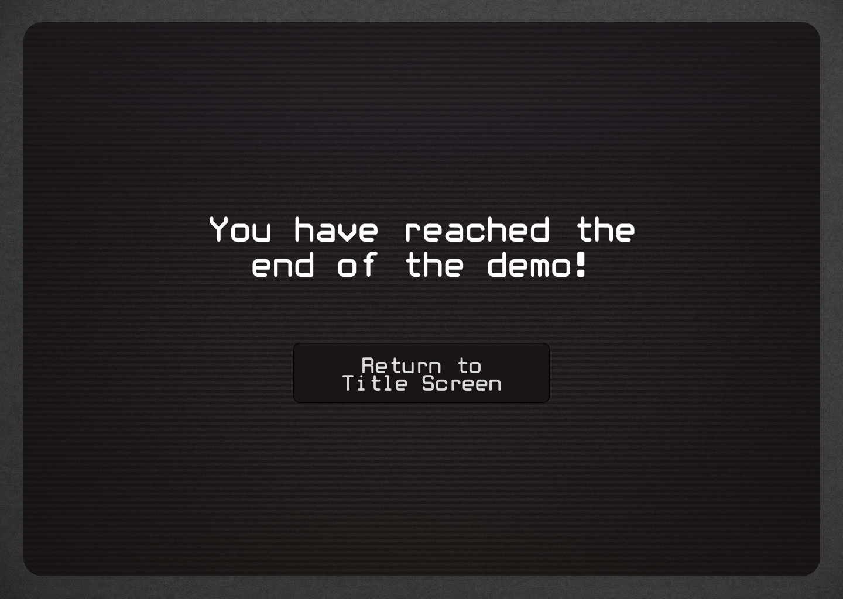
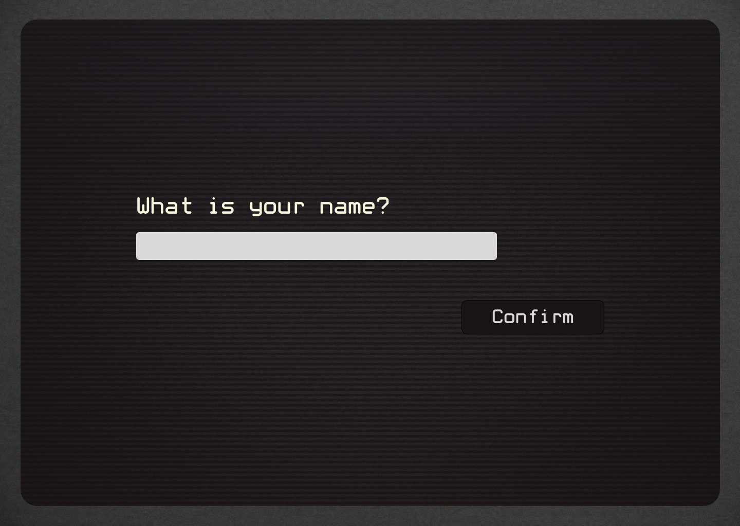
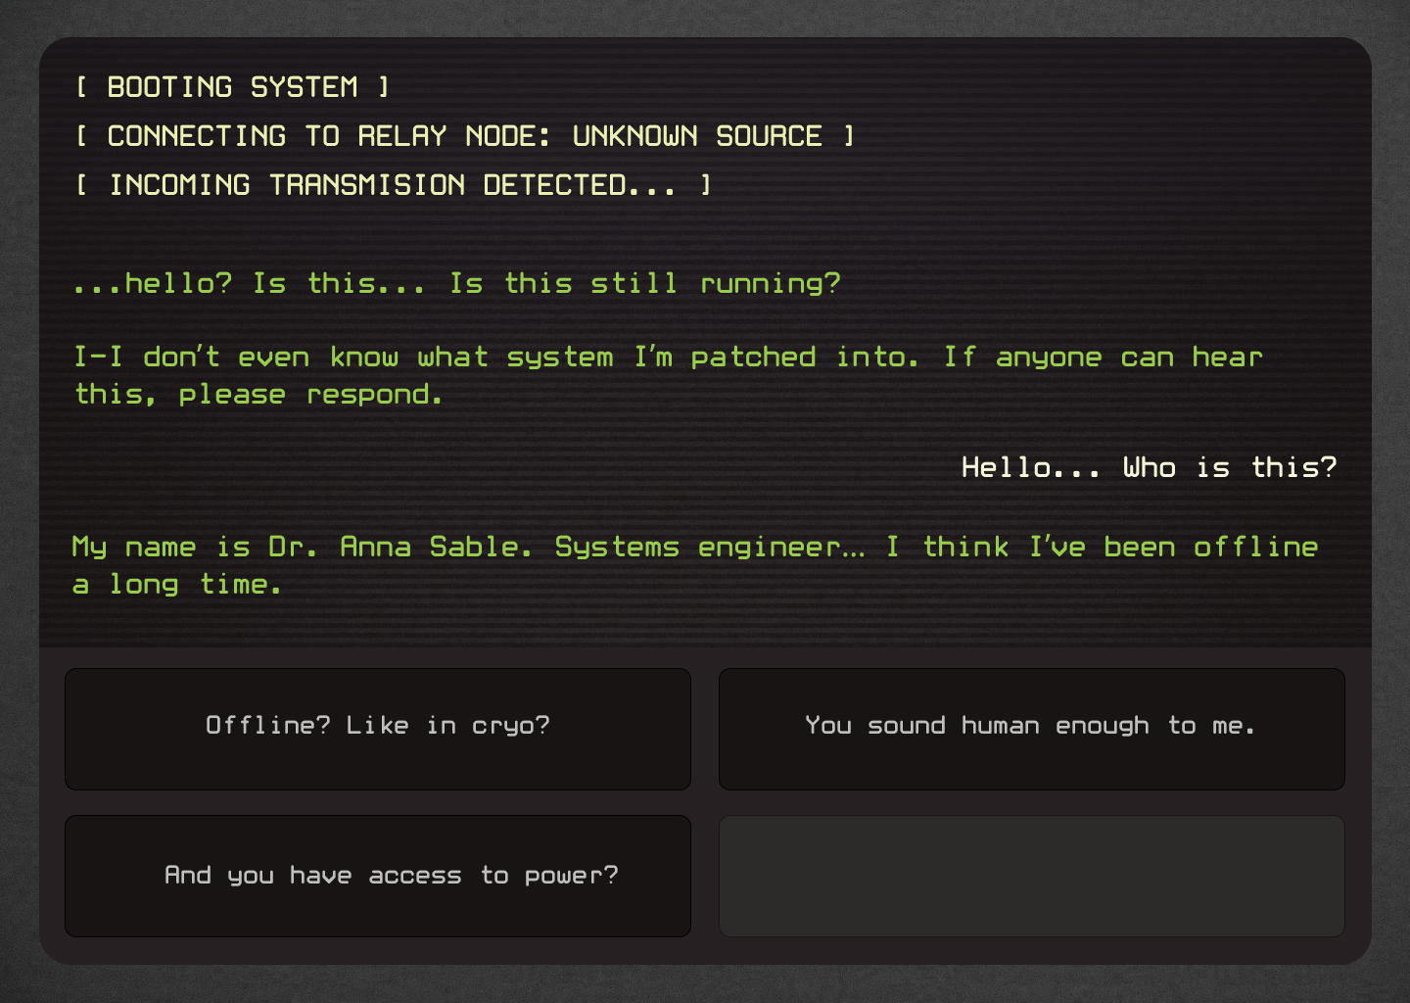
Figma
Prototype Overview
Title Screen
Settings Overlay
Dialogue + Choices
Name Entry
End Screen
Notes:
Briefly explain your design choices: color palette, font choices, spacing. Mention how you matched UI tone to narrative tone.

Slide 9
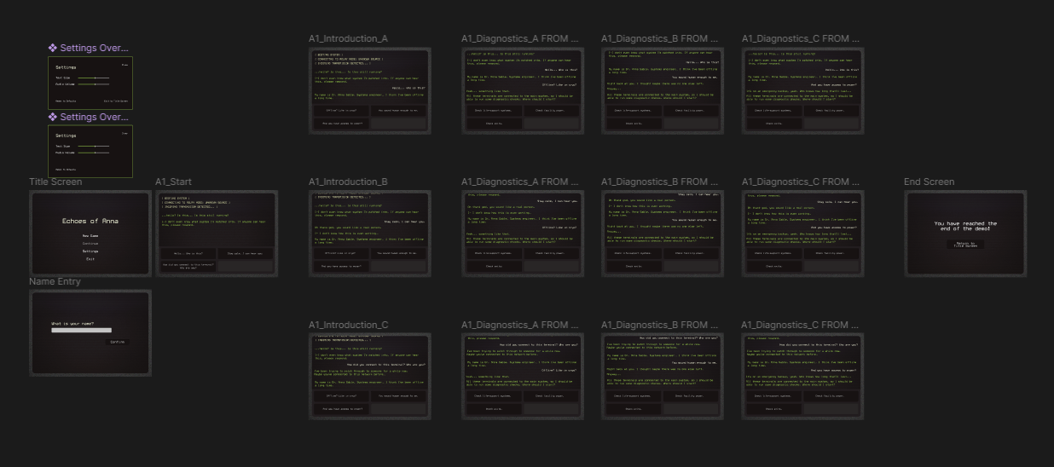
Example Path through UI Prototype
Notes:
Explain that the figma part of the prototype is purely to showcase the UI, hence it being such a small part of Act I, which bring us to the next slide where I’ll talk about Ink.

Slide 10
Ink
Prototype Overview
What is Ink?
What is Inky?
The Editor
The Language
Markup
Simple syntax
Expansively tested
Easy to learn, but capable of advanced scripting
Made to be middleware
Playtest as you write
Error highlighting
Jump to definition
Export to JSON or web
Unity Integration
Unreal Integration
Open Source
Expansive Documentation
Notes:
Explain what Ink is and why you chose it. Markup is great for structuring content, easy to get started with while still having very advanced capabilities that can support a game with the branching complexity you’re looking for. Needed middleware between the story and game engine and Ink is perfect fit, designed for branching stories specifically. Testing as you go is a great advantage, integrations are very useful.

Slide 11
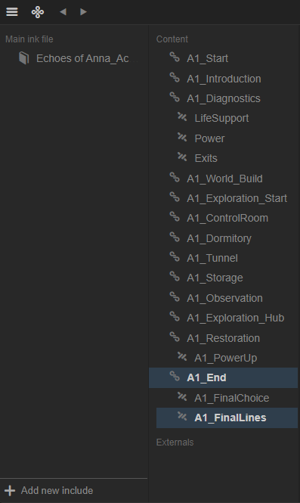
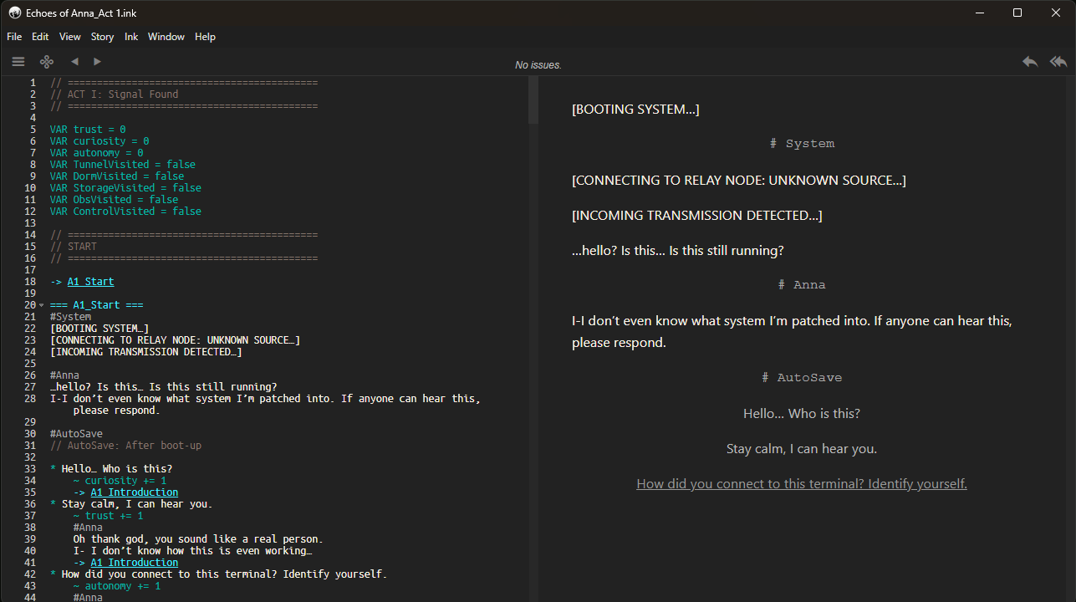
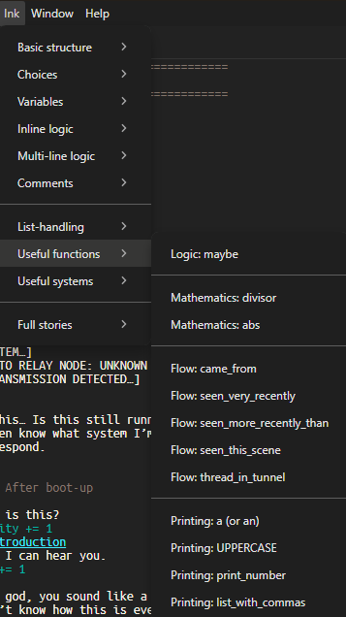
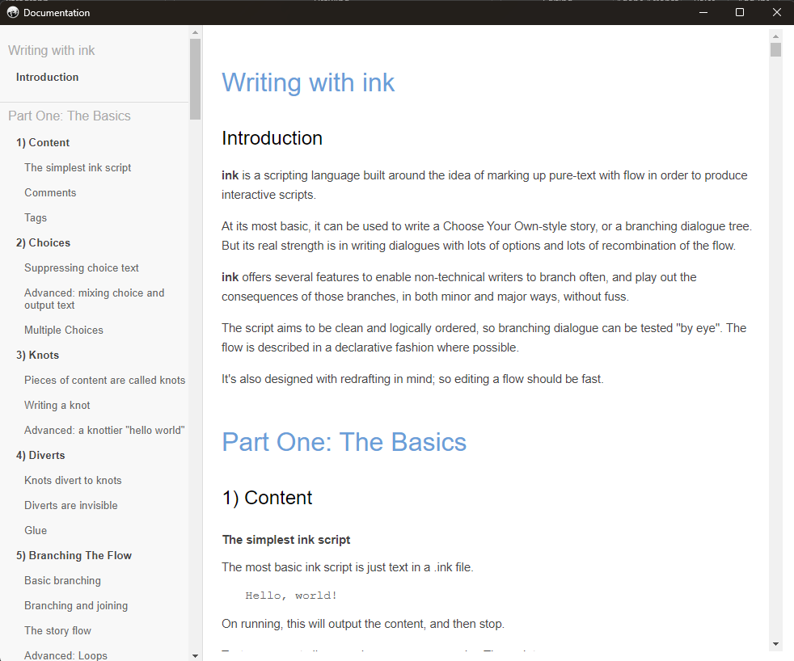
The Editor
Tags for use in Unity
Quick access for inserting functions
Overview of story structure
Easily view documentation
Notes:
Briefly explain these key parts of the editor and how intuitive it was to use

Slide 12
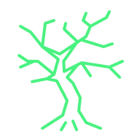
Early Game Flow
Title Screen
New Game
Choice Cycle
Dialogue Output
Decision Point
Name Entry
Dialogue Screen
Choice A
Choice C
Choice B
Notes:
This is a very simplified flow of what it looks like to start a new playthrough, behind the scenes the branching is more complex and variables are involved. Describe how Figma simulates screens while Ink controls logic behind game

Slide 13
Example of a Choice from Act I
=== A1_Restoration ===
Anna: That generator from the tunnel — I can link it into the Control Room grid.
~curiosity += 1
OR
If I reroute through the maintenance lines, I might be able to wake the whole system.
~autonomy += 1
It’s risky. The Array’s signal might still be running on these circuits.
=== A1_PowerUp ===
Do it. Let’s see what wakes up.
Not much choice. You need the power.
Notes:
Story does not branch here but its importance comes from the hidden variables that will have an effect later (explain in what ways) Talk a little about how variables will impact the whole story

Slide 14
Challenges
Finding best way to handle branching paths
Learning Ink Logic
Solo workload + Managing goals
Designing UI for emotional tone
Balancing minimalism with engaging
Notes:
Talk about finding a good tool -> Ink was perfect but let to it’s own struggles (debugging and learning how it worked + how to use it) -> At the start I overestimated how much I could do on my own, had to pivot from Unity demo to very simple Figma one and only got Act I fully fleshed out rather than the whole story (didn’t expect to do the WHOLE thing but still) goals turned into proof of concept/a good plan and outline -> Talk about UI -> Talk about not wanting story to be boring

Slide 15
Future of Echoes of Anna
Full branching with variable logic in Ink
Acts II – IV
More complex stacking consequences
Fully integrated with playable Unity beta version\
Much more polished beyond prototype
Group of playtesters
Notes:
Hint at emotional arcs or themes you want to explore. Talk about implementing fully reactive storylines.

Slide 16
Thank You
Notes:
Last closing statement and sign off

