Slide 1


Slide 2
Airbnb Final Report
Overview:
This project explored how pricing differs across Airbnbs and the influences it has on demand. It also explored the seasonal pattern of airbnb prices in New York and the effects it has on travel.
Key Questions:
What causes the different pricing across neighbourhood groups?
How do prices affect demand for Airbnbs in New York?
How do holidays and seasonality affect pricing for Airbnbs in New York?

Slide 3
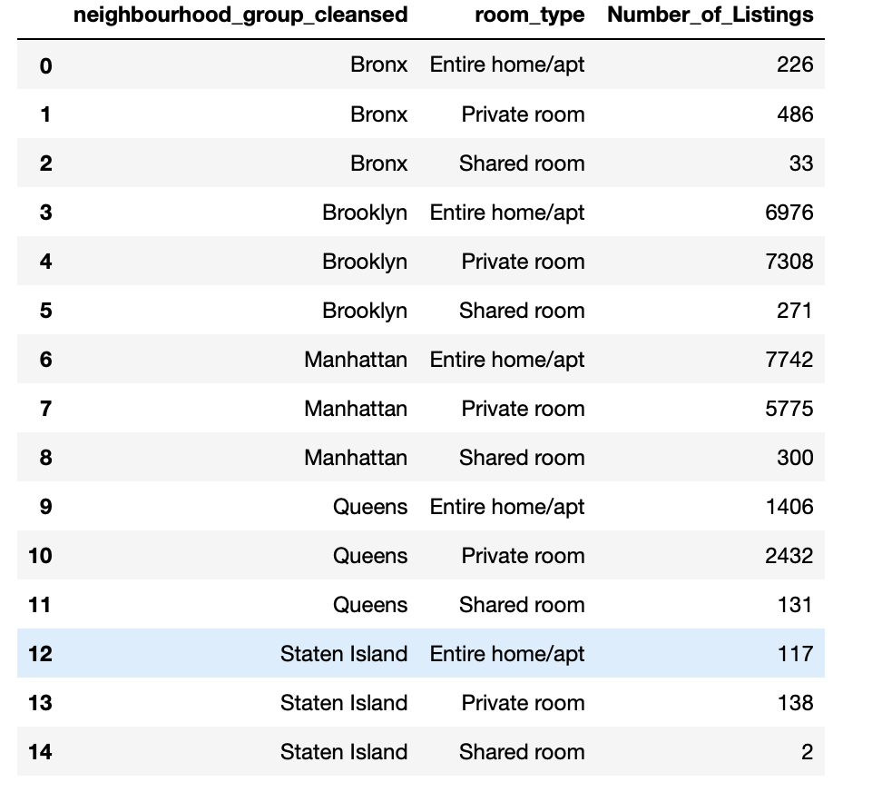
Types of Listings per Neighborhood:
Determines the overall amount of listings per neighborhood, as well as what type of listings are most prevalent.

Slide 4
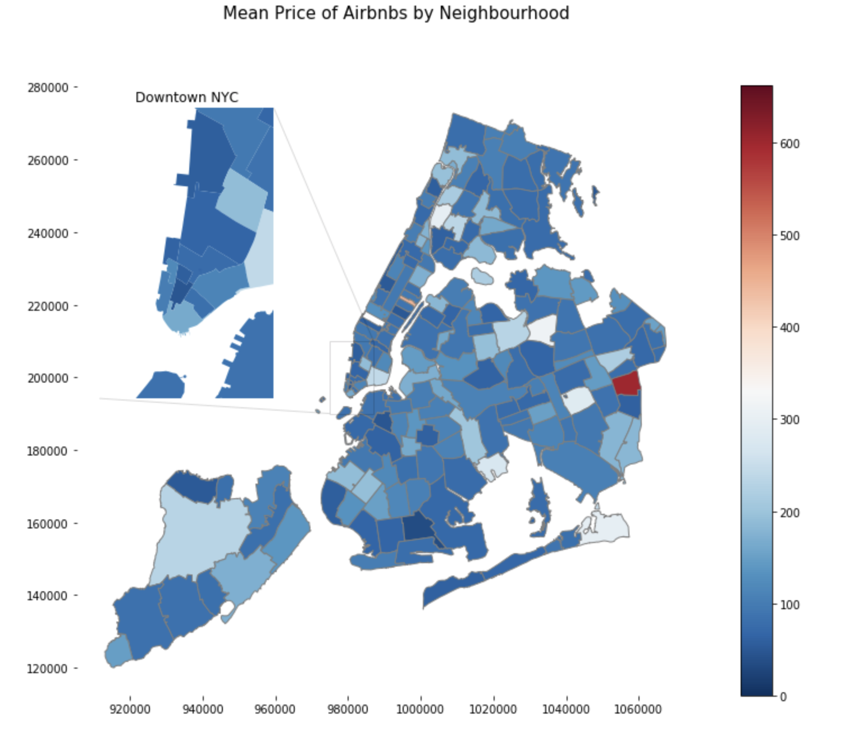
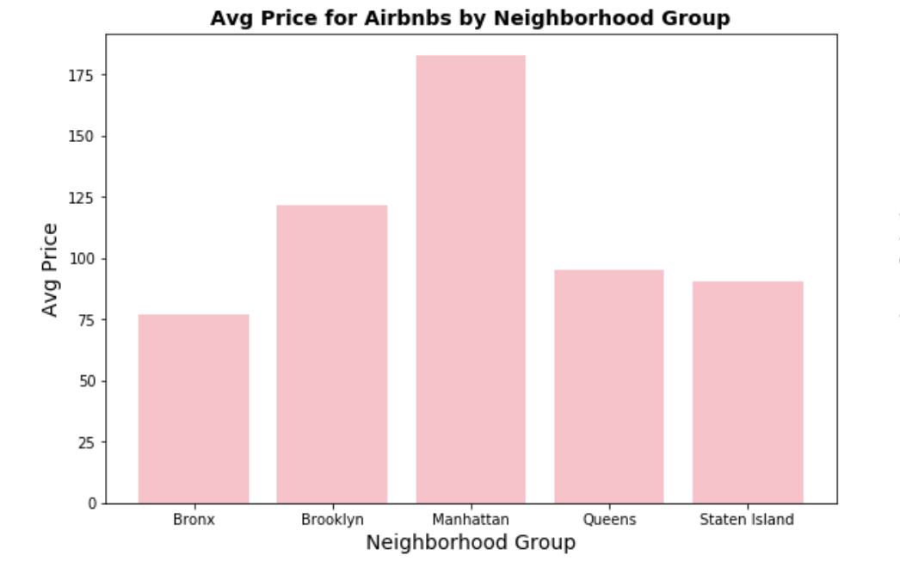
Avg Price by Neighborhood:
These graphs show the correlation between pricing and location.

Slide 5
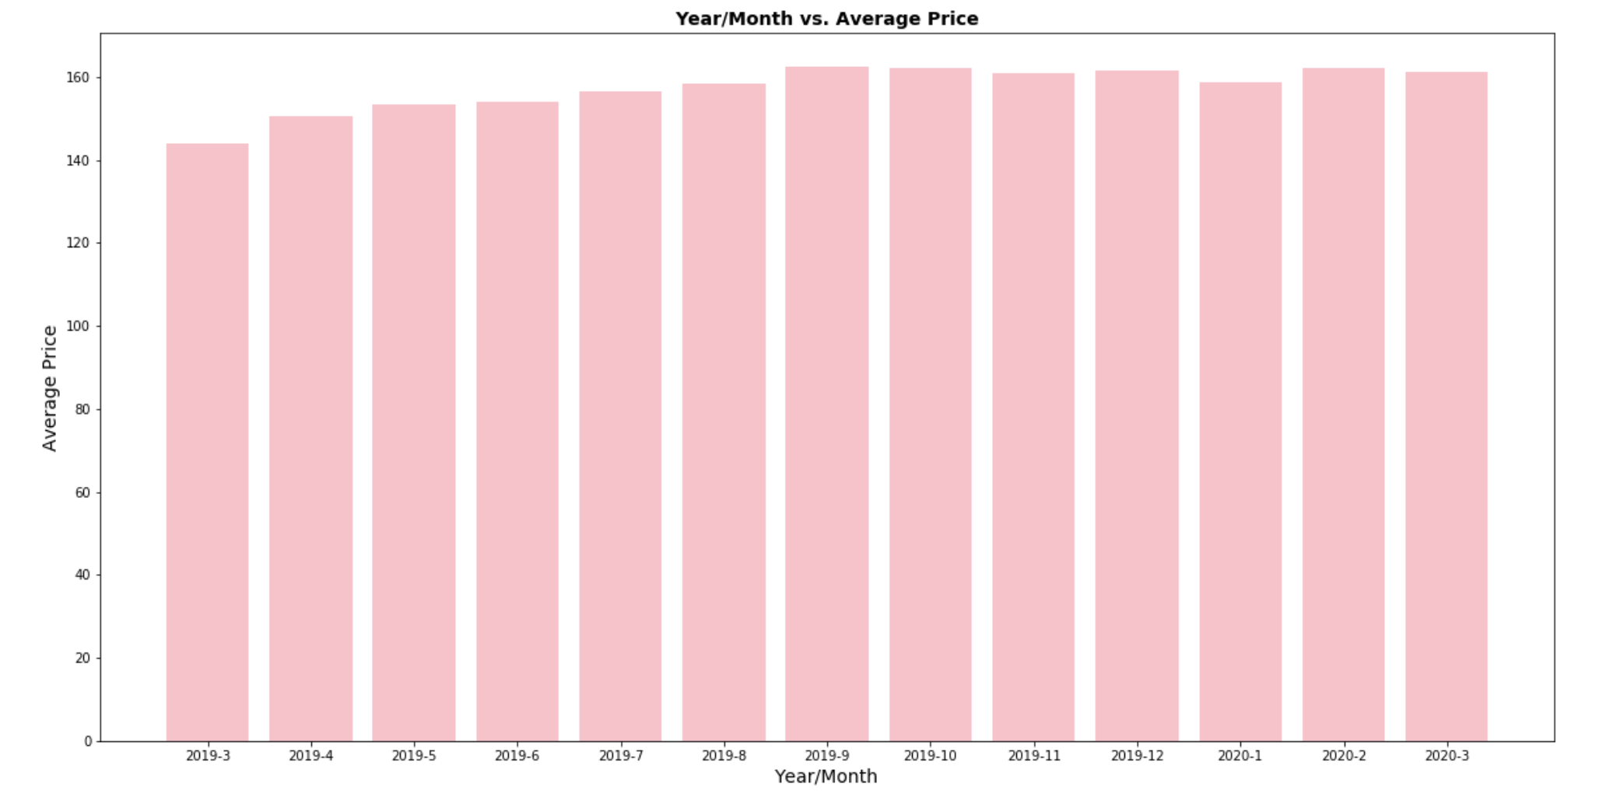
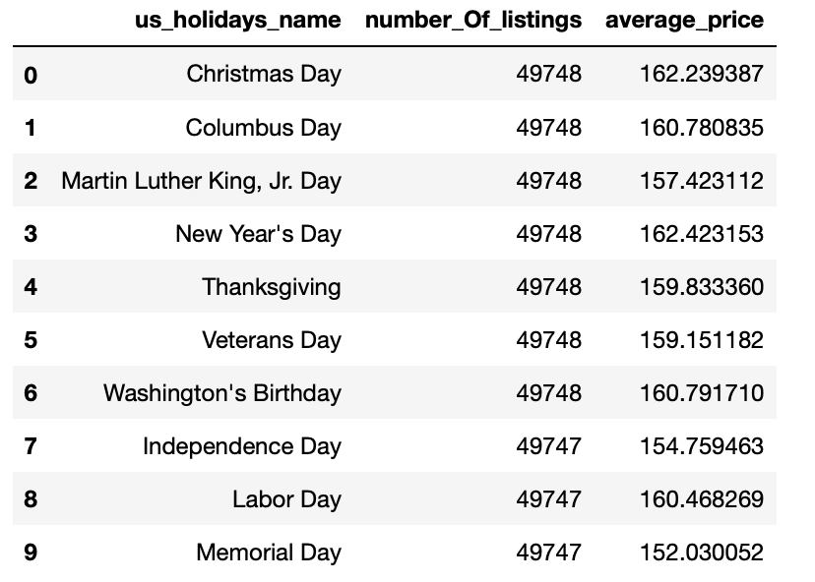
Seasonality:
General upward trend overall, with little indication of meaningful seasonality.

