Slide 1
Welcome to Data Science
Will Doyle

Slide 2
What is Data Science?
Elements of Data Science:
Programming (“Hacking”) Skills
Statistics
Content Knowledge

Slide 3
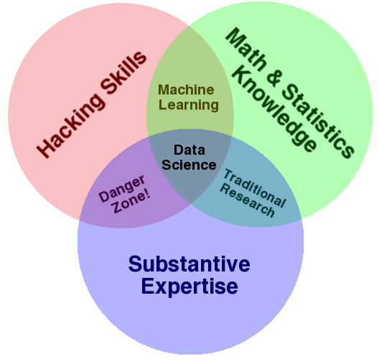
The Data Science Venn Diagram
Source: http://drewconway.com/zia/2013/3/26/the-data-science-venn-diagram

Slide 4
This Class
Introduction to practice of data science
No previous expertise expected
Teaches concepts through hands-on applications
Uses real world data and examples

Slide 5
Topics for the Class
Getting Data
Analyzing Data
Presenting Results

Slide 6
Topics: Getting Data
Tools of the Trade: R and Rstudio
Flat Data
Data from the Web
Databases

Slide 7
Topics: Analyzing Data
Conditional Means
Linear Regression
Classification
Cross Validation
Machine Learning: Clustering

Slide 8
Topics: Presenting Results
Descriptive Plots
Scatterplots
Plots and Tables for Classification
Interactive Graphics

Slide 9
Putting it All Together
Final Project: Predict an outcome using a dataset
This will challenge you to combine all of the skills you will master:
Getting data
Conducting an analysis
Communicating your results

