Slide 1
The Mighty Conditional Mean
Will Doyle

Slide 2
Applications of the Conditional Mean
Course attendance by day of the week
School enrollment by number of young people
Teacher attrition by age
Test scores by GPA
Wages by education level

Slide 3
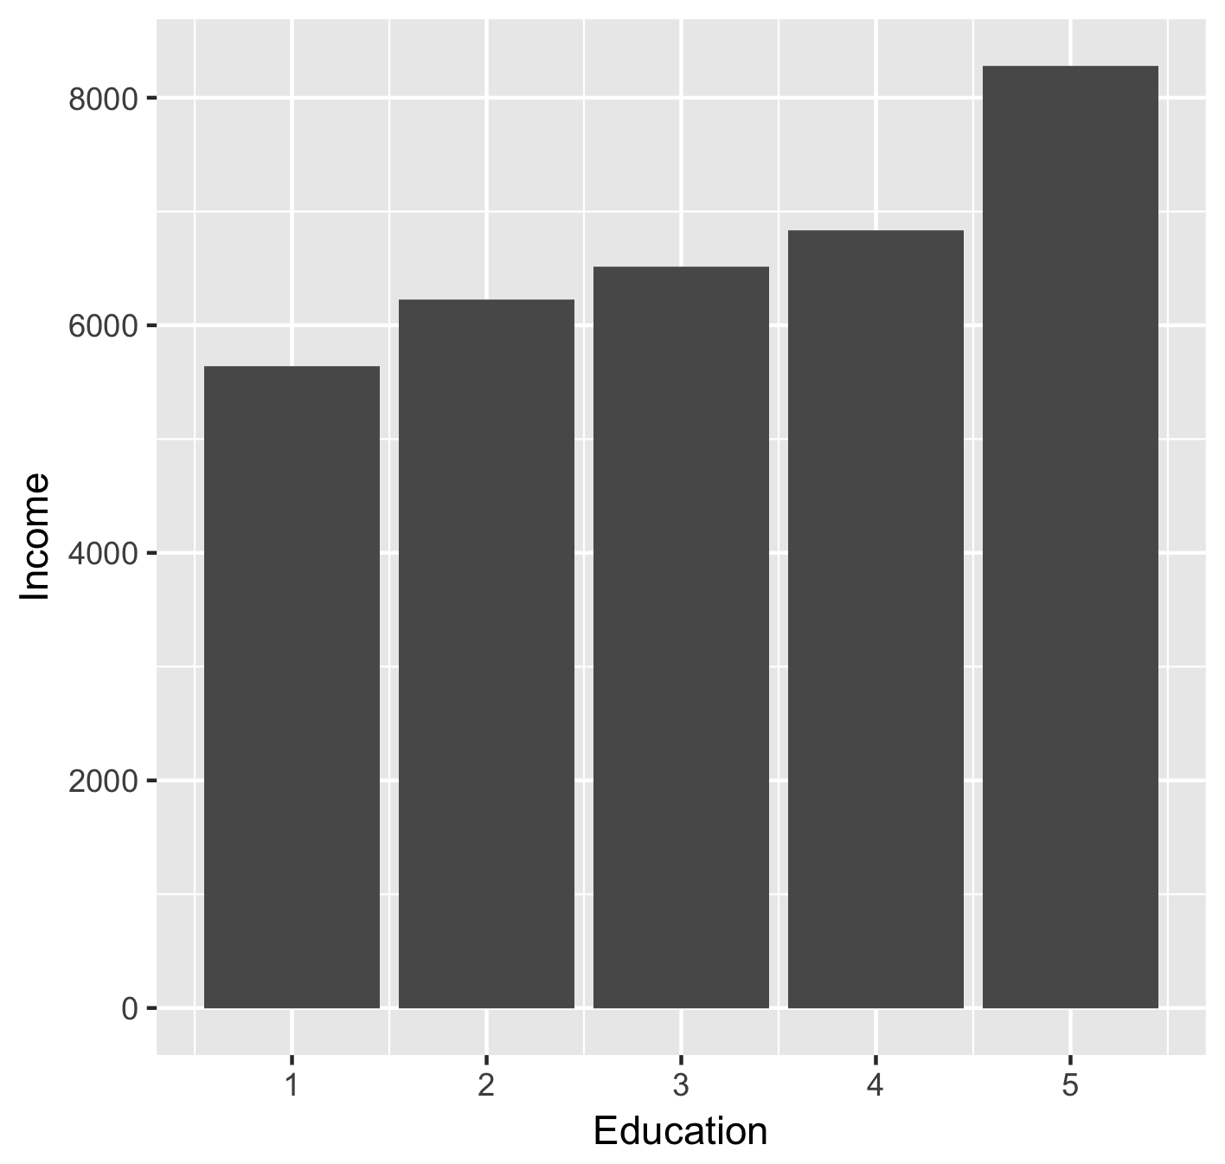
Example: Wages by Education Level

Slide 4
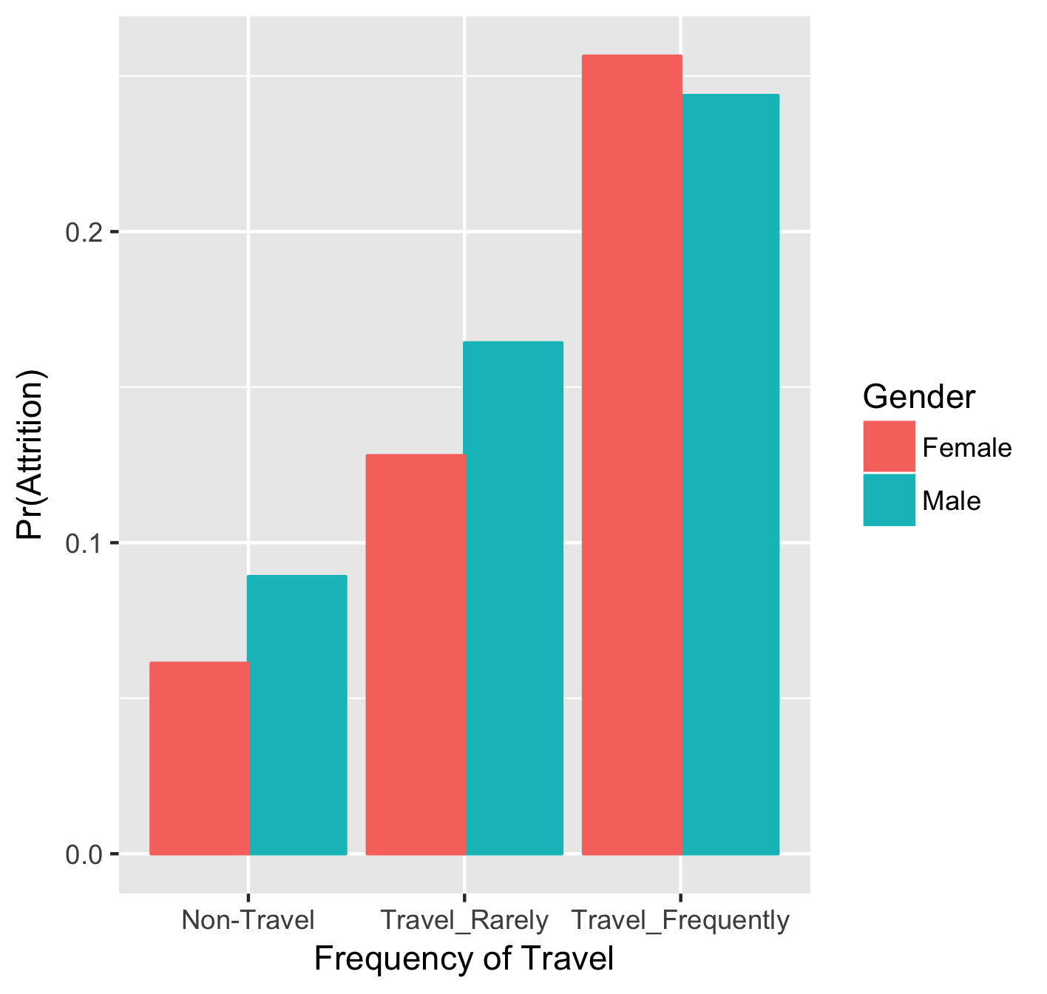
Example: Attrition by Travel and Gender

Slide 5
The Conditional Mean as a Prediction
What do you predict the temperature will be where you live next July?
You probably would look up average temperatures
What do you predict an engineer with two years of experience will make next year?
You would probably look up average income by experience for engineers

